Slide 5
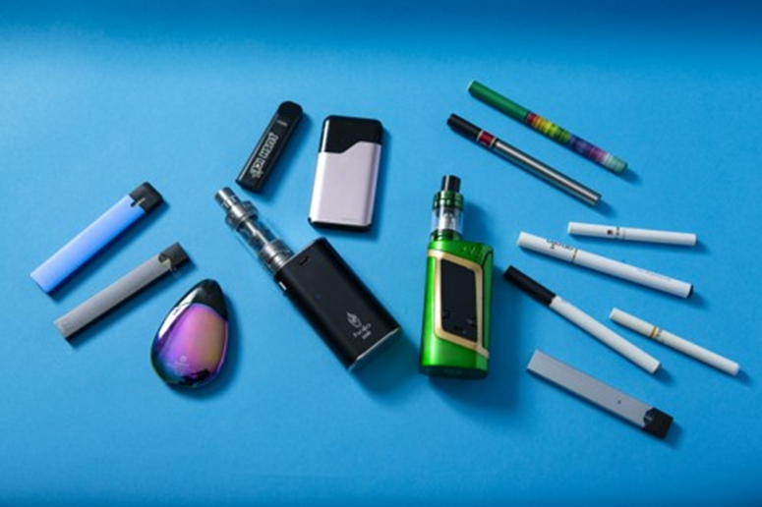
Never Touch, Drink or Breath In Anything that Looks Like This

Slide 6
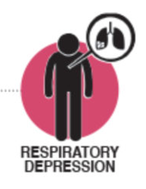
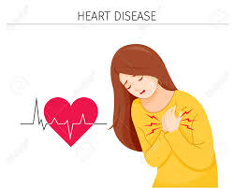
You Could Get Nicotine Poisoning
DIZZINESS
CONFUSED
FAST HEART RATE
BREATHING PROBLEMS
Notes:
Symptoms of nicotine poisoning. 15 to 60 minutes after exposure may get symptoms

Slide 7
Adapted from Poison Prevention Superhero
WHO CAN HELP?
If you found something that you don’t know what it is?
What if someone you are with touched, swallowed or breathed in a poison?

Slide 8
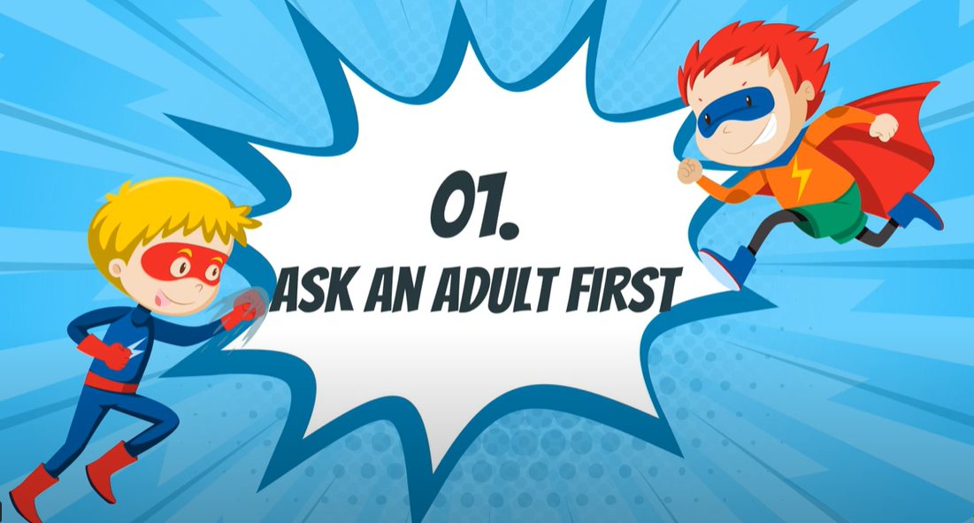
TELL AN ADULT RIGHT AWAY
Notes:
If any exposure to nicotine through touching, inhaling or swallowing the e-juice the child should be taken to the emergency department as soon as possible.

Slide 9
HELP

Slide 10
References
Georgia Poison Superhero

