Slide 1
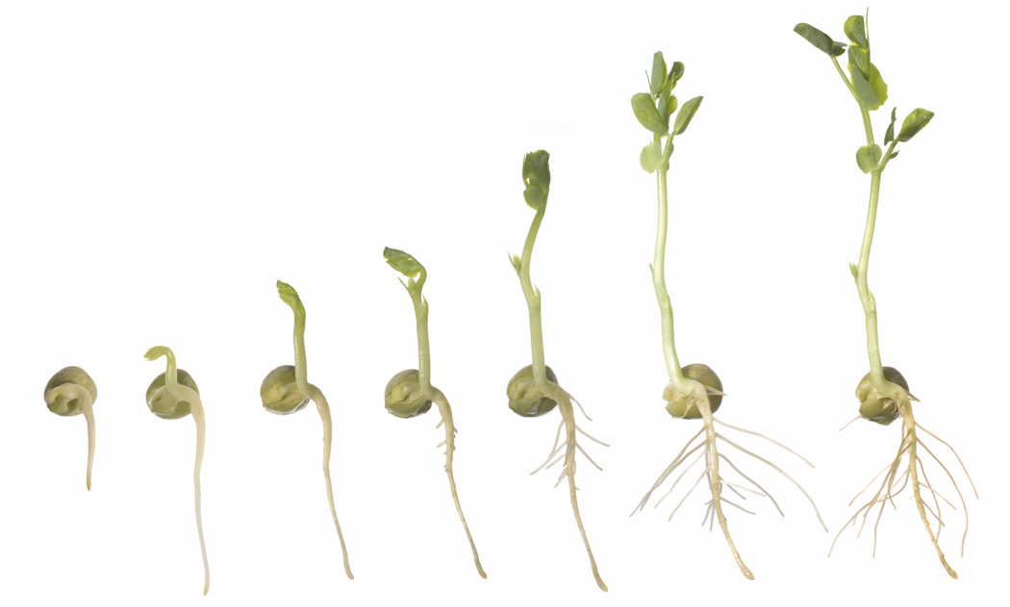
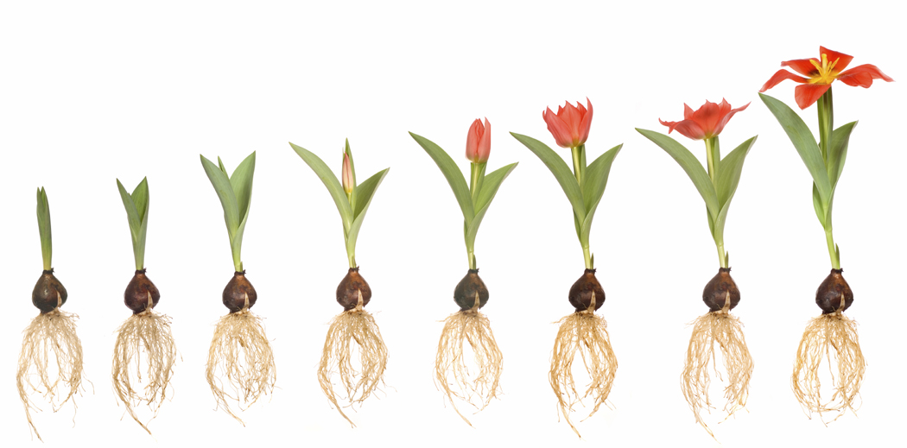
Plants and Seeds

Slide 2
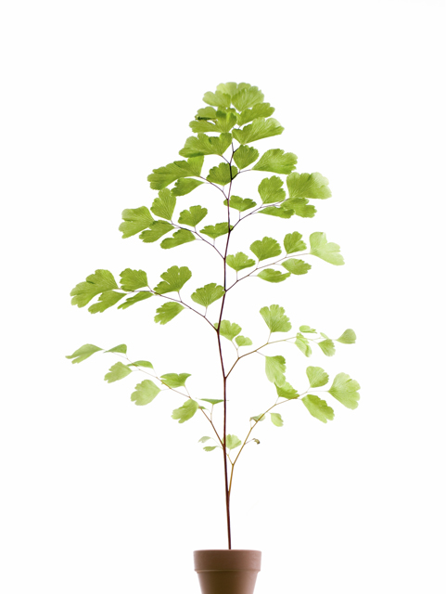
Plants and Seeds
Table of Content
  Terms
What is a seed?
What will you see in a seed?
Monocots &Dicots
Seed parts
Life cycle of plant
Germination Steps
Pictures of seeds and their parts
Activities & Discussion
Activity websites

Slide 3
Terms
Plants and Seeds
Embryo - developing plant still inside the seed. The embryo has cotyledons (embryonic leaves), a root cap, a food source and a plumule (shoot).
Micropyle - the small pore in a seed that allows water absorption
Primary Root (hypocotyl) - the part of the stem of a sprouting plant that is above the root and below the stalk of the cotyledon (seed leaves)
Seed coat (testa) - seed coat is the outer, protective layer covering the seed
embryonic leaves - the embryonic leaf within a seed
Cotyledon- large part of embryo and the first leaf to grow and provides nourishment to the various parts of embryo during growth.
Endosperm- The nutritive tissue within seeds of flowering plants, surrounding and absorbed by the embryo.

Slide 4
Plants and Seeds
What is Seed?
Seeds are the beginnings of a new plant. From the seeds new plants grow; however, they do not start to grow until they receive the things they need to grow, such as adequate soil, water and sunlight. When seed receive the things needed to grow, it is called germination. All seeds are different and unique and require different condition to germinate. However, most seeds have three main parts in common; the seed, coat, endosperm and embryo.

Slide 5
Plants and Seeds
What you will see in plants!
Seed is very similar to eggs. Like eggs are covered with eggshells for protection, seeds are covered by a layer called seed coat. Inside the seed, there is something called endosperm, where food that will used for seed to grow into plant is stored. Also inside the seed there is an embryo, which is will grow into a plant. The embryo has the primary roots, cotyledons, and embryonic leaves. Addition to these structures you will also see Micropyle, which is a small pore in a seed that allows water absorption during germination and growth.

Slide 6
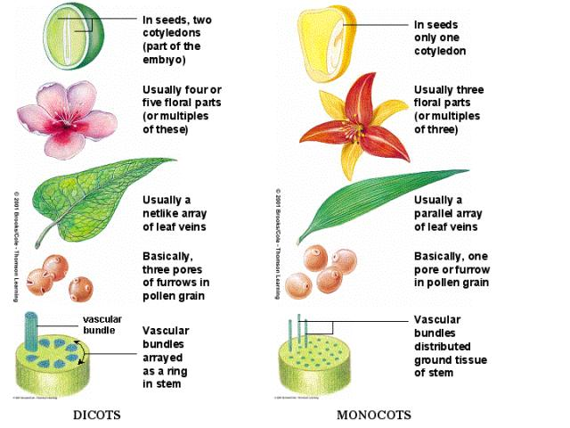
Plants and Seeds
Monocots & Dicots
There are two types of seeds. All seeds are one of the following, monocots and dicots. Monocots seeds have only one cotyledon and dicots seeds have two cotyledons.
Other ways to distinguish between monocots and dicots

Slide 7
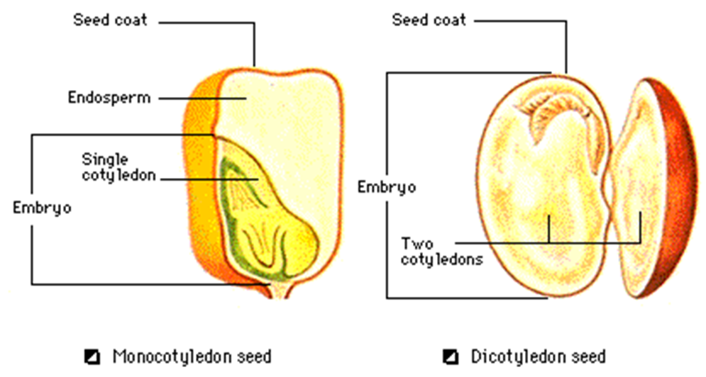
Plants and Seeds
Seed Parts-simple

Slide 8
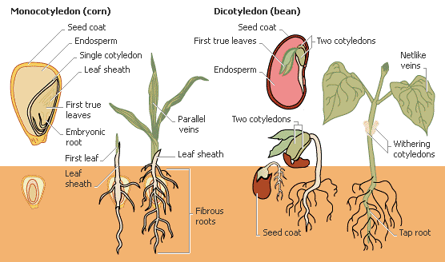
Plants and Seeds
Seed Parts-growth

Slide 9
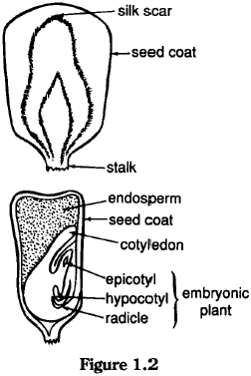
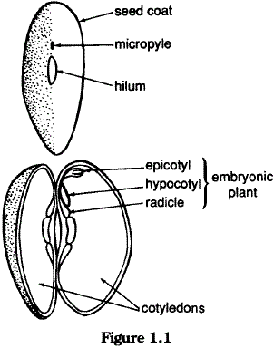
Plants and Seeds
Seed Parts-Detail

Slide 10
Plants and Seeds
Life of a plant
The life of a plant begins as a seed. Within the seed is the embryo, endosperm and the seed coat. The embryo is the developping plant, this is what will eventually become the fully mature plant. The endosperm is the nutrient-rich tissue which provides nourrishement (food) for the developping embryo. Thirdly the seed coat is the tough outer covering of the seed, the seed coat encloses and protects the embryo and endosperm.
When the conditions are right (enough warmth, daylight, and water) germination begins. That is the embryo will begin to grow. (Up until this point it was dormant/ asleep). A root will grow out of the protective seed coat and search for water in the soil or environment. Then seed leaves push up from the soil which contain nurtients from the endosperm. Afterwards real leaves develop and begin to harness energy from the sun. As well, nutrients and water from the soil are absorbed by the roots and the plant develops until maturation (a fully grown plant).
The fully mature plant will begin releasing seeds and the cycle begins again.

Slide 11
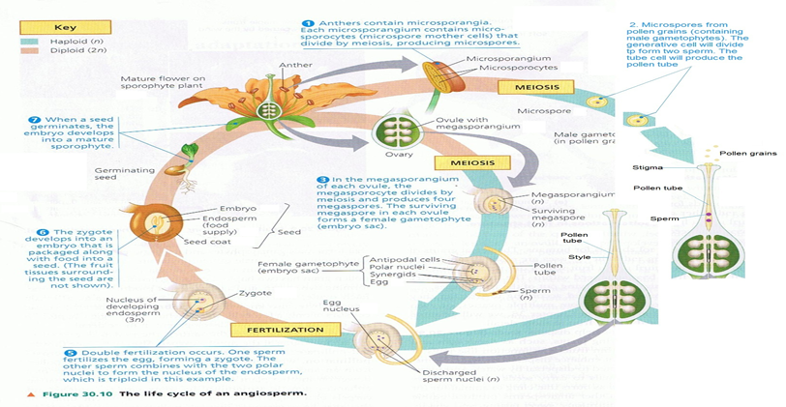
Plants and Seeds
Life cycle of a plant-Detail

Slide 12
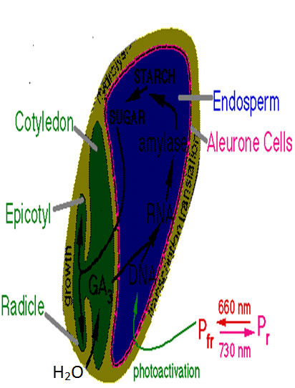
Plants and Seeds
Germination Steps
Water enters through the Micropyle and other condition for germination are meet.
Causes the cells to start dividing and starch is turned into sugar.
The sugar is used for growth

Slide 13
Plants and Seeds
Activities and Discussion

Slide 14

Plants and Seeds
Introduction
Look at the following pictures of seeds and come up with a way to categorize these seeds into groups and discuss with the class how you came up with these categories. (e.g. monocots or dicots)

Slide 15
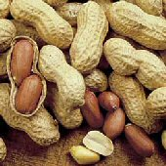
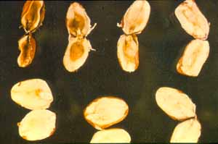
Plants and Seeds
Peanuts

Slide 16
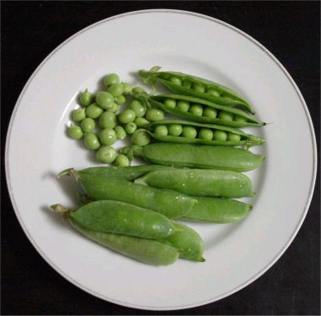
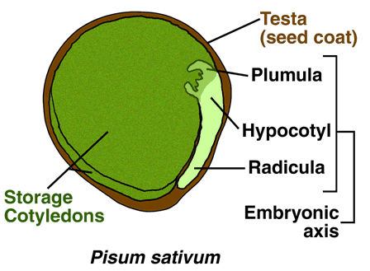
PEA
Plants and Seeds

Slide 17
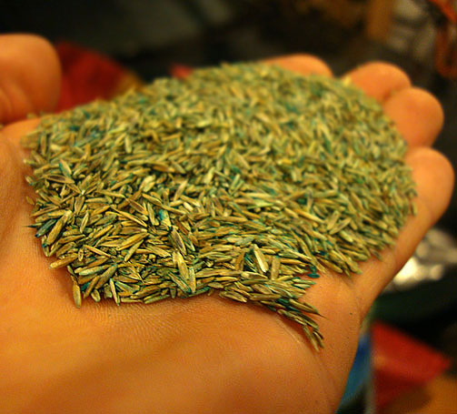
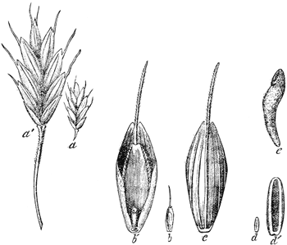
GRASS SEED
Plants and Seeds

Slide 18
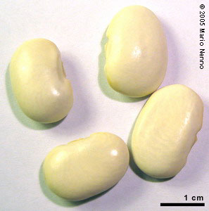
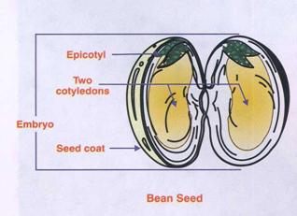
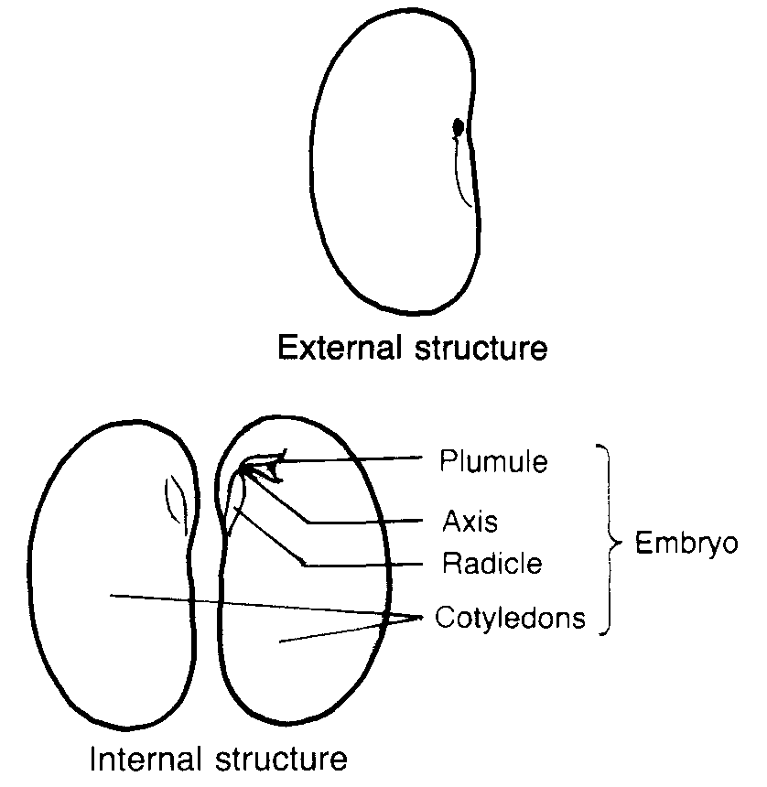
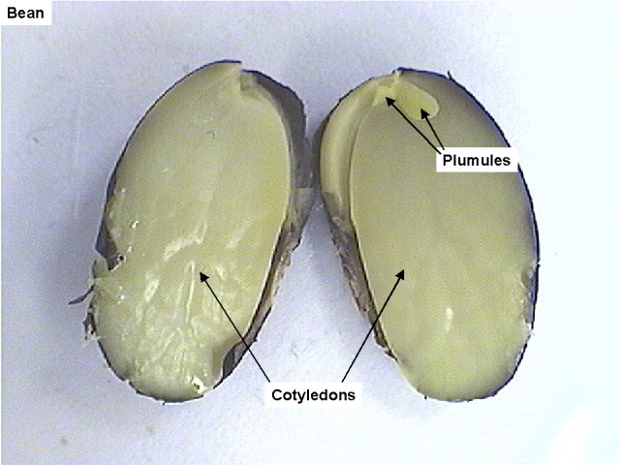
BEAN
Plants and Seeds

Slide 19
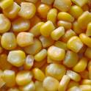
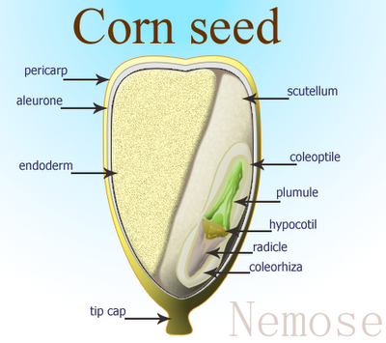
CORN
Plants and Seeds

Slide 20
Plants and Seeds
You can also test your friend if they know their seed parts, terms and life cycle!!!!!!!!!!!

Slide 21

Other activities on Internet
Plants and Seeds
Games, pictures, facts and quizzes - http://www.sciencekids.co.nz/plants.html
Advanced plant info - http://www.biology4kids.com/files/plants_main.html
Easy games, Range of videos - http://www.neok12.com/Plants.htm
Interactive website for beginners - http://urbanext.illinois.edu/gpe/gpe.html

