Slide 1
Healthier School Food Environment
Public Health Workshop
Notes:
Welcome!
This workshop was developed to complement the presentation that the Department of Education and Early Childhood Development (or EECD) has circulated containing some highlights of the revised Policy 711. We will not focus on all elements of the policy in this workshop, but will tailor our discussions based on the questions and ideas that you have brought with you today. Copies of the full policy are available online and we have a few paper copies in the room. This policy document should be the main reference document when there are questions regarding school food environments.
EECD is responsible for setting, implementing and evaluating policies for public schools in New Brunswick. Public Health (PH) provides support and advice as needed when requested by EECD. For example, EECD contracted Public Health to conduct an audit of Policy 711 on their behalf in 2016. EECD again reached out to Public Health in 2017 to request assistance in reviewing and revising Policy 711.
Public Health is committed to promoting school health and healthy food environments. The Healthy Learners in Schools program where PH nurses support schools and districts in promoting health has been in place for almost 20 years. The Public Health Nutrition Framework for Action also identifies school-aged children & youth and healthy environments as key priorities for the PH system.

Slide 2
Workshop overview
Policy overview
Evidence
What’s new & what’s not
Healthy school food environments
Activity
Notes:
This workshop will include:
a quick overview of the policy format
how and why it was updated
what changed and what is the same
information on how to create healthy school food environments
Activity

Slide 3
Did you know unhealthy eating is a leading contributor to chronic disease the same as tobacco?

Slide 4
Policy Overview
Requirements
Guidelines
Three Appendices
Notes:
The main components of the policy are the requirements, guidelines and appendices.
The requirements are divided into four categories:
Healthier School Food Environment
Foods and Beverages
Food Services
Support and Promotion
The new categories will help make it easier for school personnel, school districts and community stakeholders to navigate through the policy requirements and determine their roles and responsibilities.
The guidelines section provides additional best practices and suggestions to implement and support the improvements of the overall healthy school environment.
Three supporting appendices are also included:
Food and Beverage Requirements
À la Carte
Steps for Improving Our School’s Food Environment

Slide 5

Notes:
New Brunswick has a history of leadership when it comes to promoting healthy eating in schools. NB released the first version of the provincial school nutrition Policy 711 in 2005. The policy was updated in 2008 with the addition of nutrition criteria.
Any changes that were made to the policy took into account:
Research findings and best practices
Clarifying and simplifying the policy
Findings from the 2016 audit
Feedback from the 2017 Dialogue Day with the education sector
Current research shows that unhealthy diets are the leading risk factor for the development of chronic diseases, such as heart disease, diabetes and obesity. In fact, research released since the first provincial policy came out tells us that Canadian diets continue to be high in sugar, sodium and saturated fat and low in fruit, vegetables and fibre intake. These dietary trends are in line with the increases in rates of diet-related chronic diseases.
Foods that are high in sugar, saturated fat and salt are often the foods that are most readily available and affordable. The environments around us make healthy choices difficult to make. For example, finding a healthy and affordable option for a snack or meal when at a gas station, mall, or sporting event is often challenging.
These types of food are being used more and more often to reward children for a variety of things. Children get rewarded with treats for completing swimming lessons, reading a book, attending soccer practice, or even at the checkout of the hardware store. Associating the completion of a routine event with food can result in long-term effects for the child.
Finally, research continues to show a strong connection between healthy eating and student behaviour and academic outcomes in school.

Slide 6

What didn’t change?
Notes:
There are many elements of the policy that did not change, such as:
Providing adequate space and time to eat
Pricing meals as close to cost as possible
Not using food as a reward or punishment
Not using minimal/lower nutritional value food in fundraising
Food safety requirements
Responsibility for foodservice contracts
The policy does not apply to foods brought from home
While these elements were in the original policy, results from the 2016 audit showed that there is room for improvement in many of these areas.
The policy outlines the minimum requirements that must be met. Schools and/or districts may go above and beyond the requirements in the policy.

Slide 7
What’s new?
NEW
Notes:
There are a few noteworthy changes in the revised policy.
1) The title of the policy has changed from “Healthier Foods and Nutrition in Public Schools” to “Healthier School Food Environment”. This is more inclusive of how the environment and messages within the school impact a student’s knowledge, attitudes and behaviours when it comes to food. Eating is more than just focusing on nutrients – how, where, when and why we consume food is also important. These factors are influenced by what is taught in the classroom, the attitudes exhibited by trusted adults as well as the foods and beverages that are offered and promoted on a regular basis.
2) In addition to providing a pleasant eating environment, school personnel will trust students to eat according to their appetites. This means that students are responsible for determining if or how hungry they are, and that school personnel will not comment on how much or how little a student is eating. It is important for children to listen to their internal hunger and fullness cues and recognize for themselves when they are hungry and when they are full.
No exceptions – policy applies equally to everyone and every situation
Positive attitudes toward food and feeding children (e.g. free/subsidized programs)

Slide 8

What is a Healthier School
Food Environment?
Notes:
A healthier school food environment provides consistent messaging between what is taught in the classroom and what is available in the broader school setting.
It includes the types of foods available, the physical setting where students eat and how food is portrayed and used throughout the school.
When schools promote a healthy eating environment, it helps to reinforce the healthy messages that are being taught in the classroom.
Students and parents, through the Parent School Support Committee, will be given the opportunity to provide input into the school food environment, including foods and beverage options consistent with the policy.

Slide 9

Marketing to children
Notes:
Requirement 6.1.7 states that “Restaurants that sell, serve or offer foods and beverages will not promote or market their products or brand. The foods and beverages will be supplied in plain packaging without the company’s brand name or logo.”
Restricting the Marketing of Unhealthy Food and Beverages is one of the major goals of Canada’s Healthy Eating Strategy.
Evidence shows that the marketing of foods and beverages that are high in sugar, fat and salt influence the choices made by children and youth up to the age of 17 years.
The revised policy will help reduce the impact of marketing by requiring that restaurants use plain packaging on any items offered or sold in schools.
For example, this means that if a school is buying food from a fast food chain for a hot lunch program, then they need confirm that the company will provide the meal in plain packages without a logo.

Slide 10

Lunch Meal
Milk &
Alternatives
Fruit
Whole Grain Products
Vegetables
Meat & Alternatives
Notes:
Requirement 6.2.3 states that “The price of a lunch meal will include at least: vegetables, fruit, whole grain products, milk or alternatives and meat or alternatives.”
The Lunch meal is a new concept that has been added to the Policy. It outlines what must be included in a meal that is being sold as a “complete lunch meal”. This contributes to creating a healthy school food environment by encouraging lunch meals that are well balanced and nutrient-dense.
Therefore, a complete lunch will could be:
- INSERT A FEW EXAMPLES

Slide 11

Appendix A
Food & Beverage Requirements
Notes:
Appendix A – Food and Beverage Requirements
The Food and Beverage Requirements look much different than in the previous policy. The changes that have been made to the appendix make it easier to follow, remove “grey” areas and reflect current evidence, best practices and market availability.
Appendix A is a tool for ensuring that all foods and beverages offered or sold in schools meet at least a minimum standard.
It is very easy to tell if a food or beverage falls into either the Higher or Lower Nutritional Value categories. If a food or beverage is not in one of those categories, then there is nutrient criteria to determine if that product can be served, sold or offered.
The appendix promotes and encourages the use of whole, minimally processed foods and beverages, and recipes that are prepared from scratch.

Slide 12
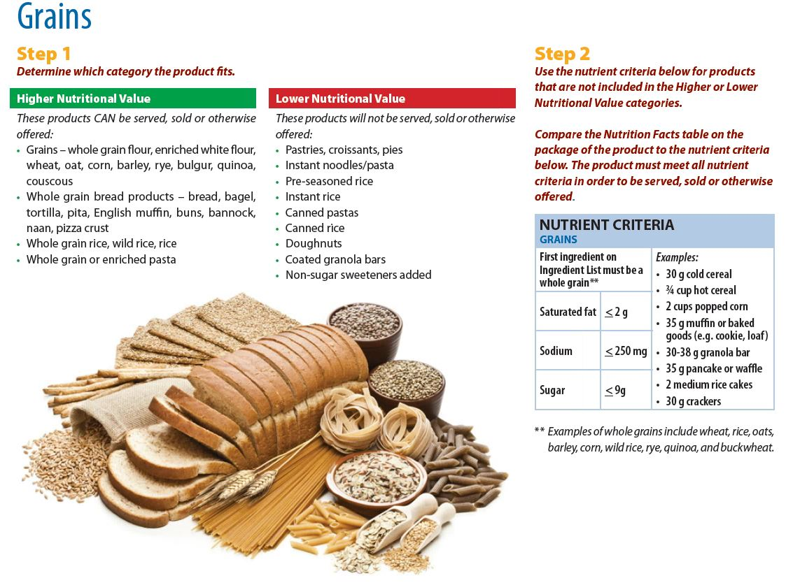
Notes:
What is included in Appendix A?
The first page lists important definitions:
Added Sugars
Non-Sugar Sweeteners
Whole Grains
Caffeine
The appendix is organized by food groups:
Vegetables and fruit
Grains
Milk and Alternatives
Meat and Alternatives
Mixed Entrees and beverages also have their own page
A list of additional ingredient and condiments are provided on the last page.

Slide 13
How to determine if a food or beverage can be sold, served or offered.
Step 1
Higher Nutritional Value
Lower Nutritional Value
Step 2
Meets criteria
Doesn’t meet criteria
Not on a list
Notes:
How to determine if a food or beverage can be served, sold or offered.
Step 1
Check to see if the food or beverage is of Higher Nutritional Value or Lower Nutritional Value.
If an item falls in the Higher Nutritional Value list or the Lower Nutritional Value list, it is not necessary to look at the nutrient criteria table.
Step 2
If products are not found on the Higher Nutritional Value or Lower Nutritional Value lists, use the nutrient criteria table to determine if it can be sold, served or otherwise offered. A product must meet ALL of the nutrient criteria.

Slide 14
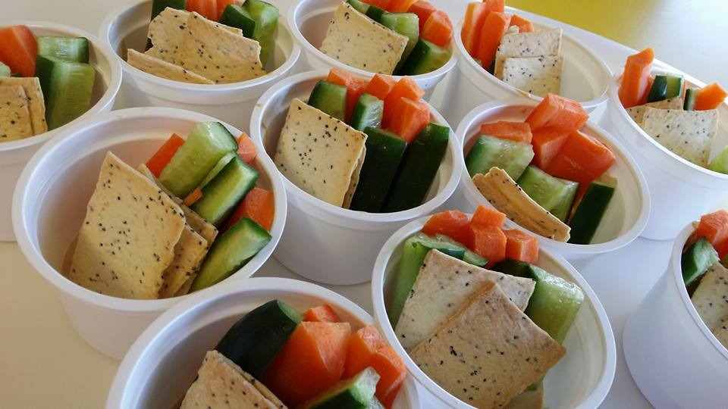
Appendix B
À La Carte Items
Notes:
Appendix B provides a list of foods and beverages that can be sold or offered separately from the lunch meal.
This list applies to all school food settings, such as; cafeterias, vending machines, canteens and at celebrations.

Slide 15
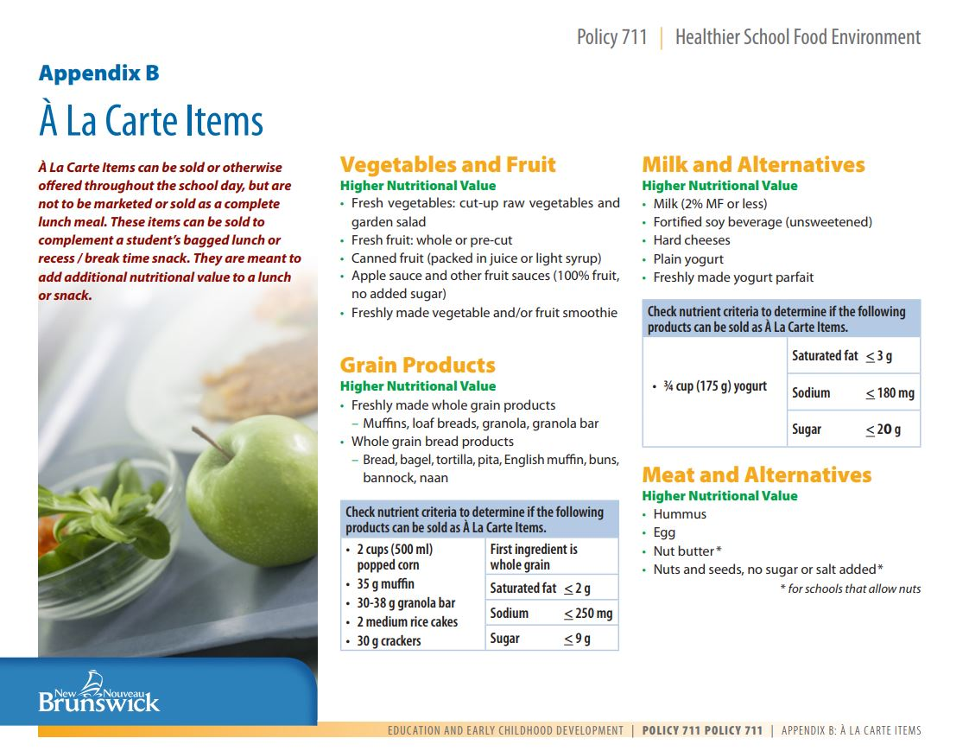
Notes:
Items included on the À la Carte list are nutritious foods and beverages that can be used to either complement a lunch brought from home or as a snack.
Only the items found in Appendix B can be sold or offered outside of the complete lunch meal. For all food groups a list of Higher Nutritional Value food/beverage is provided.

Slide 16
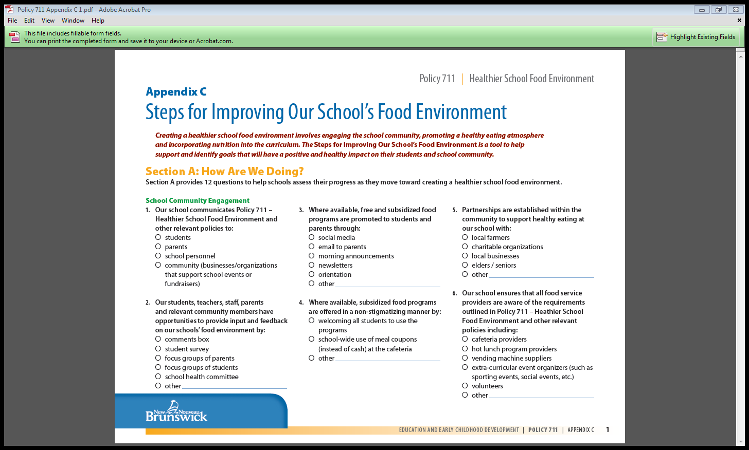
Appendix C – The Steps for Improving Our School’s Food Environment
Notes:
Requirement 6.4.1 states: “The principal with the support of the Parent School Support Committee will set goals to monitor and support a healthier school food environment. The goals will be communicated to the school district, students, parents and school personnel.”
Appendix C is a tool to help support and identify goals that will have a positive and healthy impact on the students and school community.
Schools and Parent School Support Committees are encouraged to use Appendix C as a tool to help set goals to support their schools food environment.
Appendix C includes two sections.
Section A: How are we doing? Is a list 12 questions to help schools assess their progress and current level of support for Policy 711.
Section B: Goals Setting. After completing the questions in Section A, the next step is to identify the school’s goals for the upcoming school year. The appendix provides a template for identifying at least three goals for each school year.

Slide 17

Activity

