Slide 1
Peace Poster
Theme: "Journey of Peace"

Slide 2
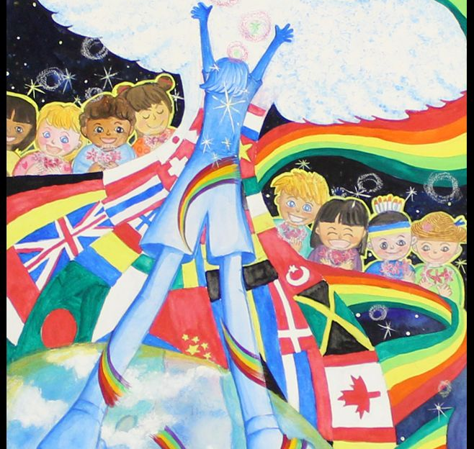
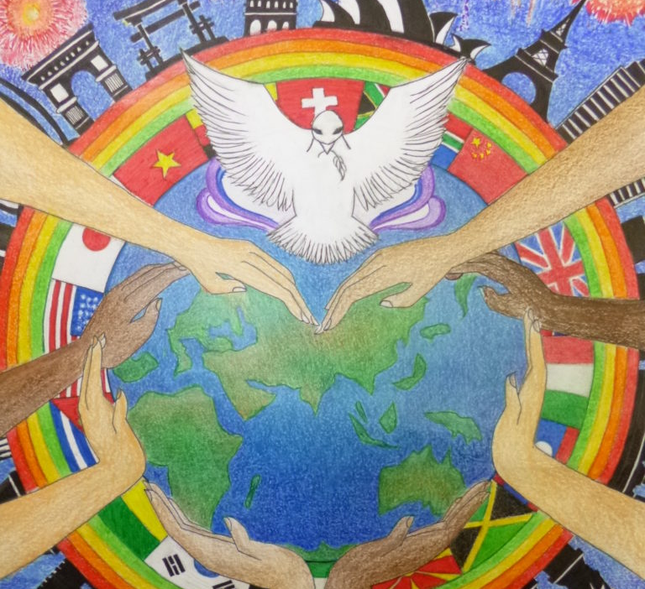
Journey of Peace
THINK ABOUT IT:
- What does "peace" mean to you?
- What are some images that come to mind when you think of a journey? When you think of peace? Think about our community and the world.
GUIDELINES:
- Rough copy must be completed first and approved by Ms. Smith
- NO WORDS on poster, only images
- Good copy in pencil first
- Pencil crayon and/or marker for good copy

