Slide 1
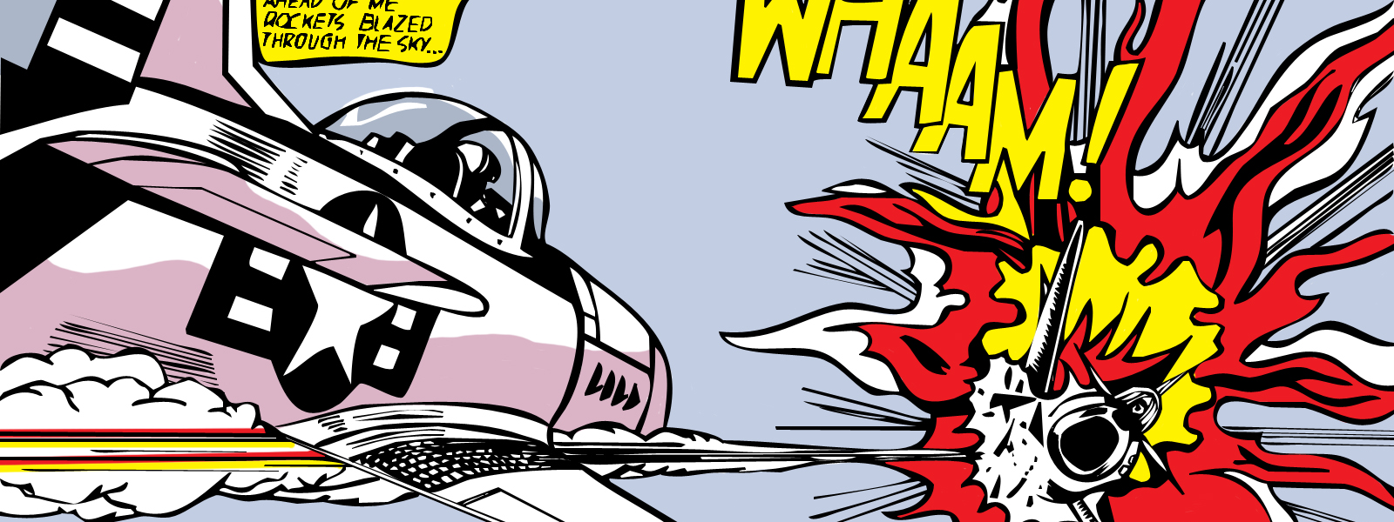
Pop Art Portraits
Roy Lichtenstein

Slide 2
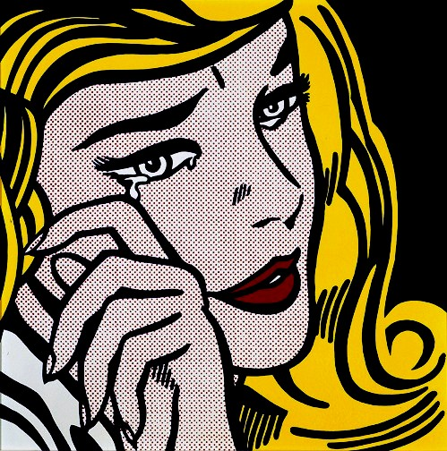
Roy Lichtenstein
American pop artist
Emerged in the 1960’s alongside Warhol, Jasper Johns and others
First paintings were based on imagery from comic strips & advertisements
He gravitated toward what he would characterize as the “dumbest” or “worst” visual items he could find and then went on to a letter or improve them.
Later, he began combining cartoons with abstract backgrounds and started using “Benday dots” (mechanical patterning used in commercial engraving to show texture and gradations of colour)
Video: https://www.pbs.org/video/chicago-tonight-may-29-2012-the-pop-art-of-roy-lichtenstein/

Slide 3
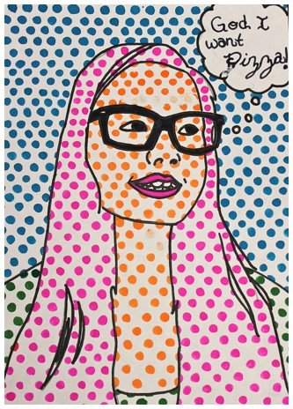
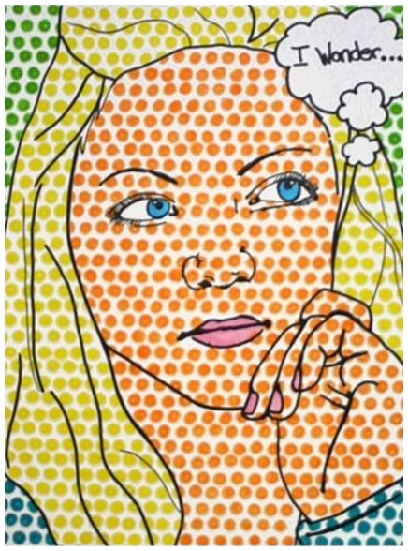
Self-Portrait Directions
When finished:
- Put work in portfolio
- Work on a free draw challenge or...
- Choose one of the "Art Task Cards"/drawing prompts in the black duotang (on the piano)
- Start by drawing a picture of yourself that includes your whole face, neck and shoulders.
- Draw the face cartoon-style (no shading necessary)
- Include a word bubble
- Outline your drawing in black sharpie
- Choose the colours you are going to use for your dots (face, clothing, hair, lips, background, etc.)
- Begin colouring USING PENCIL CRAYON. Your dots should be fairly close together (see examples).
- Do NOT shade any areas you have dots (background, hair, etc.) as the dots are to act as the shading technique.

