Slide 1
Mixed media
Bad Hair Day (Line and Shape)

Slide 2
Bad Hair Day
Goals
Vocabulary
To explore the use of line, shape and space (positive & negative).
To gain a better understanding of how to use balance, pattern & repetition to create a unified piece of artwork.
Line
Shape
Positive vs. negative space
Balance
Pattern
Repetition
Unity

Slide 3
To start…
Find an image of your hero (portrait close up)
Cut out the image (Do NOT include the hair!)
Glue the portrait to your paper.

Slide 4
Next…
Design the new hairdo: use pencil only to lightly draw the outline of the new hair.
Divide the hair into shapes (spaces).
Use a heavy lineweight to trace the outline of the hair.
Use a medium lineweight and trace the shapes within the hair.
Within the new spaces, create doodles and patterns (like a zendala).

Slide 5
Last…
Design the background. Use a pencil and ruler to lightly draw geometric shapes in the background.
Use a medium lineweight to trace over these new shapes.
Within the new spaces, created geometric doodles and patterns.

Slide 6
Don’t forget…
Visible Learning Criteria
Project: Bad Hair Day
On my piece of art I can show examples of:
Line
Shape
Space (positive vs. negative)
Balance
Pattern
Repetition
Unity
Complete the Visible Learning Criteria checklist
(Conference with Ms. Smith)

Slide 7
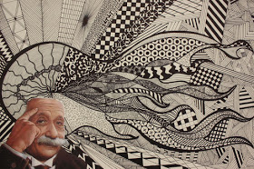

Slide 8
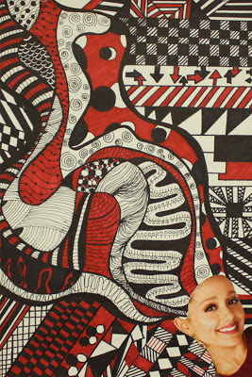

Slide 9
