Slide 1
What is culture?
Chapter 5

Slide 2
Journal Question #1
What does the word “culture” mean to you?

Slide 3
Journal Question #2
Do you think you would like to live in a wigwam? Why or why not?

Slide 4
Journal Question #3
What would you like to say to the world?

Slide 5
Journal Question #4
What is your favourite season and why?

Slide 6
Journal Question #5
What do you think you’re going to do your Heritage Fair project on?

Slide 7
Journal Question #6
Do you like snow? Why or why not?

Slide 8
Journal Question #7
What is your favourite food and why?

Slide 9
Journal Question #8
What is an object that is really important to you? Why do you think makes it so special?

Slide 10
Journal Question #9
Do you think Canadian culture is very different from American culture?

Slide 11
definitions
2.1.1
Culture: the customs, arts, social institutions, and achievements of a particular nation, people, or other social group.
Tradition: the customs, beliefs, opinions, and stories passed down from one generation to another.
Oral expression: the use of storytelling to pass history, morals, and lessons learned over time from one generation to the next.
Material Culture: the physical objects produced and/or used by a society

Slide 12
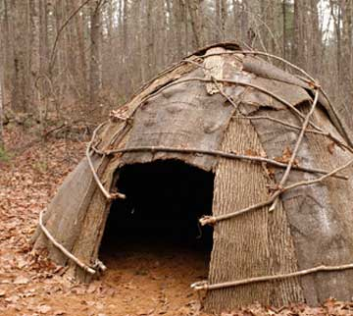
2.1.2, 2.1.3
How have Atlantic Canadians adapted to their environment?

Slide 13
2.1.2, 2.1.3
Wigwam
Wigwams were homes built by the Algonquian tribes in Canada.
They were built from trees and bark.
Wigwams used poles from trees that would be bent and tied together to make a dome shaped home.
The curved surfaces of the wigwam made them an ideal shelter in many different types of climates and even the worst of weather conditions.
Building a wigwam

Slide 14
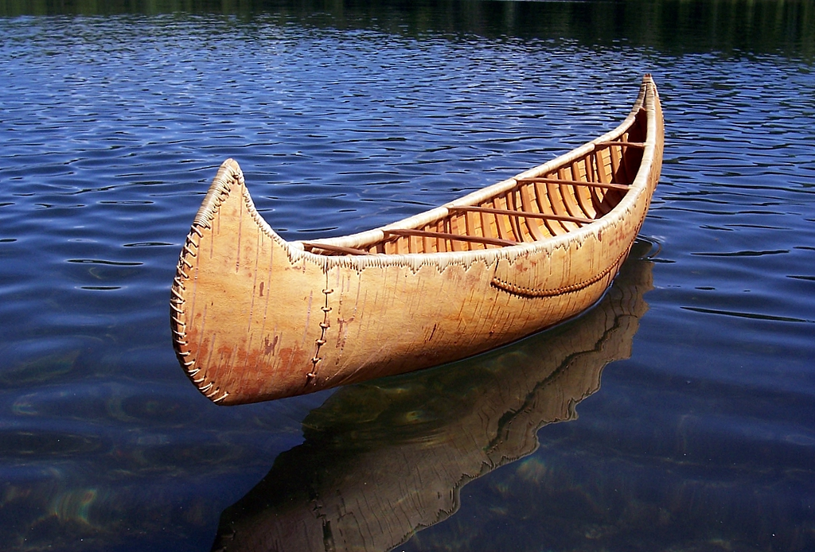
2.1.2, 2.1.3

Slide 15
Birch Bark Canoe
2.1.2, 2.1.3
The birchbark canoe was the principal means of water transportation for Aboriginal peoples, and later voyageurs, who used it in the fur trade in Canada.
They were light and maneuverable, and perfectly adapted to summer travel through the network of shallow streams, ponds, lakes and swift rivers.
Birchbark was an ideal material for canoe construction, being smooth, hard, light, resilient and waterproof.
Building a birch bark canoe

Slide 16
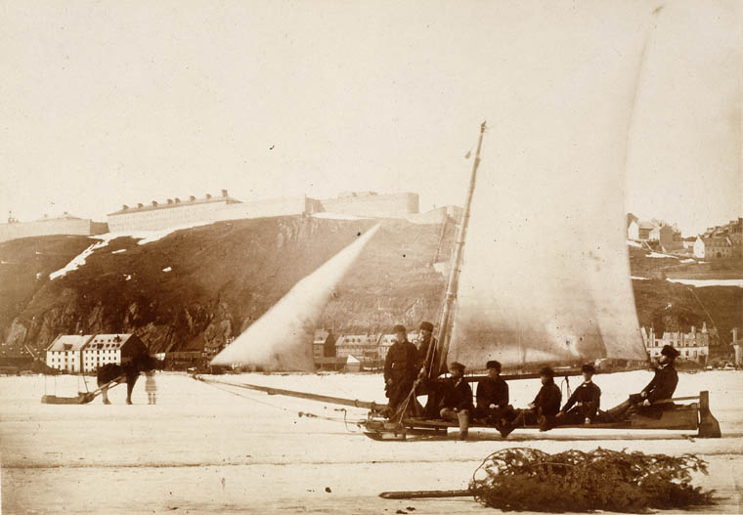
2.1.2, 2.1.3

Slide 17
Ice Boats
2.1.2, 2.1.3
Ice boats are wide, stubby, scow-like vessels used in the 1800s.
They were sailed by adjusting the basic sails and had no rudder.
Parallel rails were mounted on the bottom, like sled runners.
They were used for travelling both open water and jumping onto stretches of ice.
They were used primarily for winter transportation to and from lighthouses and for ice fishing.
Racing an ice boat

Slide 18
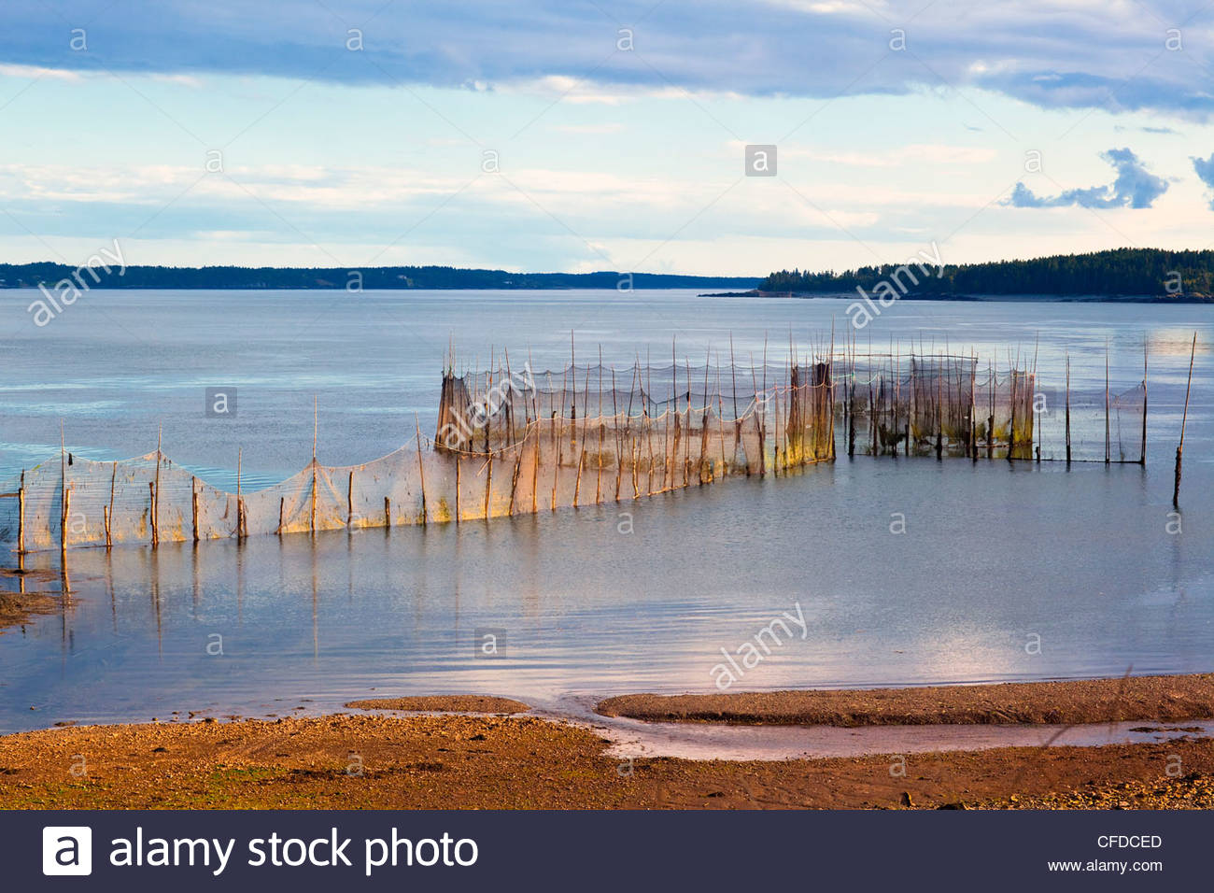
2.1.2, 2.1.3

Slide 19
Fundy Shore Weir
2.1.2, 2.1.3
Weir fishing is one of the oldest known fishing methods.
It is one of the most sustainable fishing methods.
The Fundy Weir catches herring in May and early June, then mackeral and shad in early summer.
The fish swim into the weir when the tide comes in, and then they are trapped when the tide goes out.
Fishing weirs were first used by the Mi’kmaq people 11000 years ago.
Fish weir

Slide 20
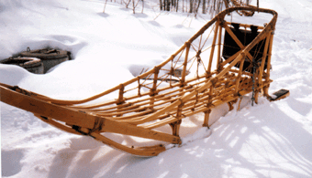
2.1.2, 2.1.3

Slide 21
Dogsleds
2.1.2, 2.1.3
Dogsledding is a method of winter travel developed by northern Aboriginal peoples.
Early European explorers and trappers adopted it as the most efficient way to haul goods across snow-covered terrain.
Teams of two to 12 or more dogs are commonly tied in pairs to a single towline, or gangline.
Early French Canadian drivers called "Marche!" to spur their teams. English explorers misinterpreted this as "mush" — that’s why drivers were called "mushers."
Building a dogsled
Iditarod

Slide 22
2.1.4
Oral Expression in Aboriginal Culture
The aboriginal people of Atlantic Canada have a rich culture and history. Listen to the following stories and write down:
The values reflected in the story.
The lessons taught by the story.
Any relationships mentioned.
Examples of material and non material culture.
The Legend of the First Moose
The Raven Steals the Light
Algonquin Cinderella

Slide 23
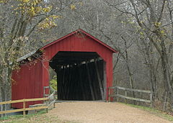
2.1.3
Examples of Material Culture in Atlantic Canada
Covered Bridges
A covered bridge is a wooden bridge with a roof, decking, and siding.
This creates an almost complete enclosure that protects the wooden structure from the weather.
Uncovered wooden bridges have a lifespan of about 20 years because of the effects of rain and sun, but a covered bridge could last 100 years.

Slide 24
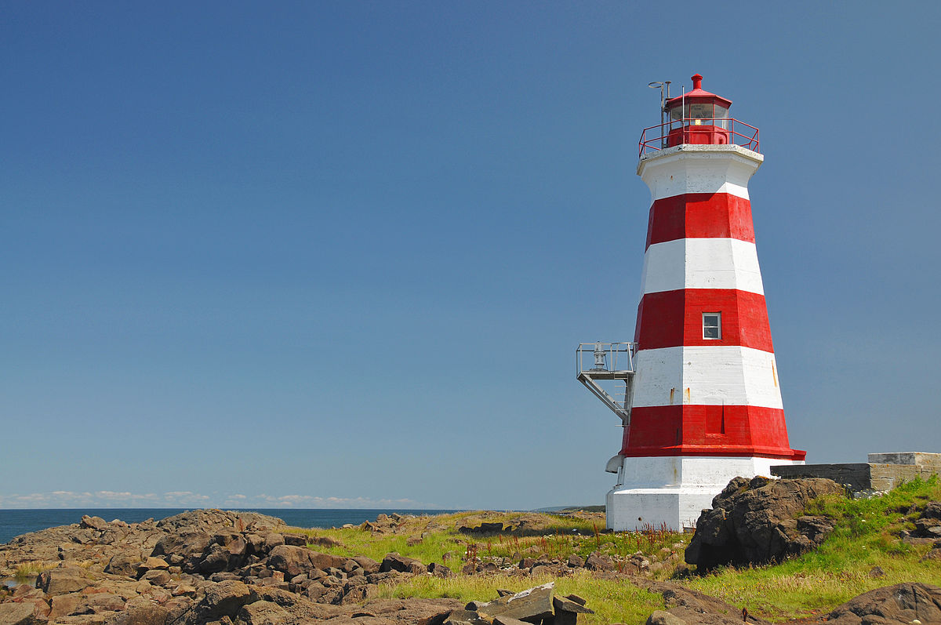
2.1.3
Examples of Material Culture in Atlantic Canada
Lighthouses
A lighthouse is a tower with a bright light that helps ships at sea navigate.
Lighthouses mark dangerous coastlines, hazardous shoals, reefs, rocks and safe entries to harbors.
They used to be used a lot, however, the number of operational lighthouses has declined because it is expensive to maintain them, and the use of electronic navigational systems.

Slide 25
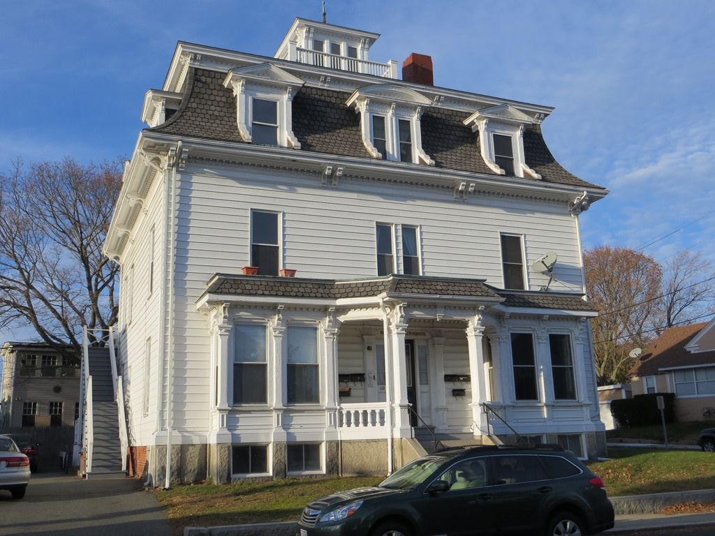
2.1.3
Examples of Material Culture in Atlantic Canada
Widow’s Walk
Also known as a widow's watch or roofwalk, is a railed rooftop platform often with a small enclosed area.
They were often found on 19th-century North American coastal houses.
The name is said to come from the wives of sailors, who would watch for their spouses' return, but often the ocean took the lives of the sailors, leaving the women widows.

Slide 26
2019 Heritage Fair Project
Choose a topic that reflects our Canadian heritage and complete a project on it. You will need:
A tri-fold board to display your project.
A model or visual aid for your project.
The date of the school heritage fair will be April 16th, 2019. Your project will be due sometime the week before, so you can present it to the class. You may choose any topic you wish, but some ideas are:
2019 – International Year of Indigenous Language
75th anniversary of D-Day
100th anniversary of Women’s Suffrage in New Brunswick

Slide 27
2.1.6
What Shapes Culture?
Culture is dynamic. This means that it is always changing, and doesn’t stay the same. Some things that can shape culture include:
A change in thinking – There may be a change in religious beliefs, or beliefs in who should make decisions.
Technological changes – Advances in technology can change how a society farms, travels, communicates, etc.
Interaction with other cultures – This is known as cultural diffusion. Meeting people of new cultures can cause people to adapt their traditions and beliefs.
Geographical area – Our cultures are shaped by where we live, if that area changes due to natural or man made reasons, it can change our culture.

Slide 28
2.1.6
Atlantic Canada and the Sea
Atlantic Canadians have a fascination with the Ocean. It is a very important part of our lives because of how close we are to it, and how many people make their livelihood from it through fishing and military service.
Farewell to Nova Scotia
Lukey’s Boat
I’s the By

Slide 29
2.1.7
Culture Diversity at a Global Level
Culture is different from country to country, province to province, and even town to town.
Examples of interesting cultures around the world include:
Huli – Papua New Guinea
The Huli are one of the most famous tribes on the island of Papua New Guinea. The Huli are proud and fearless warriors who are known for their ornate headdresses and unique way of painting their faces and bodies. The men also put cassowary quills through their noses, snakeskin across their foreheads, a hornbill beak on their backs, kina shells around their necks, and a belt of pigtails to attract the ladies

Slide 30
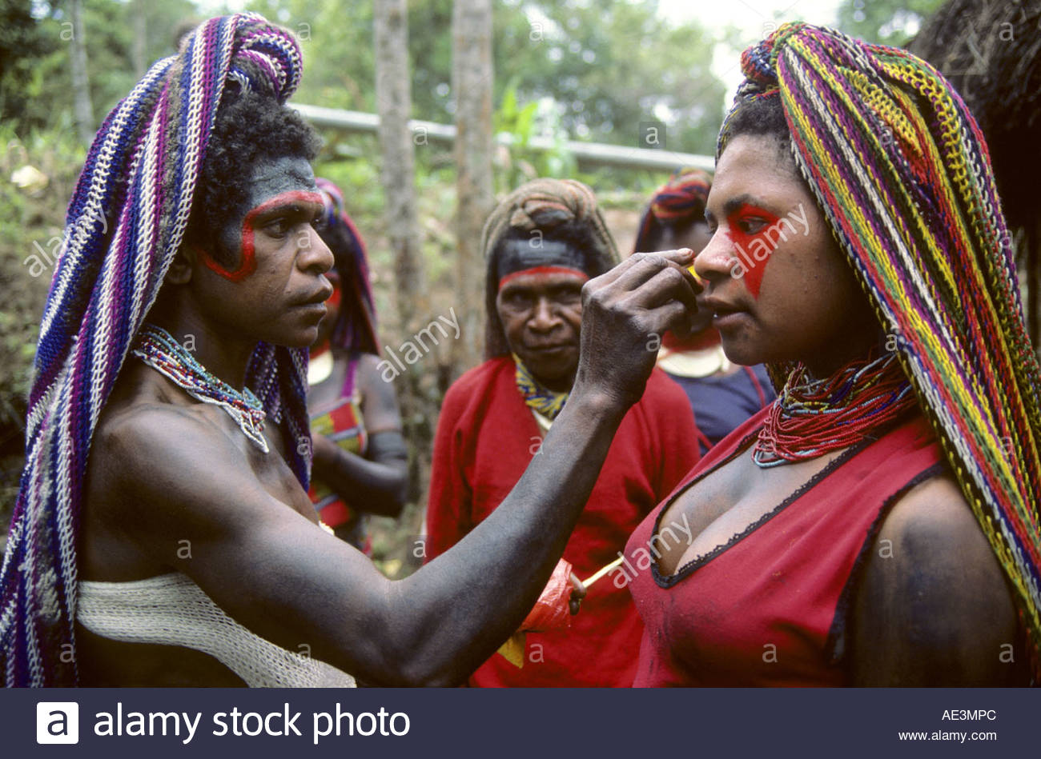
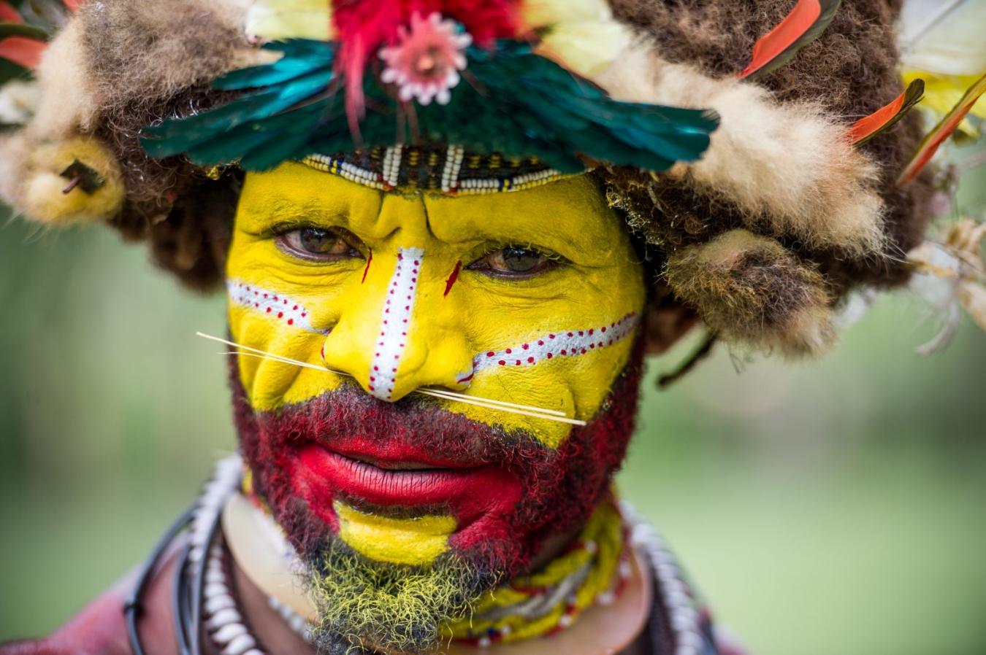
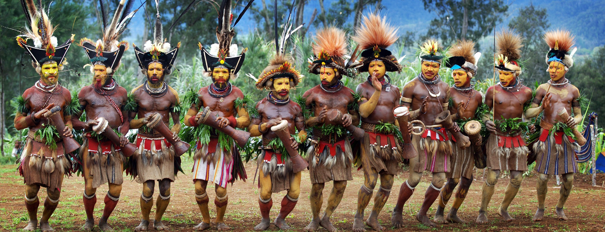
The Huli

Slide 31
2.1.7
Kazakhs – Kazakhstan
The Kazakhs are a semi-nomadic tribe who have been travelling through the mountains and valleys of Kazakhstan since the 15th century. They are descendants of Mongols and other nomadic tribes. They still hold onto traditions that are centuries old. Along with taming wild horses, one of their most famous ancient traditions is hunting with eagles. It is seen as the highest form of art and dedication.

Slide 32
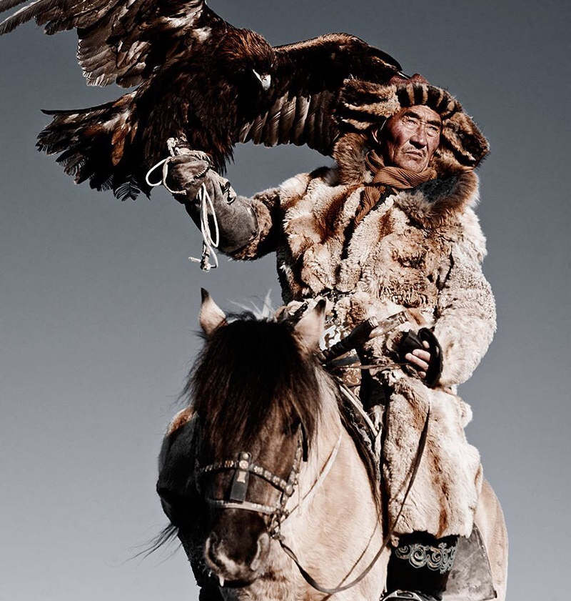
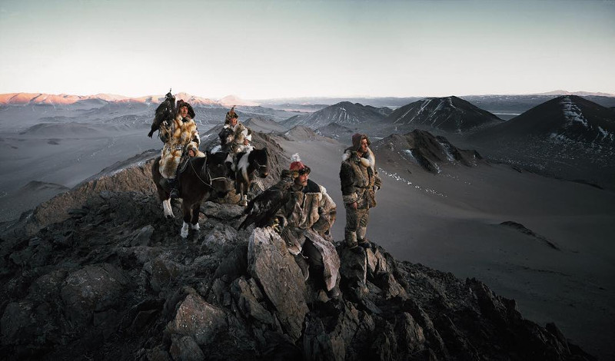
Kazakhs

Slide 33
2.1.7
Culture Diversity at a Regional Level
Culture within Canada is very different from province to province.
There is a very prominent hunting and fishing culture in many areas of Canada.
For example, Atlantic Canada, Quebec, and the northern territories.
Another example would be surfing culture in British Columbia.

Slide 34
2.1.7
Culture Diversity at a Regional Level
Countries with large land masses, like Canada, are special because we have so much territory, there is a lot of room for cultures to change and grow.
Canada is often referred to as having a “cultural mosaic”.
Main components of Canadian culture are humour, symbols, art, literature, theatre, film & television, music, sports, and food.

Slide 35
2.1.7
Culture Diversity at a Local Level
Culture is even different from town to town.
These differences may not be as big and obvious as the differences seen between countries.
Some examples of things important to local culture here in Upper Miramichi are hunting, snowmobiling, church activities, and fishing.
Mrs. Hay grew up near Petitcodiac. Some examples of things important to the local culture there are the legion, dairy farming, and hockey.

Slide 36
End of Chapter 5!

