Slide 1
Biographies
What are they?

Slide 2
KWL - What is a biography?
Know:
Would like to know:
Learned;
Please take two minutes to create a KWL chart. Fill out what you know and would like to know about biographies.
After we individually write down what we know and would like know about biographies, we will spend a few minutes going over our answers on the board.

Slide 3
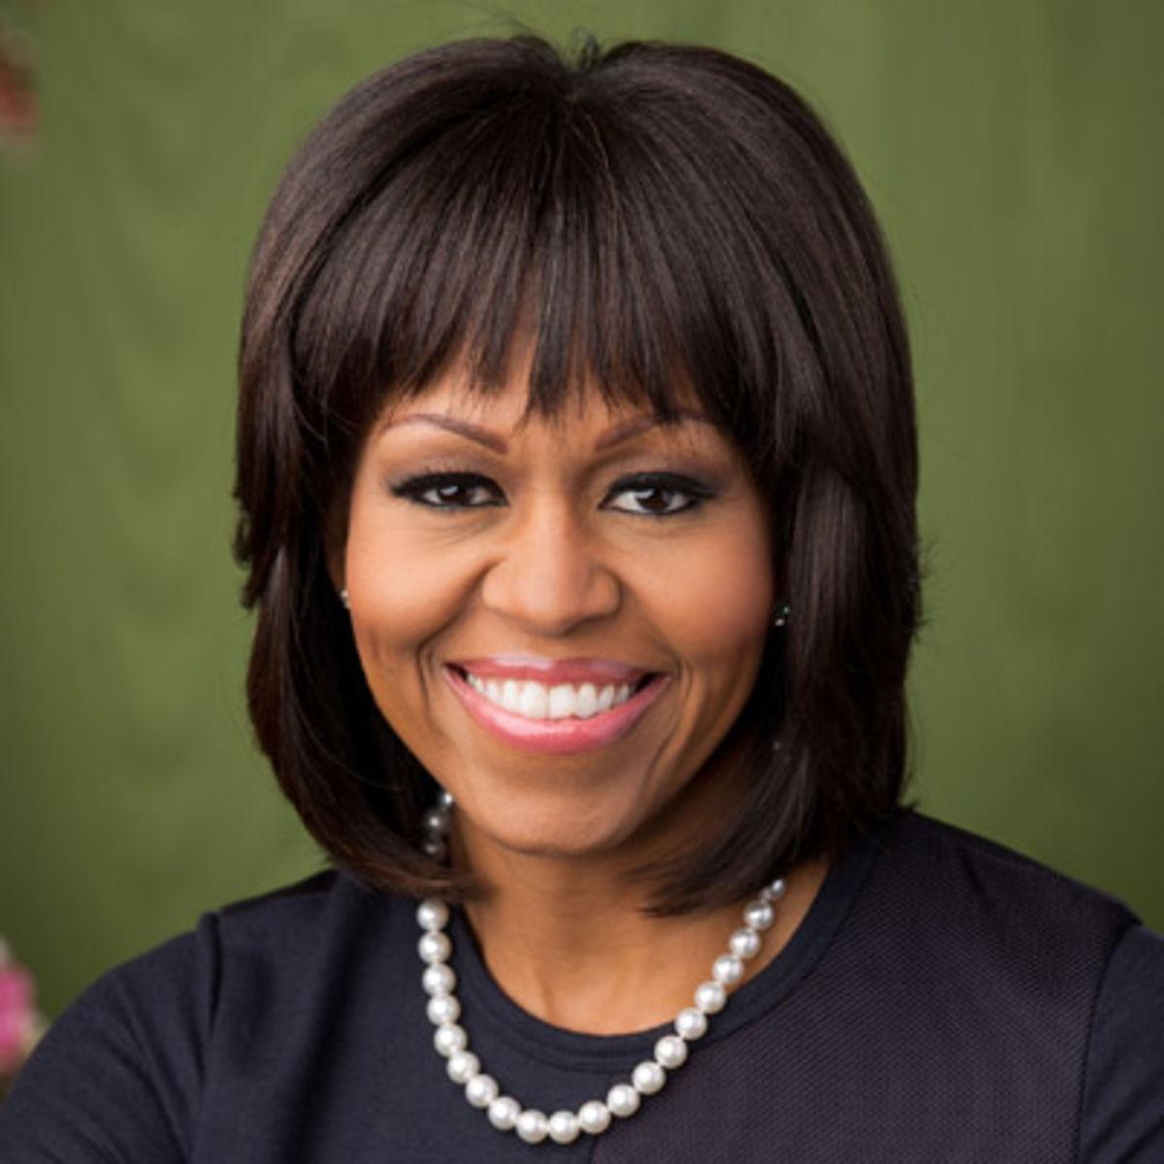
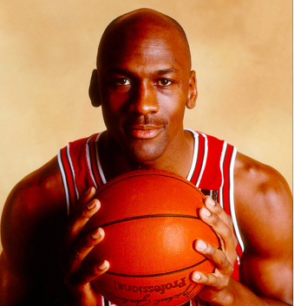
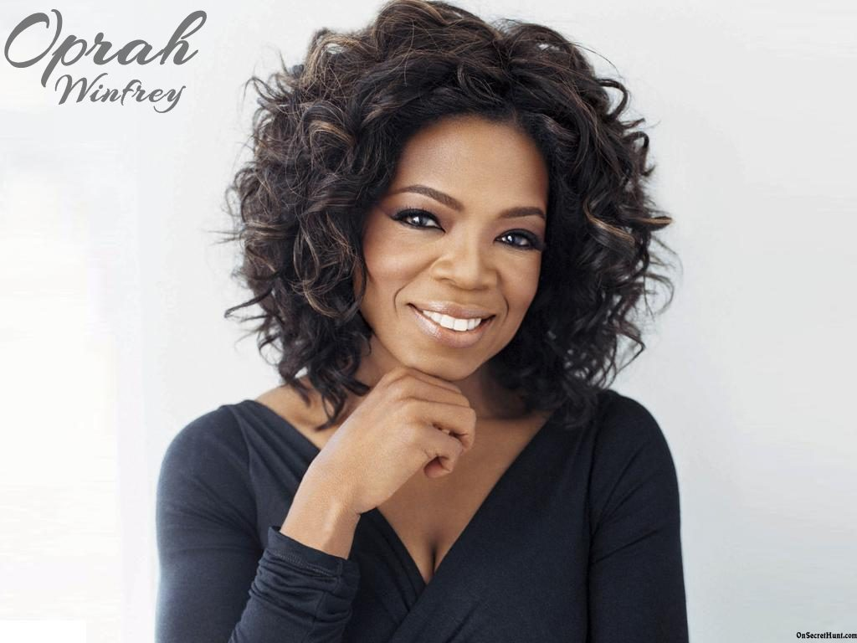
Choose 1 of 4 mini Bios
Michelle Obama: https://www.youtube.com/watch?v=g0CYL9qdOvk
Michael Jordan; https://www.youtube.com/watch?v=F_uhbJycTDU
Mark Zuckerberg: https://www.youtube.com/watch?v=RCqzT3ezz0A
Oprah Winfrey: https://www.youtube.com/watch?v=HChdxsXUVs8
*Pay close attention to what type of information is included in the biography.

Slide 4
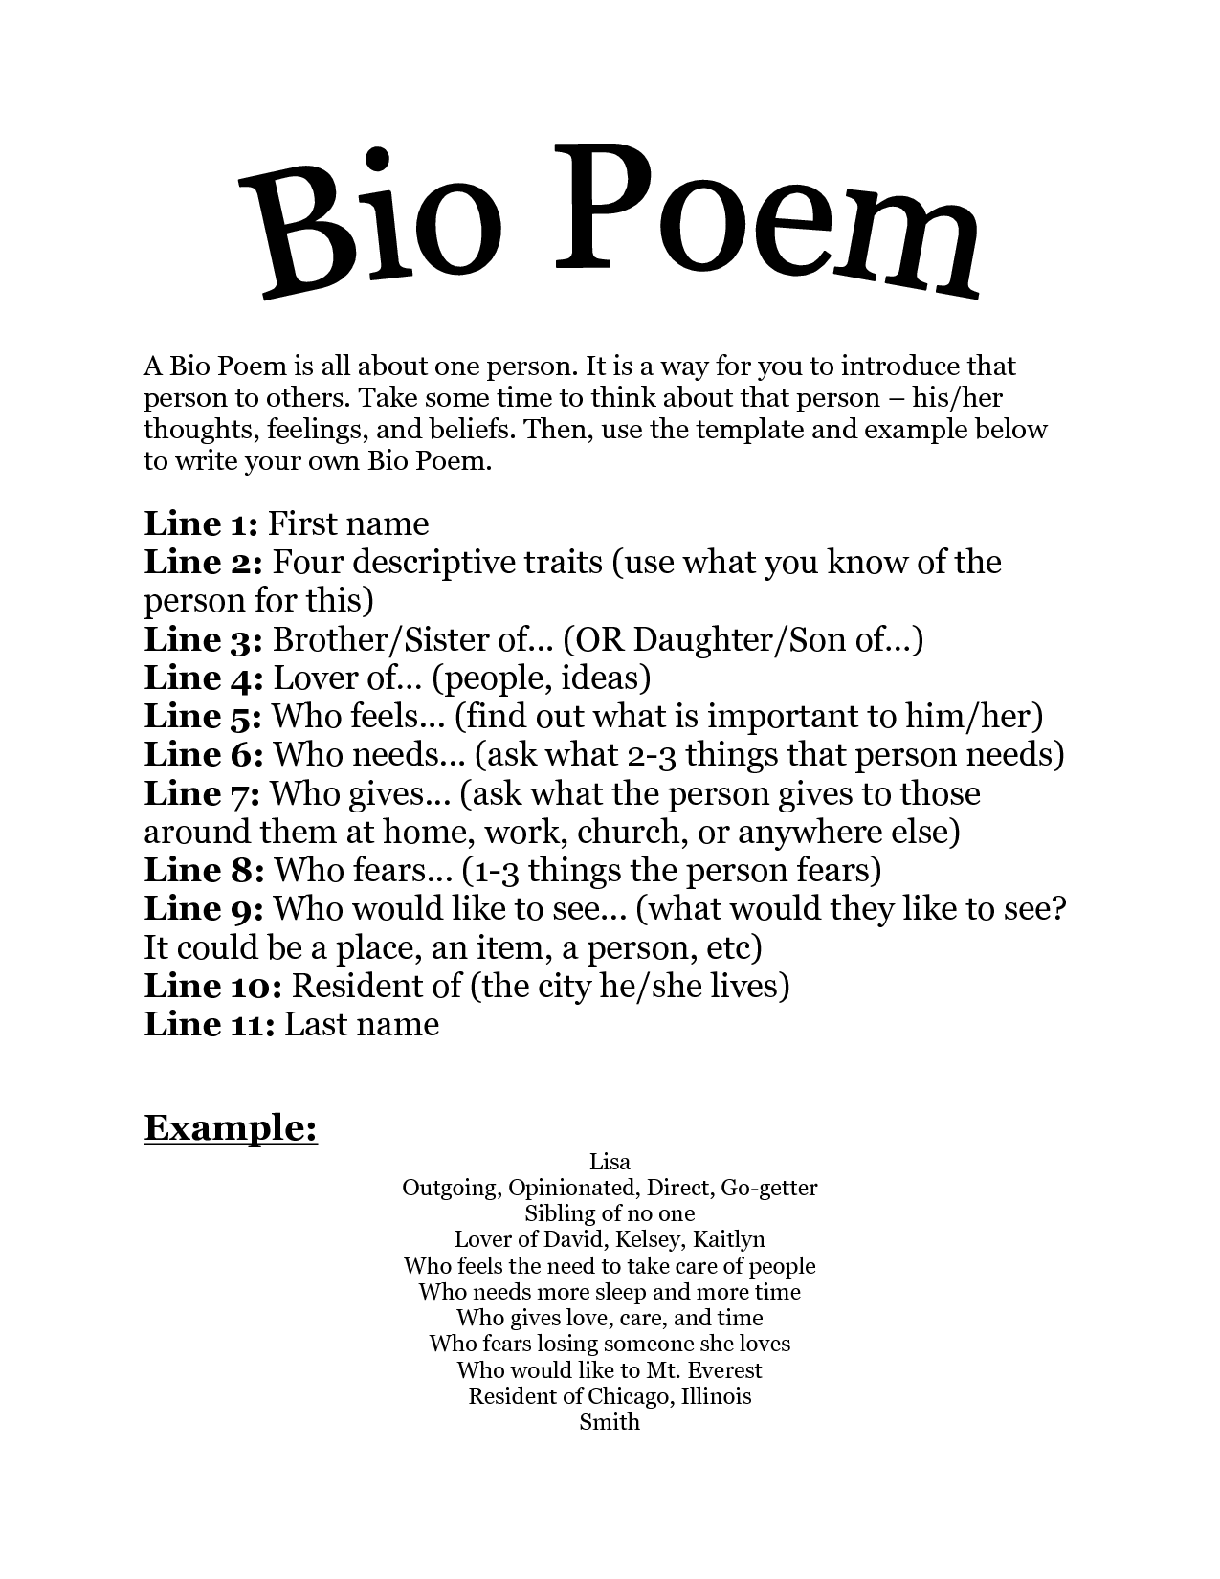

Slide 5
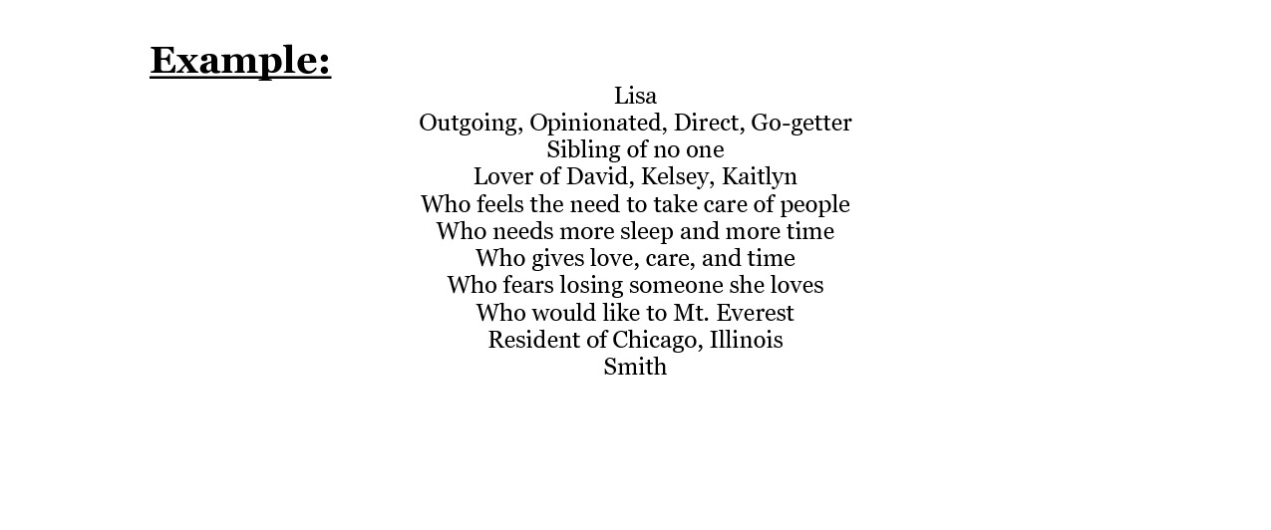
Example of a Bio Poem

