Slide 1
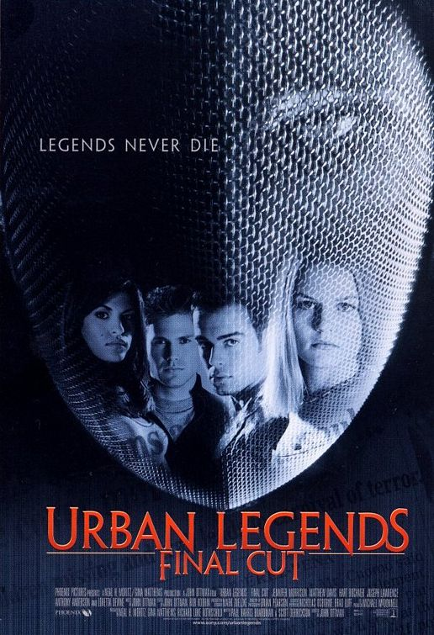
WHY DO….

Slide 2
URBAN LEGENDS!
Urban Legends are very similar to regular legends.
They follow the same set of rules as regular legends.
They are also known as "contemporary legends."

Slide 3
True or False?
Why do Urban Legends continue to circulate?
1) The person telling them believes them to be true.
2) They may not be completely false.
3) The story may change slightly to sound more realistic.

Slide 4
What is FOAF?
FOAF is a word that stands for “friend of a friend.”
Often with Urban Legends, the story did not happen to the teller or even a best friend or relative, rather somebody who knows somebody you know.
Take 2 minutes. Write why you think this is!

Slide 5
Clues to whether it’s true!
1) If you have heard the story many times before, but different versions, it is probably FALSE.
2) If it happened to a FOAF, it’s probably FALSE.
3) If it about a new device/trend, it MAY be FALSE.

Slide 6
More Clues!
4) If the story lacks specific details such as names, dates, and places, it’s probably FALSE.
5) If you did not hear the story on the news, it’s probably FALSE.
6) If it seems like it tries to “warn” you of something, it’s probably FALSE.

Slide 7
Let’s try!
Everyone get out a piece of loose leaf and write the numbers 1-25 along the side.
Everyone is going to get an Urban Legend card. Do not speak to anyone!
When I call your name, read your Urban Legend.
Write down whether you think it is TRUE or FALSE on your paper. This is a TEST! The winner gets a PRIZE!

