Slide 1
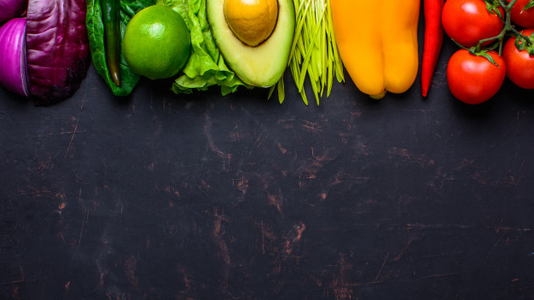
2020
Give Us a Try
Forest Hill
$5.50 | Monday | Tuesday | Wednesday | Thursday | Friday
Week 1 |  | Spaghetti with Lean Meat Sauce or Marina Sauce, with Caesar Salad, Fruit of the Day |  | Lunchables Naan Wedges Pizza Sauce Pepperoni Slices Shredded Cheese Mini Brownie Fruit of the Da | Cheese Pizza Slice Veggies & Dip Fruit of the Day
Week 2 |  | Homemade Pancakes topped with Berries, with or without Ham Slice, Cucumber Slices |  | Chicken Fingers, Baked Wedges and Fruit of the day | Cheese Pizza Slice Veggies & Dip Fruit of the Day

