Slide 1
Individual & Family Dynamics
120

Slide 2
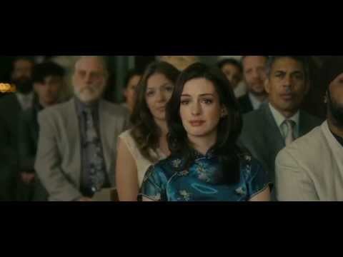

Slide 3
AGENDA
Discussion based on Friday’s Reflection. Question: In which time period would you like to be dating and why? Explain your reasoning.
Review: 7 Functions of Dating
Functions of Dating Handout
Dating today in our Society
Ted Talk, “Dating is Dead”
Technology and Dating
*Workbook check tomorrow (Tuesday)

Slide 4
Discussion: In what time period would you like to be dating and why? Explain your reasoning.

Slide 5
7 Functions of Dating
Understanding Others
Understanding Yourself
Providing Companionship
Improving Communication Skills
Learning to Negotiate
Learning to be Responsible
Evaluating Personality Traits

Slide 6
Dating Today in our Society
Dating styles and dating etiquette certainly has changed over the last century

Slide 8
Technology and Dating
The rapid march of technology has changed every aspect of our lives in the last couple of decades, and relationships and dating are no different. Our love lives have changed profoundly with the advent of things that go “beep.” The changes have come from two main developments--the internet and the mobile phones. Some of these changes that influence the way we date are:
Texting & Sexting
Googling
Facebook stalking
Online dating sites
Speed dating
Virtual dating

Slide 9
Technology certainly has changed the way we communicate with significant others and potential significant others and added new complications to the process.

Slide 10
...
With the multitude of relationship options that exist today, it is ultimately up to the individual to choose which style of dating is right for them. No matter what form of dating a person chooses to pursue, they should focus on establishing mutual trust and communication--the universal key to maintaining a happy relationship.

Slide 11
Group Activity - Dating in our Society
Discuss the following questions in groups or pairs and write your answers in your workbook.
How does dating take place in your age group?
How does technology influence dating in your age group?
Do you think technology is a negative influence on dating or a positive influence on dating or both? Explain.
REFLECTION #12 Based on everything we have learned about dating, what are your dating standards going to be?

