Slide 1
Procedure for boiling water
Put water in a clean and sanitized pot;
heat water until it is brought to a rapid rolling boil;
continue rolling boil for at least five minutes; and
after five minutes, if necessary, cool water by placing it in another sanitized container and storing it in the refrigerator.

Slide 2
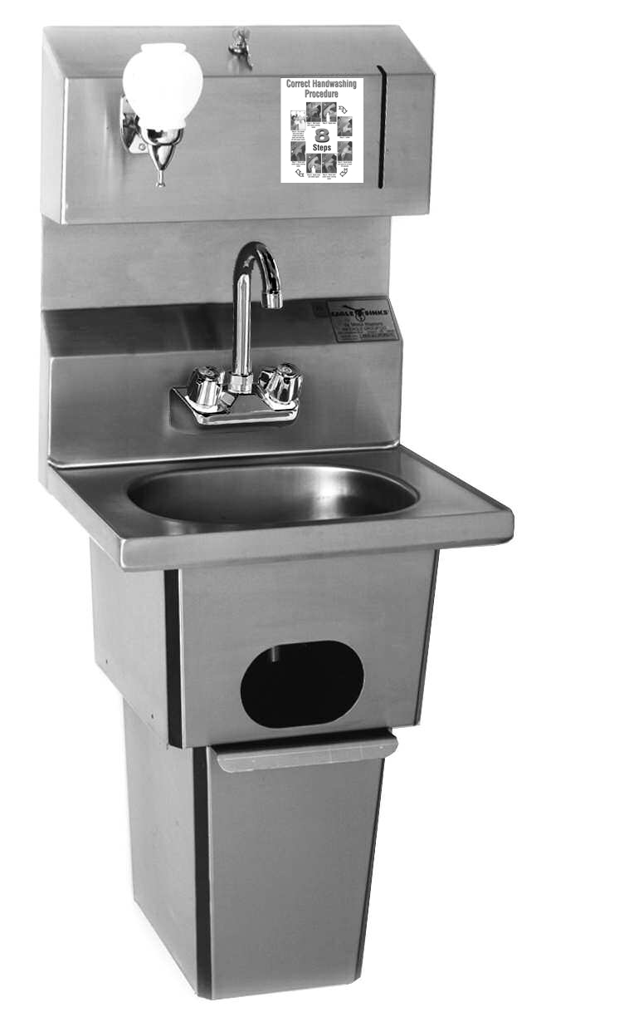
Hand Wash Station
All hand wash stations must be equipped with liquid soap dispensers.
A hand washing sign with proper hand washing procedures.
Single-use hand drying devices such as paper towel dispensers.
Hand wash stations must have adequate hot and cold, (warm) running water.
Self-closing faucets should flow for at least 20 seconds, without the need to reactivate the faucet.
A waste receptacle for used paper towels and gloves (if used).
Notes:
Food handler's hands are a primary source of food contamination.
Conveniently located and fully equipped hand washing facilities are key factors in getting employees to routinely wash their hands to minimize this contamination.
The number of hand washing stations required and the location of these stations are governed by the National Building Code.
It is important that hand washing facilities never be used for purposes other than hand washing.
Soap
All hand wash stations must be equipped with liquid soap dispensers.
Hot & Cold Water
Hand wash stations must have an adequate flow of hot and cold, or pre-mixed warm, running water.
If a self-closing faucet is installed, it should flow for at least 20 seconds, without the need to reactivate the faucet.
Paper Towels
Single-use hand drying devices such as paper towel dispensers, or properly functioning cloth roll dispensers.
Hand Washing Instructions
A hand washing sign posted which explains the proper hand washing procedures to staff.
Waste Receptacle
A waste receptacle for used paper towels and gloves (if used).

Slide 3
Dressing Rooms
Putting uniforms on at home can result in contamination of these clothes at home, during transit to work, and during other non-work related occasions.
Dressing rooms can promote the practice of having dedicated clean and sanitary work uniforms.
Separate dressing rooms can minimize potential contamination and the wearing of street clothes in food preparation areas.

Slide 4
Janitorial Facilities
In a foodservice operation, a janitorial facility should:
Be located away from food handling areas;
Be equipped with a service sink or curbed cleaning facility to dispose of waste water;
Be equipped with a floor drain, for the cleaning of mops and for the disposal of mop water and similar liquid waste;
Have a place to store brooms, mops, pails and cleaning equipment.
Notes:
Dirty water from wet floor cleaning is a source of contamination as it contains microbiological and chemical contaminants.
It is necessary to have a service sink or curbed cleaning facility with a drain. This will allow for the safe disposal of waste water.
Cleaning utensils such as mops, brushes and pails should have a designated storage area when not in use to decrease risk of contamination to food and food contact surfaces

Slide 5
Storage Areas
Food,
food ingredients,
equipment,
non-food materials (i.e.utensils, linens, packaging) and
chemical agents.
All food items must be stored in a separate location away from non-food items including packaging materials.
Notes:
Contamination of food, food ingredients and equipment can occur in unsanitary storage facilities. Separation of food and food contact surfaces from non-food material reduces the risks of cross contamination.
Foodservice operations must have storage facilities for food, food ingredients, equipment, and non-food materials such as utensils, linens, single-service and single-use articles, packaging, and chemical agents. All food items must be stored in a separate location away from non-food items including packaging materials.
Storage areas must be maintained in a manner that protects food and food contact services from contamination such as dust, dirt, water, pest infestation and any other unsanitary condition such as raw meat dripping on ready-to-eat food.
The sanitary and mechanical condition of storage areas should help to maximize the potential shelf life of products and protect food from contamination.

Slide 6
Storage Guidelines
Keep food 5cm (2 inches) away from the wall.
Keep food 15cm (6 inches) off the floor.
Notes:
Organize the storage areas with:
Adequate shelving for supplies
Shelving, if not sealed to the floor, raised off the floor at least 15 cm (6 inches) to permit cleaning and minimize pest access ;
Shelving at least 5 cm (2 inches) from the walls to allow for access and permit easier visual inspection for pests and dirt;
If shelving is attached to the wall, ensure that it is easily accessible for cleaning and storage purposes.

Slide 7
Non-food Storage
Keep linens, packaging, and single service utensils/containers away from contamination from food, equipment and non-food materials such as chemicals.
Landscaping tools, marketing materials and posters must also be stored to minimize contamination of food.
Store personal belongings of employees separately from food storage and food preparation areas.
Notes:
Store non-food products such as linens, packaging, and single service utensils/containers in an area that prevents the potential for contamination with food, food ingredients, equipment and non-food materials such as chemicals.
Other non-food materials such as landscaping tools, marketing materials and posters must also be stored in a manner so as to minimize contamination of food.
Store personal belongings of employees separately from food storage and food preparation areas.

Slide 8
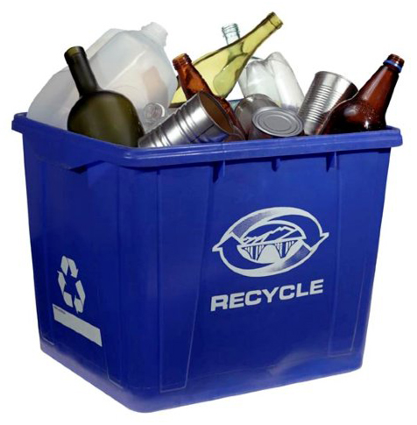
Recyclables
Recyclables need to be stored in a sanitary manner and removed regularly to prevent pest infestations.
Un-rinsed, improperly stored food containers can attract insects.
Notes:
In foodservice operations, all recyclables such as bottles and cans need to be stored in a sanitary manner and removed regularly to prevent the harborage and infestation of pests.
For example, if pop cans are not rinsed and stored in a sanitary manner, they can attract insects into the premise, creating unsanitary conditions.

Slide 9
Summary
Locate buildings away from potential sources of contamination and design with a forward flow to reduce cross contamination;
Floors walls and ceilings must be easy to clean and maintain;
Utilities such as lighting, ventilation, plumbing, water supply and sewage must be safe and sufficient;
Garbage must be properly stored and frequently removed to prevent contamination of food and infestation of pests;
Personal hygiene must be supported with facilities such as hand wash stations, restrooms and dressing rooms; and
Food and non-food storage areas must be properly designed to prevent contamination of food.

Slide 10
Equipment Installation
If you can’t clean equipment properly it can contaminate the food you are preparing.
Attach fixed equipment to surrounding walls, floors, or other equipment; or
Space it in a manner to allow for cleaning under and around equipment and prevent the accumulation of dirt.
Equipment should be installed by licensed professionals and must meet all local, provincial and national regulatory requirements.

Slide 11
Food Contact Surfaces
Ensure that the food contact surfaces:
Are corrosion resistant, smooth, non-absorbent and easy to clean to eliminate contaminants;
Non-toxic, free from pitting, cracks and crevices;
Do not introduce substances into food, such as colour, odours and tastes or substances (metals) which are harmful; and
Are durable for the safe preparation and cooking of food.
Notes:
The food contact surfaces should not introduce harmful substances into the food. Copper, cast iron, lead glazed utensils and galvanized metals are all areas of concern.
Food preparation surfaces, utensils or containers can introduce physical contaminants into food items. If food is prepared on a wooden surface that is splintered or damaged, customers may eat wooden particles that could cause serious physical harm.
Ensure that the food contact surfaces:
Are corrosion resistant, smooth, non-absorbent and easy to clean to eliminate contaminants;
Non-toxic, free from pitting, cracks and crevices;
Do not introduce substances into food, such as colour, odours and tastes or substances (metals) which are harmful; and
Are durable for the safe preparation and cooking of food.

Slide 12
Wooden Food Contact Surfaces
Can deteriorate becoming difficult to clean and prone to food contamination;
Must be re-surfaced (or discarded) if they are too worn to clean and sanitize;
Can be used for cutting boards; cutting blocks; baker's tables; and utensils such as rolling pins, doughnut dowels, salad bowls, chopsticks, and wooden paddles.
Notes:
Wooden food contact surfaces are not generally recommended for cutting, especially for meat and poultry. Moist foods may cause the wood surface to deteriorate and become difficult to clean, leading to contamination of the cutting board.
Hard maple or an equivalently hard, close-grained wood may be used for: cutting boards; cutting blocks; baker's tables; and utensils such as rolling pins, doughnut dowels, salad bowls, chopsticks, and wooden paddles.
Surfaces such as cutting blocks and boards that are subject to scratching and scoring should be resurfaced if they can no longer be effectively cleaned and sanitized, or discarded if they are not able to be resurfaced.

Slide 13
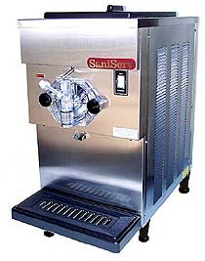
Clean in Place Equipment
Cleaning and sanitizing solutions must contact all interior food contact surfaces.
Must be capable of being completely drained of cleaning and sanitizing solutions.
Should be inspection access points to ensure equipment is effectively cleaned.
Notes:
Cleaning and sanitizing solutions should circulate through a fixed system and contact all interior food contact surfaces.
The system or equipment should be self-draining or capable of being completely drained of cleaning and sanitizing solutions.
There should be inspection access points to ensure all interior food contact surfaces throughout the fixed system or equipment are being effectively cleaned.

Slide 14
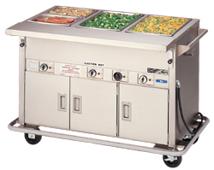
Heating & Cooling Equipment
Must achieve and maintain temperatures to prevent, eliminate or reduce growth of harmful micro-organisms.
Must be equipped with devices to monitor and control temperatures.
Temperature measuring devices on the equipment must be easily readable and accurate to 1.0°C (2.0°F).
Notes:
Must be designed and operated to achieve and maintain the required food temperatures to prevent, eliminate or reduce growth of harmful microorganisms.
Equipment used to heat, cool or hold food for service must be equipped with devices to monitor and control temperatures.
Temperature measuring devices on the equipment must be easily readable and accurate to 1.0°C (2.0°F).

Slide 15
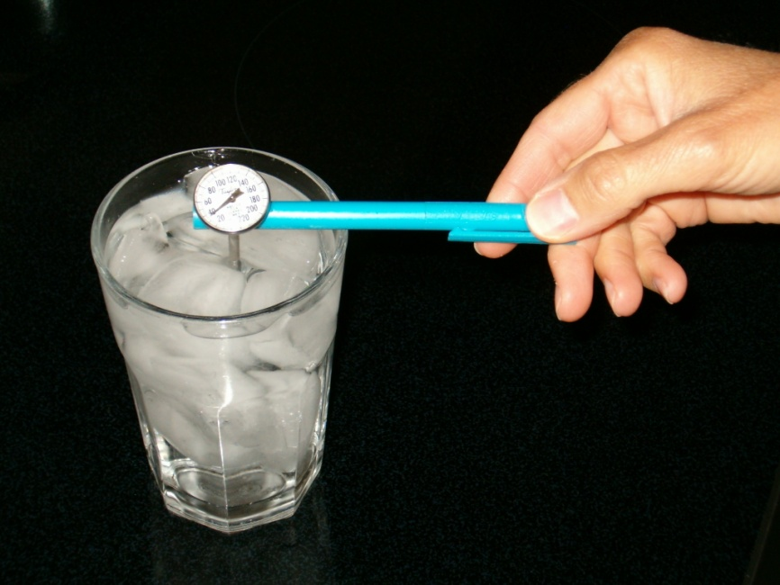
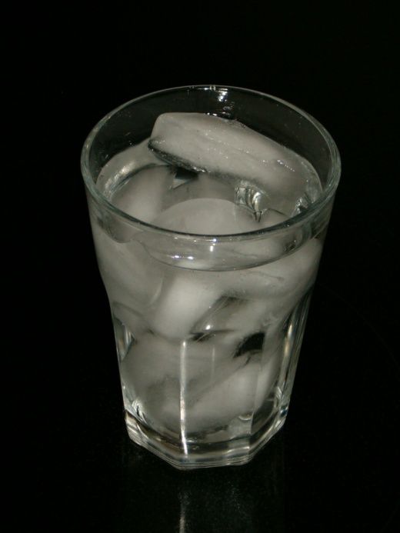
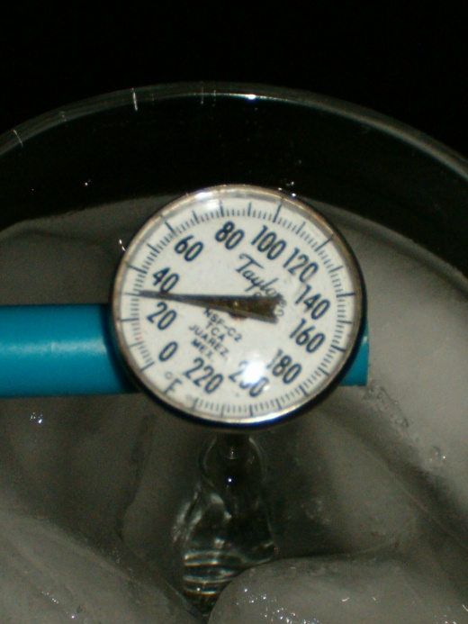
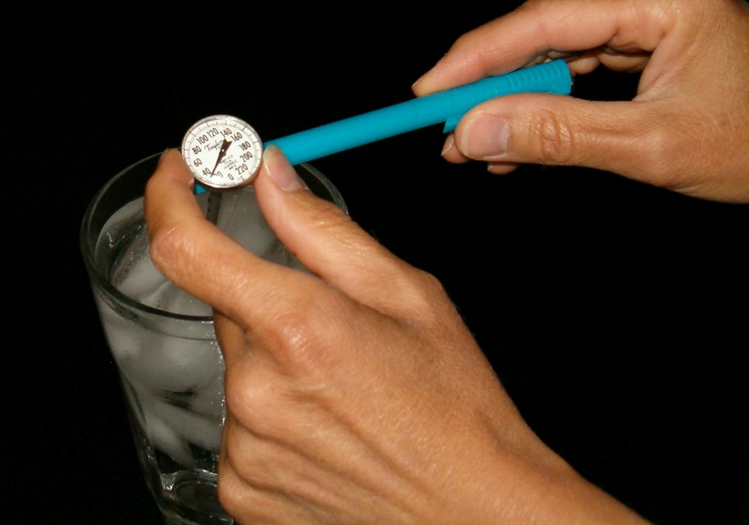
Calibration
Submerge the probe
Calibrate
Make an Ice
Water Solution
Check the
Temperature
Notes:
All heating and cooling equipment must be calibrated regularly, according to manufacturer specification, to ensure safe food temperatures.
Temperature measuring devices must be easy to read and accurate to 1°C (2°F).
A good calibration program includes recording the calibration results, as well as any corrective action taken, for each piece of equipment.
Food temperature measuring devices should not have sensors or stems constructed of glass unless they are encased in a shatterproof sleeve.
All temperature measuring devices (including portable thermometers) must be calibrated on a routine basis.
The following steps will show how to calibrate a thermometer.
Make an Ice Water Solution
Fill a large glass with ice. Add enough clean tap water until the glass is full. Stir the mixture well to mix the ice with the water to form an ice-water solution.
Submerge the probe
Put the thermometer or probe stem into the ice water so that the sensing area (the immersion area below the dimple) is completely submerged.
Wait at least 30 seconds (Note: Do not let the stem touch the bottom or sides of the glass. The thermometer stem or probe stem must remain suspended in the ice water).
Calibrate
Hold the adjusting nut securely with the sleeve of the thermometer or other tool and rotate the head of the thermometer until it reads O°C (32°F). If using a digital thermometer, press the reset button on the digital thermometer to adjust the readout.
Check Temperature
Confirm the temperature is set to the freezing point O°C (32°F).

Slide 16
Summary
Equipment should be located where it is easy to properly maintain
Equipment must be safe for use with food and be designed to prevent, eliminate or reduce potential hazards
Food contact surfaces should be smooth making them easy to clean and sanitize
Equipment should be regularly maintained according to manufacturer’s recommendations
Frequent calibration ensures the equipment is working properly to keep food safe

Slide 17
Choosing a supplier
The company should:
Be reliable;
Use refrigerated delivery trucks;
Train their employees in food safety;
Use clean, protective, leak-proof packaging;
Ensure deliveries arrive during off-peak hours;
Cooperate with employees inspecting the food;
Allow you to inspect their delivery trucks and production facilities.

Slide 18
Approved Suppliers
The following must be purchased from approved suppliers:
Potentially hazardous food such as meat, poultry, fish, eggs and milk;
Foods in sealed containers and/or products packaged under modified atmosphere packaging;
Meat from commercial game farms that raise, slaughter and process the animals.
Note: Government-inspected and graded foods should have an inspection stamp like the ones below.

Slide 19
Unapproved Sources
Do not buy:
Food that has not been prepared in a place approved by the health authorities;
Wild game that has not been inspected and approved by the health authorities.
In some jurisdictions, regulatory authorities may allow some exemptions to this requirement.
Check with your local regulatory authority.

Slide 20
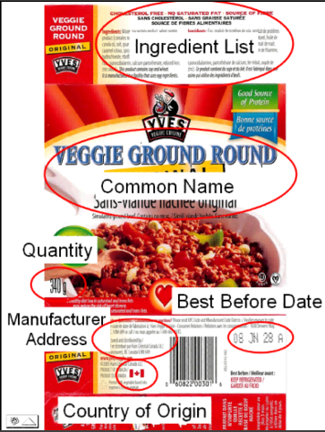
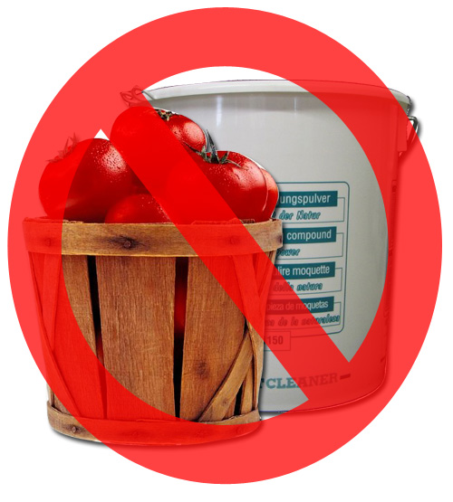
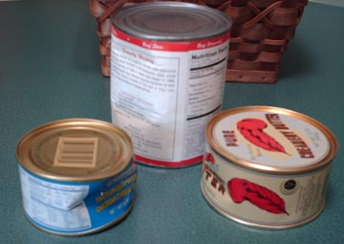
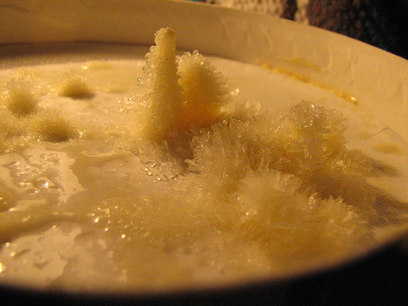
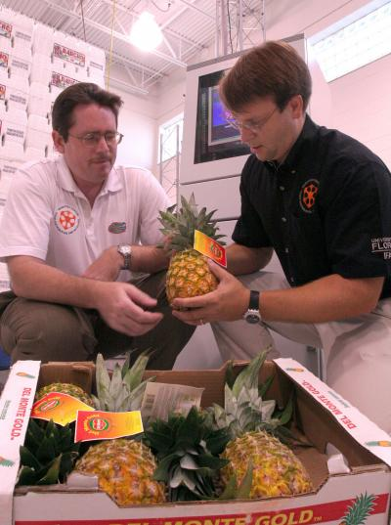
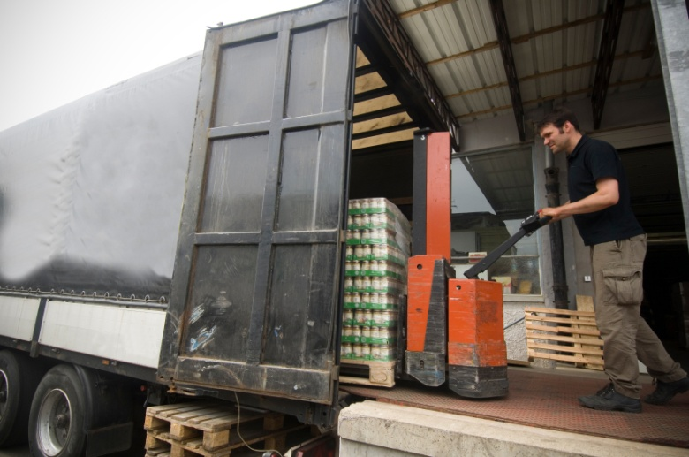
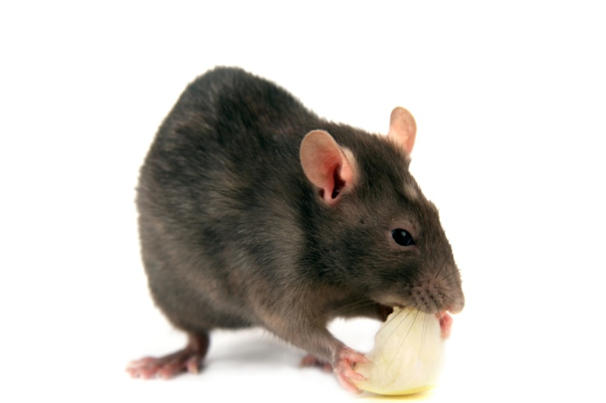
Steps to Receiving
Check the truck.
Check for temperature abuse.
Avoid cross contamination.
Properly labelled supplies.
Packaging intact.
No pests.
Notes:
It is important that the person receiving food and supplies knows how to check them when they arrive.
Discuss the steps below to explain what you must do to properly receive food and supplies.
Check the Truck
Check the truck to ensure it is not contaminated.
If it is delivering refrigerated or frozen food it must have proper refrigeration units that can keep refrigerated food at 4°C or 40°F and frozen food at -18°C or 0°F.
Temperature Abuse
Check for visible signs of temperature abuse such as thawing and re-freezing. This might look like water stains on boxes, frost or large ice crystals such as the ones in the picture of ice cream.
Check the temperatures of the food using a sanitized and calibrated thermometer.
Cross Contamination
If food and non-food items such as chemicals are shipped in the same truck they should be separated to prevent cross contamination.
Food and chemicals should always be kept separate.
Proper Labels
Do not accept packaged food without labels. Labels are important if the food needs to be recalled. Labels should include:
the common name of the product;
ingredients list;
quantity;
best before date;
grade;
country of origin;
name & address of manufacturer or distributor.
For products such as produce, baked goods or raw meat, invoices or shipping receipts should have lot codes.
Packaging Intact
The packaging for food and supplies must be not be damaged. Some examples of unacceptable damage includes:
broken boxes;
leaking packages;
dented or swollen cans;
signs of pests such as insect or rodent droppings.
If 'best before' dates have passed the food must be rejected.
No Pests

Slide 21
Shipment Rejection
If any food is unacceptable then it must be rejected.
Get a credit note and return the food.
Keep records of suppliers that delivered food that was rejected.
If the problem is repeated too often you will need to find a different supplier.

Slide 22
Disposal of Rejected Food
If food is rejected you must keep it away from safe food to prevent cross contamination.
Follow these steps:
Mark the food with a label or mark on the package “Rejected – do not use”;
Put all rejected food in a place separate from your safe food to prevent contamination;
Have the supplier pick up the rejected food or put it in the garbage.

Slide 23
Storage
Proper storage and rotation of food reduces spoilage and potential contamination.
Quality and freshness help ensure happy customers.
Notes:
Optional: Review chart of recommended storage times

Slide 24
FIFO
To maintain a First In First Out storage system:
Write on each food package/box/container:
the expiration date, or;
the date the item was received, or;
the date the item was put into storage.
Shelve new products behind old products;
Regularly check expiration dates to ensure older product is used first;
Never use products past their expiration date.
Notes:
First-In-First-Out stock rotation ensures the oldest food will be used first.

Slide 25
Refrigerated Storage
Keeping products at refrigerated temperatures helps to decrease the growth of microorganisms in food. Food must be maintained at 4°C / 40°F or lower.

Slide 26
Refrigerated Storage Guidelines
Check food temperatures regularly with a sanitized and calibrated thermometer.
Place hanging thermometers in the front and back of refrigerators.
Do not overload refrigerator shelves or line them with foil or paper because this prevents proper airflow.
Store raw meat, poultry and fish separately from cooked and ready-to-eat foods to prevent cross-contamination.
Wrap, label and date food to prevent cross-contamination and use oldest product first.
Notes:
Keeping products at refrigerated temperatures helps to decrease the growth of microorganisms in food and reduces product deterioration.

Slide 27
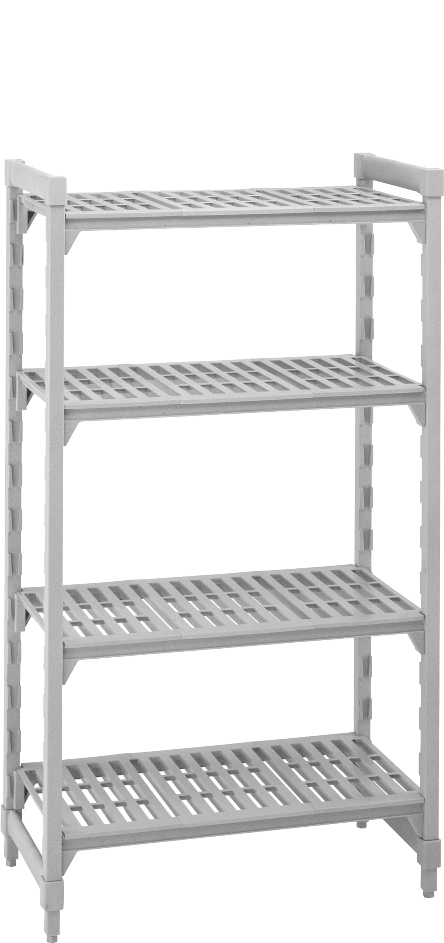
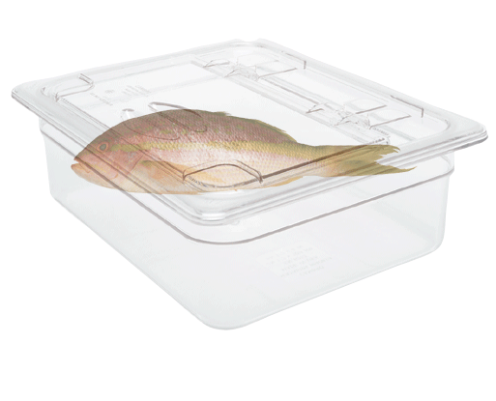
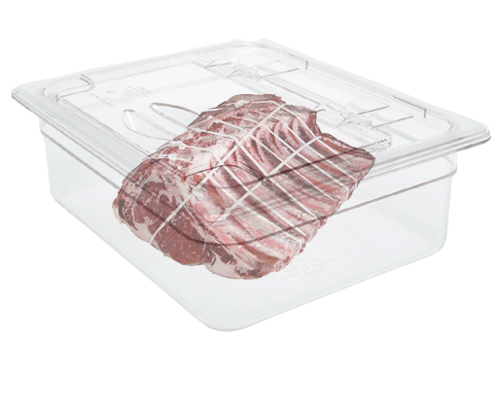
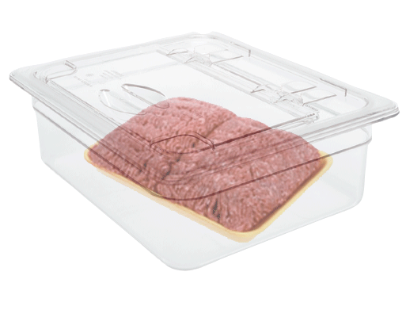
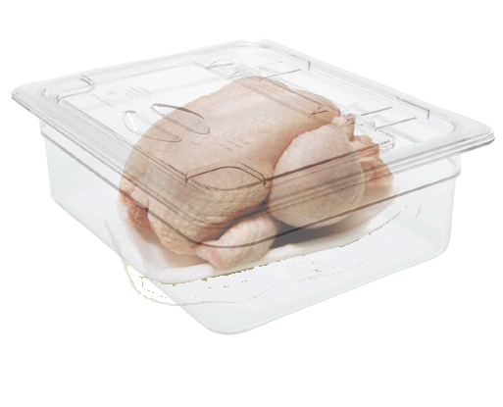
Top Down Storage
Top Down Storage
Fish;
Whole cuts – beef, pork, ham, sausage, bacon;
Ground beef & pork;
Poultry.

Slide 28
Frozen Storage
Frozen foods must be received and maintained in a solid frozen state at a temperature of -18°C (0°F) or less.

Slide 29
Frozen Storage Guidelines
Monitor freezer temperature daily.
Rotate food using the FIFO method.
Discard food that is damaged from freezing.
Defrost the freezers frequently.
If possible move frozen food to another freezer during defrost.
Notes:
Frozen food must be stored at temperatures that will keep it frozen.

Slide 30
Dry Food Storage
Foods not requiring refrigeration or frozen storage, must be stored in a clean, well ventilated, well lit, enclosed area, specifically designated for food storage.

Slide 31
Dry Food Storage Guidelines
Temperature between 10°C to 21°C (50°F and 70°F).
Humidity should be 50 to 55 %.
Store dry foods 15 cm (6 inches) off the floor.
Away from direct sunlight and heat.
Store foods in original packages.

Slide 32
Chemical Storage Guidelines
A dry, well lit, monitored area;
Separate from food and food contact surfaces;
Kept in original packaging with instructions; and
Returned to storage after use to prevent cross contamination.

Slide 33
Food Preparation
Potentially hazardous foods must not be exposed to temperatures between 4°C and 60°C (40°F and 140°F) for longer than four hours total accumulated time.
During preparation, food must not be contaminated by other sources in the foodservice operation.
Notes:
Food preparation is the step in which operators have the least amount of temperature control.
Also, exposure to potential contamination from many sources such as food handlers, equipment, other food (raw or allergens) and the foodservice operation is possible.
As foods are thawed, cooked, held, served, cooled and reheated, they may pass through the temperature danger zone of 4°C (40°F) to 60°C (140°F).
Each time food is handled, it runs the risk of cross contamination from other foods and from contaminated food contact surfaces.

Slide 34
Preparation Guidelines
Wash your hands before preparing food;
Prepare quickly, in batches to decrease time in the temperature danger zone;
Avoid cross-contamination from foods containing allergens or potentially hazardous raw foods;
Minimize advance preparation time ; and
Label products to ensure FIFO.

Slide 35
Thawing
Potentially hazardous foods must be thawed in a manner that will prevent the rapid growth of harmful bacteria.

Slide 36
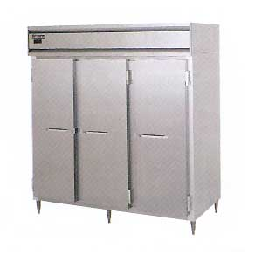
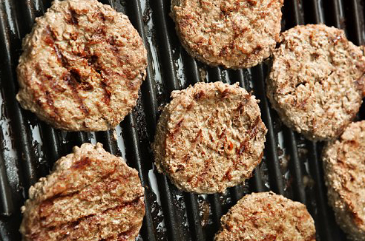
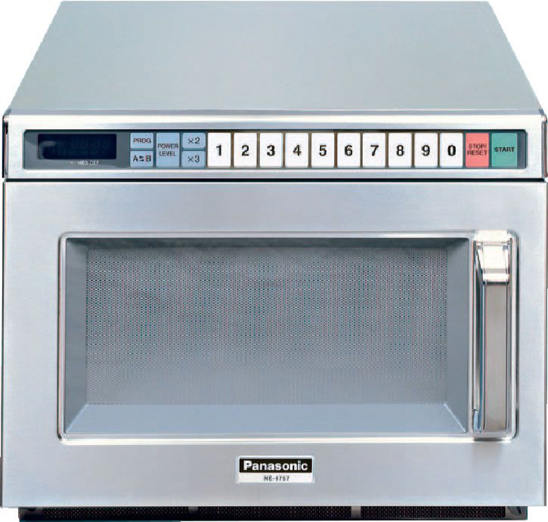
Thawing Methods
Cold running water
Refrigeration thawing
Part of the cooking process
Microwave thawing
Notes:
Improper thawing provides an opportunity for surviving bacteria in the food product to grow to harmful numbers and/or produce toxins.
Thaw foods under one of the four safe methods to prevent the growth of microorganisms and decrease the health risk to customers.
Refrigeration thawing
Ideally, frozen foods are best thawed under refrigeration temperatures below 4°C (40°F).
When thawing under refrigeration:
Store/thaw raw meat, poultry and fish separately from cooked and ready-to-eat foods to prevent cross contamination.
When thawing raw meat, poultry, and fish, they should be stored in the following top-to-bottom order in the refrigerator:
fish;
whole cuts of beef; pork; ham, bacon, and sausage;
ground beef and ground pork;
poultry.
Thawing with cold running water
Food may also be thawed while completely submerged in cold running potable water with velocity sufficient to shake any loose particles into the overflow.
Water temperature should be 20°C (68°F) or lower.
Large meat products should be left in their plastic wrapping.
The sink must be large enough to allow the food item to be covered and the sink should have a standpipe for its drain.
The maximum time allowed for this method is 2 hours.
Thawing as part of the cooking process
Thawing as part of the conventional cooking process is not recommended for the following:
large items of food;
for meat, fish, poultry; or
casseroles.
This is because internal temperatures may not reach levels to kill bacteria.
Thawing as part of the cooking process is only allowed when the total accumulated time in the temperature danger zone, including thawing and cooking, is less than 4 hours.
Microwave thawing
Always follow the microwave manufacturer's instructions when using this method.
Each make and style of microwave requires different defrosting times and intensities.
Foods thawed in the microwave should be cooked immediately.

Slide 37
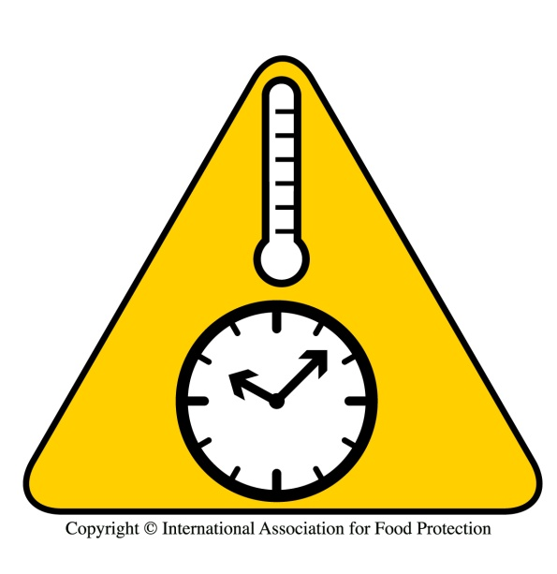
Cooking Meat
Raw foods of animal origin, and food mixtures containing raw foods of animal origin, must be cooked to heat all parts of the food to the minimum temperatures and for the minimum times outlined.

Slide 38
Cooking Guidelines
To cook to the proper temperature, and kill bacteria:
Cook food in small batches;
Stir when cooking large quantities of liquids;
Cook in one continuous process (i.e. whole turkeys and large cuts of beef);
Cook dressings/stuffing separately because they act as an insulator keeping part of the food in the temperature danger zone.

Slide 39
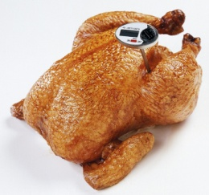
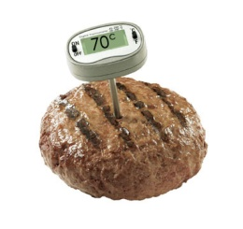
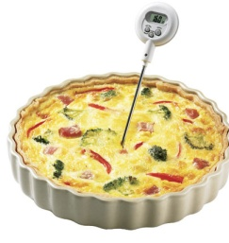
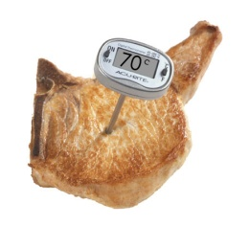
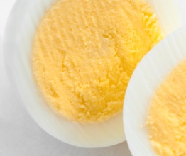
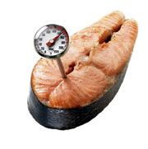
Cooking Guidelines for Different Foods
85°C (185°F)
70°C (158°F)
74°C (165°F)
70°C (158°F)
63°C (145°F)
70°C (158°F)
Notes:
Pathogen reduction involves a time-temperature relationship.
Other times and temperatures may be acceptable, if considered equivalent and approved by the local regulatory authority.
Review items below to see their specific cooking requirements.
Poultry
Health Canada recommends that poultry be cooked to a minimum internal temperature of 85°C (185°F) for 15 seconds
Some concerns exist about product quality when poultry is exposed to these temperatures. Consequently, local regulatory authorities may stipulate different temperature requirements.
Contact your local regulatory authority to determine the internal temperatures they require.
A probe-type thermometer should be placed deeply under the drumstick.
All stuffing or other dressings should be cooked separately from the poultry.
Ground/flaked meats. Includes chopped, ground flaked or minced beef, pork, or fish.
Thoroughly cook all ground meat products until all the pink is gone and the juices are clear.
Check with a thermometer to ensure a minimum temperature of 70°C (158°F) is achieved.
Cooking mixtures such as prepared foods with dressings, mayonnaise, milk base sauces & gravies.
If mixtures contain poultry, eggs, meat, fish or other potentially hazardous foods, these mixtures must be cooked to a minimum internal temperature of at least 74°C (165°F).
Whole cuts of meat includes: whole cuts of pork, lamb, veal and beef.
Whole cuts of meat require a minimum internal temperature of 70°C (158°F).
Eggs
Eggs require a minimum internal temperature of 63°C (145°F).
Customers requesting a runny yolk egg must be informed that pathogens are not destroyed until the yolk has been completely cooked.
Fish
Fish requires a minimum internal temperature of 70°C (158°F).
Customers wishing raw marinated fish and raw mollusc and shellfish should be advised that cooking is the only way to assure the food's safety.

Slide 40
Microwave Cooking & Reheating
Microwaves can be used for cooking and reheating.
Special guidelines must be followed to ensure the food reaches the recommended time and temperature relationship when microwave cooking.
Note that microwave ovens lose their power over time, and therefore temperature levels and even cooking should be checked periodically.
Notes:
Microwave cooking requires different consideration than conventional cooking
The rapid increase in food temperatures resulting from microwave heating does not provide the same cumulative time and temperature relationship necessary for the destruction of microorganisms as compared to conventional cooking methods.
Also, cold spots may exist in food cooking in a microwave oven.
In order to achieve comparable destruction of germs the food must attain a higher temperature. To verify the internal temperature of the product it is critical to measure the temperature of the food at multiple sites (middle; each side; front and back) after the food is removed from the microwave oven.

Slide 41
Microwave Guidelines
Food heated in a microwave must be:
Rotated or stirred during the cooking process;
Allowed to stand covered for at least 2 minutes after cooking;
Heated to higher temperatures (as per manufacturers‘ instructions) to compensate for shorter cooking times;
Checked in several places with a probe thermometer when the food is removed from the oven to ensure there are no cold spots.

Slide 42
Holding
We will review 3 types of holding:
Hot Holding;
Cold Holding; and
Room Temperature Holding.

Slide 43
Hot Holding
Potentially hazardous foods that have been prepared, cooked, and are to be served hot, must be held at a temperature of at least 60°C (140°F) until served.
To maintain hot holding temperatures the equipment needs to be higher than 60°C (140°F). Measure the food temperature with a calibrated thermometer every two hours.
Hot holding equipment includes: steam tables, double boilers, bain-maries, heated cabinets and chafing dishes.
Notes:
Improper hot holding, below 60°C (140°F), often contributes to foodborne illness.
Pathogenic microorganisms can grow well in the temperature danger zone 4°C (40°F) to 60°C (140°F).

Slide 44
Hot Holding Guidelines
Good practices for hot-holding include:
Using hot-holding equipment to keep food hot, not for cooking;
Never mix new food with old food when restocking;
Never mix raw food with cooked food;
Using sneeze guards for food on display (i.e. buffet service);and
Checking food temperatures every two hours.

Slide 45
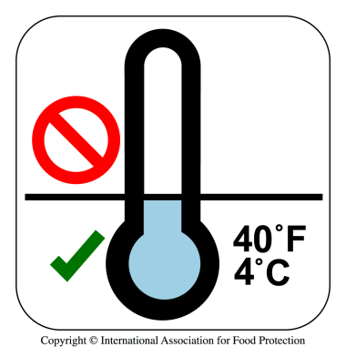
Cold-Holding
All potentially hazardous foods must be stored at a temperature of 4°C (40°F) or less.
Notes:
Foods requiring "cold-holding" include cold food that has been previously cooked (i.e. sliced turkey or roast beef) and foods consumed without cooking (i.e. salads or sandwiches).
By keeping these foods at 4°C (40°F) or less, they are out of the temperature danger zone.

Slide 46
Cold-Holding Guidelines
Good practices for cold-holding include:
Checking the temperature of foods being kept cold (i.e. salad bar) every two hours;
If using ice to keep "ready-to-eat" food cold, never put the food directly on the ice. Put the food in pans or on plates;
Sneeze guards are required on buffets.

Slide 47
Room Temperature Holding
Potentially hazardous foods intended for immediate consumption, may be held for service (not kept on ice or other equivalent methods).
This is a risky practice which should be kept to a minimum.
Notes:
The majority of microorganisms can double in number every 20 minutes while being held in the temperature danger zone. Some microorganisms can double every seven minutes.
However, foods with low initial bacterial levels that have undergone careful handling, cooking and/or chilling, may be held without temperature control for a short period of time.
Products removed from proper refrigeration or cooking can hold these temperatures for a period of time. It is unlikely that significant growth of pathogens or toxin production is possible in a very limited time.

Slide 48
Room Temperature Holding
Foods must be marked with the time at which they were removed from temperature control.
After no more than 4 hours food must be discarded.
Cover foods to prevent them from being contaminated.
Notes:
Room temperature holding is a very high-risk activity that must be monitored closely.
Tracking and keeping records of the products and the time at which they were removed from temperature control (such as cooking or refrigeration) must be recorded.
The products exposure to the temperature danger zone (room temperature) must be limited to a cumulative time exposure of no more than two hours.
This means that a product cannot be held for 1.5 hours, returned to refrigeration and then put on display for another two hours. In this example, the cumulative time exposure to the temperature danger zone would have been 3.5 hours. The product should have been discarded after two hours

Slide 49
Cooling
Cooked potentially hazardous foods, intended for refrigerated storage prior to serving, must be:
Cooled from 60°C (140°F) to 20°C (68°F) or less within two hours;
And then from 20°C (68°F) to 4°C (40°F) or less within four hours.
Notes:
Excessive time for cooling potentially hazardous foods has been consistently identified as one of the leading causes of foodborne illnesses.
During extended cooling, dangerous germs may grow to a sufficient number to cause illness.
In a foodservice operation, foods that are not served right away need to be cooled as quickly as possible and within the specified parameters.

Slide 50
Cooling from Room Temperature
Potentially hazardous foods prepared at room temperature, intended for refrigerated storage prior to serving, must be cooled from room temperature 20°C (68°F) to 4°C (40°F) or less within four hours.

Slide 51
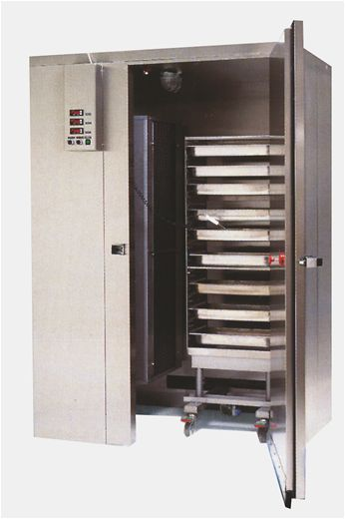
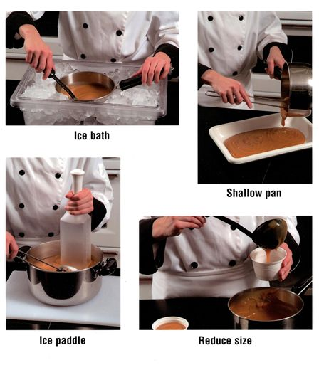
Methods of Cooling
Notes:
Excessive time for cooling potentially hazardous foods is often identified as one of the leading causes of foodborne illnesses.
If cooling takes too long the growth of dangerous micro organisms can increase causing people to become ill.
Please the points below to learn how to cool foods faster.
Blast Chiller
Depending on your type of operation you might have a blast chiller. This piece of equipment is specially designed to cool foods quickly.
Cover and label foods you place in the blast chiller. Follow the manufacturer's directions to ensure your food is cooled within the required time.
These are expensive pieces of equipment so you might want to look at the other methods if your operation does not have a blast chiller.
Ice Water Bath
Clean and sanitize a food service sink and make a mixture of cold, potable water and ice. Place the container of food in the ice bath and stir to increase the rate of cooling.
To further speed cooling you can use an ice paddle as shown in the inset picture.
Once the food has cooled below room temperature cover, label and date and place in the refrigerator.
Reduce Size
Put large quantities of liquid into several smaller containers. Cut large pieces of meat into smaller pieces. This increases the surface area so that food cools faster.
Shallow Pan
Slice meats such as turkey and large roasts and place them in a shallow pan.
Divide larger liquid food batches into several smaller amounts in pre-chilled stainless steel pans. The depth of the liquid should not be more than 8 cm (3 inches). For thick liquids such as stews fill the pan no more than 5 cm (2 inches). Leave a corner uncovered during cooling to allow heat to escape.
Cover, label and date and place the pans in the refrigerator.
Combined Methods
Many times it may be possible to combine methods to cool food faster. For example, if you had a large pot of hot liquid (soup, stew, sauce) you could:
Pour it into smaller pots, and
Place them in an ice water bath, and
Stir the smaller pots with an ice paddle, and
Once cooled, place the liquid in a shallow pan, and
Cover label and date the food before placing it in the refrigerator.

Slide 52
Reheating
Reheat products to an internal temperature of at least 74°C (165°F) or higher.
Ensure food passes through the temperature danger zone 4°C (40°F) to 60°C (140°F) within two hours.
Notes:
The potential for growth of pathogenic bacteria is greater in reheated foods than in raw foods. Most bacteria are killed during the original cooking process.
However, any subsequent contamination (e.g. contamination from a food handler sneezing on the product), that may have occurred in the product after the original cooking process, may now be allowed to grow if temperature abuse occurs.

Slide 53
Serving Reheated Food
Food that has been cooked and cooled can only be reheated once. Leftovers must be thrown out.
Prepared food (such as canned chili sauce) from an HACCP approved supplier may be reheated, cooled and reheated a second time. Leftovers must be thrown out.

Slide 54
Service
Food handlers must avoid touching tableware, such as cups, glasses and cutlery in a way that could contaminate the surfaces.
Tables should be set and cleared properly to prevent contamination.
Any item of food that is served but not consumed must be discarded (except unopened, single service items).
Notes:
Every effort must be made to prevent contaminating hands to prevent contamination of food contact surfaces.
Cross contamination can cause serious foodborne illnesses in customers.
This is important to note in a buffet style service, as both customers and employees need to handle serving utensils/dishware.

Slide 55
Distribution
During distribution:
Properly package and label foods;
Maintain proper and consistent temperatures;
Prevent exposure to cross contamination.
Notes:
Food can be seriously contaminated, or existing microbial contamination can be permitted to increase to dangerous levels, by unsanitary or careless distribution.
Foods should be packaged in a way to prevent contamination; and temperature control should be maintained during distribution.

Slide 56
Summary
Purchase supplies from approved suppliers;
Carefully inspect deliveries at receiving;
Store in dedicated areas at proper temperatures using FIFO stock rotation;
Minimize time in the temperature danger zone during food preparation;
Thaw foods under temperature control;
Cook food to required internal temperatures;
Hold hot food at 60°C (140°F) & cold food at 4°C (40°F);
Cool hot food quickly;
Reheat food to 74°C (165°F) or higher;
Prevent contamination during food service;
Maintain temperatures and avoid contamination during food distribution.

Slide 57
Definitions
Clean:
The removal of all visible dirt
The removal of chemical residue
The removal of allergens
Sanitize:
The reduction of dangerous micro-organisms to a safe level
All food contact surfaces must be cleaned and sanitized.

Slide 58
Cleaning Program
A Cleaning Program should specify:
Areas, equipment and utensils to be cleaned;
Designated employees responsible for cleaning;
Cleaning products, concentrations and procedures;
Equipment required to do the cleaning;
Frequency of cleaning and sanitizing;
Cleaning and sanitizing logs; and
Inspection and monitoring of equipment and records.
Notes:
An effective cleaning program has written procedures or instructions for staff on how to clean and sanitize the facility, equipment, utensils, and things like refrigeration units that impact food safety.

Slide 59
Points to Include
Clean and sanitize food contact surfaces after each use;
Items used continuously at room temperature should be cleaned & sanitized every 4 hours;
Disconnect power supply, tag and lock out electrical equipment while cleaning;
Remove guards and shields before cleaning;
Clean and sanitize infrequently used food contact items before use.
Notes:
You can develop a master cleaning schedule for all cleaning operations and equipment. A Cleaning on the Dot Chart is available from the CRFA.

Slide 60
Factors Affecting Cleaning
Object to be Cleaned
Nature of the Soil
Water Condition
Temperature
Cleaning Agents
Method of Cleaning
Notes:
There are several factors that can affect how equipment and facilities are cleaned. Review some of the key factors to consider.
Object to be Cleaned
Different equipment will have special cleaning requirements. For example, you will need to consider:
size
shape
crevices
what it is made of
resistance to cleaners
location and accessibility
Nature of the Soil
Different types of soil require different cleaning methods. Examples of different soil types include:
Fats
Proteins
Carbohydrates
Mineral deposits
Water Condition
Minerals in water can affect the cleaner's effectiveness. For example, hard water can reduce the detergent's ability to remove soil from food service equipment.
Hard water also causes a build up of lime requiring a special de-scaling agent.
Soft water is ideal for cleaning.
Temperature
The temperature of the water will affect cleaning. Generally higher temperatures are better, but some soils (proteins) can be set at high temperatures making them harder to remove.
Most fats melt at a temperature range of 37 - 48ºC (100 -120ºF).
60-70ºC (140-160ºF) is often adequate for cleaning most types of soil.
Low temperature cleaners work best at 43-54ºC (110-130ºF).
Cleaning Agents
Different soils require different cleaning agents. As well, different equipment can be damaged by using incorrect cleaners. For example, stainless steel pots can be damaged by cleaners containing chlorides (bleach).
Alkalis are particularly effective on fats (turning them into soap).
Detergents used for ware washing are highly alkaline. Degreasers, also called solvent cleaners, are also very alkaline.
Acids are effective for removal of hard water's mineral deposits.
Enzyme cleaners are used on equipment that can’t stand up to acids or alkalis. They help to break down proteins.
Method of Cleaning
Different types of soil and different equipment will require various methods of cleaning:
Manual Cleaning - such as washing in a sink or using a bucket and soap;
Soak Cleaning - allowing the wares to soak until soil is easily removed;
Pressure Spray - such as in a dishwasher;
Foam/Thin Film Cleaning - allows a thin film or foam to work on loosening soil;
Automated Cleaning - such as Clean in Place equipment that has cleaning solutions feed through pipes such as a soft ice cream machine.

Slide 61
Methods of Sanitizing
Hot water
Chemical
Chlorine
Iodine
Quaternary Ammonium
Notes:
You can use other sanitizing procedures that have been scientifically proven to produce results equivalent to those achieved by use of the methods mentioned, and which have been approved by the local health authority.

Slide 62
Hot Water Sanitizing
For manual washing immerse for at least 2 minutes in hot water at a temperature of 77°C (171°F).
Rinse water must reach 74°C (165°F) for 10 seconds for single tank, stationary rack, single temperature machines;
82°C (180°F) for 10 seconds for all other machines.
Notes:
Note: When following manual washing procedures and using hot water to sanitize there is a danger of burns and scalds. Take precautions such as using a basket or rack to hold items being lowered into the sanitizing compartment.
Do not put your hands in the hot water.

Slide 63
Factors Affecting Chemical Sanitizing
Concentration
Temperature
Contact Time
Notes:
Chemical Sanitizers are affected by several factors. The most common include concentration, temperature and contact time.
Concentration
Chemical sanitizers must be mixed with potable water to dilute them to the proper concentration. Solutions with too much chemical could leave a residue that would be dangerous to people or damage equipment.
Weak solutions will not be effective in killing dangerous micro-organisms.
You can check the sanitizing solution by using a test kit.
The sanitizing solution must be changed if the concentration becomes too weak.
Temperature
Sanitizers work well from 13°C (55°F) to 49° C (120° F).
Higher temperatures help kill the micro-organisms faster, but if they go above 49° C (120° F) the chemical may damage some metals.
Temperatures below 13°C (55°F) may not be effective in killing micro-organisms.
Contact Time
Different sanitizers require different contact times to work. If the equipment is not exposed to the sanitizer for long enough the micro-organisms will not be reduced to a safe level.
Check the manufacturer’s directions regarding contact time for the chemical sanitizer you are using.

Slide 64
Safety
Read Material Safety Data Sheets
Never mix chemicals
Potential for dangerous reactions
Wear personal protective equipment
Gloves, safety shield, glasses, apron, boots
Dispose of empty containers properly
More is not always better
Use recommended concentration
Notes:
Consult your sanitation chemical supply companies for information on the proper use of cleaners and the right combination of chemicals for your operation.

Slide 65
Clean Food Equipment & Utensils
Clean and sanitize equipment and utensils after each use;
Food contact surfaces of cooking equipment must be cleaned and sanitized often to prevent the accumulation of grease;
Equipment such as pizza pans or baking dishes may be cleaned less frequently.
Notes:
All food contact equipment and utensils used in the preparation, service, display, or storage of food must be cleaned and sanitized after each use.
Food contact surfaces of cooking equipment need to be cleaned and sanitized as often as is necessary to prevent the accumulation of grease deposits and other residues.
However, some types of equipment such as pizza pans or baking dishes, which do not pose a public health risk may be cleaned less frequently.

Slide 66
Clean-in-Place Equipment
Cleaning and sanitizing solutions must:
Remain within a fixed system of pipes for a predetermined amount of time;
Not leak into the rest of the machine; and
Reach all food-contact surfaces.
Notes:
Some equipment such as ice machines or soft-serve ice cream machines are designed to be cleaned in place by flushing detergent, hot water, and sanitizing solution through them.
This process should be done daily unless otherwise indicated by the manufacturer.

Slide 67
General Washing Guidelines
Scrape and Pre-soak;
Don’t use dish rags to wash;
Rinse soap before sanitizing;
Sanitize with heat or chemicals;
Do not towel dry;
Wash hands before touching clean wares;
Wares should be dry and cool before storage.
Notes:
Scraping and pre-soaking loosen foods and prevent 'setting' during mechanical wash and rinse cycles.
Dish rags can permit bacterial growth and result in cross-contamination.
Soap will reduce the effectiveness of chemical sanitizers.
Damp dish towels permit bacterial growth and can result in cross-contamination.
Don't re-contaminate clean and sanitized dishes with your hands.
If stored while wet or hot they provide conditions favourable for bacterial growth.

Slide 68
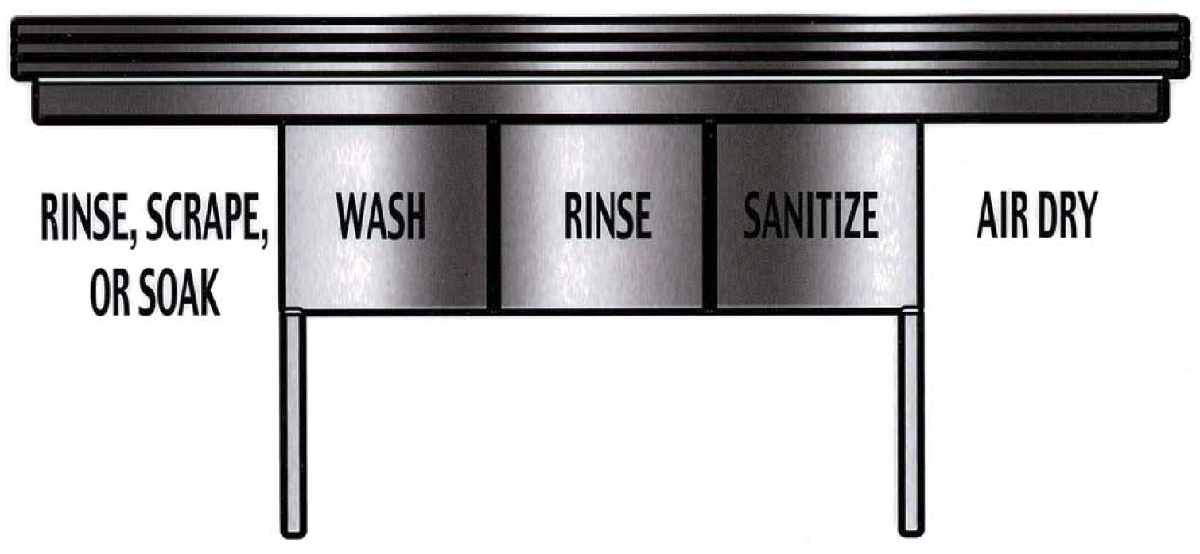
Manual Ware Washing
Notes:
The manual dishwashing setup should include:
A 3-well sink large enough to immerse equipment being sanitized;
Shelving and sinks with drain boards sloped for self drainage;
A space for holding soiled utensils separate from areas used for clean utensils;
A clock or a timer to time how long items have been immersed in the sanitizing sink;
A thermometer to measure water temperature; and
Testing equipment to determine the strength of chemicals used for sanitizing.
Scrape and Pre-rinse
Sort, scrape, and pre-rinse utensils so they are free of food scraps.
Wash
Wash dishes, pots, pans and utensils in the first sink compartment;
Use a detergent solution capable of removing grease and food particles;
Maintain at a temperature of not less than 45°C (113°F) or above.
Rinse
Rinse dishes, utensils, etc. in the second compartment sink;
Use a water temperature of not less than 45°C (113°F) or above;
If water becomes soapy or dirty replace it.
Sanitize
Immerse for 2 minutes in hot water at a temperature of 77°C (171°F), or
Immerse for 2 minutes in a chlorine solution of 100 - 200 mg/l (ppm) at 45°C (113°F), or
Immerse for 2 minutes in a quaternary ammonium solution of 200 mg/l (ppm) at a temperature specified by the chemical manufacturer, or
Immerse for 2 minutes in an iodine solution of 25 mg/ml (ppm) at 45°C (113°F).
Air Dry
Allow equipment and utensils to air-dry. Do not towel dry equipment and utensils.

Slide 69
Mechanical Ware Washing
Notes:
Mechanical Ware Washing Machines spray a mixture of hot water and cleaning chemicals under high pressure to clean table ware, utensils, pots and pans.
There are two types of machines:
one that uses a high temperature rinse to sanitize; and
another that uses lower temperatures with a chemical sanitizer.
A booster heater may be required to maintain water temperatures. If you have a booster heater, turn it on and allow time for it to heat up.
Follow the manufacturer's directions when operating your machine.
Scrape and Pre-rinse
Scrape all dishes and utensils. Then rinse them before loading them.
Cutlery may need to be pre-soaked to assist in removing the soil before washing.
Load Dishes
Load dishes in racks.
Make sure there is space between dishes to ensure all sides are exposed to the spray arms in the dish machine.
Glasses, bowls and cups should be inverted.
Cutlery can be placed in an open rack.
Washing
Allow the dishes to go through the full cycle of the ware washing machine.
Temperature of the wash solution in spray type washers must not be less than:
74°C (165°F), for a stationary rack, single temperature machine
66°C (151°F), for a stationary rack, dual temperature machine
71°C (160°F), for a single tank, conveyor, dual temperature machine
66°C (151°F), for multi-tank, conveyor, multi-temperature machine
Sanitize
Rinse water exposure must be to 74°C (165°F) for 10 seconds for single tank, stationary rack, single temperature machines; and
82°C (180°F) for 10 seconds for all other machines.
Air Dry
Allow the dishes to air dry after washing.
Make sure to wash your hands before handling clean dishes.
Store all pots, glasses, bowls, cups and similar containers upside down.
Cutlery should be stored so it is picked up by the handle and not where it touches food.

Slide 70
Cleaning the Machine
Some common steps for cleaning the machine include:
Turn off power
Check rinse nozzles are clean and free of lime deposits
Drain the machine
Clean wash arms
Wash machine interior
Empty & wash strainer pans & baskets
Notes:
A mechanical ware washing machine must be cleaned at the end of each shift.

Slide 71
Storing Equipment & Utensils
After cleaning & sanitizing store equipment:
on regularly cleaned & sanitized shelving
15 cm (6 inches) off the floor
away from contaminants like garbage
Notes:
Make sure your hands are clean before you handle equipment and utensils that have been cleaned and sanitized. Otherwise you will contaminate the equipment you just cleaned.

Slide 72
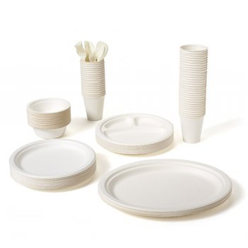
Single Service Utensils
Single-service utensils and containers must not be used more than once.
Notes:
Single-service utensils and containers have not been constructed to be easily cleanable or sanitized.
Bacteria, viruses and food particles would be carried from one customer to the next if these materials were reused.
This would result in a very high risk of foodborne illness and possible allergen reactions.

Slide 73
Use of Single Service Utensils
Single-service utensils and containers should:
Be stored in closed cartons or containers and stored away from exposed sewer lines or water lines;
Be dispensed in a manner that prevents contamination of surfaces that come in contact with food or with the mouth of the user; and
Be disposed of properly, so they do not spread odour and disease or attract pests.

Slide 74
Wiping Cloths
Wiping cloths used for wiping food spills on food contact surfaces such as tables must be:
Routinely cleaned and, when not in use, kept in a separate sanitizing solution
Be disposed of properly, so they do not spread odour; and
Be used for no other purposes, such as wiping raw animal juices.
Notes:
If a server at a busy full-service restaurant uses the same cloth all evening to clean tables, there is a high risk of spreading harmful microorganisms.
Each customer that comes in contact with a table surface that has been wiped by a dirty wiping cloth can potentially become ill .

Slide 75
Housekeeping & Maintenance Schedules
Floors, walls and ceilings throughout the operation, must be cleaned often to prevent accumulation dirt.
Establish a schedule and include:
Cleaning light fixtures, wall hangings, areas under booth cushions, highchair trays, windows and drapes; and
Cleaning and sanitizing tables, counters, and other work surfaces.

Slide 76
Housekeeping Tips
Dry sweeping should be kept to a minimum to prevent dust in the air that can contaminate food contact surfaces
A dust control type vacuum cleaner is the best method of dry cleaning floors.
Remove dirt or refuse from under fixtures, in corners, and in hard-to-reach places.
Daily cleaning should be done after closing or prior to opening.

Slide 77
Summary
Cleaning programs require written procedures for cleaning and sanitizing the facility and equipment.
Equipment and utensils that come in contact with food must be cleaned and sanitized after each use.
Single use utensils must be protected from contamination and cannot be reused.
Wiping cloths must be clean and kept sanitized between uses.
The facility, must be cleaned often to prevent the accumulation of dust, dirt, food residue and debris.

Slide 78
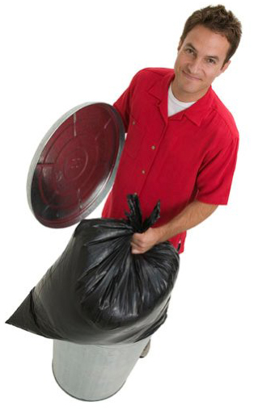
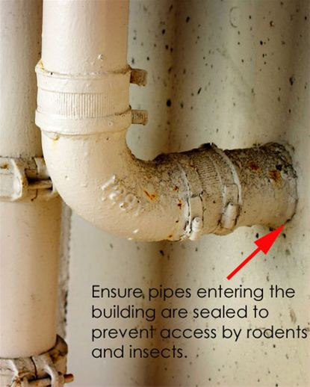
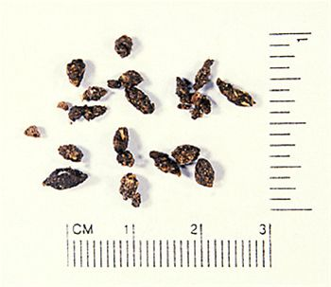
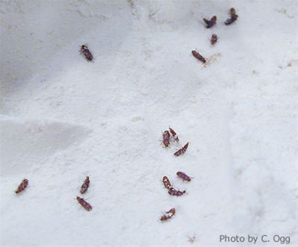
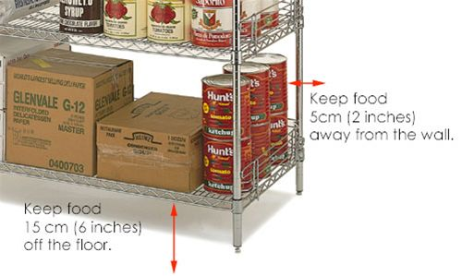
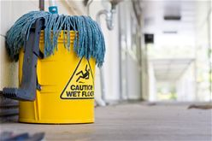
Steps to Prevention
Inspect Incoming Supplies
Monitor Storage Areas
Stock Rotation
Keep Food off the Floor
Keep Storage Areas Clean
Seal Access Points
Remove Refuse
Notes:
The best method of pest control is preventing the entry of the pests into your food service operation in the first place. This can be done through the steps outlined below.
Inspect Incoming Supplies
Inspect all incoming food and supplies as they are received and stored.
Look in the truck as it is unloaded. If insects, rodents or their droppings are seen the receiver should closely inspect the boxes and bags of product.
If there is insect or rodent contamination, the entire truck should be rejected and the supplier notified of the problem.
Monitor Storage Areas
Monitor storage areas for problems on an ongoing basis, and formally at least every two weeks.
Using a flashlight, look for signs of rodent droppings (see picture - recent ones will be shiny and soft). Other signs include footprints in the dust and signs of urine stains.
Also look at the base of boxes and bags for signs of rodent gnawing and smear marks from fur. If you find a problem, call your pest control contractor for follow up action.
Stock Rotation
Use a "first-in-first-out" inventory control program for food stocks, particularly for cereals and grains. This means that you always use the old product first and the newest product last.
This avoids the problem of having old product sitting around that can be unknowingly infested and an ongoing source of food for pests.
Keep the temperature of the dry food storeroom between 10°C to 21°C (50°F and 70°F) to minimize insect infestations. Some foods commonly infested with insects include cereals, flour, baking mixes, crackers, macaroni, cured meats, powdered milk, dried fruits, nuts, popcorn and spices. The picture shows flour beetles.
Keep Food off the Floor
Keep stored items on shelves or raised skids at least 15 cm (six inches) off the floor.
Keep Storage Areas Clean
In small storage areas where food and supplies are moved in and out weekly, clean storage areas along the wall as they become available.
In large storage areas where movement of product might be only monthly, keep shelving two inches from the wall to allow for cleaning and monitoring where the floor and wall comes together. These junctions can be breeding grounds and roadways for rodents and insects.
Seal Access Points
Keep pests out of the foodservice operation by making sure that doors and windows are shut or screened.
Seal holes in walls, floors or ceilings.
Remove Refuse
Remove garbage and unused equipment from food storage areas.
This action removes harbourage areas (i.e. places to live) for insects and rodents.

Slide 79
Contaminated Food
When pests are found you must:
Discard all food that has been contaminated;
Clean and sanitize areas to prevent further contamination;
Destroy nesting places and seal them off to prevent future use; and
Consult a licensed pest control operator.
Notes:
Food contaminated by insects, larvae, rodents and/or rodent faecal matter; or birds and/or bird faecal matter, likely contain pathogenic microorganisms and other diseases.
The food involved must be discarded.

Slide 80
Pest Control Operators
Check experience and references
Ensure you know the extent of services provided, including:
Frequency
Pests covered
Emergency response
Reporting
Inspection services and advice
Obtain a list of the chemicals to be used and ensure that they meet Canadian standards for use in foodservice operations.
Notes:
Certified pest control operators are skilled in identifying and eradicating pests.
They can provide professional advice on preventing pest infestations and are qualified to handle dangerous pest control chemicals.

Slide 81
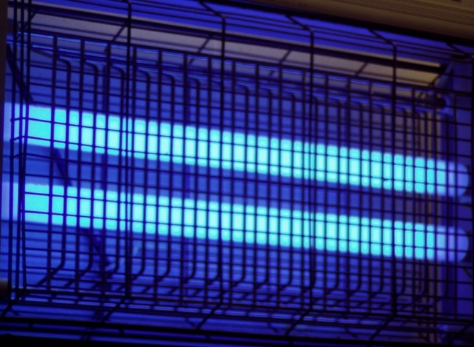
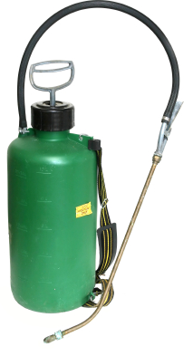
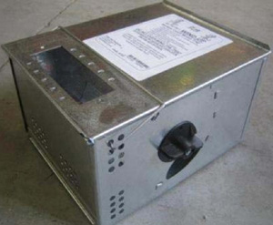
Methods of Pest Control
Yikes!
Notes:
A certified pest control operator can use a number of methods to control pests on an ongoing basis.
Electrocuters
Devices that electrocute flying insects. These should be located at least two metres (six feet) away from any food handling areas.
This means that these devices should not be located near preparation, cooking, or serving areas.
They should also be located away from places where clean utensils, glassware, dishes or pots might be stored
Insect Traps
Adhesive tapes or traps for insects.
These devices should not be located near food products or clean kitchen or service ware.
Rodent Traps
Live rodent traps, such as mechanical traps and glue boards.
These devices should be checked regularly, at least every week, to remove live and dead rodents. Foodservice operators should monitor their pest control operator to ensure that traps are being checked during regular visits.
Traps containing poison should never be located inside a foodservice operation
Chemicals
Rodenticides and insecticides must be applied only by a licensed pest control operator.
These chemicals are highly toxic and can cause illness and the possibility of death if consumed in food or from affected food contact surfaces.
Food preparation, cooking and serving should not be taking place when these chemicals are being applied, and should not resume until they are at safe levels.
This may not be possible for 24 hour foodservice operations.
In these cases, non-spray methods, such as those previously mentioned (traps, devices that electrocute, glue boards) should be used. At all times, open food must be protected from contamination.

Slide 82
Illness and Disease
Food handlers must be free from any symptoms of illness or disease that could be transmitted through food.
The foodservice operation must have a program to handle illnesses.
Notes:
Infected employees are the third largest cause of food borne illnesses in the foodservice industry. Sick food handlers can directly deposit pathogens onto equipment, utensils and other food contact surfaces. These germs can produce toxins, or infect customers, resulting in food borne illness.

Slide 83
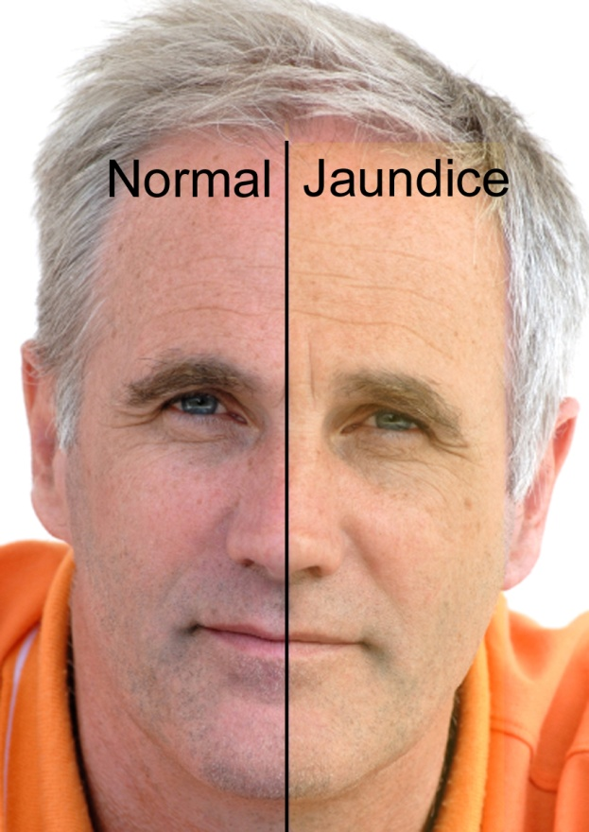
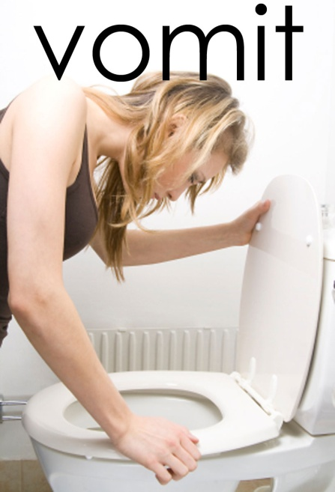
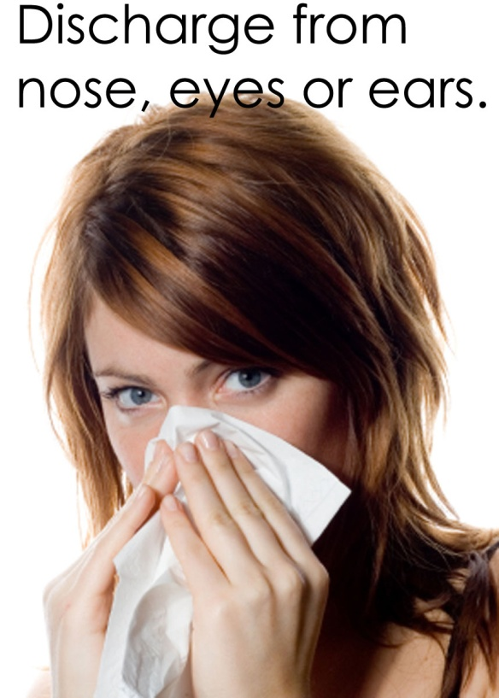
Symptoms of Illness
Notes:
These symptoms must be reported to management so that the need for medical examination and exclusion from food handling can be considered.

Slide 84
Asymptomatic carrier
Carriers have no symptoms but can transmit illness to others.
People with hepatitis A virus can spread the illness for weeks prior to any visible symptoms
Notes:
"Typhoid Mary Mallon" was a cook for families in New York in the early 1900s. She spread typhoid fever to some of the people in the families she cooked for, but she never had any symptoms of the disease.
Food handlers who are exposed to people with a contagious illness should see their doctor.

Slide 85
Reporting Illness
Employees must report symptoms of illness
Employees with symptoms must not handle food or touch food contact surfaces
Sick employees should visit their doctor
Employees cannot work if diagnosed with reportable disease (Hepatitis A, Shigella, E.coli 0157:H7, etc.)
Contact the health department if an employee has a communicable disease
Employees must get a doctor’s written permission before returning to work
Notes:
If a food handler is directly or indirectly exposed or suffering from a communicable disease, it must be immediately reported to management.

Slide 86
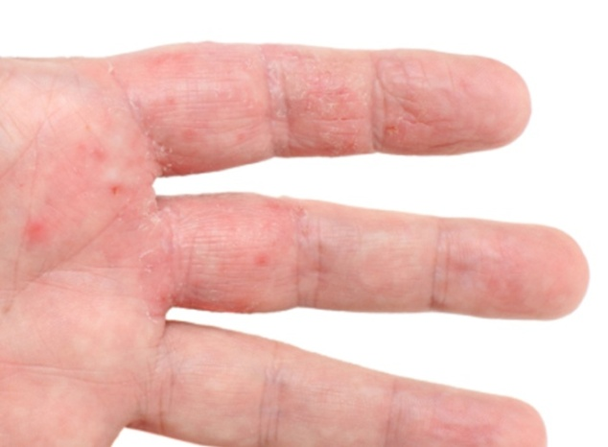
Injuries
Food handlers working with cuts, burns, boils, open sores and wounds are a health hazard;
Cuts can produce Staphylococcus aureus germs which produces a heat-stable toxin;
Employees with exposed wounds must not handle food.

Slide 87
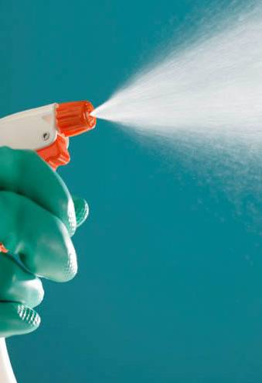
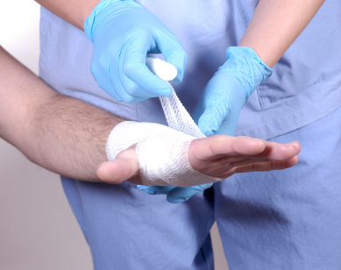
Treating Injuries
Clean
Stop food handling
Covering the Wound
Notes:
An employee with an open wound containing pus that is exposed and draining can be a source of Staphylococcus aureus.
This pathogen can easily be transmitted to food and food contact surfaces, increasing the risk of food borne illness.
Follow the steps below if an employee has a cut, burn, boil, sore, skin infection or infected wound.
Clean
If the employee obtained the injury at the foodservice operation the immediate area must be cleaned and sanitized and any food contacted must be disposed of immediately.
Stop food handling
Depending on the severity of the injury the food handler should be removed from food handling activities entirely. Bad cuts or burns should be treated by a doctor.
For less severe injuries go to the next step.
Cover the Wound
The injury should be bandaged with a clean, dry and tight fitting bandage to prevent the wound from leaking. Brightly coloured bandages are best as they are more likely to be seen if lost.
A waterproof, disposable plastic glove must be worn over the bandage.
Employees wearing bandages may need to be moved to tasks away from the direct handling of food and food contact surfaces.

Slide 88
Clean Clothing
Hair Covering
Clean Apron
Safe Shoes
Notes:
Uniforms can be a source of contamination.
Food handlers in food preparation areas must wear clean outer clothing.
Clothing must be cleaned daily.
Uniforms, aprons and cleaning cloths should be changed when they become contaminated.
Uniforms should be put on and worn only at work.
Hair Covering
Hair and face have millions of bacteria.
Hair and beard restraints prevent hair from contaminating food or food contact surfaces.
They help prevent touching hair and beards.
Personnel in food preparation areas should wear a hair restraint.
Where required, beard nets should also be worn.
Clean Apron
Aprons must be changed if they are dirty.
Aprons must be changed when a food handler moves from raw to ready-to-eat food preparation.
Safe Shoes
Shoes should be clean, non-slip, and be worn only in the foodservice operation.
Shoes that have been worn on a farm or in other unsanitary conditions could result in cross-contamination.

Slide 89
Behaviours
Notes:
Bacteria and viruses can be carried on cigarettes, dirty tissue, and food containers such as juice and water bottles.
False fingernails, nail polish, and false eyelashes can transport microorganisms as well as cause a physical hazard in foods.
These things can lead to customer injury and illness.
The following activities are prohibited during food handling, preparation, service, and cleaning:
smoking;
eating and drinking;
chewing gum;
spitting;
sneezing and coughing onto foods or food contact surfaces; and
blowing your nose.
Food handlers should not wear false nails or nail polish.
They must refrain from behaviour that could result in food contamination.

Slide 90
Sneezing & Coughing
If sneezing and coughing are unavoidable, direct the sneeze or cough into the bend of your elbow and always away from the food.

Slide 91
Bathe Daily
Good hygiene habits include bathing and washing hair on a daily basis.

Slide 92
Jewellery Policy
For everyone's safety, a "no jewellery" policy should be enforced.
Medical alert bracelets or necklaces can be worn underneath clothing.
Notes:
Jewellery is difficult to keep clean. Bacteria can hide between your skin and the piece of jewellery and then be transferred into the food product.
Jewellery is also a danger as it could accidentally fall into the food and become a choking hazard, or become caught on a piece of equipment and become an occupational hazard.

Slide 93
Hand Washing
Why
When
How
Notes:
Bacteria and other contaminants are present on hands, especially on the fingertips and under the fingernails.
While hand washing may seem to be common sense, many food handlers fail to wash their hands thoroughly and as often as needed. If hands are not washed properly and often, there is an increased risk of contamination to the food and food contact surfaces.
Employees involved in food preparation and food service must thoroughly understand when and how to wash their hands.
Show hand washing video called “Handwashing for Life: Why, When and How.”
Why
Germs are found on hands and easily spread to food and food contact surfaces causing foodborne illness.
When
Every time your hands become contaminated; you are interrupted; or you change tasks.
How
Scrub hands and exposed arms with soap and water for at least 20 seconds.

Slide 94
How to Wash Hands
Wet hands with warm running water
Apply soap
Lather
Scrub hands and arms for at least 20 seconds
Rinse under warm running water
Apply soap and lather again
Rinse under warm running water
Dry hands with a paper towel and use it to shut off the taps
Notes:
Optional slide if you do not use the video.
Optional exercise: BugBeams Handwashing Exercise.

Slide 95
Glove Use
Wash hands before putting on gloves
Disposable gloves should be changed:
after each use;
after four hours of use;
after interruptions and breaks;
if torn, damaged or contaminated.
Use nitrile gloves to avoid latex allergies
Notes:
Procedures for gloves include that:
Employees must wash their hands before putting on disposable gloves;
Gloves must be discarded after each use and/or after four hours of continuous use performing the same task provided there has been no contamination;
New gloves are worn after breaks, meals or visits to the washroom;
Gloves should be changed if they become torn or after any action that might cause contamination such as picking up an item from the floor.

Slide 96
Visitor Policy
Visitors must:
Wash hands when entering the operation;
Wear hair nets;
Wear an outer protective coat, provided by the food service operator;
Not get close to food preparation;
Not touch food or food contact surfaces.
Notes:
Visitors such as salespeople and delivery personnel can cause contamination in the foodservice operation. Their clothing and hair may have contaminants that could be transferred to food, or food contact surfaces.
All visitors, including delivery and repair personnel, should observe the same hygiene and dress code as food handlers working in the foodservice operation.

Slide 97
Summary
Food handlers must:
Not work if they are sick;
Report illness to management;
Cover cuts, sores and rashes;
Wear clean uniforms, aprons & hair restraints;
Practice good hygiene by bathing daily and washing their hands often;
Not wear jewellery at work; and
Follow proper procedures for wearing gloves.
Visitors must follow the same hygiene policies including proper hand washing and hair restraints.

Slide 98
Food Safety Training Courses
Courses may be offered by public or private organizations.
These courses should be:
Valid for five years after completion of the certification course;
Based on national training standards; and
Recognized by the Health Authority in your jurisdiction.
Notes:
There are two levels of food handler training programs for foodservice operations. These levels are:
food handler training; and
operator training.
For details on various certification courses contact the Canadian Restaurant and Foodservices Association (CRFA) and your local health department.
After five years, operators or food handlers may be required to participate in a refresher or updating course.

Slide 99
Operators
Foodservice operators must hold a certificate confirming their completion of a food handler training program recognized by the regulatory authority.

Slide 100
Food Handlers
All employees in food service operations must have the necessary skills and knowledge to handle food safely.
Foodservice operators must ensure food safety education is available to food handlers through training, formal food safety certification and employee meetings.
Notes:
Foodborne illness are often due to food handler error related to improper time/temperature management, personal hygiene and health, and cross-contamination.
In the absence of the foodservice operator, at least one other employee must have a recognized food safety certification, to ensure the consistent application of food safety practices.

Slide 101
Food Handler Training Topics
Food Handlers should have knowledge of:
Their role & responsibility in protecting food;
Properties of foods (i.e. colour, texture, odour);
Main types of microorganisms, their sources, and factors affecting their growth;
Common causes of foodborne illnesses;
Procedures and practices that prevent foodborne illnesses;
Basic elements of HACCP; and
Allergenic properties of certain foods.
Notes:
Educational courses and programs provided to food handlers should be designed to meet or exceed the learning objectives set by the Food Retail and Food Service Code.

Slide 102
Training Records
Keep a copy of the original certificate in the employee's personnel file; or
Copy the attendance list for the course date, and keep it in a master employee training file.
Notes:
Foodservice operators should maintain records of which employees have taken courses, the dates, and any additional relevant information.

Slide 103
Summary
Identify a recognized food safety training program ;
Operators must be certified in a recognized food safety training program;
Employees must have the skills and knowledge to handle food safely; and
Training and certification must be documented.

Slide 104
Supervising Food Safety Programs
The supervisor should:
Be accessible during operating hours;
Understand safe food practices, food risks and corrective actions; and
Have food safety training.
Notes:
Knowledgeable supervisory staff need to be accessible during all hours of operation to respond to food hazard concerns and, if necessary, apply corrective actions.

Slide 105
Components of Food Safety Programs
Procedures – explaining what must be done and how to complete tasks that keep food safe;
Activities – employees perform to prevent food contamination which are based on the written procedures; and
Records – the forms completed by employees, as activities are completed, to prove that procedures are followed.

Slide 106
What is HACCP?
It stands for Hazard Analysis and Critical Control Points.
HACCP helps identify and correct possible food safety risks to prevent foodborne illness.
It is a recognized, proven system that has been adapted for use in foodservice operations.
Notes:
Across Canada HACCP is being implemented on the farm, in food processing plants, in food distribution centers, in retail food stores and foodservice operations.

Slide 107
HACCP Preparation
Assemble the Team
Develop GOPs
Group Menu Items
List Incoming Ingredients
Menu Flow Diagrams
Draw the Floor Plan
Notes:
Most operations are already doing many of the activities necessary to keep food safe.
HACCP goes one step further: it helps you to anticipate potential problems and prevent them from occurring. HACCP protects your business by managing biological, chemical (including allergens) and physical hazards.
The following steps will provide you with a brief overview of how to prepare for HACCP implementation.
Assemble the Team
Assemble the HACCP team. They will provide the details of what happens at every step of the flow of food through the operation from receiving to service of food.
It is good to have employees that work in different areas of the foodservice operation in order to get a complete picture of how food is handled. This team should be knowledgeable about food safety and be part of the HACCP team from development through to implementation.
Develop GOPs
Develop Good Operating Practices:
This step requires simple documented procedures on:
Facilities
Receiving
Storage
Equipment
Personnel
Sanitation
Pest Control
Traceability
These are the procedures you have been learning about through the National Food Safety Training Program. By implementing the practices you have been learning you will have Good Operating Practices for your foodservice operation.
Group Menu Items
Group menu items by categories. By grouping similar menu items you can reduce the number of HACCP plans required for the food safety program.
For example, you may be able to have one plan for clear, hot soups instead of a different HACCP plan for each individual soup on your menu.
List Incoming Ingredients
Identify all your incoming ingredients and materials.
This list will help you to conduct your hazard analysis and identify products that might have hidden hazards such as allergens.
Menu Flow Diagrams
These diagrams describe the step-by-step process of preparing a group of menu items.
In this example for meat stew, you see what happens to the meat at each step from receiving through to preparation and storage of the finished product.
Draw the Floor Plan
Draw your foodservice operation floor plan. This floor plan helps to identify potential hazards associated with the flow of food, people and equipment in your foodservice operation.
For example, if your receiver has to go through a food preparation area to store incoming food there is the potential risk of incoming food contaminating food that is being prepared.

Slide 108
HACCP Plans
Hazard Analysis
Identify CCPs
Establish Critical Limits
Monitoring
Corrective Actions
Verify the System Works
Record Keeping
Notes:
Once the six preparation steps are completed, then a foodservice operator can develop a HACCP plan.
There are seven principles in the development of each HACCP plan. One HACCP plan will be required for each grouping of menu items. A foodservice operation may have one or many HACCP plans.
Hazard Analysis
The foodservice operator lists all the possible biological, chemical (including allergens) and physical hazards associated with the ingredients and process steps in a group of menu items.
Identify CCPs
Critical Control Points are steps where we can intervene to control the hazards. Some of the hazards will be controlled by your good operational practices such as storage temperatures.
Other hazards can only be controlled at a specific point in the process of making that menu item. A CCP is defined as a point, step or procedure where control can be applied and the hazard can be prevented, eliminated, or reduced to an acceptable level.
If we lose control at this point, someone could get sick. Critical control points are based on criteria such as cook time and temperature.
Establish Critical Limits
Once you have determined the critical control points (CCPs) for a specific group of menu items, you need to establish critical limits.
Critical limits are minimum and maximum limits that the critical control point must meet to keep food safe. The critical limits must be measurable (such as time and temperature). They must also be based on scientific data, food regulations (such as the Food Retail and Food Services Code), and expert advice.
For example, whole poultry must be cooked to an internal temperature of 85°C (185°F) for 15 seconds. This would be the Critical Limit for the Cooking Step for poultry.
Monitoring
Monitoring lets you know that critical limits are being met, and that you are doing things right. To develop a successful monitoring program, you need to focus on:
Who will monitor;
How to monitor;
When to monitor; and
Where to monitor.
Monitoring techniques should be explained in detail, measurable and clear. Taking temperatures is an example of monitoring.
Corrective Actions
Corrective actions are predetermined steps taken when food does not meet a critical limit during the monitoring procedure.
This is the last opportunity you have to prevent a possible foodborne illness. The corrective action tells employees what to do if the product does not meet the predetermined food safety requirements.
For example, if food has not achieved the correct temperature during the cooking step a corrective action may be to continue cooking until the critical limit is met. Discarding the food is another corrective action that would prevent foodborne illness if critical limits have not been met.
Verify the System Works
After you have developed your system you need to confirm that it works according to the plan. This is called verification.
Verification of your plan should be performed on a regular basis.
This is sometimes done by reviewing records, watching people perform critical control point checks, or through things like microbiological analysis.
Record Keeping
Recording how food is produced and kept safe is important to the success of a HACCP system. The forms your employees complete during the monitoring step are examples of record keeping.
Proper records allow you to document that you are continuously preparing and serving safe food. Record keeping also allows you to analyze problems and make changes to prevent any recurrence of problems.

Slide 109
Summary
Knowledgeable supervisors must be available to answer food safety questions;
PAR – Food Safety Programs need Procedures, Activities and Records to be successful;
HACCP is a proven food safety program that can be adapted for your operation;
There are 6 steps to prepare for HACCP planning;
There are 7 principles to applied during development of your HACCP Plan.

