Slide 1
Research Methods
Week 2 AP-Psych
Bamford Winter/Spring

Slide 2
Contradictory Common Sense
Opposites attract vs. Birds of a Feather Flock Together
Early Bird Gets the Worm vs. Haste Makes Waste
All good things come to he who waits vs. A stitch in Time Saves Nine
Great minds think a like vs. Fools seldom differ
Clothes make the man vs. You cannot judge a book by its cover
Familiarity breeds contempt vs. Home is where the heart is

Slide 3
The Need for Psychological Science
Psychology is more than common sense
Common sense appears as truth because they are often repeated
3 Reasons why common sense is not solely reliable:
  Hindsight Bias
  Overconfidence
  Perceiving Patterns in Random events

Slide 4
Hindsight Bias
The tendency to believe, after learning an outcome that one would have foreseen it (a.k.a. I Knew it all Along Phenomenon)
  “They were not a good match”- after a couple breaks up
  “bad call by the refs”- after the team loses
  Experiment:
    Group A: “Psychologists found that separation weakens romantic attraction. As the saying goes: out of sight, out of mind”
    Group B: “Psychologists have found that separation strengthens romantic attraction. As the saying goes: absence makes the heart grow fonder”.
    Both groups were able to find their hypothesis true. When opposite findings both seem like common sense, there is a problem.
    “Anything seems commonplace, once explained” –Dr. Watson to Sherlock Holmes

Slide 5
Overconfidence
We humans tend to think we know more than we do
Knowing the answers tends to make us overconfident
Overconfidence in History:
  “We don’t like their sound. Groups of guitars are on their way out.”
    Decca Records, in turning down a contract with The Beatles in 1962
  “Computers in the future may weigh no more than 1.5 tons.”
    Popular Mechanics, 1949
  The telephone may be appropriate for our American cousins, but not here, because we have ad adequate supply of messenger boys.”
    British expert group evaluating the invention of the telephone

Slide 6
Perceiving Order in Random Events
For most, a random, unpredictable world is unsettling
Try to find patterns and sense of the world
In random data-random sequences often don’t look random
We find a pattern that puts us at ease
  Why the team is on a losing streak

Slide 7
The Scientific Method and Description
Scientific Attitude (curiosity, skepticism, and humility) combined with Scientific Method- a self correcting process for evaluating ideas with observation and analysis.
Psychological science welcomes hunches and plausible-sounding theories- and puts them to test.
Constructing Theories:
  Theory- an explanation using an integrated set of principles that organizes observations and predicts behaviours or events.
  Hypothesis- a testable prediction
  Operational Definition- a carefully worded statement of the exact procedures used in a research study.

Slide 8
Example on Sleep:
We observe over and over that people with good sleep habits tend to answer questions correctly in class and at test time.
Theory: Sleep improves memory (organizes and predicts)
Hypothesis: When sleep deprived, people will remember less from the day before. To test: assess how well people remember course materials they studied before a good night’s sleep. (Results will either support or reject theory)
Operational Definition: Bias check. Sleep deprived to be defined: “X hours less than the person’s natural sleep”.

Slide 9
Operational Definitions
Using carefully worded statements, other care able to replicate the original observations with different participants, materials, and circumstances.
If the get similar results, confidence in the finding’s reliability grows.
Replication is confirmation
Variations within testing hypothesis and refining theories:
  Descriptive Methods
  Correlational Methods
  Experimental Methods

Slide 10
Descriptive Methods
Describe behaviours, often by using case studies, surveys, or naturalistic observations
Observe, describe, draw conclusions
Case Studies: a descriptive technique in which one individual or group is studied in depth in the hope of revealing universal principles.
  Among the oldest research methods
  Examines one individual or group in-depth to reveal conclusions relatable to all
  Brain Damage, Children’s Minds, and Animal Intelligence
  Intensive case studies can be revealing and often suggest directions for further case study
  Most reveal significant results-individual
    Counter results

Slide 11
Descriptive Methods Continued
Naturalistic Observation: a descriptive technique of observing and recording behaviour in naturally occurring situations without trying to manipulate or control the situation
Ex: watching chimpanzees in the jungle to videotaping and analyzing parent-child interactions
“Small Science”- science that can be done with pen and paper.
“Big Data”- new technology that helps collect more/various data more efficiently
Naturalist Observations do not explain behaviour; but describes it.

Slide 12
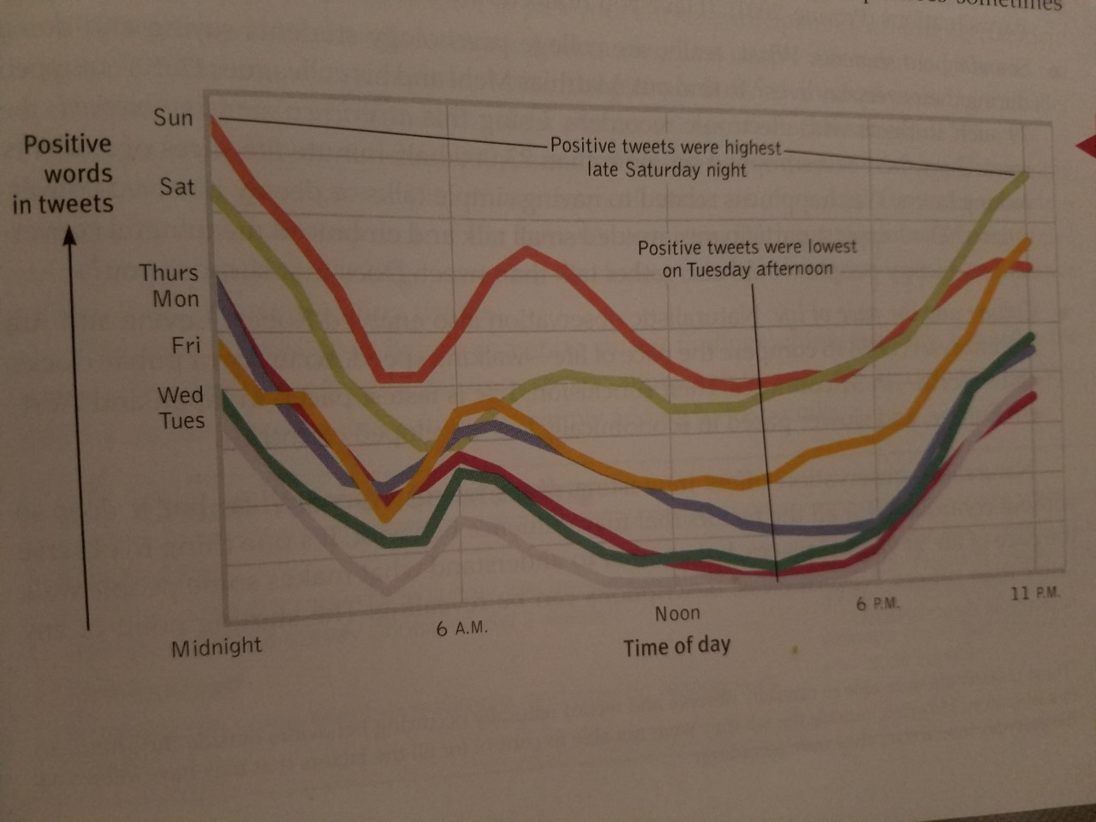
Technology in Naturalist Observations

Slide 13
Descriptive Methods Continued
The Survey: a descriptive technique for obtaining the self-reported attitudes or behaviours of a particular group, usually by questioning a representative, random sample of the group.
Wording Effects: “aid to the needy” vs. “welfare”, “gun safety” vs. “gun control”
Sampling Bias: a flawed sampling process that produces an unrepresentative sample
Population: all those in a group being studied, from which samples may be drawn (ex: a population to represent the student population)
Random Sample: a sample that fairly represents a population because each member has an equal chance of inclusion.

Slide 14
Correlational Methods
Correlate: a measure of the extent to which two factors vary together, and thus how well either factor predicts the other
Correlation Coefficient: a statistical index of the relationship between two thing (from -1.00 to +1.00)
  Ex: knowing how much aptitude test scores correlate with school success tells us how well the scores predict school success
Variable: anything that can vary and is feasible and ethical to measure
  Ex: How closely stress is related to disease
Scatterplot: a graphed cluster of dots, each of which represents the values of two variables. The slope of the points suggests the direction of the relationship between the two variables. The amount of scatter suggests the strength of the correlation (littler scatter indicates high correlation).

Slide 15
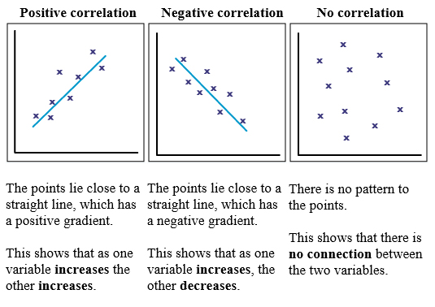
Correlational Examples

Slide 16
Correlational Methods Con’t
Illusionary Correlation: perceiving a relationship where none exists, or perceiving a stronger-than-actual relationship
  Ex: If we believe that dreams forecast actual events, we may notice and recall confirming instances more than disconfirming instances
Regression Toward the Mean: the tendency for extreme or unusual scores or events to fall back (regress) toward the average
  Ex: Students who score much lower or higher on an exam than they usually do, are likely when re-tested, to return to their average.
Failure to recognize regression is the source of many superstitions and of some ineffective practices as well.
  Ex: Things that happen one time, do not necessarily mean that they will happen again, even if you repeat the variables.

Slide 17
Experimentation Method
Experiment: a research method in which an investigator manipulates one or more factors (independent variables) to observe the effect on some behaviour or mental process (the dependent variable). By random assignment of participants, the experimenter aims to control other relevant factors
Experiment Group: the group exposed to the treatment, that is, to one version of the independent variable
Control Group: the group not exposed to the treatment; contrasts with the experimental group and serves as a comparison for evaluating the effect of the treatment.
Random Assignment: assigning participants to experimental and control groups by chance, thus minimizing pre-existing differences between the different groups.

Slide 18
Experimentation Method Con’t
Double-Blind Procedure: an experimental procedure in which both the research participants and the research staff are ignorant about whether the research participants have received the treatment or a placebo
Placebo Effect: experimental results caused by expectations alone; any effect on behaviour caused by the administration of an inert substance or condition, which the recipient assumes is an active agent
Both of these procedures eliminate potential for bias

Slide 19
Experimentation Con’t
Independent Variable: the factor that is manipulated; the variable whose effect is being studied
  Ex: How many hours were spent sleeping
Confounding Variable: a factor other than the factor being studied that might influence a study’s results
  Ex: Random assignment controls for possible confounding variables
Dependent Variable: the outcome that is measured; the variable that may change when the independent variable is manipulated
  Ex: test scores
Validity: the extent to which a test or experiment measures or predicts what it is supposed to

Slide 20
Check-In
With your peer group’s theory, decide what research method would be best for your results. Go through the process and set up the unique elements of the method you chose for your theory!

Slide 21
Ethics in Psychology
How would you know which research design to use?
Psychological scientists design studies and choose research methods that will best provide meaningful results
Researchers generate testable questions, and then carefully consider the best design to use in studying those questions
Psychologists measure the variables they are studying, and finally they interpret their results, keeping possible confounding variables in mind

Slide 22
Ethics in Psychology Con’t
How can simplified laboratory conditions illuminate everyday life?
Researchers intentionally create a controlled, artificial environment in the laboratory in order to test general theoretical principles. These general principles help explain everyday behaviours

Slide 23
Ethics in Psychology Con’t
Why do psychologists study animals, and what ethical guidelines safeguard animal research subjects?
Some psychologists are primarily interested in animal behaviour; others want to better understand physiological and psychological processes shared by humans and other species
Government agencies have established standards for animal care and housing. Professional association and funding agencies also have guidelines for protecting animals’ well-being

Slide 24
Ethics in Psychology Con’t
What ethical guidelines safeguard human research participants?
The APA ethics code outlines standards for safeguarding human participants’ well-being, including obtaining their informed consent and debriefing them later.

Slide 25
Ethics in Psychology Con’t
How do values affect psychological science?
Psychologists’ values influence their choice of research topics, their theories and observations, their labels for behaviour, and their professional advice
Applications of psychology’s principles have been used mainly in the service of humanity

Slide 26
Statistical Reasoning in Everyday Life
Why do we need statistics in psychology and in everyday life?
  Psychological researchers use statistics to measure variables and interpret results
  All of us benefit from a basic understanding of statistics, which helps us think smarter about medical advice and news reports of all kinds.
  Statistical Illiteracy
    British Press in 1990s reported women taking contraceptive had a 100% increased risk of blood clots leading to a wave of unwanted pregnancies and 13,000 additional abortions
    What the study actually found was 100% increased risk from 1 in 7000 to 2 in 7000

Slide 27
Statistical Reasoning in Everyday Life
What are descriptive statistics?
  Researchers use descriptive statistics to measure and describe characteristics of groups under study, often using a histogram (bar graph depicting a frequency distribution) to display data
  Descriptive statistics include measure of central tendency and measures of variation
**Read labels and note the range. This graph is of a truck company indicating that their truck has greater durability; but looking closely all of the trucks rank as 95% and above

Slide 28
Statistical Reasoning in Everyday Life
How do we describe data using the three measures of central tendency?
  A measure of central tendency is a single score that presents a whole set of scores. Three such measures are the:
    Mode: the most frequently occurring score
    Mean: the arithmetic average
    Median: the middle score in a group of data
    Skewed Distribution can happen when a representation of scores lack symmetry around the mean value.
    FYI: According to the 2010 U.S. Census, nearly 65% of U.S. households have “below average” income. The bottom half of earners receive much less than half the national income. So, most Americans make less than average.
    N.B. Literacy Scores…..same!

Slide 29
Statistical Reasoning in Everyday Life
What is the relative usefulness of the two measures of variation?
Measures of variation tell us how diverse data are. Two measures of variation are the range (which describes the gap between the highest and lowest scores) and the standard deviation (which states how much scores vary around the mean score).
The range offers only a raw measure of how much the data may vary; the standard deviation is far better at giving researchers a clear understanding of variation
Scores often form a normal/bell shaped curve.

Slide 30
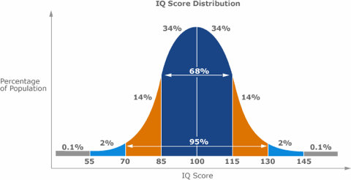
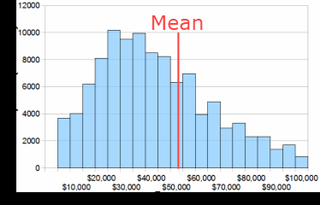
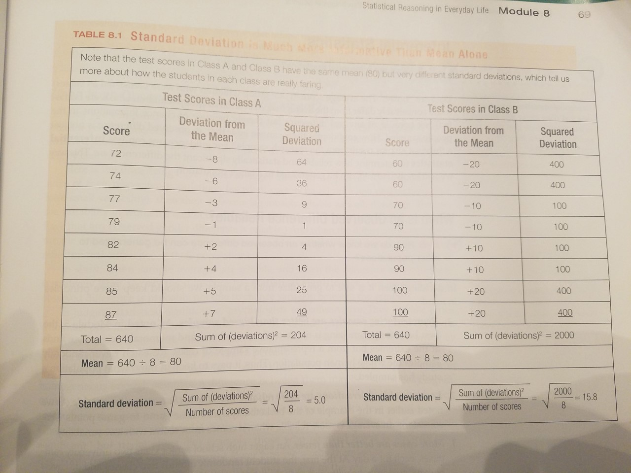
Examples of Data
Example of the Bell Curve
Raw Data
Skewed Distribution: People vs. Income
**Positively skewed because the tail continues past the last point.
It is skewed because more people make less; but for a few, they make significantly more

Slide 31
Statistical Reasoning in Everyday Life
What are inferential statistics?
Numerical data that allow one to generalize to infer from sample data the probability of something being true of a population
Researchers use inferential statistics to determine the probability of their findings being also true of the larger population
Inferential statistics include ways of determining the reliability and significance of an observed difference between the results for different groups

Slide 32
Statistical Reasoning in Everyday Life
How do we know whether an observed difference can be generalized to other populations?
To feel confident about generalizing an observed difference to other populations, we would need to know if the difference was reliable and also significant
Reliable differences are based on samples that:
  Are representative of the larger population being studied
  Demonstrate low variability, on average
  Consists of many cases
We can say that an observed difference has statistical significance if the sample averages are reliable and when the difference between them is large.

