Slide 1
Analyzing Poetry

Slide 2
Preview: Read and Listen
Listen to get an overall feel for the language, rhyme, and rhythm of the poem.

Slide 3
Visualize
Visualize the images, clarify words and phrases.
What does the quotation "there are pictures in poems and poems in pictures" mean. Visualizing is when the author paints a picture in your head.

Slide 4
Evaluate: Inferencing
Evaluate the poem's theme, and allow your understanding to grow.
When you make an inference, you are "reading between the lines." In order to make an inference, you pay close attention to the details in the poem to make a logical assumption. An inference is a logical judgment based on a writer's words as well as your own knowledge and experience. Think about what the poet is trying to help them understand. Does it connect to anything in their lives?

Slide 5
Poetry: Inferring
The Cold, Hard Facts
Sometimes I'm very square
and sometimes I'm very hard.
But heat me up and soon
I've melted like a tub of lard.
I look excellent in glasses,
I look lovely in a tray.
And with me inside your cooler
you can picnic all darn day.
When kids fall down in football
I make sure their wounds don't swell.
And when someone has a bloody lip
I comfort them as well.
You can eat me when I'm solid.
You can drink me when I'm not.
And although I suffer freezer burn,
I'm not what you'd call hot.
What Am I?

Slide 6
Analyze and Discuss
Apply the strategies when reading and discussing the poem. For example, discuss the number of lines and stanzas, listen for rhyme and rhythm, etc.
Discuss unfamiliar words in poem, such as "dreary" and "bog." Look them up in the dictionaries if necessary.

Slide 7
Activity: Inference Graphic Organizer
Use your Inference Graphic Organizer to choose three descriptive statements from the poem and write an inference for each statement.
Draw illustrations to accompany your inferences

Slide 9
Discuss and Share

Slide 10
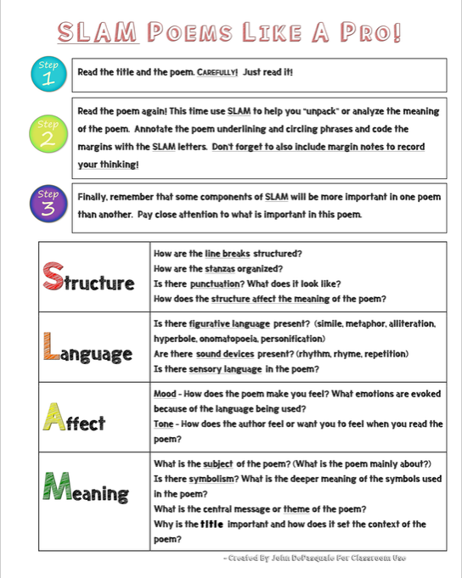
SLAM Poetry: Worksheet
Use the following worksheet to analyze the poem.

