Slide 1
Art Analysis
Social Studies 9

Slide 2
Introduction
When viewing Canadian artwork it is important to consider the many factors that influence the art itself.
Some of the influencing factors include: geography, socioeconomic status, ethnic background, and when the art was created.

Slide 3
When viewing art, consider:
What do you see?
Who is in the artwork? What are they doing?
Where was the painting painted? Or the photo taken?
Why was the art created?
What emotions are invoked?
Did the artist emphasize or omit anything from the image to convey a certain message?

Slide 4
Ask Yourself….
How are people dressed? What can we learn from that?
What facial expressions do you see?
How are people interacting?
What technology is being used? What are the buildings/structures like?
What geographic features are present and what is there influence?
How would you feel if you were in that photo/painting?

Slide 5
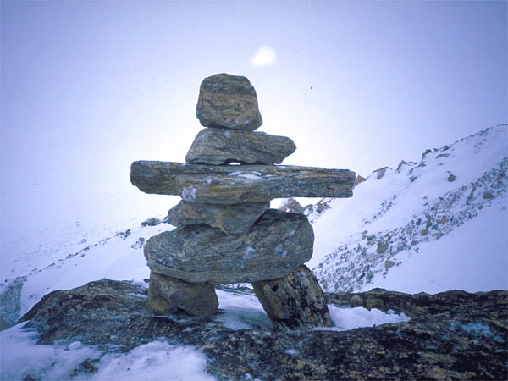
Indigenous and Inuit Art
Inuksuk - is a symbol of the Canadian Arctic. It is a stone structure built to resemble a human. They were used as messages for other travellers, for marking good hunting and fishing spots, and for showing where supplies of food were stored.
Masks and Totem Poles
Carvings
Clothing
Petroforms (boulders arranged in the shape of animals.

Slide 6
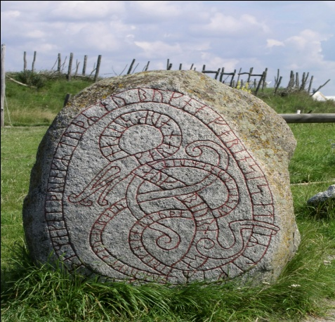
Petroglyphs
Ojibwa rock carvings, or petroglyphs are known to the Anishinabe people as “the rocks that teach,” were found in 1954 at the east end of Stony Lake, Ont. They were carved between 600 and 1200 years ago. The symbols and figures of turtles, snakes, birds, and humans tell of spiritual beliefs.
Petroglyphs stolen from sacred Calif. American Indian site - CBS News

Slide 7
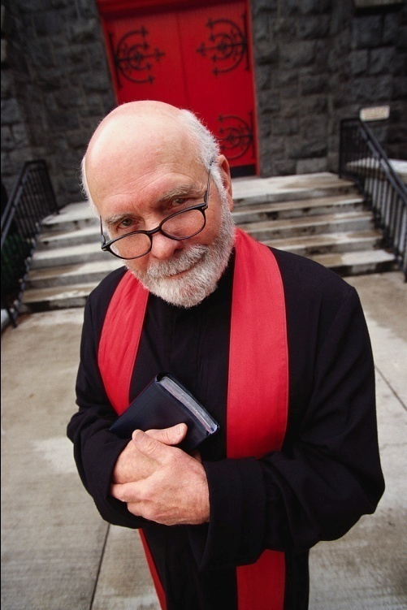
New France
Many of the earliest works of art in New France in the 1500’s and 1600’s were religious works, painted by priests who went out to the colony specifically to paint. They decorated churches and used their art to inform the people of Christianity.

Slide 8
British North America
In British North America, wealthy citizens often paid artists to paint portraits of their families or themselves.
Some of the military officers who came to British North America in the 1700s had been trained to do topographic drawings –drawings that showed landscape features such as hills or lakes
The topographers also drew the things they saw in their everyday life. This kind of painting is often called documentary painting because it provides a record of the times.
Many scenes and events in Atlantic Canada were painted this way.

Slide 9
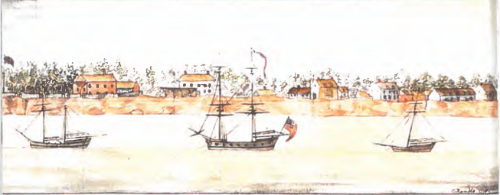
Charlottetown on the Island of St. John, c. 1778
Why does the artist use a horizontal format?
What do you notice about the strip of land that runs across the picture?

Slide 10
Canada’s Natural Beauty
Canada’s natural beauty has always been a subject for artists. Many paintings include images of rivers, lakes, and oceans as well as the people who used them for work and play.

Slide 11
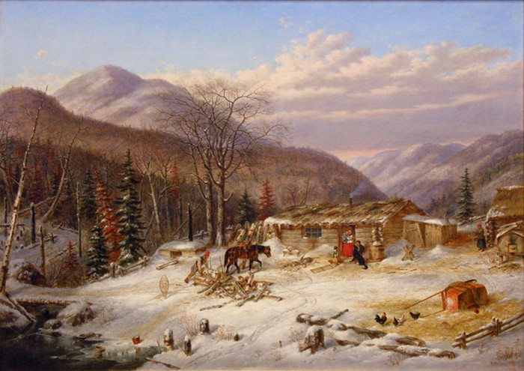
New People, New Paintings
As more and more immigrants arrived in the 1800s, new artists appeared, adding to the diversity in Canadian art. One famous painter Cornelius Krieghoff, painted landscapes and people in the European style which told a story through painting.

Slide 12
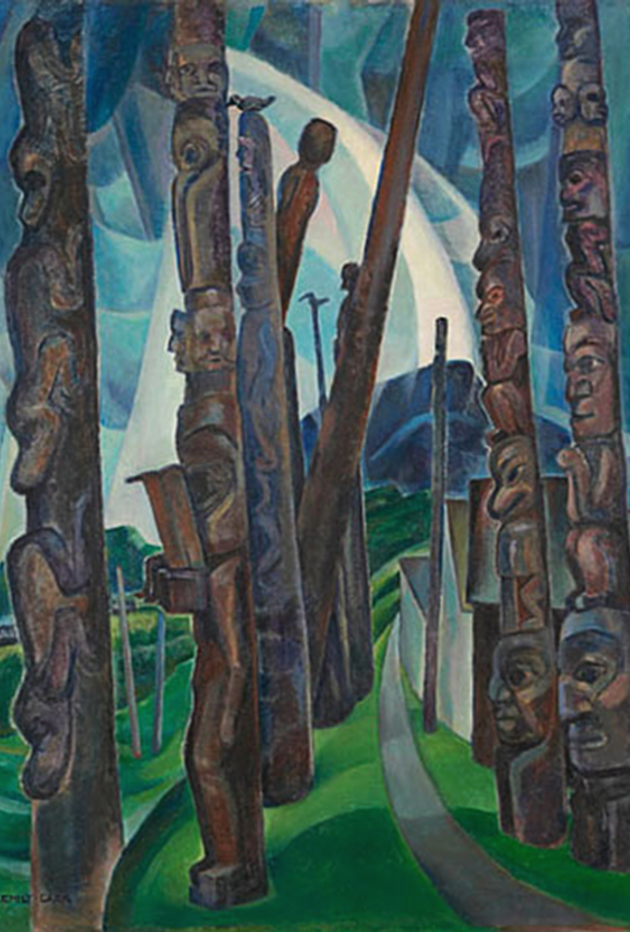
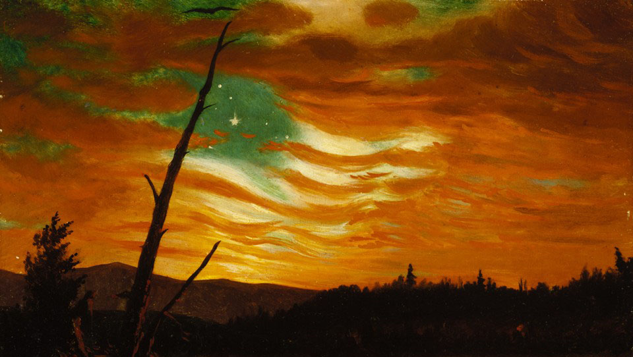
Which work of art is canadian?

Slide 13
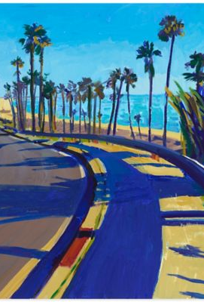
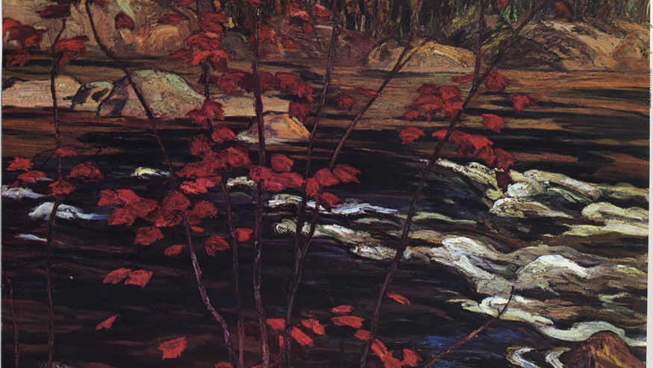
Which work of art is canadian?

Slide 14
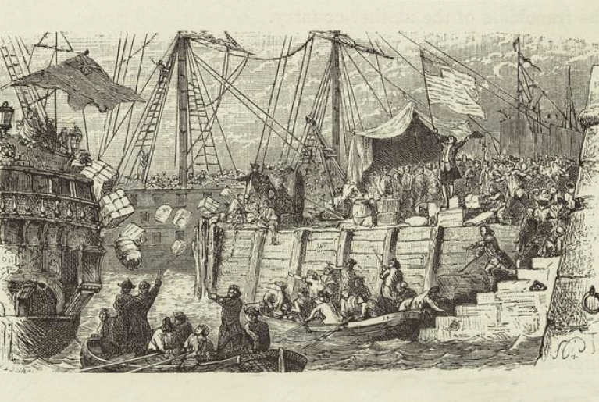
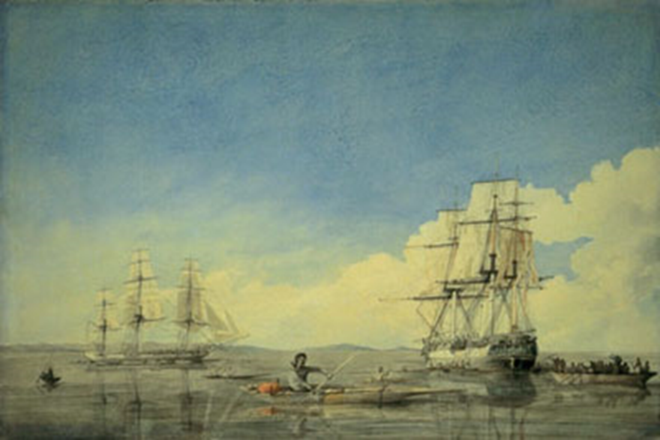
Which work of art is canadian?

Slide 15
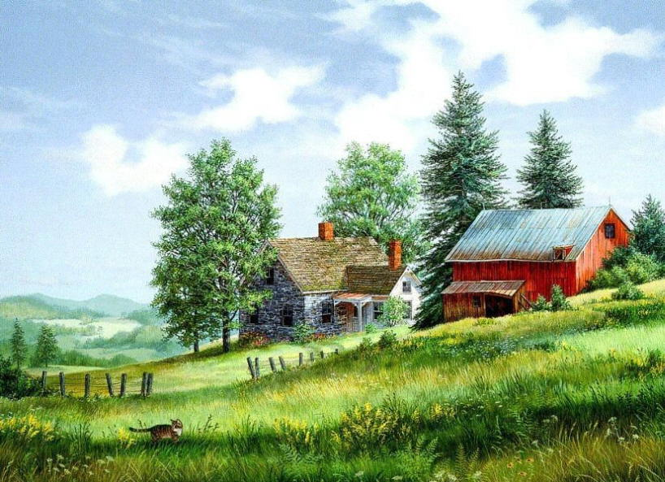
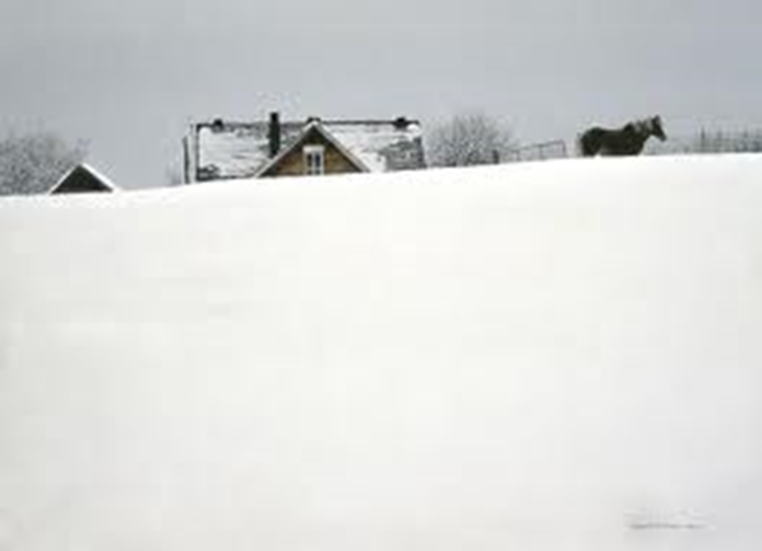
Which work of art is canadian?

Slide 16
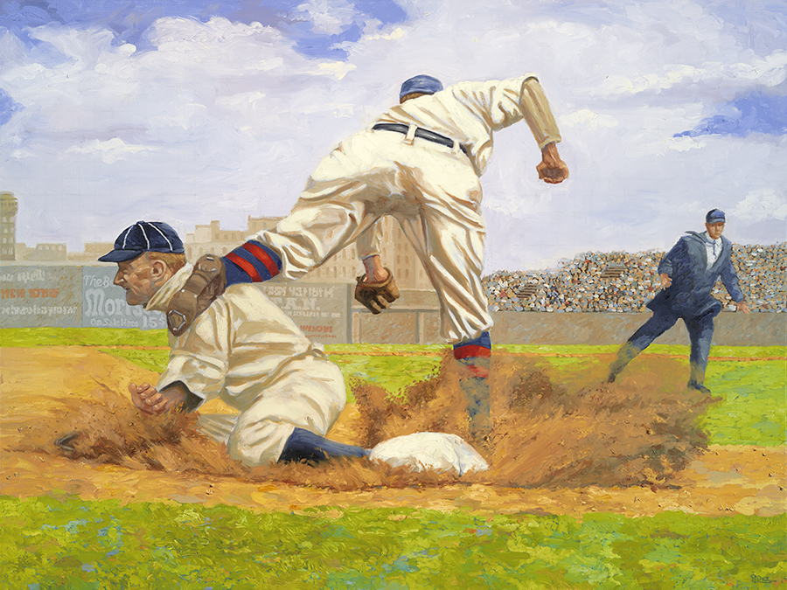
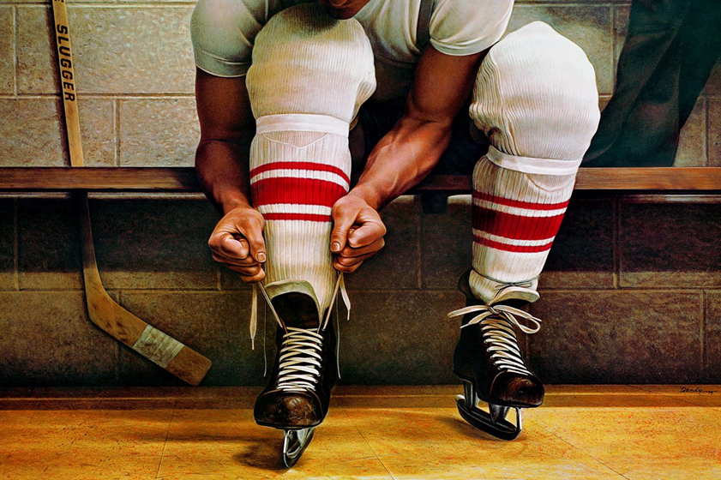
Which work of art is canadian?

Slide 17
Question?
Can a country’s culture be represented in a work of art?

Slide 18
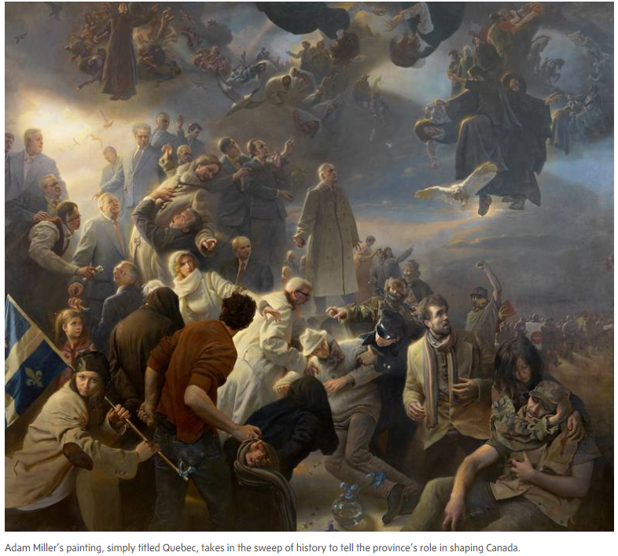
Painting to reflect the identity of a place?
https://www.theglobeandmail.com/news/national/new-york-artist-adam-miller-depicts-quebecs-role-in-canadianhistory/article35281470/

Slide 19
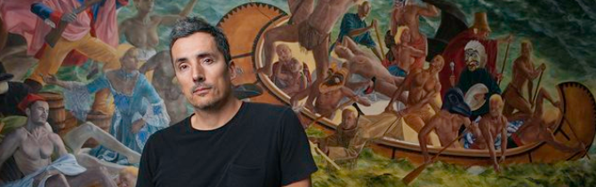
The Alternative Realism of Kent Monkman
A virtuoso paints Indigenous life into Canadian history

Slide 20
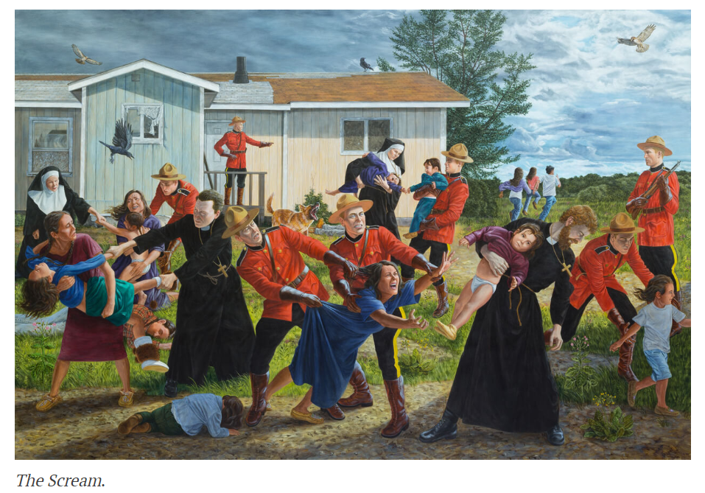

Slide 21

Emily Carr
Kitwancool
1928

Slide 22
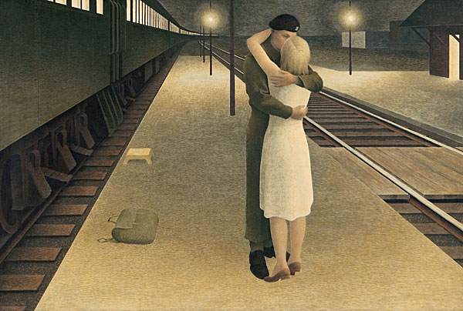
Alex Colville
Soldier and Girl at Station
1953

Slide 23

Robert Bateman
Winter Coat
1991

Slide 24

A.Y. Jackson
Red Maple
1914

