Slide 1
Biological Bases of Behaviour: The Nervous and Endocrine System
AP Psychology
S.Bamford
Winter 2020

Slide 2
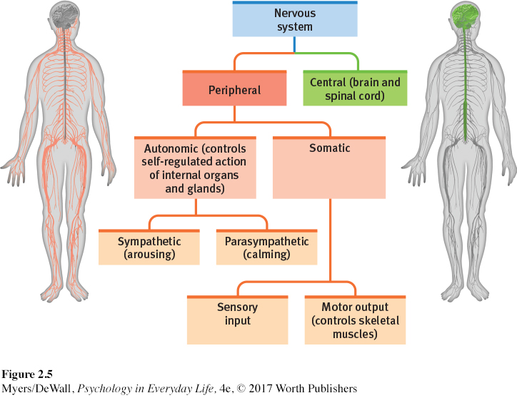
The nervous system
The body’s speedy, electrochemical communication network, consisting of all the nerve cells of the peripheral and central nervous systems
Pr-i-fr-ulh Nervous System(PNS) is responsible for gathering information and for transmitting Central Nervous System (CNS-the brain and spinal cord) decisions to other body parts.

Slide 3
Nerves in the Nervous System
Nerves are bundled axons that form neural cables connecting the central nervous system with muscles, glands, and sense organs. Ex: The optic nerve bundles a million axons into a single cable carrying the messages from the eye to the brain.
Sensory Neurons: carry messages from the body’s tissue and sensory receptors inward to the brain and spinal cord for processing
Motor Neurons: carry instructions from the CNS outward to the body’s muscles and glands.
Interneurons: enables communication between sensory or motor neurons CNS. They play vital roles in reflexes, neuronal oscillations, and neurogenesis in the adult mammalian brain.

Slide 4
The Peripheral Nervous System
Within the PNS, there are two other nervous systems:
Somatic Nervous System controls the body’s skeletal muscles
Autonomic Nervous System controls the glands and muscles of the internal organs
The autonomic Nervous system breaks down further into two more systems:
Sympathetic Nervous System: arouses the body, mobilizing energy
Parasympathetic Nervous System: that calms the body, conserving energy

Slide 5
Sympathetic vs. Parasympathetic System

Slide 6
The Central Nervous System
Neurons “talking” to other neurons. The brain has over 86 billions neurons clustered into work groups called “Neural Networks”- neurons that fire together, wire together- Learning to play the violin, speak another language, and solve a math problem only strengthens connections.
The spinal cord serves are as two-way information highway that connects the PNS and the brain. Ascending neural fibers send up sensory information, and descending fibers send back motor-control information.
These pathways govern our reflexes: an automatic response to a sensory stimulus.

Slide 7
The Endocrine System
EN-duh-krin is the body’s “slow” chemical communication system; a set of glands that secrete hormones into the bloodstream
Hormones are chemical messengers that are manufactured by the endocrine glands, travel through the bloodstream and affect other tissues including the brain which can influence our interest in sex, food, and aggression.
Endocrine messages long out last neural messages. Ex: Still feeling angry after the problem has resolved?

Slide 8
The Endocrine System

