Slide 1
Biological Bases of Behaviour: Studying the Brain and Limbic System
AP Psychology
S. Bamford
Winter 2020

Slide 2
Neural Measures

Slide 3
Parts of the “Old” Brain
The brainstem is the oldest and innermost region of the brain. Beginning where the spinal cord swells as it enters the skill; the brainstem is responsible for automatic survival functions. Hence why it is the oldest part of the brain.
The medulla (muh-dul-uh) is the base of the brainstem that controls heartbeat and breathing.
The pons sits above the medulla and help coordinate movements and control sleep
The brainstem is the crossover point where most nerves to and from each side of the brain connect with the body’s opposite side.

Slide 4
Parts of the “old” Brain Continued
The Thalamus is the brain’s sensory control center, located on top of the brainstem; it directs messages to the sensory receiving areas in the cortex and transmits replies to the cerebellum; except smell and routes it to the higher brain- the thalamus is a hub in which traffic flows in and out on tis way to various locations.
The Reticular Formation is a neuron network that travels through the brainstem into the thalamus and plays an important role in controlling arousal.

Slide 5
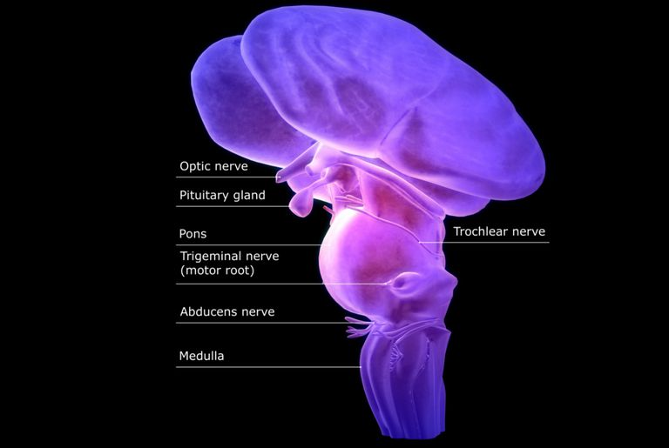
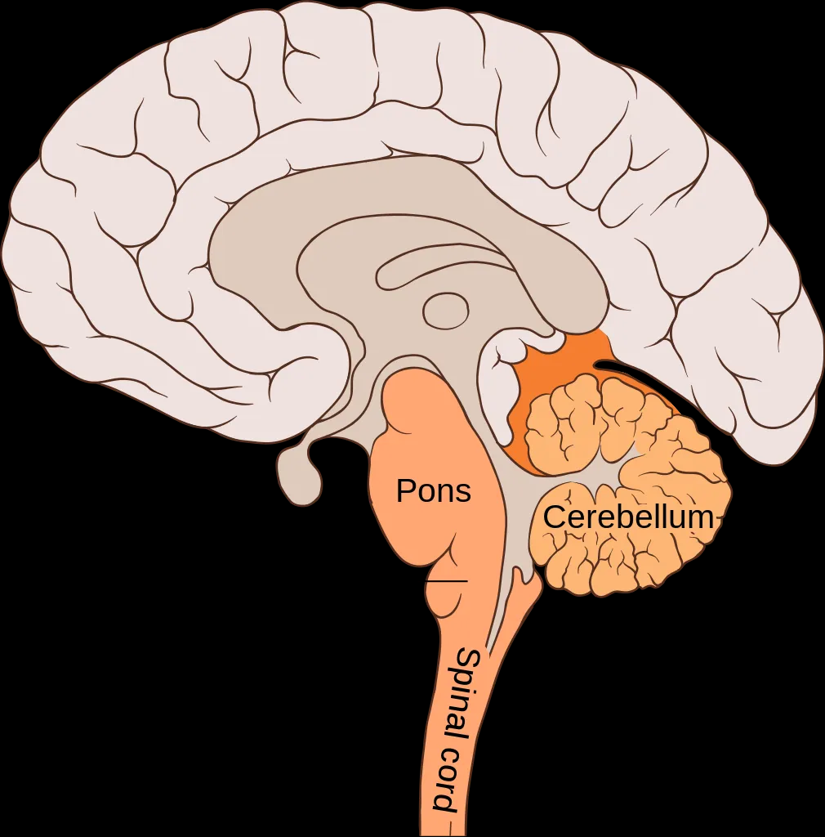
Parts of the “oLd” Brain Continued
Finally, the Cerebellum (sehr-uh-BELL-um) is known as “little brain” at the rear of the brainstem where processing sensory input occurs, coordinating movement output and balance, and enabling nonverbal learning and memory.

Slide 6
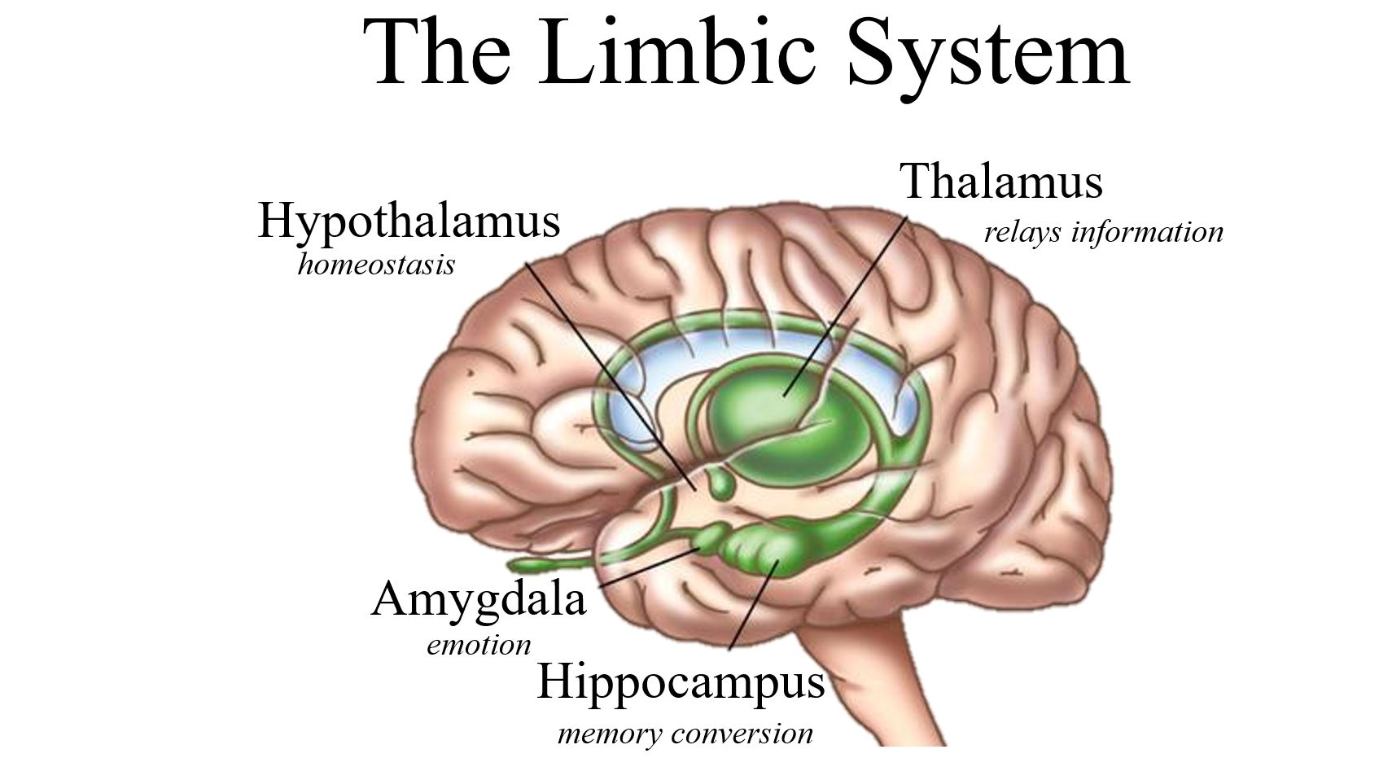
The Limbic System
The Lymbic System is a neural system located below the cerebral hemispheres that are associated with emotions and drives. It includes the amygdala, hypothalamus and hippocampus

Slide 7
The Amygdala
The uh-MIG-duh-la has been identified to be as small as two lima beans. It is a neural cluster of the limbic system that is associated to emotions; especially aggression and fear.
Those with lesions on the amygdala often show signs of redcued arousal to fear and anger-arousing stimuli.
Researchers found that math anxiety shows hyperactivity in the right amygdala
Other studies link criminal behaviourwith amygdala dysfunction

Slide 8
The Hypothalamus
Located just below the thalamus (hence, hypo) is the hypothalamus which directs several maintenance activities such as eating, drinking, and body temperature and helps govern the endocrine system via the pituitary gland, and is linked to emotion and reward.
The hypothalamus monitors the body’s state by communicating with the blood chemistry and any orders coming in from other brain parts.
Ex: Cerebral Cortex thinks about sex→ Hypothalamus secretes hormones→ Hormones trigger pituitary gland→ Pituitary gland influences sex glands to release their hormones (quite the process)
Why it is known as the Reward Center….

Slide 9
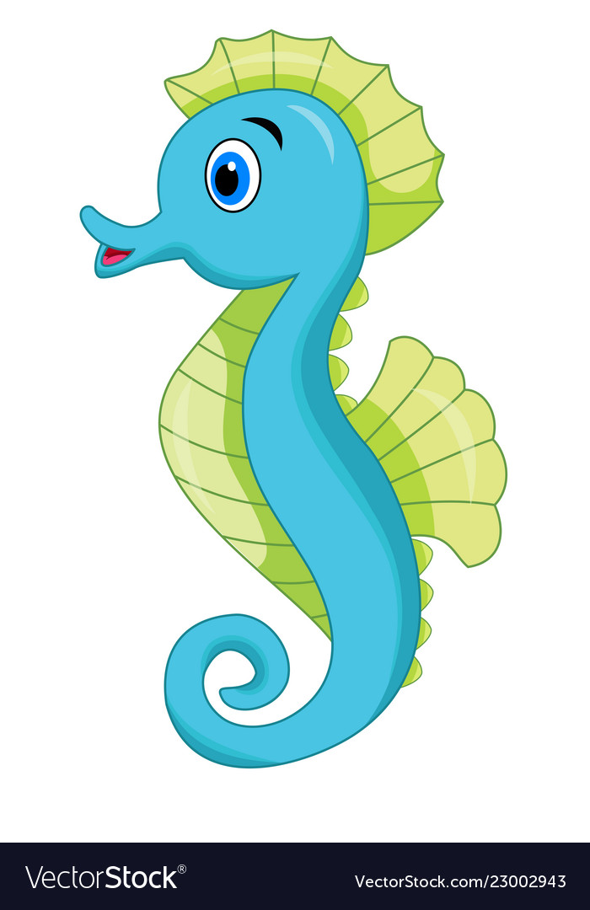
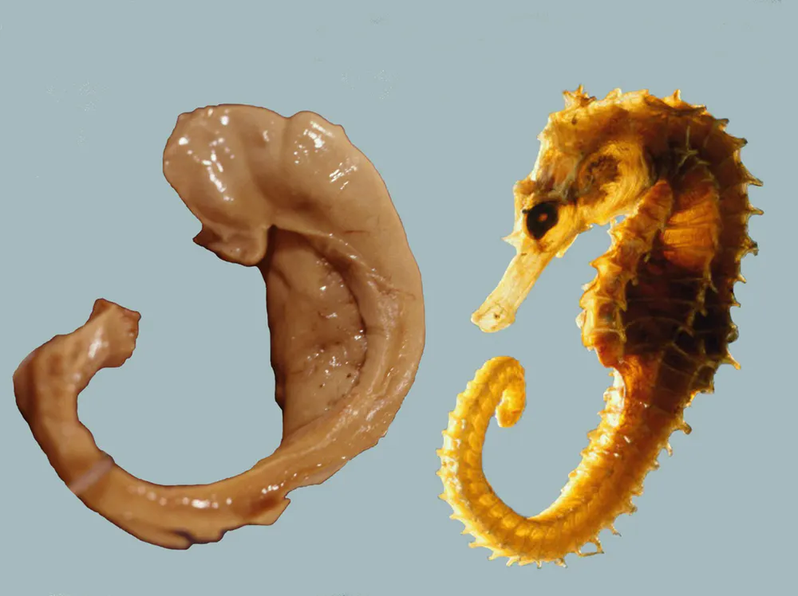
The Hippocampus
The hippocampus is a neural center located in the limbic system which helps process for storage explicit (conscious/intentional) memories of facts and events.
It is shaped like a seahorse
Decreases in size and function as we grow older
Loss of hippocampus; unable to form new
Memories of facts or events

