Slide 1
Biological Bases of Behaviour
AP Psychology
S. Bamford
Winter 2020

Slide 2
Introduction
Everything psychological is simultaneously biological
Read Wang Huanming’s story (2016)
Every idea, every mood, every urge is a biological happening

Slide 3
Biology, Behaviour, and the Mind
Hippocrates (Hip-POH-Crah-Tis)- Greek physician who correctly located the mind in the brain.
Franz Gall-1800’s Phrenology which studied the bumps on a skull to reveal a person’s brain size, associated mental abilities and character traits
Localization of Function- the idea that various brain regions have particular functions

Slide 4
Why psychologists are concerned with human biology
Biological Psychologists/Researchers have discovered:
Our adaptive brain is wired by our experiences
Among the body’s cells are nerve cells that conduct electricity and “talk” to one another by sending chemical messages across a tiny gap that separates them
Specific brain systems serve specific functions
We integrate information processed in these different brain systems to construct our experience pf sights and sounds, meanings, memories, pain and passion

Slide 5
BiopsychoSocial Systems
This is the understanding that the human body is made of serval systems that connect to one another
Cells=Body Organs→ Digestion, Circulation, Information Processing→Individual = family, culture, and community

Slide 6
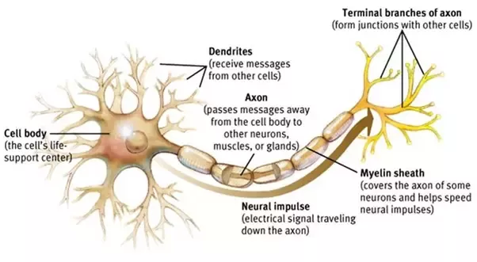
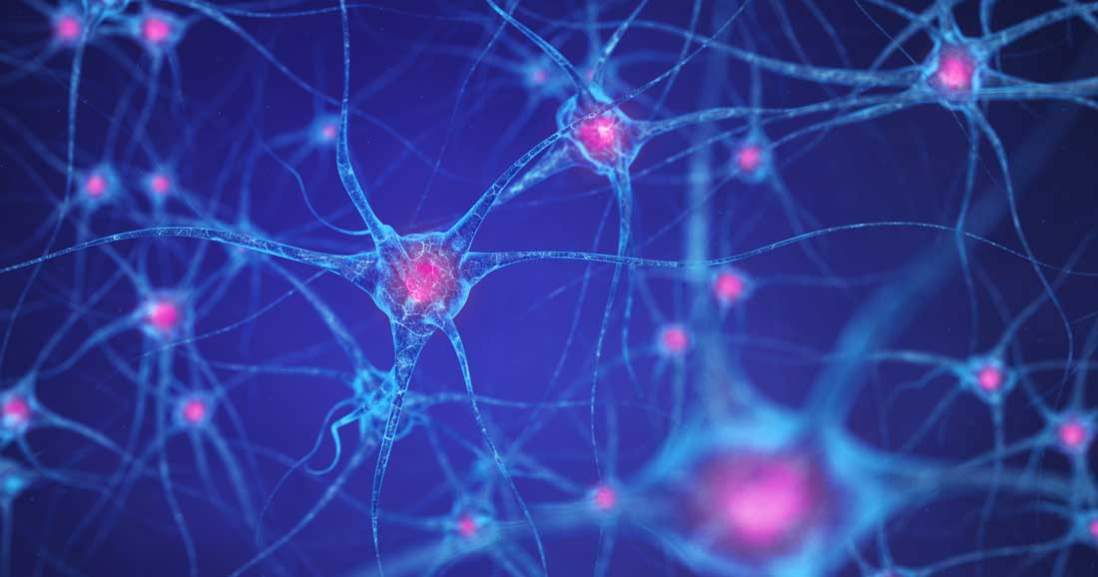
Parts of A Neuron
Image of many neurons together

Slide 7
Neural Impulses
Action Potential: a neural impulse; a brief electrical charge that travels down an axon
3kms an hour to <320kms an hour YET 3 million times slower than electricity through a wire
Brain activity is measured in milliseconds YET computer activity in nanoseconds
Brain is more complex than a computer, but slower than at executing responses

Slide 8
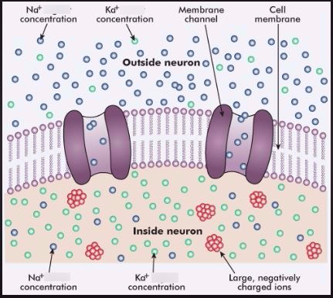
Neural Impulse Continued
Neurons generate electivity from chemical events
In the chemistry to electricity process, ions are exchanged
A resting axon has positively charged sodium ions outside and negatively charged ions inside (protein and potassium
…this is called Resting Potential
Positive-outside/negative-inside=resting potential
When a neuron fires, the first section of the axon
opens, flooding in positive ions. The loss of inside/
Outside charge is depolarization and causes the next
section of axon channels to open, then the next, etc.

Slide 9
Neural Communication
For a neuron to “turn on”, it must reach its Threshold
The minimum amount of neurotransmitters to ignite the dendrite
Most neural signals are excitatory (gas pedal)
Some are inhibitory (breaks)
If excitatory exceeds inhibitory by minimum intensity, action potential can be triggered
Ex:Class vote: if the excitatory people with their hands up outvote the inhibitory people with their hands down, the vote passes
Action potential travels down the axon, then branches out into junctions with hundreds or thousands of other neurons or with the body’s muscles or glands

Slide 10
Neural Communication Continued
Neurons need a break
Refractory Period is a neural rest when action potentials cannot occur until the axon returns to its resting state.
All or None Response is a neuron’s reaction of either firing (with full-strength response) or not firing at all

Slide 11
Neural Communication Continued
Synapse: the junction between the axon tip of the sending neuron and the dendrite or cell body of the receiving neuron
Synaptic Gap/Cleft: the axon terminal of one neuron is separated from the receiving neuron
Neurotransmitters: chemical messengers that cross the synaptic gaps between neurons. When released by sending neuron, neurotransmitters travel across the synapse and bind to receptor sites of receiving neuron; will it generate a neural impulse?

Slide 12
Neural Communication Continued
Within 1/10,000th of a second, the neurotransmitter molecules cross the synaptic gap and bind to receptor sites on the receiving neuron…fitting like a lock and key.
The neurotransmitter unlocks tiny channels at the receiving site, and electrically charged atoms flow in, exciting or inhibiting the receiving neuron’s readiness to fire.
Excess neurotransmitters float away, then broken down by enzymes or reabsorbed by the sending neuron…this is called reuptake

Slide 13
Neurotransmitters and Behaviour
Neurotransmitters influence our motions and emotions.
A particular brain pathway may use only one or two neurotransmitters, such as serotonin and dopamine, a particular neurotransmitters affect specific behaviours and emotions.
Neurotransmitters don’t work in isolation; they must interact and the results vary with the receptors they stimulate
Acetylcholine (Ach)- plays a role in learning and memory. It is the messenger at every junction between motor neurons(carry information from brain and spinal cord to the body’s tissues). If Ach is released, the muscle contracts. If Ach transmission is blocked, muscles cannot contract and we are paralyzed (anesthesia)

Slide 14
Neurotransmitters and Behaviour Continued
The brain produces its own naturally occurring opiates
Our body releases several types of neurotransmitter molecules similar to morphine in response to pain and vigorous exercise…endorphins
Artificial opiates (heroine and morphine) “feel good” drugs disrupt the brain’s natural chemical balancing act; suppressing its own natural opiates.
Agonist increases neurotransmitter’s action; antagonist decreased neurotransmitter action (Ex: opiate drugs vs. Botox)

Slide 15
Neurotransmitters Influence

