Slide 1
Biological Bases of Behaviour: The Cerebral Cortex
AP Psychology
S. Bamford
Winter 2020

Slide 2
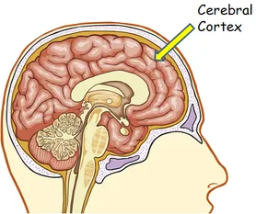
Cerebral Cortex
The “new brain” of neural networks within the cerebrum-two cerebral hemispheres contributing to 85% of the brain’s weight- form specialized work teams that enable our perceiving, thinking, and speaking.
The she-REE-bruhl Cortex covers the two hemispheres in a thin layer of interconnected neural cells. This is a evolutionary new comer to the brain.
It is the body’s ultimate control and information-processing center.

Slide 3
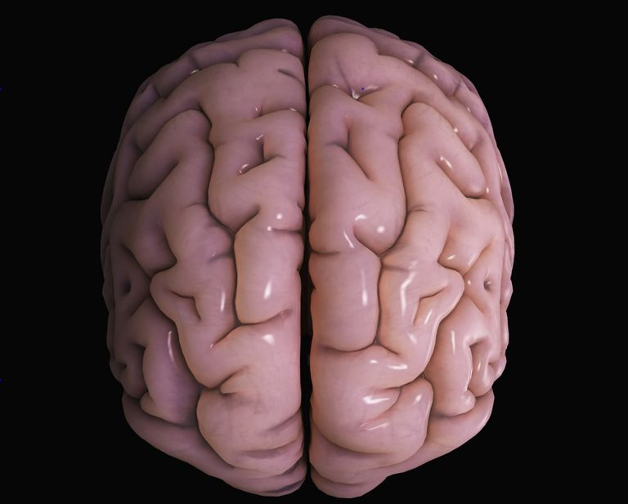
Structures of the Cortex
If the cerebral cortex was straightened it would roughly the area of a large pizza
The brain’s left and right hemispheres are filled with axons connecting the cortex to the brain’s other regions
The cortex contains 20 to 23 billion nerve cells and 300 trillion synaptic connections. Being human takes a lot of nerve (not my joke)
Each hemisphere is divided up by 4 lobes and separated by fissures (or folds)

Slide 4
The 4 Lobes

Slide 5
Functions of the Cortex-Motor
The 1800’s brought research that stimulated the frontal lobe on the right and left hemisphere which would cause movements of specific body parts on the opposite side of the body which is now known as motor cortex.
Mapping the Motor Cortex: scientists were able to predict a monkey’s arm motion in a tenth of a second before it moved by repeatedly measuring motor cortex activity
Brain-Computer Interfaces: Researchers programmed a computer to monitor the signals and operate a joystick. When the monkey merely thought about a move, the mind-reading computer moved the cursor with nearly the same proficiency as the reward/placebo monkey

Slide 6
Functions of the Cortex-Sensory
Motor cortex SENDS messages and the Somatosensory Cortex registers and processes body touch and movement sensations. This cortex is located in the front of the parietal lobes.
The more sensitive the body region, the larger the somatosensory cortex area is devoted to it (Ex: Lips vs. Toes
More processing occurs in the occipital lobes and auditory cortex (temporal lobes)
Cool Research: MRI of patients with schizophrenia have revealed active auditory areas in the temporal lobes during false sensory experience of auditory hallucinations.

Slide 7
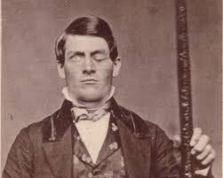
Functions of the Cortex- Sensory
Association Areas are areas of the cerebral cortex that are not involved in primary motor or sensory functions; rather they are involved in higher mental functions such as learning, remembering, thinking, and speaking.

Slide 8
The Power of PLasticity
How does a brain adjust to new experiences?
The brain is sculpted by genes and life experiences. The brain is constantly changing , building new pathways as it adjusts to little mishaps and new experiences. This neural change is called plasticity- the brain’s ability to change, especially during childhood, by reorganizing after damage or by building new pathways based on experience. Your brain is a work in progress. With repeated practice, it develops unique patterns that reflect your experiences.

Slide 9
Response to Damage
To what extent can a damaged brain reorganize itself, and what is neurogenesis?
Although brain damage is permanent, some of the brain’s neural tissue can reorganize in response to damage. Plasticity may also occur after serious damage. For example, blindness and deafness makes unused brain areas available for other uses (i.e. the expansion of the sense of touch for those who are blind).
Neurogensis is the formation of new neurons; through this process, the brain can sometimes mend itself.

Slide 10
Brain Hemisphere Organization and the Biology of Consciousness
The Divided Brain- what do split brains reveal about the functions of our two brain hemispheres?
Research has shown that accidents, strokes, and tumors to the left hemisphere can impair reading, writing, speaking, arithmetic reasoning and understanding. Similar damage to the right hemisphere has less visibly dramatic effects.

Slide 11
Splitting the Brain
The Corpus Callosum [ KOR-pus kah-LOW-sum] is the large band of neural fibers that connects the two brain hemispheres and carrying messages between them. (See textbook for example research to help clarify)
Split Brain a condition resulting from surgery that isolates the brain’s two hemispheres by cutting the fibers (mainly those of the corpus callosum) connecting them. (Also see textbook for extra references)

Slide 12
Left-Right Differences in the Intact Brain
Perceptual Tasks= Right Hemisphere
Speech/Arithmetic= Left Hemisphere
Right Hemisphere:
Excels at making inferences
Helps modulate our speech
Helps orchestrate self-awareness

Slide 13
The Biology of Consciousness
Consciousness- our subjective awareness of ourselves and our environment. Consciousness helps us cope with novel situations and act in our long-term interests rather than merely seeking short-term pleasure and avoiding pain. Consciousness also promotes our survival by anticipating how we seem to others and helping us read their minds: “He looks really angry, I better run!”

Slide 14
Cognitive Neuroscience
Neuroscientist Marvin Minksy (1987) stated: “the mind is what the brain does”. We just don’t know HOW it does it.
Cognitive Neuroscience is the interdisciplinary study of the brain activity linked with cognition (including: perception, thinking, memory, and language). In modern research, they are relating specific brain states to conscious experiences. (See textbook for examples of this kind of research)
Conscious experience arises from synchronized activity across the brain. If a stimulus activates enough brain-wide coordinated neural activity, it crosses a threshold of consciousness

Slide 15
Dual Processing- The Two-Track Mind
Dual Processing is the principle that information is often simultaneously processed on separate conscious and unconscious tracks (see textbook for examples of meaning)
Blindsight is a condition in which a person can respond to a visual stimulus without consciously experiencing it.
Parallel Processing is processing many aspects of a problem simultaneously; generally used to process well-learned information or to solve easy problems.
Sequential Processing is processing one aspect of a problem at a time; generally used to process new information or to solve difficult problems

Slide 16
Behaviour Genetics; Predicting Individual Differences
What are chromosomes, DNA, genes, and the human genome? How do behavior geneticists explain our individual differences?
Behaviour Genetics the study of the relative power and limits of genetic and environmental influences on behavior
Heredity the genetic transfer of characteristics from parents to offspring
Environment every nongenetic influence, from prenatal nutrition to the people and things around us.

Slide 17
Genetics Continued
Chromosomes are threadlike structures made of DNA molecules that contain the genes
DNA (deoxyribonucleic acid) are complex molecules containing the genetic information that makes up the chromosomes
Genes are the biochemical init of heredity that make up the chromosomes; segments of DNA capable of synthesizing proteins.
Genome is the complete instructions for making an organism, consisting of all the genetic material in that organism’s chromosomes
Read textbook for how these fit into psychology

Slide 18
Twin and Adoption Studies
Identical Versus Fraternal Twins
Identical Twins develop from a singl fertilized eggs that splits. Thus, genetically identical.
Although identical twins share the same genes, they do not always have the same number of copies of those genes within their genome. That variation helps explain why one twin may have a greater risk for certain illnesses and disorders
Most identical twins share a placenta; but 1 of every 3 sets has separate placentas. One twin’s placenta may provide slightly more nourishment which may contribute to a few identical twin differences
Fraternal Twins develop from two separate fertilized eggs. They are no more genetically similar than ordinary siblings
See textbook for studies done between genetics of identical vs fraternal twins
Also read about Separated Twins and Biological vs. Adoptive Relatives

Slide 19
Heritability
Heritability is the proportion of variation among individuals in a group that we can attribute to genes. The heritability of a trait may vary, depending on the range of populations and environments studied
For personality traits it is about 40% genetic
General intelligence is estimated 66%

Slide 20
Molecular Behaviour Genetics
Molecular Genetics study the molecular structure and function of genes
Molecular Behaviour Genetics’ goal is to find some of the many genes that together orchestrate complex traits such as body weifht, sexual orientation, and impulsivity.
Interaction is the interplay that occurs when the effect of one factor (ex: environment) depends on another factor (ex: heredity)
Epigenetics is the “above” or “in addition to” genetics; the study of environmental influences on gene expression that occur without a DNA change.

