Slide 1
International Borders
What international borders have you crossed?
What questions are asked of you when you cross a border?
Why do you need a passport to cross a border?
Is it important for countries to carefully guard their borders or should people be able to move more freely across international borders?

Slide 2
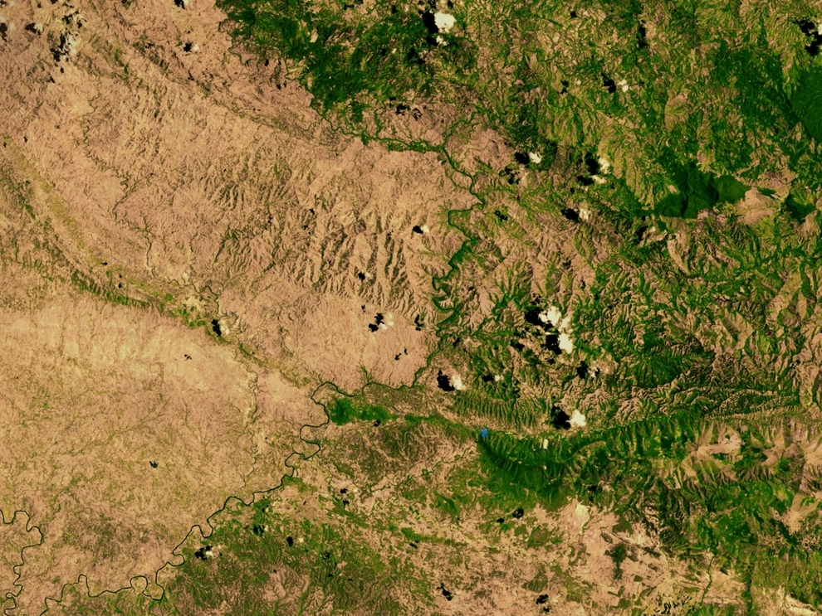
Haiti (deforested) / Dominican Republic

Slide 3
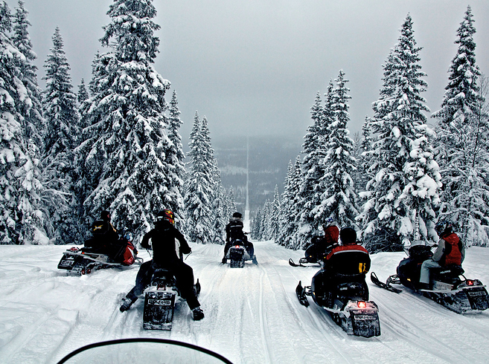
Norway / Sweden

Slide 4
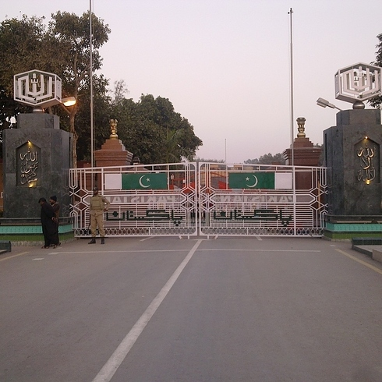
India / Pakistan

Slide 5
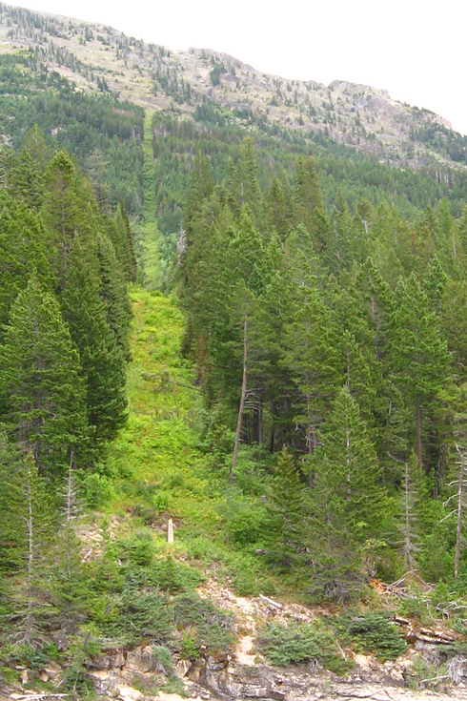
Canada / USA

Slide 6
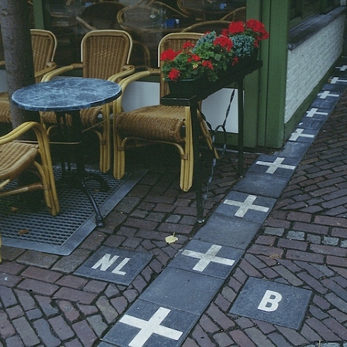
Netherlands / Belgium

Slide 7
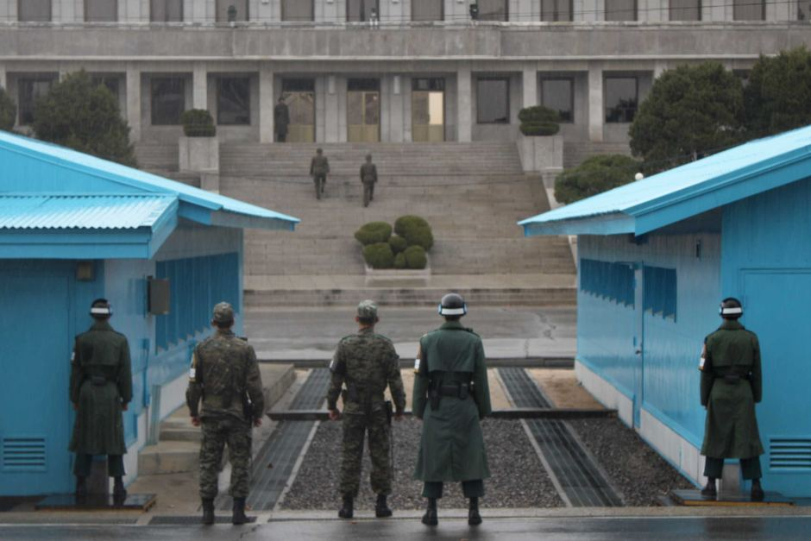
North Korea / South Korea

Slide 8
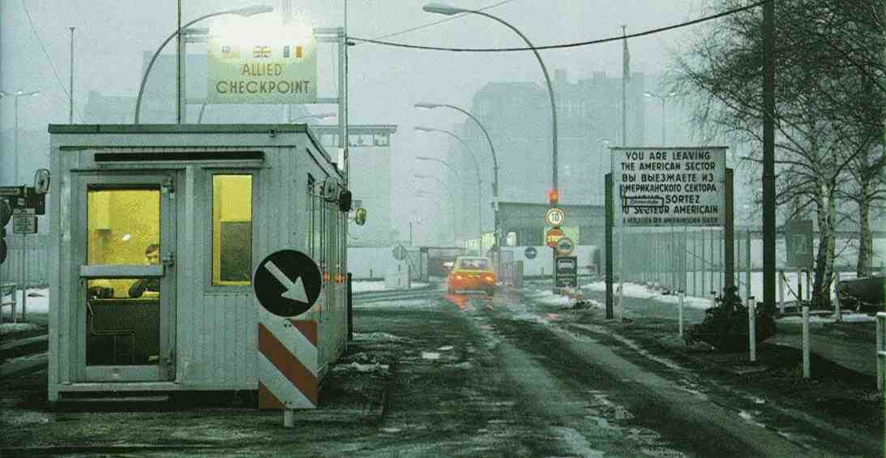
East Berlin / West Berlin (Checkpoint Charlie)

Slide 9
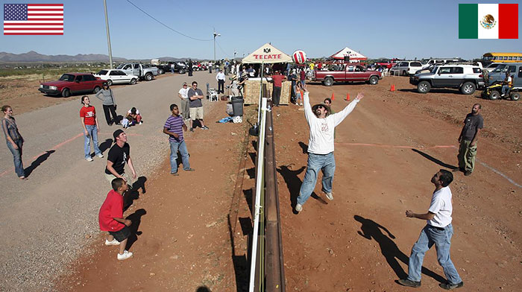
USA / Mexico

Slide 10
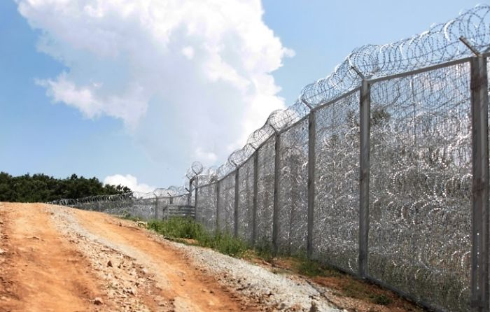
Bulgaria / Turkey

Slide 11
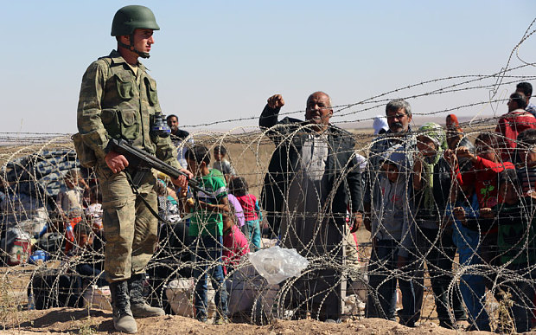
Turkey / Syria

Slide 12
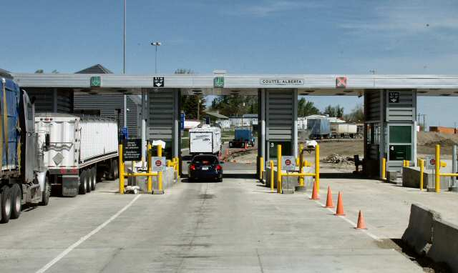
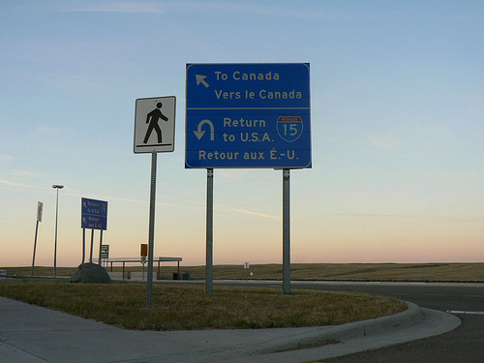
Coutts, Canada / Sweetgrass, USA

