Slide 1
Character Types
In Narratives

Slide 2
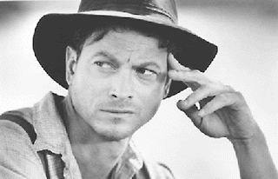
Protagonist
The character whose goal and transformation drive the story
Traits: unforgettable and fascinating (smart, brave, funny, good at what they do)
Usually…in some sort of trouble, needs something crucial, chases, sacrifices and/or battles something, and shows transformation by the end of the novel

Slide 3
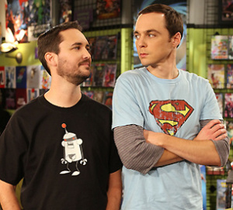
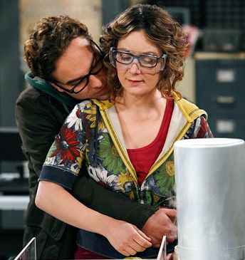
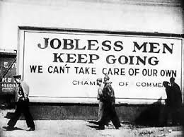
Antagonist
The character whose goal is to drive the conflict and push the protagonist towards transformation
Traits: as fascinating, smart, real, determined and active as the protagonist but stronger physically or mentally
Not necessarily a human or a villain. Examples: society or mental state of protagonist
Constantly fighting the protagonists in brilliant moves and countermoves to make the protagonist on their feet, thinking.

Slide 4
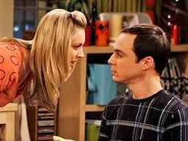
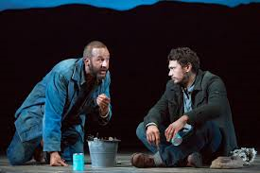
Foil
Think of tinfoil….one side is shiny and one side is dull. The dull side amplifies the shiny side…showing both its true colors. A foil is the same in literature. It is TWO characters that bring out the contrasts of each other….Good vs Bad. Happy vs Sad.

Slide 5
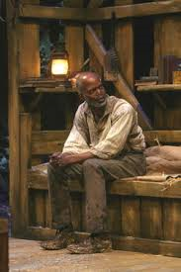
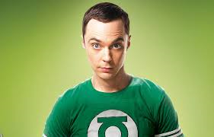
Threshold Guardian
Someone who likes things the way they are and opposes the protagonist when they want to change “those things”.

Slide 6
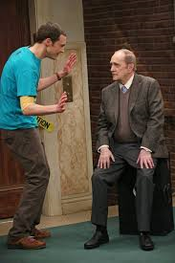
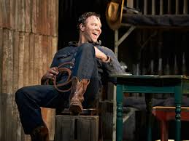
A Mentor
Someone in the story who gives the protagonist answers, gifts, training, or assistance to attain their transformation or goal

Slide 7
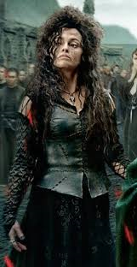
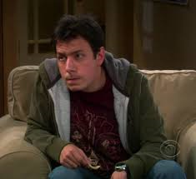
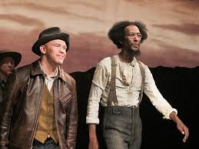
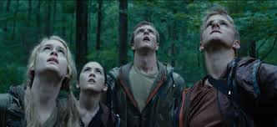
A Minion
An agent of the antagonist or someone who wants the same thing as the antagonist

Slide 8
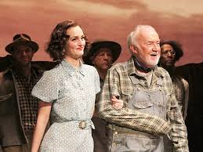
A Ficelle
A character who helps avoid an infodump for the audience by revealing information, sometimes creating a worse situation for the protagonist.

Slide 9
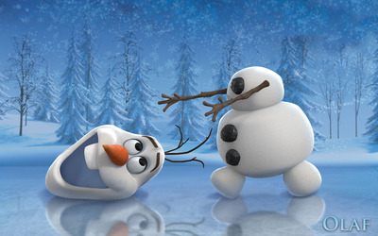
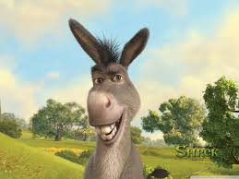
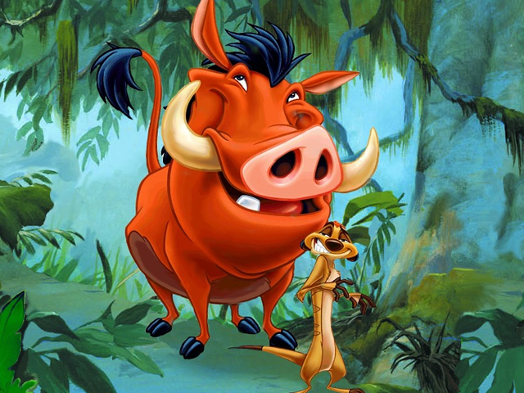
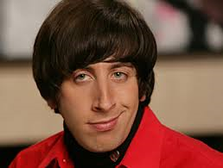
Comic Relief
The inclusion of a humorous character, scene or witty dialogue in an otherwise serious work, often to relieve tension

