Slide 1
The Breadwinner
Deborah Ellis

Slide 2
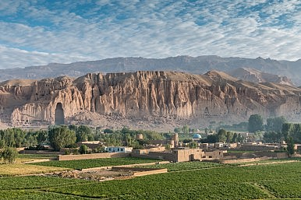
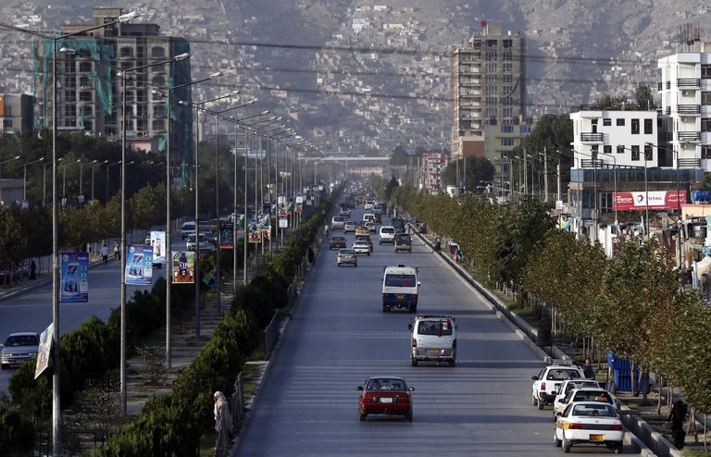
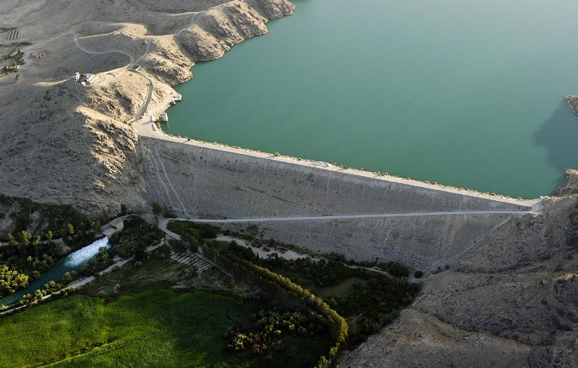
What do we think we know:
What do we think we know about… Afghanistan:

Slide 3
What does the term Breadwinner mean?

Slide 4
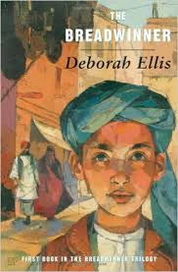
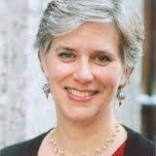
Author’s Note
Read the Author’s Note (pages 167–69) for background information and
context.
Deborah Ellis Interview
https://www.youtube.com/watch?v=U2AThCracxE

Slide 5
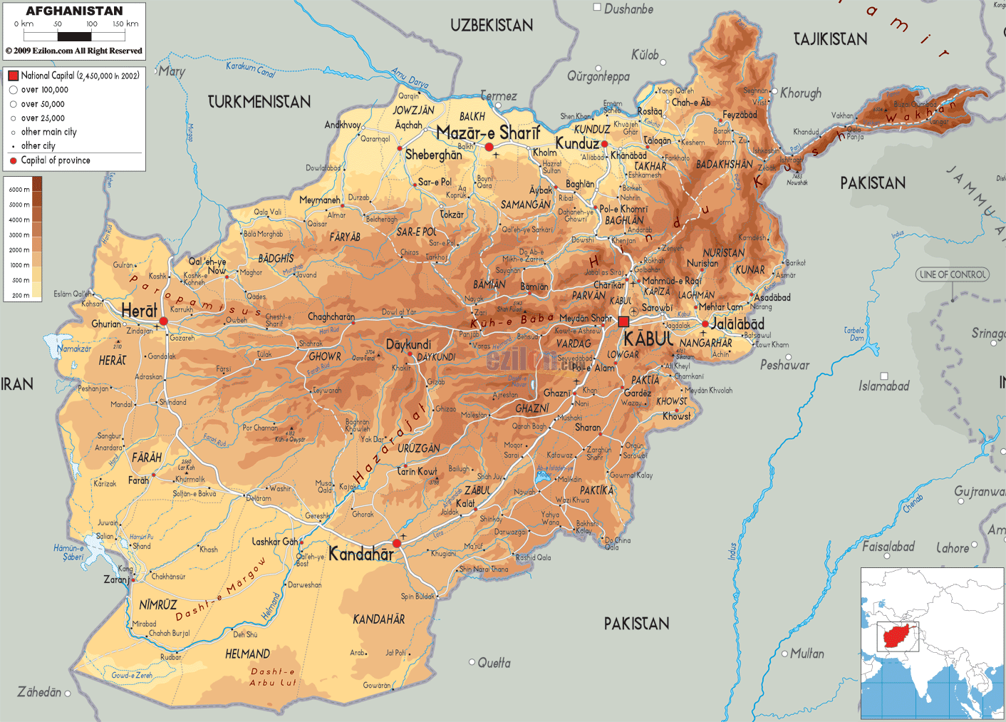
Map of Afghanistan
This is a map of Afghanistan. Look at it’s geographical features such as its landlocked situation, bodies of water, regions, major cities and bordering countries.
Discuss the effects of these features on the people who live there.

Slide 6
Background
Homework:
Research these topics about Afghanistan (e.g., languages,
religion, population, area, capital, life expectancy, literacy rate, monetary
unit, flag, geographical features, climate, historical information, art,
architecture, music, media).
Present and Discuss with the Class Tuesday

Slide 7
Chapter One
1. What characters do you meet in this chapter? Begin character profiles for each one: write their names or sketch the character and write some notes about what you have learned about each of them.
2. Imagine that suddenly you were not allowed to go to school. How would you
feel after the first day? After the first month? After a year?
3. How long has it been since the mother and children, except for Parvana, have been outside the house? Imagine you were not allowed to leave your home. How do you think you would cope?
4. What do you learn about the Taliban in this chapter?

Slide 8
Chapter 2
1. What did the soldiers do to the family? Where do you think they have taken
the father?
2. Draw a sketch of the room where the family lives and its contents.
4. When you are reading, what techniques do you use to figure out a word you
don’t know (e.g., read ahead and back to see if it is defined; use the glossary;
use context)? How does the author give clues to a word’s meaning (e.g., how
does “stretched out on a toshak” help a reader understand what a “toshak”
is)?

Slide 9
Chapter 3
1. Why did the Taliban order all windows to be painted over with black paint?
2. What emotions did you feel as you were reading this chapter? What caused
them?
3. What character strengths has Parvana shown in the novel so far?

Slide 10
Chapter 4
1. What has happened to the mother?
2. How do Parvana and Nooria differ on how they should handle their mother?
3. “Everybody leans on everybody in this family” (page 18). What does
Parvana mean by this? Would you say this is true in your own family? How
could you be a better support for family and/or friends?

Slide 11
Chapter 5
1. What are your first impressions of Mrs. Weera? Find two things she says or
does that give you a strong sense of her character.
2. Parvana is responsible for bringing in water for the family. Why is it such
an important and tiring job? Why must the water be boiled before they can
drink it?
3. A reference to an Afghan Women’s Union appears on page 57. What kind of
services and support do you think this organization would offer?

Slide 12
Chapter 6
1. What is the plan that Mrs. Weera thought of? How well did it work on the
first day?
2. How does Parvana feel when she is out in the market as a boy?
3. The author mentions Parvana’s special red shalwar kameez on page 69,
already described on page 24. Why is it important to Parvana? As you read,
watch for further mentions of it and think about what it might symbolize.

Slide 13
Chapter 7
1. What is Parvana’s job? How does she feel about it?
2. Why do you think the author included the scene with Parvana reading the
letter for the Talib?
3. Parvana must sell her special shalwar kameez. How would you feel if you
were forced to sell something that was important to you?

Slide 14
Chapter 8
1. How does the family’s life change when Mrs. Weera moves in?
2. Nooria says that she had forgotten how good the sun feels on her face.
Maryam has to be helped to walk down the stairs. If you were forced to stay
indoors, what would you miss most about being outside? Why is it unhealthy
to be indoors for so long?
3. Why do you think the woman in the window is throwing small items down
to Parvana?

Slide 15
Chapter 9
1. How are Parvana’s and Shauzia’s lives similar? How are they different?
2. What two plans do Mrs. Weera and the mother have? Why are the plans
dangerous?

Slide 16
Chapter10
1. What is the job the girls do? Do you think you would be able to do it? What
do you think makes them able to do it?
2. “Kabul has more land mines than flowers,” the father used to say (page 109).
Share what you know about land mines.
3. The girls say that they must remember the experience of bone-digging when
they are rich old ladies drinking tea together. Do you think that vision of
their future will come true? Why do you think that?

Slide 17
Chapter 11
1. Why did Parvana end up telling her family about the bone-digging even
though she had said she wouldn’t?
2. How did digging bones lead to the girls’ new job?
3. How is the relationship between Parvana and Nooria changing?
4. What happens at the soccer stadium? Why do you think the author chooses
to include scenes like this one and the scene about the bone-digging?

Slide 18
Chapter 12
1. What is Shauzia’s dream? What is your opinion of her wanting to leave?
2. Why did Parvana’s parents disagree about leaving Afghanistan?
3. What does Parvana want her life to be like? Are you surprised by what she
wants?

Slide 19
Chapter 13
1. How is Nooria’s life going to change? How does she feel about it?
2. Parvana feels both relieved and sulky about not going to Mazar-e-Sharif.
Describe a time you have felt that kind of mixed emotion.

Slide 20
Chapter 14
1. What do we learn about Parvana’s character from her actions toward Homa,
the woman she finds?
2. Why was getting back to Parvana’s house so dangerous?
3. What news does Homa report to Parvana and Mrs. Weera? How do their
responses to the news differ? How do you think you would have responded?
4. What do you predict has happened to Parvana’s family?
5. Had you predicted that the father would return? Why or why not?

Slide 21
Chapter 15
1. What do Parvana and Shauzia say they are working toward? Why are their
plans different?
2. What do you know about refugee camps and camps for internally displaced
persons (IDPs)? What do you think the camps are like?
3. How does Parvana say goodbye to the Window Woman? What has their
interaction meant to both Parvana and the woman?
4. How does the author give a sense of hope in this chapter?
5. What do Parvana and Shauzia plan to do in twenty years? Do you think this
plan will come true? Explain your reasoning.

