Slide 1
Individual and Family Dynamics 120
Semester 2
2018

Slide 2
Individual and Family Dynamics 120
Semester 2
2018

Slide 3
Examines how you think and feel and what motivates you
Studies how people behave in groups and in society
Psychology
Sociology
Social Sciences:
The study of human behaviour
Anthropology
Economics
Individual &
Family Dynamics
Studies the production and distribution of wealth
Studies humans and their culture, beliefs, habits and institutions
How you behave in your main social group
Patterns of behaviour
Examines your own life & the roles you play

Slide 4
Unit 1: Self-awareness (pt 1)
How can self-awareness help you in your life?
It can help you care about other people
It can help you know why you make the decisions you do
It can help you reflect on those decisions and make better ones
It can help you understand your feelings
It can help you become a happier person in the future

Slide 5
it can help you have happier healthier relationships
It can help you make a suitable career choice
It can help you set suitable goals that you can actually reach!
And overall it can help you actually like who you are!
Others?
Reflection #1 (see handouts)

Slide 6
Do you lack self-awareness?
As you read these think about you…..
You have a hard time understanding what you are feeling
You find it difficult to speak about your feelings and thoughts with others
You are constantly lost in your thoughts
You are frequently infuriated or grieved by others
You have low self-esteem
You share many of these self-destructive signs (self-defeating mindset, over/undereating, failing to take action when you know you should, going out of your way to harm others, drug/alcohol abuse, alienating yourself, sabotaging relationships)
You have a very weak sense of self or a very rigid identity

Slide 7
Self Awareness can Change your life 14 mins

Slide 8
Self-awareness activities for beginners!
Get away from people, be still, don’t do anything. Don’t use being busy to escape fear, hatred and pain in everyday life.
Meditation and self-inquiry(Why do I feel this way?)
Keep a daily private journal. Keeping things bottled up prevents us from being our true authentic self.
self awareness with a simple fix 17 mins

Slide 9
Heredity and Who We Are
Your Biological Blueprint
All life processes begin at the level of the cell.
Human body is made up of two kinds of cells:
Body cells - continue the life of the individual.
Sex cells - continue the life of the species. ovum and sperm

Slide 10
What are chromosomes?
rod shaped particles carrying hereditary information from each parent. (Twenty-three from your father and twenty-three from your mother)
there are about 30,000 genes. Genes (the basic units of heredity) determine all inherited characteristics, or traits

Slide 11
Dominant genes determine the nature of a certain trait in a person. Dominant genes overrule recessive genes.
Recessive genes determine the nature of the trait only when two of them are present. The child must receive only one recessive gene from each parent.

Slide 12
Sex Chromosomes determine the sex of the child.
Females have two X chromosomes and males have either an X or Y.
XX combination results in a girl.
XY combination results in a boy

Slide 13
An organism’s genotype is the set of genes that it carries.
An organism’s phenotype is all of its observable characteristics—which are influenced both by its genotype and by the environment.

Slide 14
Dominant and…..
Black or Brown hair
Full lips
Free earlobes
Dimples in cheeks
High and narrow nose
Brown eyes
Long full lashes
Curly hair
Freckles
Feet with normal arches
Farsightedness and Astigmatism

Slide 15
Recessive
Blond hair
Thin lips
Attached earlobes
No dimples in cheeks
Broad nose
Blue eyes
Short thin lashes
Straight hair
Lack of freckles
Flat feet
Normal vision

Slide 16
Environment
Examples of environmental influences on our personality are: (leave a few lines after each one in your notebook)
Family
Cultural Heritage and society
School
Peers
Community

Slide 17
Religion
Technology
Media
Stress and violence
Other?
With a partner, discuss how the above can influence your growth and development

Slide 18
Family:
-changes in family structure will influence your life
-receiving warm, loving and consistent care helps children feel safe and secure
-caring environment helps you accept your identity
Cultural heritage and society:
-foods, religious traditions, ceremonies
-a multicultural society can help you develop mutual respect for others

Slide 19
School:
-a quality school environment encourages learning and growth
-can encourage friendships and extracurricular activity
-if negative can affect your self esteem
Peers:
-greatest influence during teen years (how you look, how important you are, future plans
-sometimes influence is not so great (smoking, sex, alcohol, drugs)

Slide 20
Community:
-may influence the jobs people have, friends they make, and activities
-a low crime rate makes residents feel protected and secure so they can strive to be better
Religion:
-influences your outlook in life (optimistic/pessimistic) and guidelines in life (what you want to accomplish)
-Can provide meaning and direction

Slide 21
Technology:
-the food you eat, the clothes you wear, the work you do, your relationships
-changes have resulted in higher standards of living (more goods available at lower cost, longer life spans)
-can have negative impact such as neglecting physical health, interfering in relationships

Slide 22
Media:
-what people see on TV and internet can become role models to imitate. But is it realistic?
-advertising affects how we spend our money and how we judge ourselves
-aggressive behavior and watching violent video games…..it’s a risk

Slide 23
Stress and violence:
-there is increased stress from terrorism, war and violence
-extreme or longterm stress can have an effect on your growth
-children living in this environment can develop physical issues and learning disabilities.
Other?

Slide 24
Sibling Position
A sibling is a brother or sister.
A family environment that includes siblings can be beneficial (they can learn from each other, play together and be companions)
Siblings can also be a source of conflict and competition (one can feel less favored, one may be better at something)

Slide 25
Being the first, last or middle child or only child in a family can make a difference in your development.
Why Birth Order is a Blessing and a Curse
Research on Birth Order

Slide 26
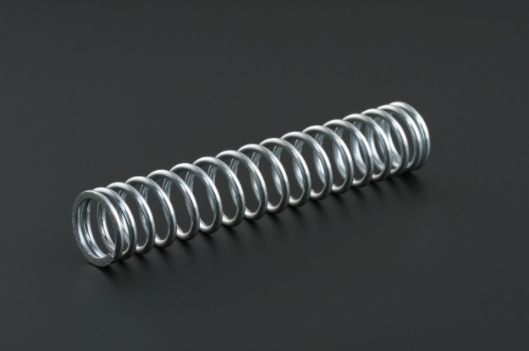
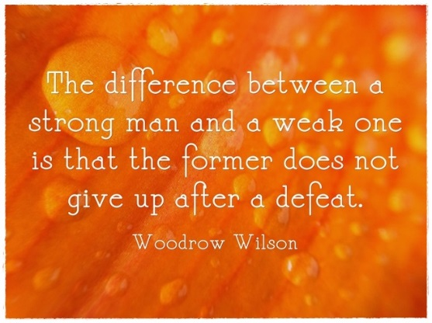
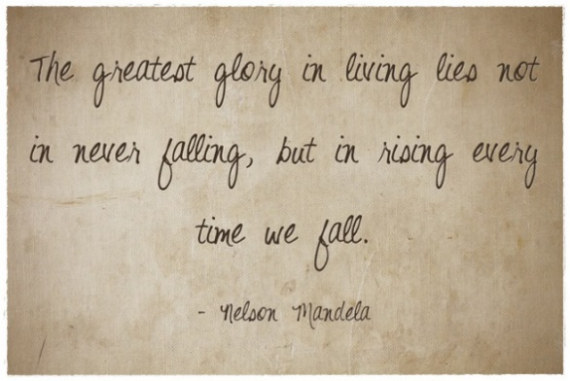
RESILIENCE
What Does it Mean?

Slide 27
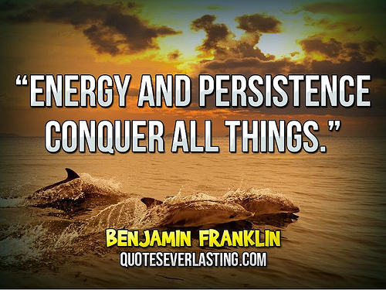
Resilience is linked with:
Persistence: persisting and focusing even in difficult circumstances and set backs.

Slide 28
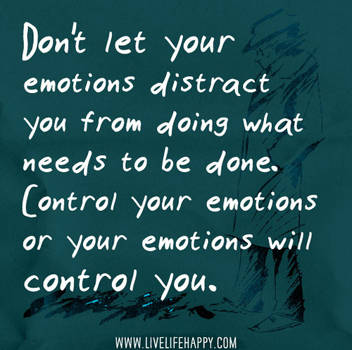
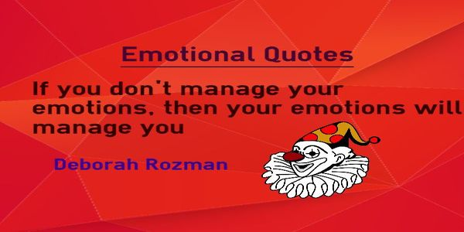
Emotional control:
monitoring your emotional reactions and remaining in control; composed and focused during a crisis

Slide 29
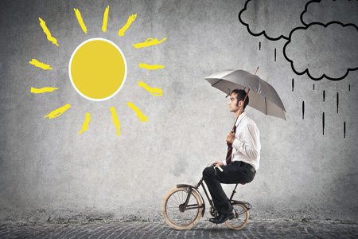
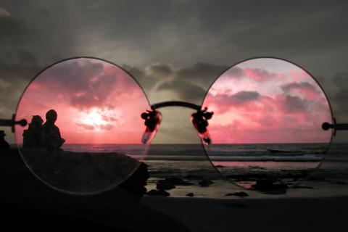
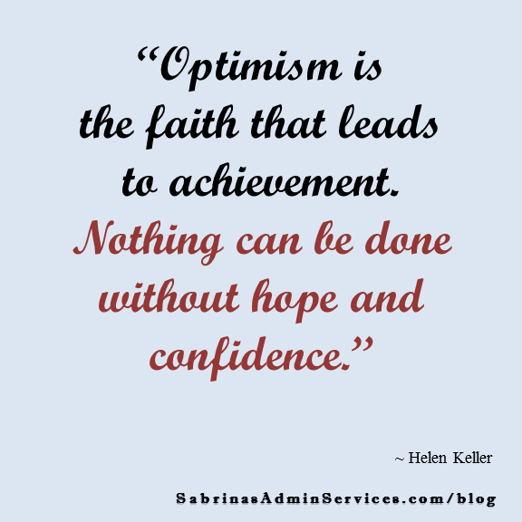
Optimism:
remaining positive and optimistic even when things are difficult or you are being criticized.

Slide 30
What does science say about resilience?
Everyone needs resilience because it is the KEY to success at work and happiness in life. Your natural level of resilience affects school performance, physical health, mental health, and the quality of your relationships. “It is the basic ingredient to happiness and success.” (Karen Reivich and Andrew Shatte)

Slide 31
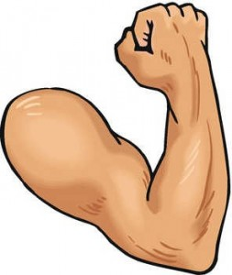
We can boost our resilience! You will need to work on these things:
Emotional regulation
Risk assessment
Self-knowledge
Self-confidence
Reaching out
Mindfulness
Stress management

Slide 32
Resilience Stories
Crack Your Shell (11 mins)
The Secret of Becoming Mentally Strong(15 mins)

Slide 33
Your Temperament
Four Temperaments:
Four fundamental personality types:
sanguine (enthusiastic, active and social)
choleric (short-tempered, fast or irritable)
melancholic (analytical, wise and quiet)
phlegmatic (relaxed and peaceful).
Most formulations include the possibility of mixtures of the types.

