Slide 1
Grade Five Creeker Celebration
Procedure

Slide 2
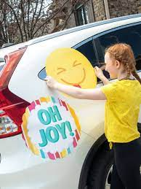
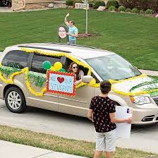
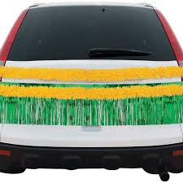
Be sure to wear your 2021 Creeker shirt on Tuesday for our celebration!
If you'd like, you can decorate your car for the day.
CREEKER 4 LIFE

Slide 3
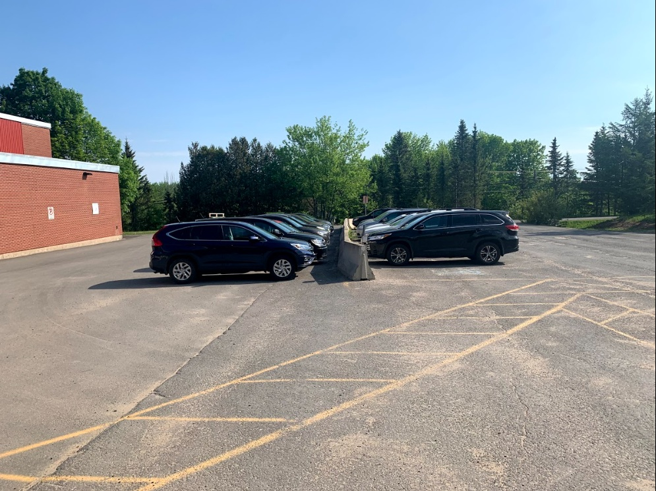
Enter the school grounds like you normally do for drop off, but proceed to the bus lane. Ushers will be there to help!
Flow of traffic
Flow of traffic

Slide 4
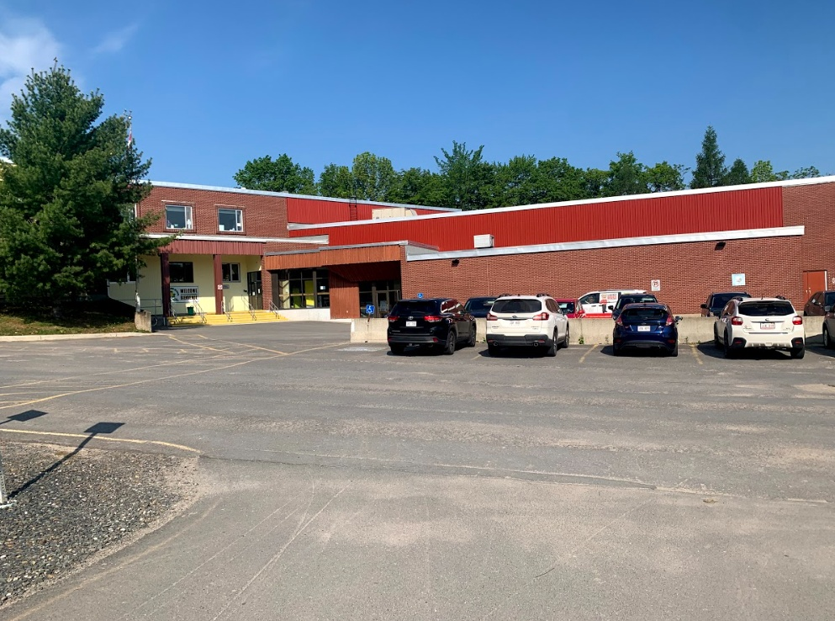
2. Students walk up to get their certificates.
1. Stop your car at the gym doors.
3. Families exit this way.

Slide 5
Your child will walk up the stairs, take thier certificate from the table, and pause while you take a photo (you can leave your car for this) before they walk back down.

Slide 6
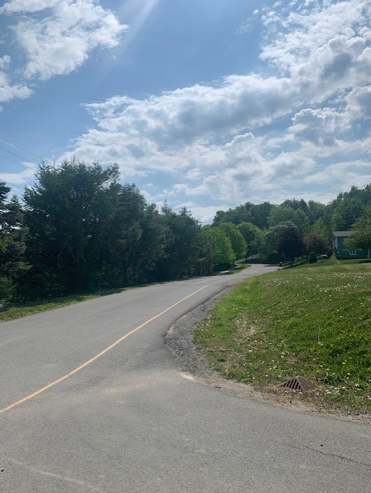
Families exit the usual way (up the hill).

