Slide 1

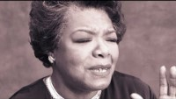
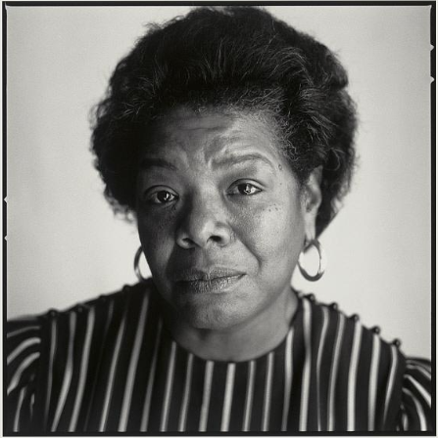
Maya Angelou
“I've learned that people will forget what you said, people will forget what you did, but people will never forget how you made them feel.”
Maya Angelou (April 4, 1928-May 28, 2014) was an American poet, memoirist, and civil rights activist. She published seven autobiographies, three books of essays, several books of poetry, and is credited with a list of plays, movies, and television shows spanning over 50 years. She received dozens of awards and more than 50 honorary degrees. She was awarded the Presidential Medal of Freedom by President Barack Obama in 2011, three years before her death.
Write: Maya Angelou was known for writing about dramatic and meaningful experiences in her life. Think of a memorable time from your childhood and write about this memory in your notebook.

Slide 2
