Slide 1

Harvey Elementary School
2020-2021 Operational Plan
Summary

Slide 2
Building Access
Visitors
Pick ups
Parents/
Caregivers
Parents/caregivers must make an appointment to enter the school.
All visitors (with the exception of students) will use the main office doors. All visitors will be required answer the Covid 19 questions posted on the door. You are also required to wear a face mask and sanitize hands upon entering the school.
If picking up your child at 2:00 dismissal, 2:45 dismissal or early, parents must write a note indicating the pickup time and reason for pickup for documentation purposes. When arriving at school parents can call the office (366-2201) or ring the bell at the main office door.

Slide 3

Bussing
K-5 students will sit one per seat, unless with a household member.
Students are asked to wear their face mask while unloading the buses upon arrival at school and again while loading at 2:45 dismissal time.

Slide 4

Arrival
Arrival time is between 8:00-8:25
All students will enter through the main office doors
Late students will enter through the main office doors and the Administrative Assistant will sign them in for the parent/caregiver.
Students will wear a face mask while entering the school and walk directly to their classroom.
Students will also wear a face mask when exiting the building at the end of the day.

Slide 5

Drop off Students
Parents dropping students off in the morning:
If at all possible, please allow the buses to drop the students off first to ensure they are on time for their second bus run.
Students are to be dropped off the main office door.
Students are to wear a face mask while entering the building and walk directly to their classroom.
Remember NEVER pass a school bus with lights flashing.

Slide 6




Common Area Procedures
Traffic flow through the hall ways will be controlled and limited. Floor markings help to ensure flow of traffic.
Students will wear a face mask while traveling in the hallways from one room to another.
Only one student in the washrooms at one time unless they are with others from the same classroom (bubble). Floor markings help to ensure physical distancing while waiting for the washrooms.
Each classroom has been provided with a water cooler.

Slide 7


Cleaning Procedures
Washrooms are checked and disinfected multiple times throughout the day.
Desk areas are cleaned daily.
Door frames and handles are cleaned multiple times throughout the day.
Hand-sanitizing stations are at school entrances and in all classrooms.

Slide 8

Playground
Each classroom bubble will have a rotational schedule for recess areas.
Totes of outside equipment are kept separate and sterilized daily.
Face masks are not required on the playground.

Slide 9
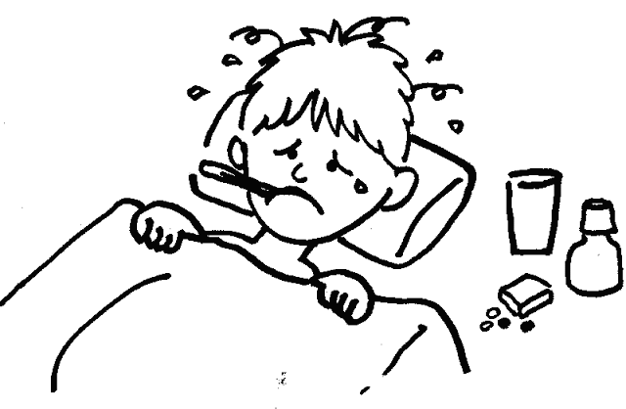
Daily Parental Responsibilities
Parents/caregivers will be required to ensure that if their child is not feeling well that their child remains home.

Slide 10

Daily Parental
Responsibilities
As per provincial protocol, parents/caregivers will need to have their child tested for COVID 19 when presenting with sufficient symptoms to require testing. Parents/caregivers will be asked to contact 811 if they are unsure if testing is required.

Slide 11

Visitors
Members of the public who have an appointment to enter the building will be required to wear a face mask and answer the COVID 19 questions printed on the door prior to entering.

Slide 12

If My Child Becomes Sick at School
If students or staff members become ill, they are to report this immediately. Students will immediately move to isolation.
Students who begin to feel ill will be required to wear a face mask immediately following the onset of symptoms.
Parents/caregivers will be notified to arrange pick up.
Students will be isolated until pick up by parents/caregiver.

Slide 13

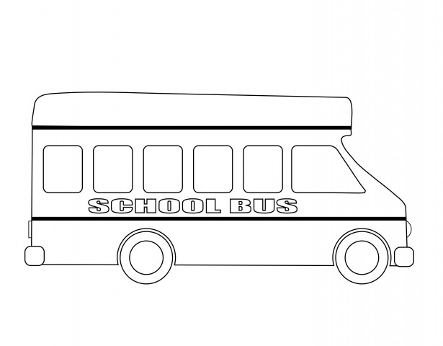
Departure
Parents/caregivers of K-2 students are able to pick your child up at 2:00 recess. You must send a note indicating the time that you will be picking your child up (2:00) and be there promptly for that time. You must park below the pylons at the end of the school driveway and wait for a teacher to dismiss your child.
Bus dismissal is at 2:45.
Parents/caregivers of K-5 students wishing to pick up your child at 2:45 dismissal must also send a note indicating the time (2:45). You must wait in line behind the buses to allow for students to be loaded first. Upon arrival at the front doors, please wait in your vehicle and your child will be sent out to meet you.
Walkers will be dismissed when the traffic is clear/safe.
Students going to the after-school program at Best Beginnings will meet program facilitators at the mobile doors after the buses have been loaded.

