Slide 1

Entering Grade 10​
Parent Information Session
2023-24

Slide 2

Required Courses and Credits
In grade 10, students will begin earning credit hours toward graduation requirements.
Each course passed counts as 4 credit hours.
In grade 10, 11 and 12 students can earn up to 120 credit hours (10 courses/year = 40 credit hours).
Students must earn a min of 100 credit hours to graduate.
Most of their grade 10 courses are required but there is some choice.

Slide 3
Students entering grade 10 must take the following courses:
English Language Arts 10 Foundational 10
**English Language Arts 10 Extended 10 Geometry, Measurement & Finance (GMF) 10 (ENG or FI) Civics 10 (ENG or FI) **Science 10 (ENG or FI) Post Intensive French 10 OR FI Language Arts 10 OR Wolastoqey 10 Personal Development & Career Planning 10 OR Career Pathway Design 10 **These courses are strongly recommended for all. See school counsellor for exceptions **

Slide 4
You Must Choose Three of the following courses:
Biology 111/112 OR FI Biology 112
Computer Aided Manufacturing 110
Creative Arts 110
Dramatic Arts 110
Entrepreneurship 110
Fashion Technology & Design 110
FI Tech de Com 110
FILA 110 (grade 3 or 6 entry)
Financial & Workplace Math 110
Hockey Class/wellness 110 (application available in guidance or from Mr. Collins)
Housing & Interior Design 120
Hospitality & Tourism 110
Human Physiology 110
Indigenous Wabanaki Art 110
Intro to Applied Tech 110
Intro to Debate 110
Introduction to Wolastoqey 110
Media Studies 120
Music 10* Only one of the following:
  Choral, Instrumental, Keyboard or Guitar
Numbers, Relations & Functions Math 10 (ENG or FI)
Physical Education 10
Post Intensive French 110
Psychology 110
Sociology 120
Visual Arts 10
Visual Arts 110
Wellness 110
Writing 110
Yoga 110

Slide 6
Choosing Electives
Choose electives carefully
Consider your interests and the courses you may wish to take in Grades 11 & 12.
Consider completing core cluster options
Courses chosen by students determine courses offered next year.
If you choose a course, you will be expected to remain in the course.

Slide 7
Core clusters:​
Language & Literacy - 24 required credit hours
Includes English, Second languages and EAL
Humanities (Social Studies)​ - 8 required credit hours
​
Mathematics (Mathematics)​ - 12 required credit hours
Science (Science)​ - 8 required credit hours
Personalized Well Being – 20 required credit hours
Includes Fine Arts, Phys Ed, Business/Family Studies & Skilled Trades
Total = 72 credit hours​

Slide 8
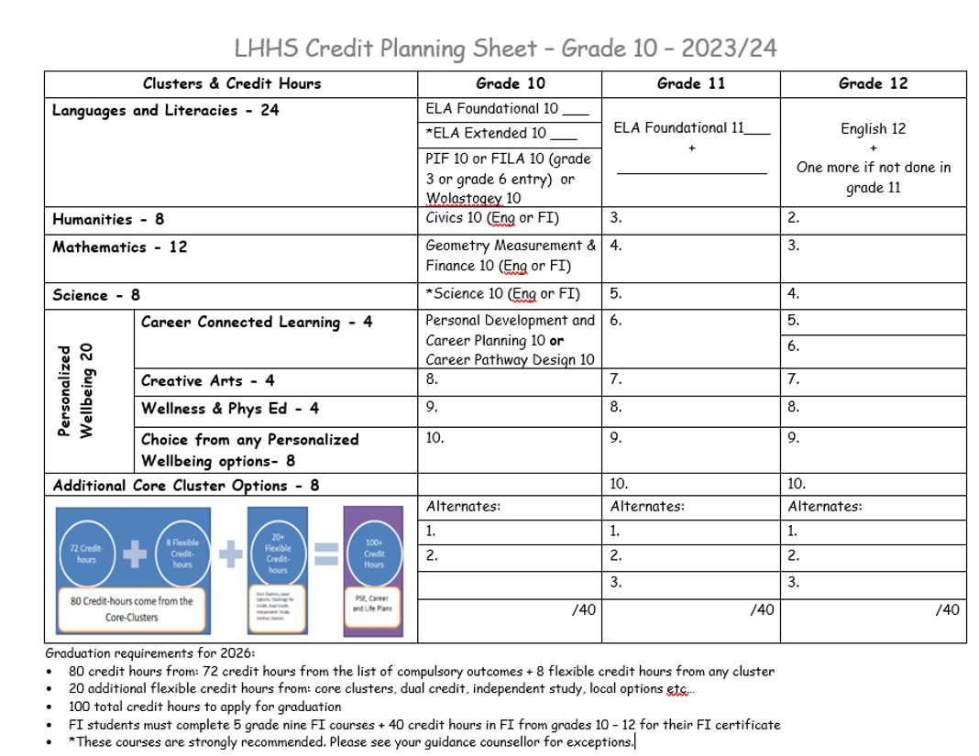

Slide 9
Enter Two Alternate Courses
Carefully consider and choose 2 additional courses that you would take if any of your chosen courses cannot be scheduled.
You must choose 2 Alternate courses
-You CANNOT select Biology 111, Fashion Tech & Design 110, Numbers, Relations & Functions 10, Intro to applied tech OR Yoga 110 as alternate courses.

Slide 10
Special Program
Skills for Success Pathway (Formerly ESAP)
The Skills for Success Program (Formerly ESAP) is an opportunity for students to earn a high school diploma that prepares them for a post-secondary education, apprenticeship, or the world of work. The program consists of personalized learning opportunities that allow students to explore their skills, talents, abilities and interests while intentionally attaining the 9 federally identified Skills for Success (i.e., reading, writing, numeracy, digital, communication, collaboration, creativity, innovation, problem solving, motor, and adaptability skills.) Proficiency in these skills is demonstrated and evaluated through problem and project-based learning in the classroom, community and workplace. The SFS program prepares students for the current skills-based economy as well as future work, learning and life. Students must select this pathway in grade 10.
**Any students who are interested in the Skills for Success” program in grade 10 should sign up at guidance for more information. You cannot select ESAP on your course selections. **

Slide 11
Course Selection Process
Talk
We encourage students to talk to their parents/teachers to help guide their decisions
Make
Make sure they select choices carefully. They will not have the opportunity to change their mind in the fall, unless it affects post secondary plans
Pass in
Pass in their completed Course selection form to their homeroom teacher by March 31st
Be
Be in their Homeroom on April 3rd to 6th to enter their choices in the computer – if they are late, they may not get the courses you want

