Slide 1
The Holocaust
Hitler’s Reign of Terror

Slide 2
Mein Kampf
In 1925, Hitler who would become the leader of the Nazi party wrote a book called Mein Kampf which translates to “My Struggle”.
In Mein Kampf, Hitler states: "...it [Nazi philosophy] by no means believes in an equality of races, but along with their difference it recognizes their higher or lesser value and feels itself obligated to promote the victory of the better and stronger, and demand the subordination of the inferior and weaker in accordance with the eternal will that dominates this universe."

Slide 3
Genocide
The term "genocide" did not exist before 1944.
It is a very specific term, referring to violent crimes committed against groups with the intent to destroy the existence of the group.

Slide 4
What was the Holocaust?
A program of deliberate extermination planned and executed in Europe, led by Adolf Hitler and the Nazi party.
The term used to describe the killing of approximately six million European Jews during World War II.

Slide 5
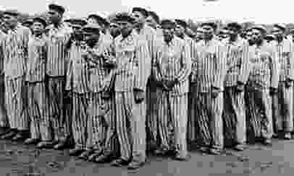
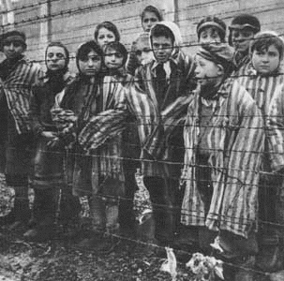
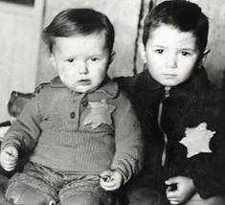
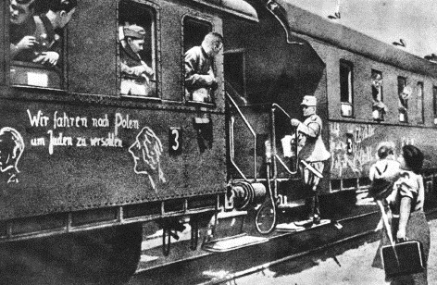
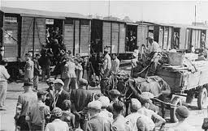

Slide 6
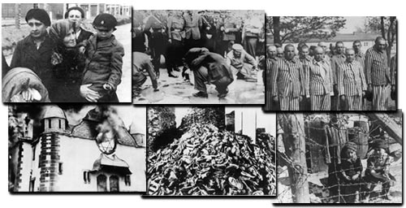

Slide 7
The Victims
Jews:
6 Million murdered
Over 800 000 who died from “Ghettoization”
1 400 000 were killed in ‘open air shootings’
2 900 000 perished in concentration camps.

Slide 8
Soviet POW’s 2-3 million were killed
Gypsies (Roma): 220,000 – 500,000 killed
Disabled and mentally ills: 75,000 – 250,000 killed
Gay men, Polish, Politicians and Jehovah Witnesses
11 Million people were killed in total.

Slide 9
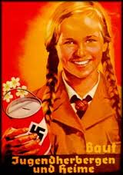
From their first days in power, the Nazis had begun passing discriminatory laws and encouraging anti-Jewish riots.
Hitler called his plans Final Solution – to rid the world of ‘impure’ people.
Those deemed racially inferior or non-Aryan were targets.

Slide 10
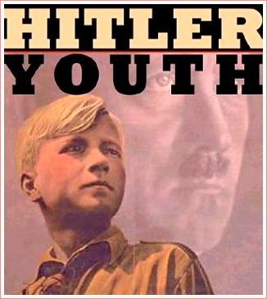
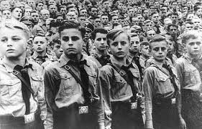
Forced Participation
Women’s Organizations
Hitler’s Jungen (Hitler’s Youth)
Education
Character vs. Intellectual building
Propaganda
Joseph Goebbels (propaganda minister)

Slide 11
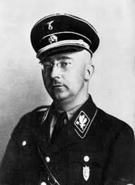
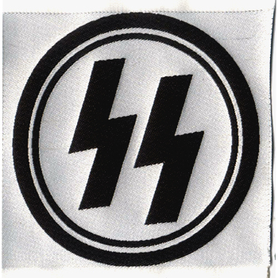
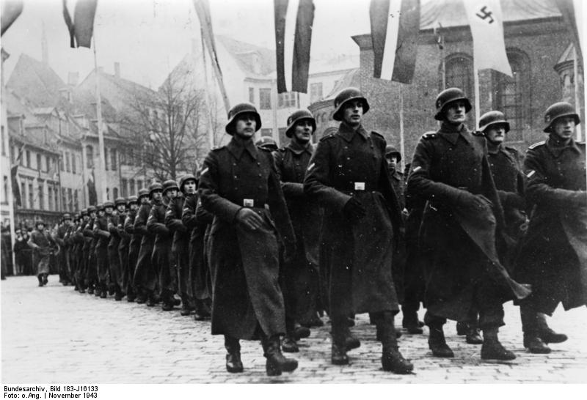
In Control:
SS – Personal Police Force to Hitler
Heinrich Himmler – Leader of the SS

Slide 12
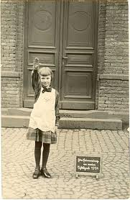
One little girl wrote, “ People are so bothered by the way we’re treating the Jews. They can’t understand it, because they are God’s creatures. But cockroaches are also God’s creatures, and we destroy them.”

Slide 13
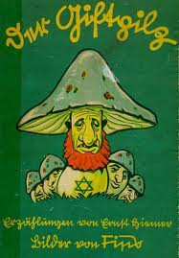
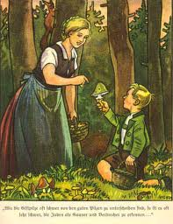
The Poisonous Mushroom
This story is from a Nazi children’s book designed to teach hatred of Jews. It was written by Julius Streicher, who specialized in anti-Semitic proganda.

Slide 14
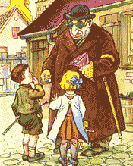
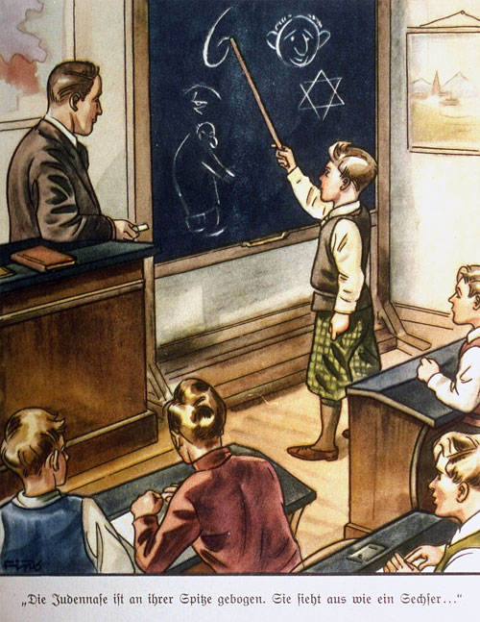
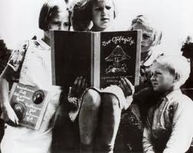

Slide 15
Treatment of Jews
1933 Enabling Act: ‘ Law for Removing the Distress of the People and the Reich’
Boycotting of Jewish Goods/Stores
Law passed against Kosher Butchering
Jewish children began experiencing restrictions in schools
1935 Nuremberg Laws
The Law for the Protection of German Blood and German Honor
The Reich Citizenship Law
Law for the protection of Hereditary Health: The attempt to improve the German Aryan breed.

Slide 16
Nuremberg Laws
Marriage between Jews and citizens of Germans or kindred blood are forbidden. Marriages concluded in defiance of this law are void, even if, for the purpose of evading this law, they were concluded abroad.
Jews could not vote or hold public office.
Jews will not be permitted to employ female citizens of German or kindred blood as domestic workers under the age of 45.
Jews are forbidden to display the Reich and national flag or the national colours.
A person who acts contrary to any of the provisions will be punished with imprisonment up to a year and with a fine, or with one of theses penalties.

Slide 17
Treatment of Jews
1938: Krysttanacht
(Night of the Broken Glass)
The starting point of The Final Solution
‘Organized’ riots against Jewish homes and businesses
20,000 Jews sent to concentration camps, 267 synagogues and 7,500 Jewish Stores destroyed
Hundreds murdered, 1000s sent to concentration camps.

Slide 18
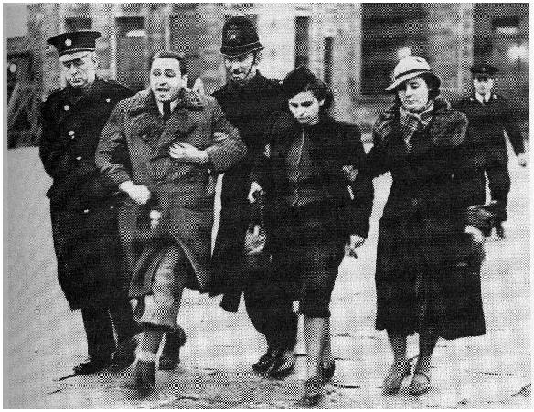
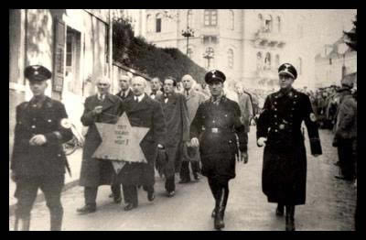
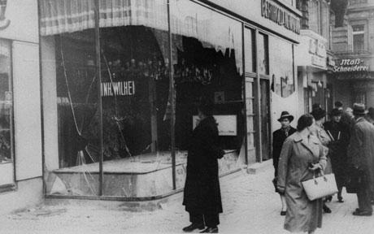

Slide 19
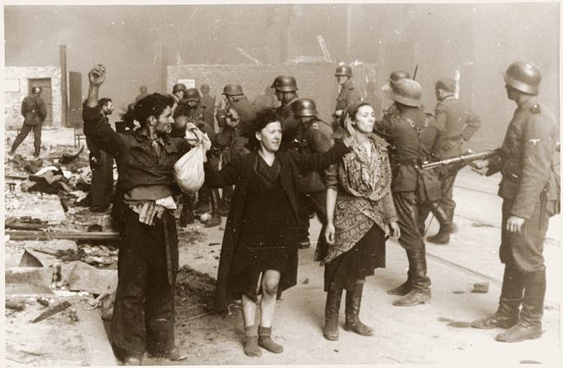
Warsaw Ghetto
1940 est. in Warsaw, Poland
380,000 people: 30% of city’s population lived in the ghetto
9.2 people per room
Warsaw Ghetto Uprising
First Jewish armed resistance

Slide 20
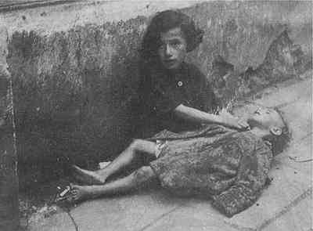
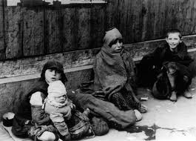
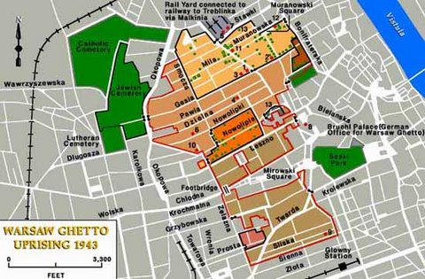
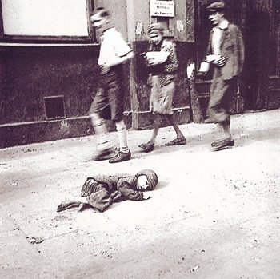
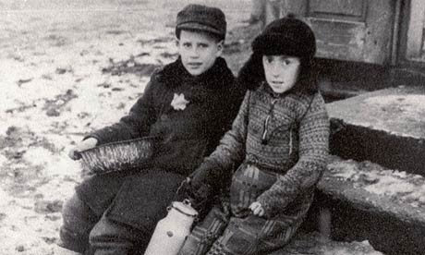

Slide 21
Wannsee Conference, 1942
Shooting was too inefficient as the bullets were needed for the war effort
The young and fit would go through a process called “destruction through work’
Women, Children, the old & the sick were to be sent for ‘special treatment’
How was the Final Solution going to be organized?
Jews were to be rounded up and put into transit camps called Ghettoes
On arrival the Jews would go through a process called a ‘selection’
Conditions in the Ghettos were designed to be so bad that many die whilst the rest would be willing to leave theses areas in the hope of better conditions.
The Jews living in these Ghettos were to be used as a cheap source of labour
The remaining Jews were to be shipped to ‘resettlement areas’ in the east.

Slide 22
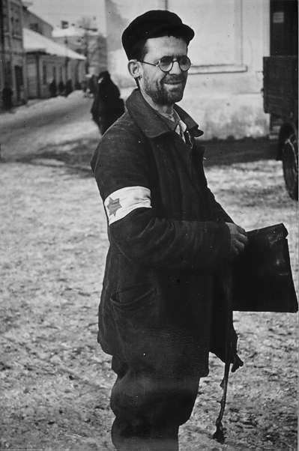
How did the Nazis decide who was Jewish?
At the Wannsee Conference it was decided that if one of a persons’ parents were Jewish , then they were Jewish.
However, if only one of their grandparents had been Jewish then they could be classified as being German.
In 1940, all Jews had to have their passports stamped with the letter ‘J’ and had to wear a yellow Star of David on their jacket or coat.

Slide 23
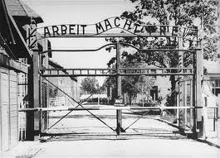
Concentration/Death Camps “Work means Freedom”

Slide 24
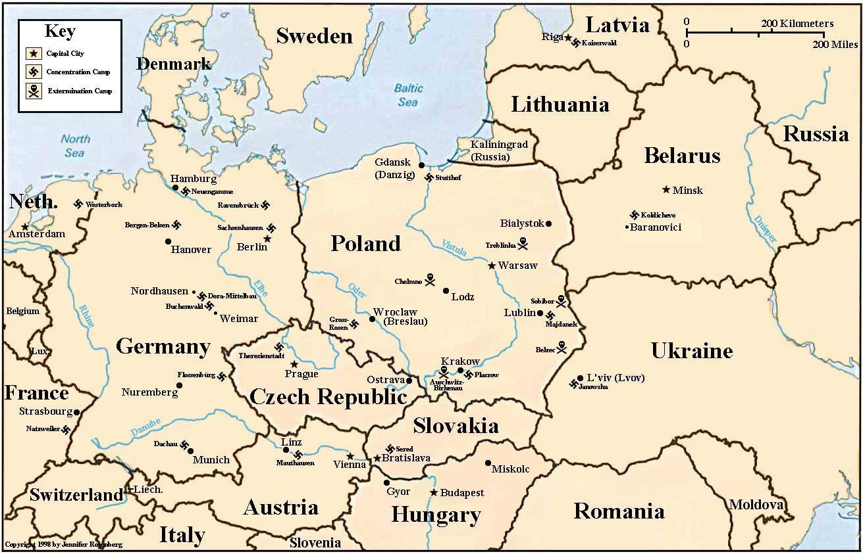

Slide 25
Types of Camps
Between 1933 and 1945, Nazi Germany established about 20,000 camps to imprison its many millions of victims.
Forced Labour camps
Brutal conditions
Sometimes pointless work
Humiliation
‘annihilation through work’
Chance of survival

Slide 26
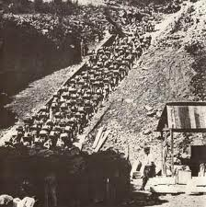
Mauthausen- prisoners were forced to run up 186 steps out of a stone quarry while carrying heavy boulders.

Slide 27
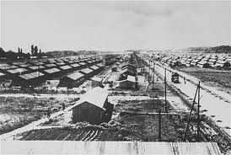
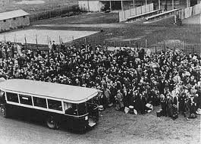
Transit camps (temporary way stations)
Receives Jewish refugees, then sends them to assigned death and labour camps.
False sense of comfort
The SS had very little to do with the transfers; the selections were made by a Jewish security service. The Nazi commandant gave the orders; the Jewish ‘governing’ body only carried them out, in fear of themselves being deported. Jews selecting other Jews for certain death.
Kapos/Sonderkommandos – Jewish prisoner in charge of the other prisoners.

Slide 28
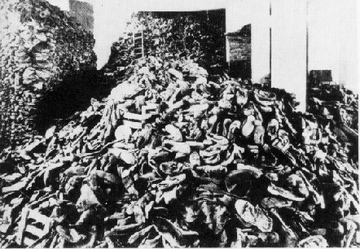
Extermination camps
Built primarily or exclusively for mass murder.
Cremation or mass graves
Usually 24 hour survival rate
2.5 million killed in all

Slide 29
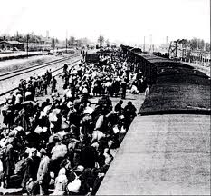
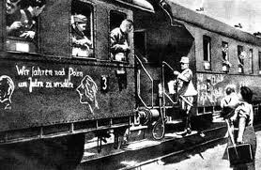
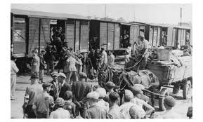
Transportation

Slide 30
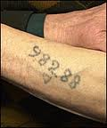
Nazi Concentration camp badges
System of identification
Badges in the shape of triangles
Color coded
Tattoos - Auschwitz

Slide 31
Daily Life
Food:
A small potato, soup broth, and a small piece of bread (not all at once)
Enough to keep a person alive
Lack of Sanitation
52 men in rooms, 12 lavatory bowls
Every moment is regulated
How you salute, making of the bed, time to sleep/eat/work, ect
Harsh working conditions
12 hour work days
Punishments
Stand still for hours

Slide 32
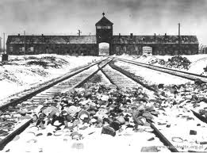
Auschwitz

Slide 33
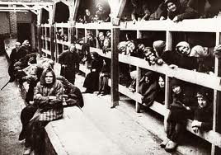
Largest concentration and extermination camp
Consisted of three camps
Auschwitz 1, Auschwitz II (Birkenau), Auschwitz III (Monowitz)
Southern Poland (central Europe)
1-4 millions died here
90 % were Jews

Slide 34
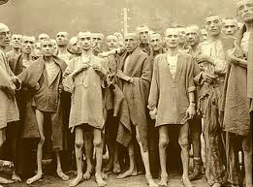
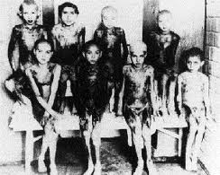
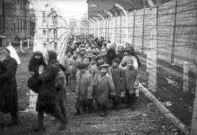
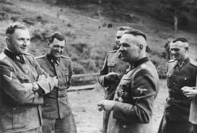

Slide 35
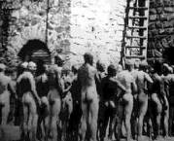
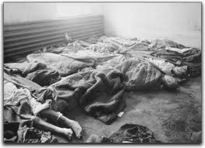
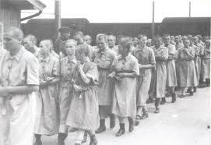
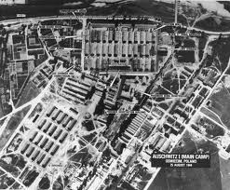

Slide 36
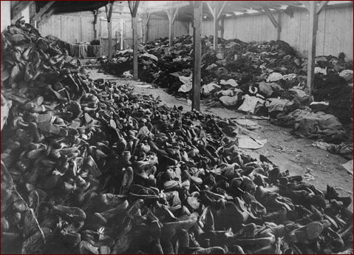
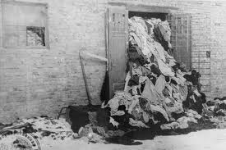
“Canada”
Jew essential belongings (clothes, jewelry, hair) were used to fund the German war effort.
Large warehouses nicknamed Canada…
Place of Abundance

Slide 38
Methods of Death
Hangings (arms behind backs)
Hanging by hooks
Prison (starvation/suffocation)
Firing squad
Overworked
Starvation
Medical Experiments
Fire Pits
Gas Chamber
“They took those legs that so loved movement and dancing, and removed a large section of bone from them. Then, for good measure, they injected them with bacteria. She lay there with her legs in plaster, still trying to smile.”

Slide 39
Gas Chambers
Gas Trucks
Portable gas chambers
Exhaust fumes
50 people
Gas Chambers
Deception
showers/Delousing
Carbon Monoxide
Zyklon B
Insecticide
3-15 min

Slide 40
Crematoriums
Disposal of bodies
24/7 at end of war
Death Pit
Sonderkommando

Slide 42
Dr. Josef Mengele “The Angel of Death”
Germans SS officer and physician at Auschwitz.
Mengele used Auschwitz as an opportunity to continue his research on heredity, using inmates for human experimentation.

Slide 43
Experiments were both physical and psychological.
Surgeries performed without anesthesia
Transfusions of blood from one twin to another
Isolation endurance
Injections with lethal germs
Sex change operations
Removal of organs and limbs
Incestuous impregnations
Twin Experiments

Slide 45
Liberation
Forced marches
When the Germans
knew the allies were
coming they started
evacuating the camps.
1944-1945
One in four died

Slide 47
Nuremberg Trails
Held for the purpose of bringing Nazi war criminals to justice, the Nuremberg trials were a series of 13 trials carried out in Nuremberg, Germany, between 1945 and 1949.
The defendants, who included Nazi Party officials and high-ranking military officers along with German industrialists, lawyers and doctors, were indicted on such charges as crimes against peace and crimes against humanity
. Nazi leader Adolf Hitler (1889-1945) committed suicide and was never brought to trial.
Although the legal justifications for the trials and their procedural innovations were controversial at the time, the
Nuremberg trials are now regarded as a milestone toward the establishment of a permanent international court, and an important precedent for dealing with later instances of genocide and other crimes against humanity.

Slide 48
First They Came for the Jews" First they came for the Jews and I did not speak out because I was not a Jew. Then they came for the Communists and I did not speak out because I was not a Communist. Then they came for the trade unionists and I did not speak out because I was not a trade unionist. Then they came for me and there was no one left to speak out for me. Pastor Martin Niemöller

