Slide 1

The Reproductive System
Part 1: Puberty

Slide 2
Question box
Sometimes when we learn about a subject we have questions that we may not always feel comfortable asking in front of the class.
There will be a question box available and you can write down any serious questions you are wondering about. It will be answered next class.

Slide 3
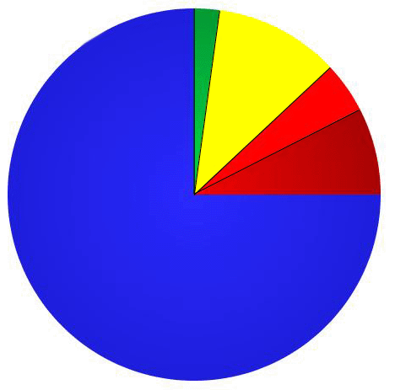
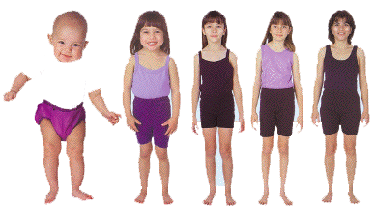
Infancy
Childhood
0-2 yrs
2-(12) yrs
Puberty
12-(15) yrs
Adolescence
Human Life Cycle
12-21 yrs
Adulthood
21-? yrs

Slide 4

Adolescence
Adolescence is a time of incredible change.
Adolescence is the stage of human development when children become adults, both physically AND mentally.
The body undergoes major physical changes.
And the brain undergoes major mental changes.

Slide 5
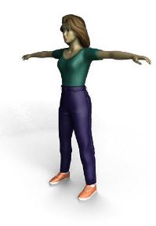
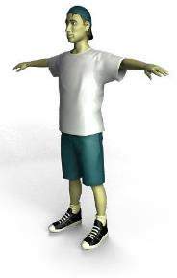
Puberty
Adolescence begins with puberty.
Puberty is a time of development where the body becomes physically able to reproduce.
Puberty usually begins around the age of 9-13 in girls.
It begins around 10-15 in boys.
And usually lasts 3-7 years in both.

Slide 6
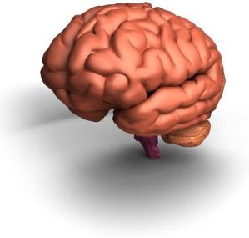
Puberty
Puberty actually begins in the brain!
The tiny pituitary gland in the brain begins to release chemicals called hormones.
The pituitary hormones are called gonadotrophins and they stimulate the sex organs to mature.
Then, the maturing sex organs start to produce their own hormones.

Slide 7
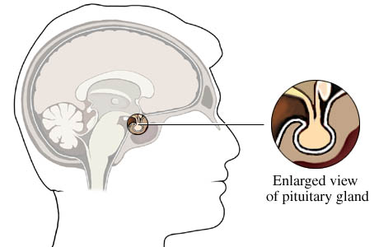
Pituitary Gland

Slide 8
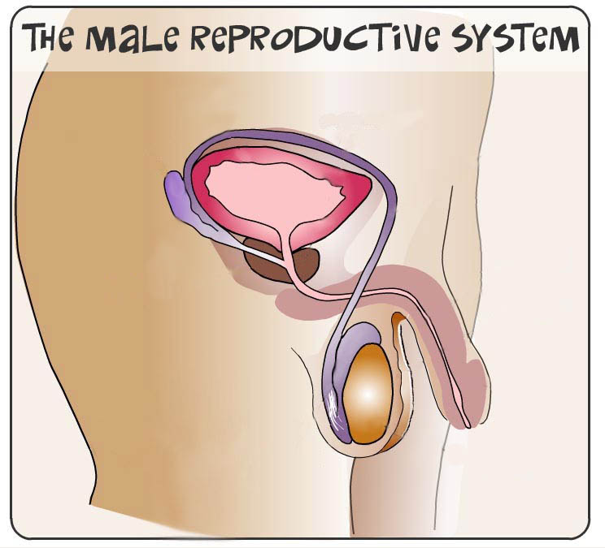

Slide 9
penis
testicle
scrotum

Slide 10
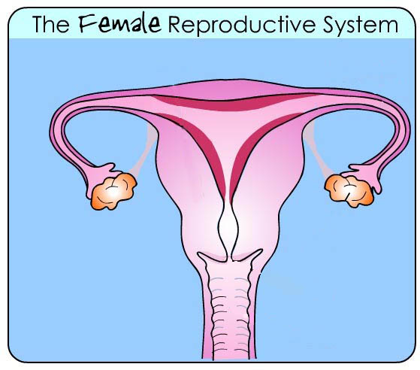

Slide 11
Simplified!
uterus
ovary
vagina

Slide 12
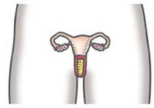
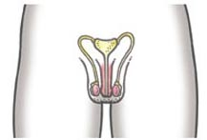
Primary Changes in Sex Organs
Girls
Boys
Ovaries start to produce egg cells
Testicles start to produce sperm cells
And estrogen
And testosterone

Slide 13
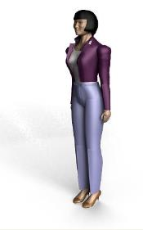
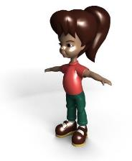
Secondary Changes
Testosterone and estrogen then cause the development of secondary sex characteristics.
Secondary sex characteristics are physical changes NOT directly needed to reproduce.
These changes make the body look more adult like.

Slide 14

Changes in Boys
Pituitary releases hormones
Shoulders widen
Voice deepens
Hair grows under arms, on chest, face
Testicles and sperm cells develop
Muscles grow and develop
Penis and testicles grow
Pubic hair grows

Slide 15

Changes In Girls
Pituitary releases hormones
Hair grows under arms and on legs
Ovaries & egg cells develop
Breasts grow and develop
Vagina grows and develops
Waist narrows & hips widen
Pubic hair grows

Slide 16


Changes in Both Sexes
Growth spurt
Perspire more
Body odor (B.O)
Oily skin - acne
Sexual emotions
Social changes…

Slide 17
Any Questions?

Slide 18
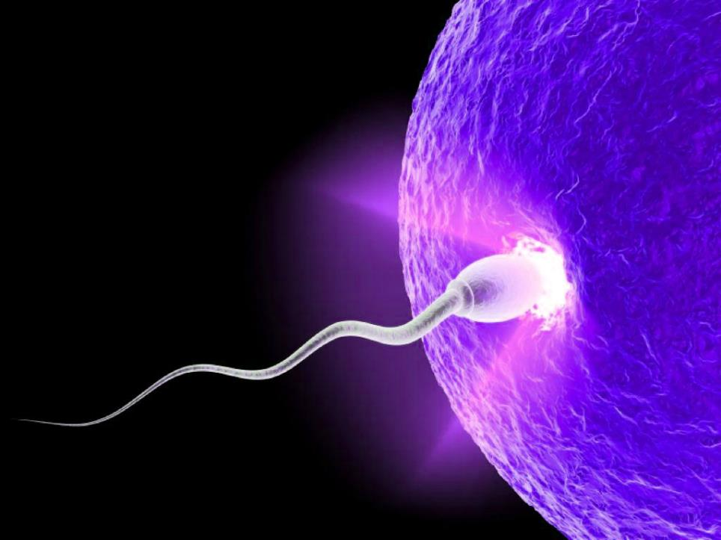
The Reproductive System
Part 2: Reproductive Organs

Slide 19
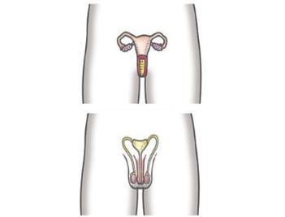
Introduction
The reproductive system allows adult humans to produce offspring.
The main job of the reproductive system is to create and to nourish sex cells.
An egg cell is the female sex cell.
A sperm cell is the male sex cell.

Slide 20
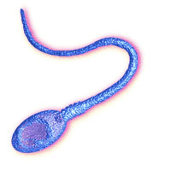
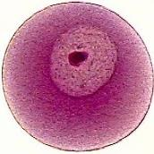

The Sex Cells
Sperm cells and egg cells are the two sex cells.
Egg (ovum)
Sperm
Can’t move on own
A swimming cell
Holds DNA
Holds DNA

Slide 21
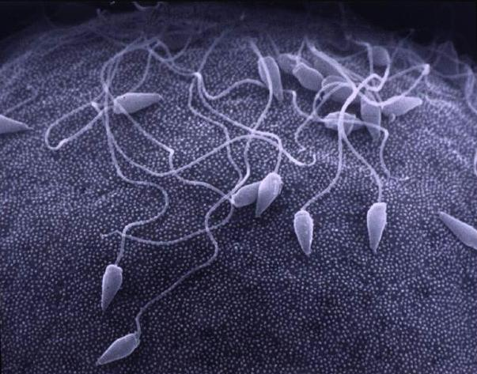
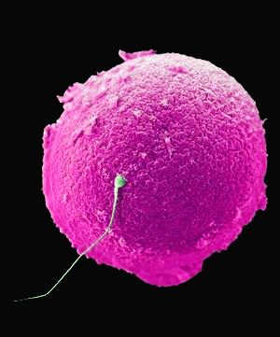
Sperm and Egg

Slide 22
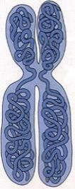


Inside the Sex Cells
Both sperm and egg cells contain genetic material.
The genetic material is in the form of DNA, which is packaged in chromosomes.
DNA is the molecule responsible for passing on inherited traits such as eye and hair color.

Slide 23
Male Reproductive System
The primary reproductive organs are the testes.
The job of the testes is to produce sperm and the male sex hormone testosterone.
Sperm can’t form properly at temperatures found inside the body.
The testes are found outside the body in a sac called the scrotum.

Slide 24
bladder
sperm duct
urethra
glands
penis
epididymis
testicle
scrotum

Slide 25
Female Reproductive System
The primary reproductive organs are the ovaries.
The job of the ovaries is to produce egg cells (ova) and the female sex hormone estrogen.
Females are born with all the ova they will ever need… 400,000!
But, only 500 or so ova fully mature and leave the ovary.

Slide 26
uterus
fallopian tube
cervix
ovary
vagina

Slide 27
Any Questions?

Slide 28
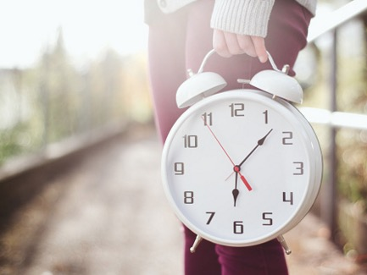
The Reproductive System
Part 3: The Menstrual Cycle

Slide 29
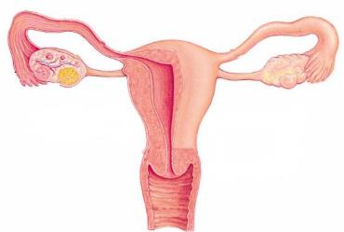
Review
The role of the female reproductive system is to produce ova and nourish offspring until birth.
The ovaries are the primary sexual organ.
Once a female reaches puberty, her ovaries will release 1 egg every 28 days in a pattern called the menstrual cycle.

Slide 30
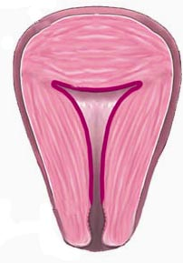
The Menstrual Cycle
Why is the menstrual cycle needed?
The goal of the menstrual cycle is to prepare the uterus in case a fertilized egg arrives.
How does it do this?
By thickening its walls (the endometrium) with new cells and blood vessels.

Slide 31
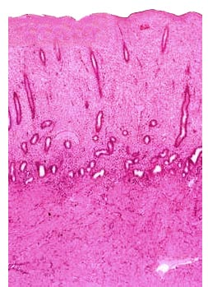
Making the Bed!
The uterus lining must become thick with new cells.
The new cells and blood vessels will nourish the growing embryo.
The “bed” must be made each month to ensure it is healthy and new.

Slide 32
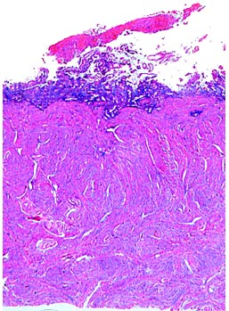
Making the Bed!
The uterus lining must become thick with cells.
But, if a fertilized egg does not arrive, it must be broken down.
The excess cells are released from the body during menstruation

Slide 33
The Menstrual Cycle
The menstrual cycle has several key events.
The maturing of an egg in the ovary.
The release of the egg.
The build up of the uterus lining.
The breakdown of the egg and uterus lining if no fertilization has taken place.

Slide 34
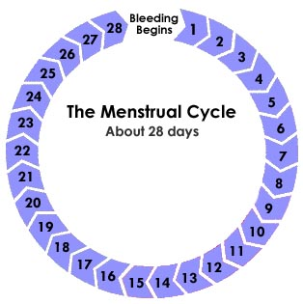
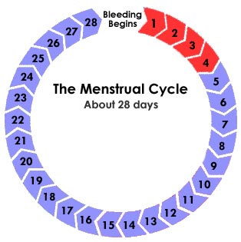
DAYS 1 – 6
Uterus lining breaks down. Blood and other tissues flow from the vagina. This is called menstruation.

Slide 35
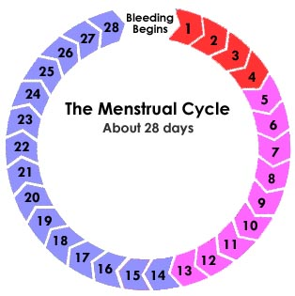
DAYS 1 – 6
Uterus lining breaks down. Blood and other tissues flow from the vagina. This is called menstruation.
DAYS 6 - 13
Uterus lining builds up in preparation for a fertilized ovum.

Slide 36
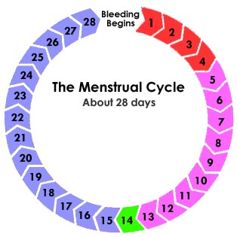
DAYS 1 – 6
Uterus lining breaks down. Blood and other tissues flow from the vagina. This is called menstruation.
DAY 14
Egg released by ovary (ovulation)
DAYS 6 - 13
Uterus lining builds up in preparation for a fertilized ovum.

Slide 37
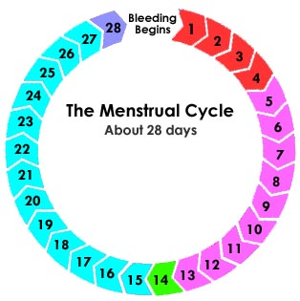
DAYS 15 - 28
Uterus lining remains ready for a fertilized egg.
DAYS 1 – 6
Uterus lining breaks down. Blood and other tissues flow from the vagina. This is called menstruation.
DAY 14
Egg released by ovary (ovulation)
DAYS 6 - 13
Uterus lining builds up in preparation for a fertilized ovum.

Slide 38

DAYS 15 - 28
Uterus lining remains ready for a fertilized egg.
DAYS 1 – 6
Uterus lining breaks down. Blood and other tissues flow from the vagina. This is called menstruation.
DAY 14
Egg released by ovary by the process of ovulation.
DAYS 6 - 13
Uterus lining builds up in preparation for a fertilized ovum.

Slide 39
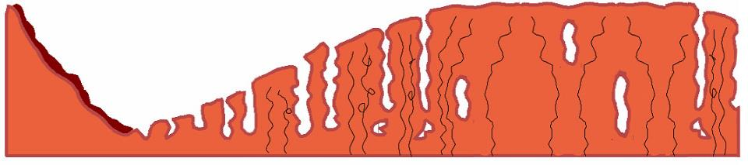
Days 1-6
Day 6-13
Day 14
Day 15-28
Lining breaks down during a “period”
Lining stays prepared for fertilized egg. Near day 28, it breaks down
Lining builds up again to prepare for ovum
Egg leaves the ovary

Slide 40
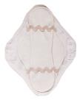


Menstruation
During a woman’s “period” she will release blood and uterus lining cells through her vagina.
The blood can be absorbed in several ways.
Sanitary pads can be worn inside her underwear.
Absorbent tampons can be placed inside her vagina.

Slide 41
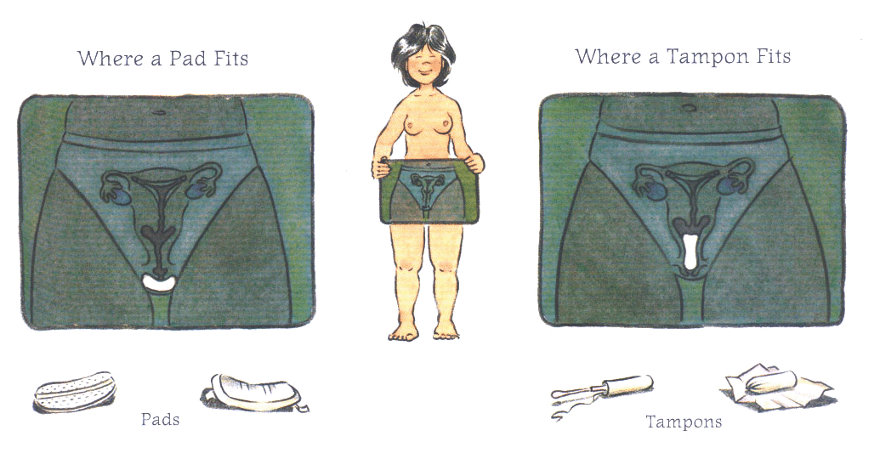
Menstruation
During a woman’s “period” she will release blood and uterus lining cells through her vagina.
The blood can be absorbed in several ways.

Slide 42
Any Questions?

Slide 43
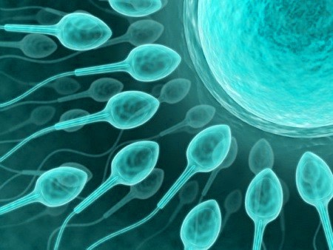
The Reproductive System
Part 4: Fertilization

Slide 44

Introduction
Reproduction involves the joining of sperm and egg.
To do this, humans must engage in sexual intercourse to bring sperm to the egg cell.
Before sexual intercourse, two adults will have decided that they are ready to have a baby and are able to provide for their child throughout its life.

Slide 45
Before Intercourse
When a man is sexually aroused, changes in his genitals prepare him for sexual intercourse.
1. The penis fills with blood, causing it to increase in size and stiffness, forming an erection.
An erection is necessary to allow the penis to insert properly into the female’s vagina.
2. The testicles are pulled towards the man’s body to greater protect them.

Slide 46
Before Intercourse
Changes also occur in the female to prepare her genitals for sexual intercourse.
1. Muscles surrounding the vagina relax.
2. The layers outside the (labia) vagina fill with blood and swell, making the vagina wider.
3. The vagina releases a clear fluid inside to lubricate it in preparation for intercourse.

Slide 47
Sexual Intercourse
During sexual intercourse, the male’s erect penis enters the female’s vagina.
Stimulation during intercourse causes sperm to be released from the epidymis.
The sperm then mix with fluids from the other glands to produce a mixture called semen.
Semen exits the penis during an ejaculation.

Slide 48

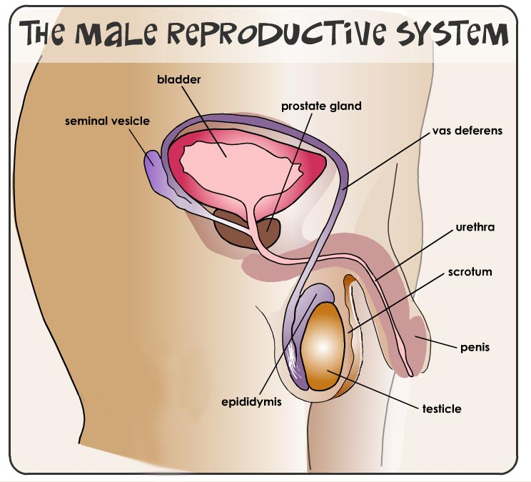


Slide 49
After Intercourse
After being released inside the vagina during ejaculation, sperm swim towards the egg.
The sperm swim up the vagina, through the cervix and uterus to reach the fallopian tubes.
There, they hope to meet an egg to fertilize it.
Only one sperm can penetrate the egg. All other sperm die off.

Slide 50
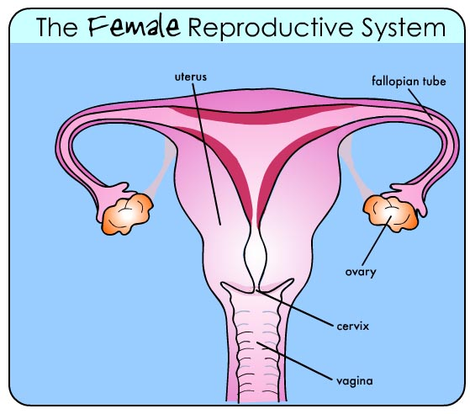

Slide 51
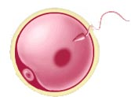

Fertilization
The goal of sexual intercourse is fertilization.
During fertilization, a single sperm cell joins with an ovum.
The nuclei of both cells join together to create one cell.
This new cell is called a zygote.

Slide 52
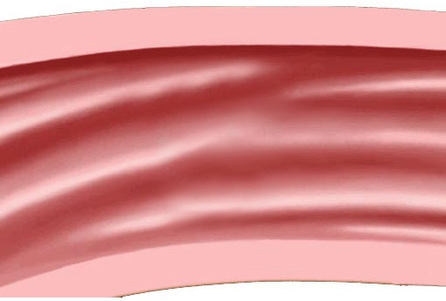
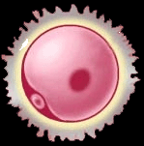
Fertilization
I WON!
zygote

Slide 53
After Fertilization
After fertilization, huge changes to the zygote begin.
The new zygote releases chemicals to block all other sperm from entering.
The zygote begins to travel down the fallopian tube towards the uterus.
On its way, it begins to divide and quickly forms a growing mass of cells.

Slide 54
After Fertilization
To the uterus!

Slide 55
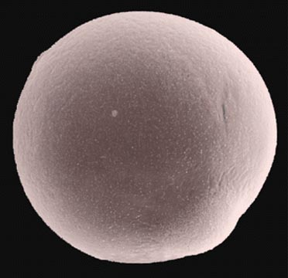
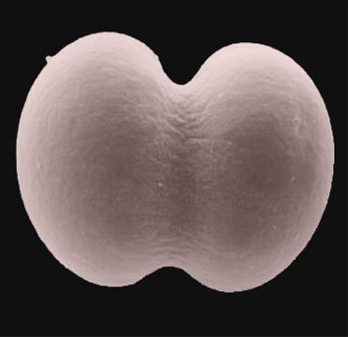
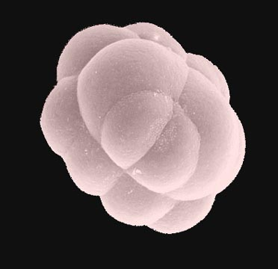
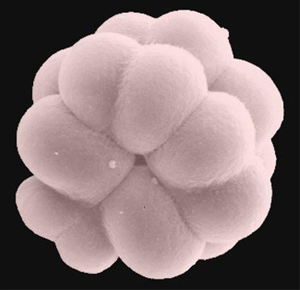
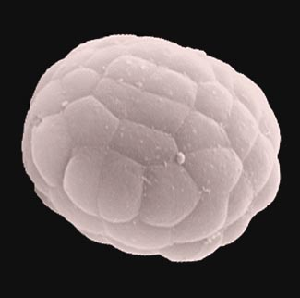
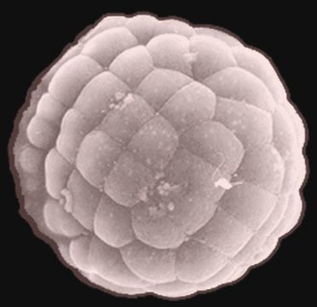
After Fertilization
The Dividing Zygote

Slide 56
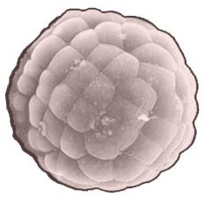
Implantation
The journey to the uterus takes 4-7 days.
By that time, the zygote divides to become a ball of cells that is now called an embryo.
Once the embryo reaches the uterus, it implants itself.
There, it will receive nourishment and grow!

Slide 57
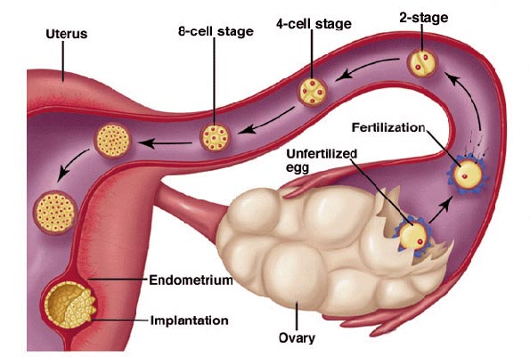
Implantation

Slide 58
Any Questions?

Slide 59
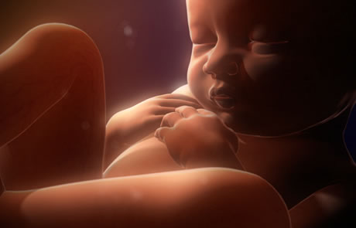
The Reproductive System
Part 5: Development and Birth

Slide 60
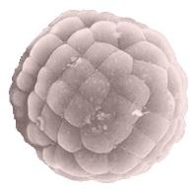
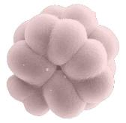
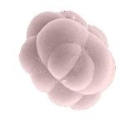


Review
A sperm and egg fuse to form a zygote.
The zygote divides as it journeys to the uterus.
In 4-7 days the ball of cells is called an embryo.
When it reaches the uterus, the embryo implants.

Slide 61
Review

Slide 62

After Implantation
Soon after the embryo implants in the uterus wall, new structures form around it.
The structures are designed to protect and nourish the developing embryo as it grows.
They include:
amniotic sac
placenta
umbilical cord

Slide 63

Fetus in the Uterus
mother’s blood
amniotic sac
placenta
amniotic fluid
umbilical cord
fetus’ blood

Slide 64

placenta
amniotic sac
BOY!
umbilical cord
amniotic fluid

Slide 65

Amniotic Sac
The amniotic sac is a fluid-filled bag.
Amniotic fluid in the sac cushions and protects the developing fetus.
It acts like a giant shock absorber!

Slide 66

Placenta
The placenta links the embryo to its mother.
It brings the fetal blood next to the mother’s blood
But they DO NOT mix!
IN: food, water, O₂
OUT: wastes, CO₂

Slide 67
Placenta
The umbilical cord connects the embryo to the placenta.
It is simply a tube that contains blood vessels
When a baby is born, the cord must be cut off.
The base of the cord forms your belly button!

Slide 68

former umbilical cord

Slide 69
Fetal Development
The ball of cells takes roughly nine months to develop into a baby.
Pregnancy is usually divided up into 3-month sections – called trimesters.
1
2
3
4
5
6
7
8
9

Slide 70
Fetal Development
The ball of cells takes roughly nine months to develop into a baby.
1
2
3
4
5
6
7
8
9
first trimester
second trimester
third trimester
cell division
organs formed
major growth
organs forming
brain growth
birth!

Slide 71

First Trimester
A small collection of cells early on
Heart and nerves form
Respiratory system forming
Not all organs have developed
1 month

Slide 72

First Trimester
Embryo is ½ inch long
Muscles are developing
Fingers, toes and teeth forming
Squinting, swallowing and tongue moving
1 month
2 months

Slide 73

First Trimester
Embryo called a fetus
All major organs have formed
Dreaming
Stretching, kicking and “womb-jumping”
1 month
2 months
3 months

Slide 74

Second Trimester
Fetus 6 inches long
Covered in soft hair called lanugo
Hair, eyelashes and fingerprints
Very active: moves 50 times per hour
1 month
2 months
3 months
4 months

Slide 75

Second Trimester
Fetus now 1 pound
Hears and recognizes mother’s voice
Can open their eyes slightly
1 month
2 months
3 months
4 months
5 months

Slide 76

Second Trimester
Skin covered in waxy layer called vernix
Learning constantly
Smiling, crying, scratching, hiccupping
1 month
2 months
3 months
4 months
5 months
6 months

Slide 77

Third Trimester
Fetus now 2-4 lbs.
All major organs maturing
Fat is being created and deposited
Can survive if born, but will be premature
1 month
2 months
3 months
4 months
5 months
6 months
7 months

Slide 78

Third Trimester
Rapid growth: gains ½ lb. per week
Organs fully mature, except for lungs
Rapid brain growth
Start to turn head downward
1 month
2 months
3 months
4 months
5 months
6 months
7 months
8 months

Slide 79

Third Trimester
Most bones hardened but skull still soft
Shedding hair and waxy vernix
Lungs mature: ready to be born!
1 month
2 months
3 months
4 months
5 months
6 months
7 months
8 months
9 months

Slide 80

Birth
After 9 months, the fetus is ready to be born.
Birth takes place in 3 stages:
labor
delivery
afterbirth

Slide 81
1. Labor
Strong muscle contractions of the uterus make the cervix enlarge
2. Delivery
The fetus pushed out of the uterus through the vagina. First breath with its lungs.
3. Afterbirth
Final contractions push the placenta and other structures out of the uterus and vagina.

Slide 82
The Reproductive System
Special Topic: Twins!

Slide 83

Twins
Twins can be formed in a few different ways.
There are 3 different types of twins:
fraternal
identical
conjoined

Slide 84

Fraternal Twins
Fraternal twins are formed when two different ova are fertilized by two different sperm.
Since the cells involved are totally different, so are the twins!
They can be girl-girl, boy-girl or boy-boy.

Slide 85

Identical Twins
Identical twins form when one ovum is fertilized by one sperm.
The dividing zygote then splits in two and both cells develop into babies.
Since both babies came from the exact same sperm and ovum, they are identical!

Slide 86


Conjoined Twins
Conjoined twins (also called Siamese twins) form like identical twins, but the zygote did not split completely.
The fetuses develop on their own, but they are still attached at some location on their bodies.

Slide 87


The Original “Siamese Twins”
Eng and Chang Bunker

Slide 88
Any Questions?

