Slide 1
Figurative Language
Poetry

Slide 2
Creating pictures in the minds of our readers and listeners

Slide 3
Simile
Is comparing two unlike things using words such as “like” or “as”
Example:
They fought like cats and dogs.

Slide 4
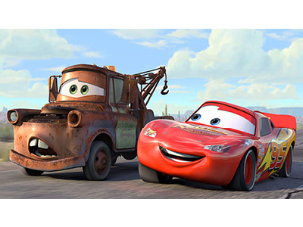
Personification
A figure of speech in which an object or animal is given human feelings, thoughts, or attitudes.
Example:
The delicious bread danced in my stomach

Slide 5
Metaphor
Comparing two unlike things NOT using words such as "like" or "as"
Example: How could she marry that snake?

Slide 6
Onomatopoeia
imitates a sound
Examples: Bang!, hiss, drip, whoosh

Slide 7
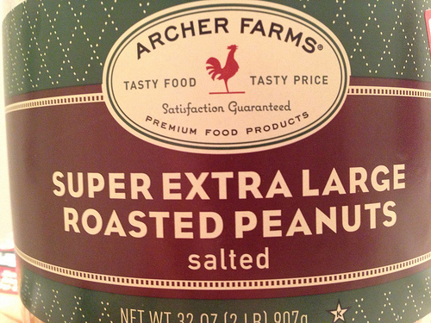
Hyperbole
exaggeration
Example: I've said that a million times

Slide 8
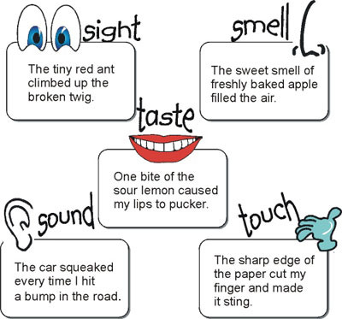
Imagery
Descriptive language that create a picture in your mind

Slide 9
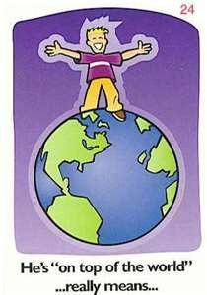
Idiom
An expression that says one thing but means something else
Example: Seeing the world through rose colored glasses = not seeing clearly or ignoring the bad in life.
Don’t Chicken Out- Don’t be Scared, just do it.

Slide 10
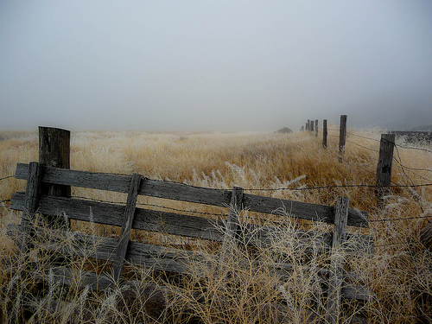
Alliteration
Repeated beginning consonant sounds.
Example: The fog filtered over the field finally hiding the fence.

Slide 11
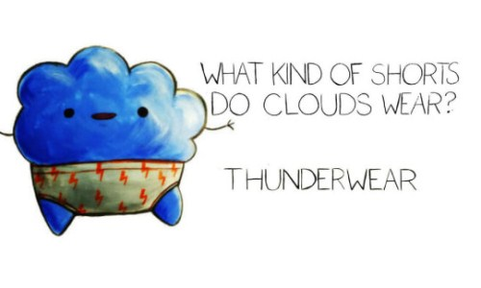
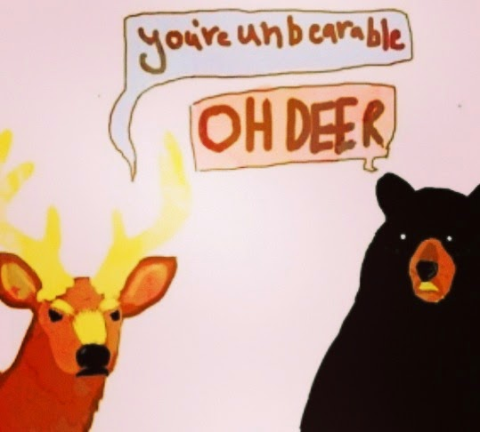
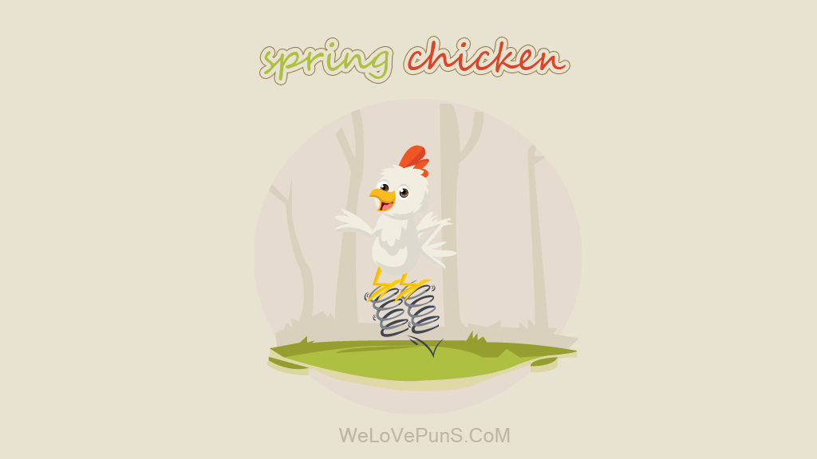
Pun
Are a humorous (funny) play on words

Slide 12
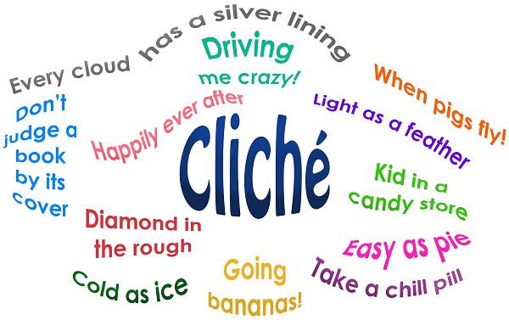
Cliché
A phrase or expression that is overused

Slide 13
Word Play

Slide 14
Figurative Language in Songs
https://www.youtube.com/watch?v=420F7adf-0E

Slide 15
Figurative Language in Movies
Youtube: Disney Movies Figurative Language

