Slide 1
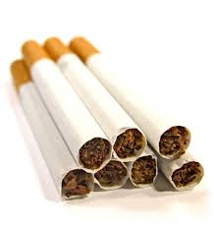

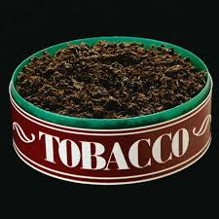
Alcohol & Tobacco
Presentation

Slide 2
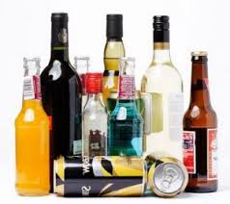
Alcohol
A drug made from fermented grains, fruits or vegetables that slows down the Central Nervous System and harms body organs.
Alcohol depresses the functions of the mind and body.

Slide 3
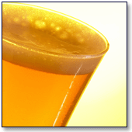

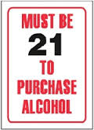
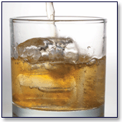

Three types of Alcohol:
Beer
Wine
Distilled Spirits (Hard Liquor
Legal age to purchase Alcohol is 19 years old

Slide 4
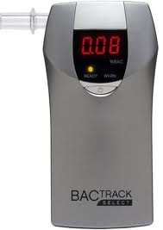
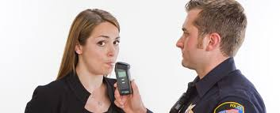
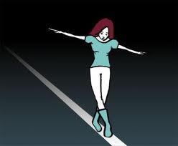
Blood Alcohol Content (BAC)
Percentage of alcohol in a person’s blood when he or she drinks
Amount of alcohol consumed and length of time drinking affect BAC
Person’s weight, height, gender and tolerance also influence BAC

Slide 5
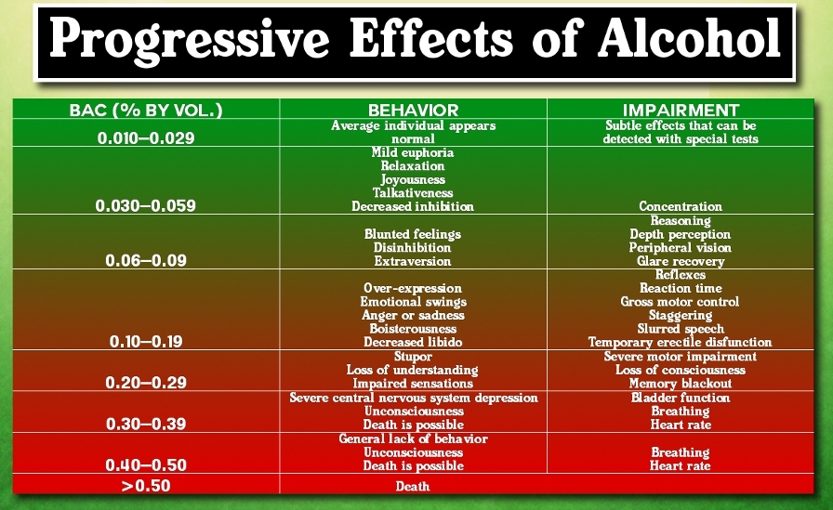
Blood Alcohol Content Chart

Slide 6
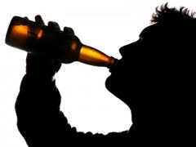
Physical Changes of Alcohol
Known as depressant so it slows down the function of the CNS
Messages to the brain are blocked
Vision, hearing, movement, perceptions are altered
Weight gain from extra calories consumed
Balance/Stagger affected
Slurred Speech
Become Intoxicated

Slide 7
Impact of using Alcohol
Thinking:
CNS damaged reduces ability to learn, remember and think logically. Alters your perceptions and emotions.
Reaction Time:
Slows down dramatically, you think you are moving properly but you are not
Behavior:
Aggression/Violent, risky behavior including sexual activity, acting out of character

Slide 8
Diseases caused by Alcohol
Alcohol poisoning
Cirrhosis - condition in which liver tissue is destroyed and replaced by scar tissue
Cardiovascular Disease
Gastrointestinal Disorders
Birth Defects - Fetal Alcohol Syndrome (presence of birth defects in a baby born to a mother who drank alcohol while pregnant)
Weaken immune system
Obesity

Slide 9


Alcoholism
Symptoms:
Strong craving for alcohol
The need for more and more alcohol in order to feel the effects
The inability to stop drinking once a person begins
Withdrawal symptoms such as nausea, sweating, shakiness and anxiety
A disease in which a person is dependent upon alcohol

Slide 10
How does Alcohol cause Problems for Comm./Family?
Community
Drinking/Driving
Absence from School/Work
Aggression
Violence
Destructive behavior to public property
Family
Less energy to family responsibilities
No interest in maintaining relationships
Aggression
Violence/Abuse
Lying

Slide 11
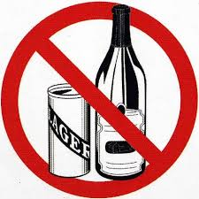

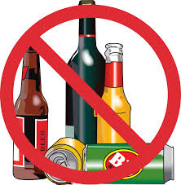
Using
Alcohol is addictive

Slide 12
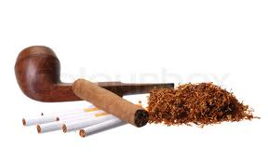
Tobacco
A plant grown for its leaves that can be smoked, chewed or sniffed for the effects of the nicotine contained in them
Used in Cigarettes, Pipes, Cigars

Slide 13
Nicotine – addictive drug found in tobacco
Nicotine alters your mood, stimulates the Central Nervous System, increases heart rate and blood pressure and increases risk of health problems
In addition to Nicotine, tobacco products also contain more than 4,000 chemicals including ammonia, cadmium (used in car batteries) and bensene (used in motor fuel)

Slide 14
Other chemicals found in Tobacco
Carcinogens – substances that cause cancer, also contained in cigarette smoke and in tar
Tar – sticky fluid formed when tobacco burns
Carbon Monoxide – odorless, colorless and poisonous gas also found in tobacco smoke

Slide 15
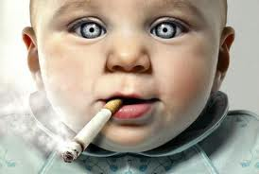
Legal age to purchase Tobacco
Legal age to purchase Tobacco in New Brunswick is 19 years old (18 years old in Quebec)

Slide 16
Physical changes of Tobacco
Increased heart rate
Limited amount of oxygen in blood
Bad breath
Receding gums and ulcers on gums
Tooth decay and loss
Black and hairy tongue
Bad skin
Wrinkles
Stained fingers and teeth
Reduced physical performance
Slower healing time

Slide 17
Impact of using Tobacco
Thinking:
Use smoking to help rationalize behavior
(ie. Smoking helps me maintain my weight)
Reaction Time:
Sports performance would be impaired due to rapid heartbeat, decreased circulation and shortness of breath
Behavior:
May lead to use of other drugs, become sneaky and
lie to hide the smoking,
lead to other poor decisions

Slide 18
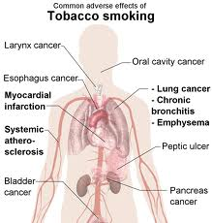
Diseases caused by Tobacco
Emphysema – condition in which alveoli become damaged and limits ability of lungs to exchange Carbon Dioxide for Oxygen
Cancer
Increased risk of Cardiovascular Disease
Strokes
Chronic Cough
Respiratory Illness

Slide 19
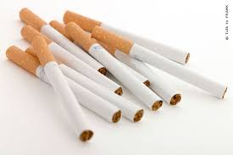
How does Tobacco cause problems for Comm./Family
Community
Expose people to second hand smoke
Pollutes the air
Disposal of cigarettes
Pay for healthcare problems
Family
Smell
Your illnesses
Secondhand smoke
Cost of tobacco

Slide 20
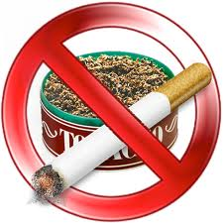
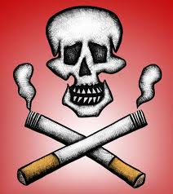

Using
Tobacco products is
Addictive

Slide 21
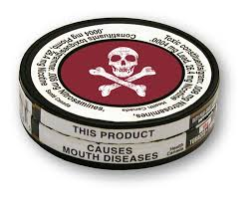
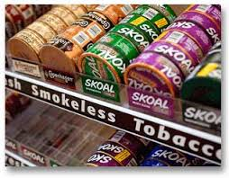
Smokeless Tobacco
A plant grown for its leaves that can be smoked, chewed or sniffed for the effects of the nicotine contained in them
Smokeless tobacco can be used as Dip, Chew or Snuff

Slide 22
Smokeless Tobacco
Increased heart rate
Increased blood pressure
Stained teeth and fingers
Bad breath
Receding gums
Ulcer on gums
Tooth decay
Tooth loss
Black and hairy tongue
Harmful eating habits

Slide 23
Impact of using
Smokeless Tobacco
Thinking –
Use smokeless tobacco to rationalize behavior (using smokless is better because you do not inhale)
Reaction Time –
Poor performance would be due to rapid heartbeat, decreased circulation and shortness of breath
Behavior – May lead to use of other drugs, sneaky
and lie the tobacco use, may lead to other poor decisions

Slide 24
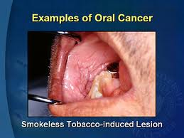
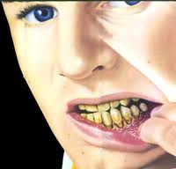
Diseases caused by
Smokeless Tobacco
Cancers of the:
Mouth
Throat
Lips & Tongue
Heart Disease
Stroke

Slide 25
How does Smokeless Tobacco cause problems for Comm./Family
Community
Litter
Spit on ground and in public places
Pay for health care problems
Family
Smell
Your illnesses
Cost

Slide 26
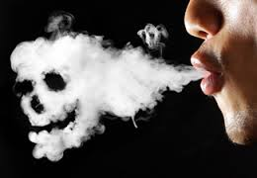
Secondhand Smoke
Is that comes from floating smoke off the end (side stream) of the cigarette, cigar or pipe or exhaled from the smoker (main stream)

Slide 27
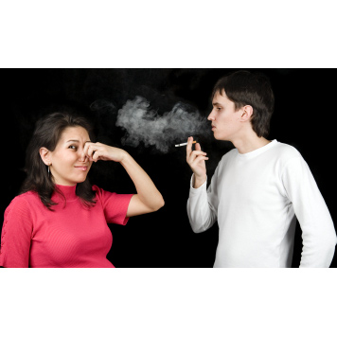
Physical affects of Secondhand Smoke
Irritates the throat, lungs, eyes and nose
Coughing
Sniffling
Sneezing
Defects in babies born to mothers that smoke
Increased risk of Sudden Infant Death Syndrome
Triggers Asthma
More frequent ear and respiratory infections

Slide 28
Impact of Secondhand Smoke:
Thinking – May result in starting to smoke. If they smoke I can smoke too
Reaction Time – Over exposure to the smoke will have the same effect as smoking
Behavior – Avoid exposure to secondhand smoke, politely
remind others to obey nonsmoking signs, keeps fans on and
windows open when around smokers, ask smokers to smoke
outside

Slide 29
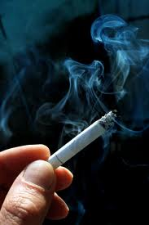
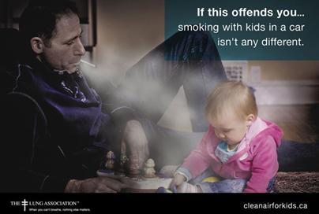
Diseases caused by Secondhand Smoke:
Lung Cancer
Heart Disease
Sudden Infant Death Syndrome
Asthma

Slide 30
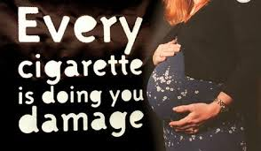
Fetal Smoke Syndrome
When a mother smokes cigarettes when pregnant and gives birth to a "deformed" baby
This is usually far less dangerous or deforming than alcohol during pregnancy, however it is more physically deforming than mentally deforming

Slide 31
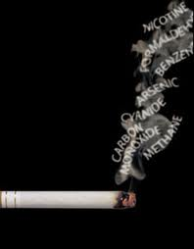
How does Secondhand Smoke cause problems for Comm./Family
Community:
Exposes others to secondhand smoke
Pay for healthcare problems
Family:
Smell
Illnesses
Income loss due to buying tobacco

Slide 32
How to Avoid Secondhand Smoke
Choose non-smoking spaces in restaurants and public places
Spend time with friends who do not smoke
Politely remind others to obey non-smoking signs
Keeps fans on and windows open if you live with a smoker
Ask the person to smoke outside

Slide 33
How to resist pressure to use Alcohol & Tobacco
Say “No” in a firm voice
Give reasons for saying “No”
Be certain your behavior matches your words
Ask an adult for help if you need help

Slide 34
Final Questions:
1. What are some reasons people use tobacco and alcohol products?
2. If a person was addicted to alcohol and drugs where can they go for help?

Slide 35
Final Questions continued
3. List some factors that influence the abuse of alcohol, tobacco and other drugs
4. Describe how substance abuse affects the individual, family and community

Slide 36
Final Questions continued
5. List some diseases caused by the use and abuse of alcohol, tobacco and drugs

