Slide 1
Prescription Drugs

Slide 2
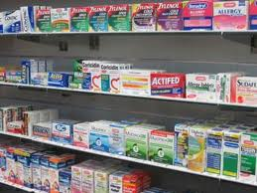
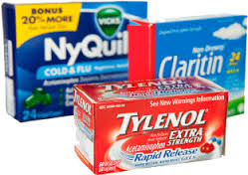
Over the Counter Drug
A drug that can be purchased to relieve signs and symptoms of an illness

Slide 3
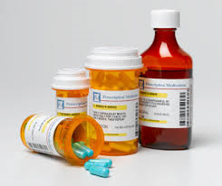
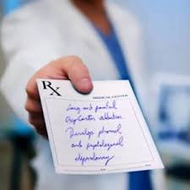
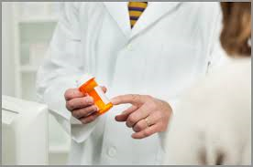
Prescription Drugs
A drug that must be prescribed by a doctor or physician to be legally used

Slide 4
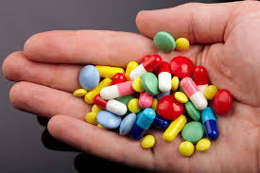
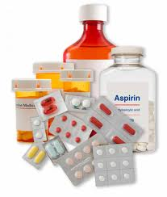
medicine
A drug that is used to treat, prevent or diagnose an illness

Slide 5
Commonly used over the counter medicines

Slide 6
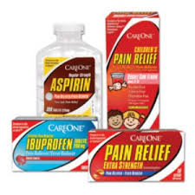
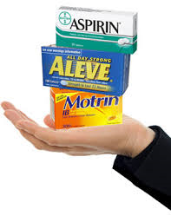
Analgesics or Anti-inflammatory medicines
Used to relieve pain, fever and inflammation

Slide 7
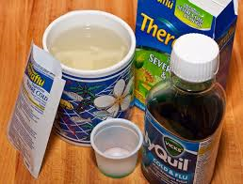
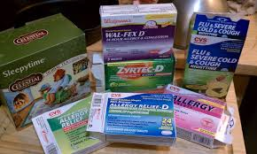
Cold remedies
Used to relieve cold symptoms

Slide 8
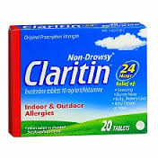
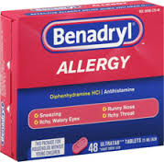
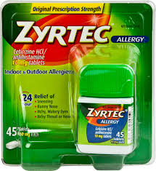
Antihistamines and allergy products
Used to relieve Allergy symptoms

Slide 9
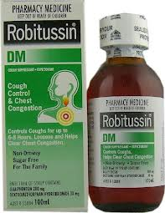
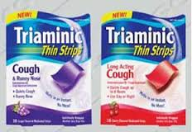
antitussives
Used to relieve and suppress coughing

Slide 10
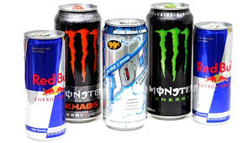
stimulants
Used to diminish fatigue and drowsiness

Slide 11
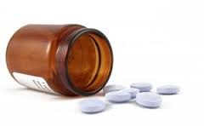
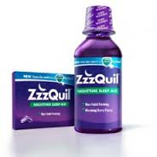
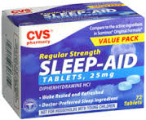
Sedatives or sleep aids
Used to promote sleep

Slide 12
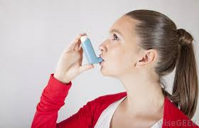
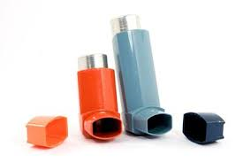
Bronchodilators and anti-asthmatics
Used to assist breathing

Slide 13
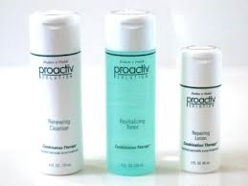
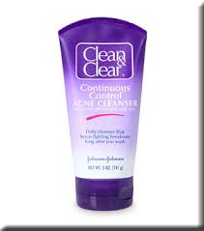
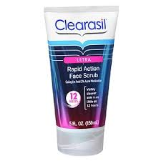
Acne medication
Used to treat and prevent acne

Slide 14
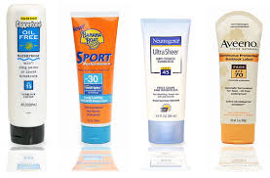
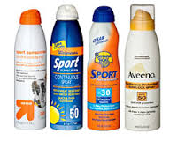
Sunburn treatments and sunscreens
Used to treat and prevent skin damage from UltraViolet Rays

Slide 15
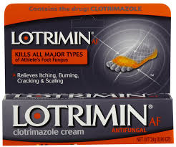
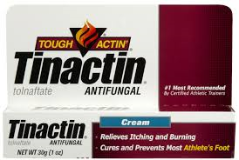
Dandruff and athletes Foot medication
Used to treat and prevent specific skin conditions

Slide 16
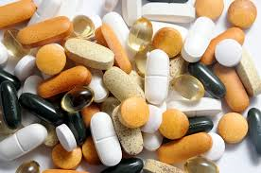
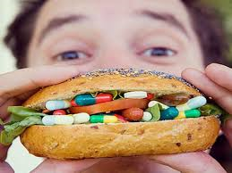
Vitamins and minerals
Used to provide diet supplementation

Slide 17
Side Effect
The unwanted body change that is not related to the main purpose of a drug
Examples:
Dizziness
Nausea
Drowsiness
Fatigue
Death

Slide 18
Safe practices for the use of prescription medicines:
Contact a doctor if drug is not producing intended effect
Report new or unexpected symptoms to a doctor
Take the drug for the intended amount of time
Carefully follow instructions on the label
Follow instructions for storage
Keep all prescription drugs out of reach of children

Slide 19
Never take prescription drugs that have been prescribed to another person
Keep prescription drugs in their original containers
Flush down the toilet any old or expired prescription drugs
Never take prescription drugs that appear to have been tampered with, are discolored or have a suspicious odor

