Slide 1
Scholarship & Bursary Information OHS 2020-2021

Slide 2
General Scholarship Timelines
First Wave National Scholarships
September – December
Second Wave Entrance Scholarships at Post-Secondary Schools
January- March
*March 1st is the deadline for Entrance scholarships at most universities. Be sure to check with your school of choice!
Third Wave Community & Local Scholarships
April - June

Slide 3
What should I be doing now to prepare for applying for scholarships?
Reference Letters- ask a teacher, coach or community member if they would be willing to write a reference letter on your behalf.
Prepare a brag sheet- highlight activities or events you have been involved throughout high school.
Give teachers/community members adequate time to prepare a reference letter.

Slide 4
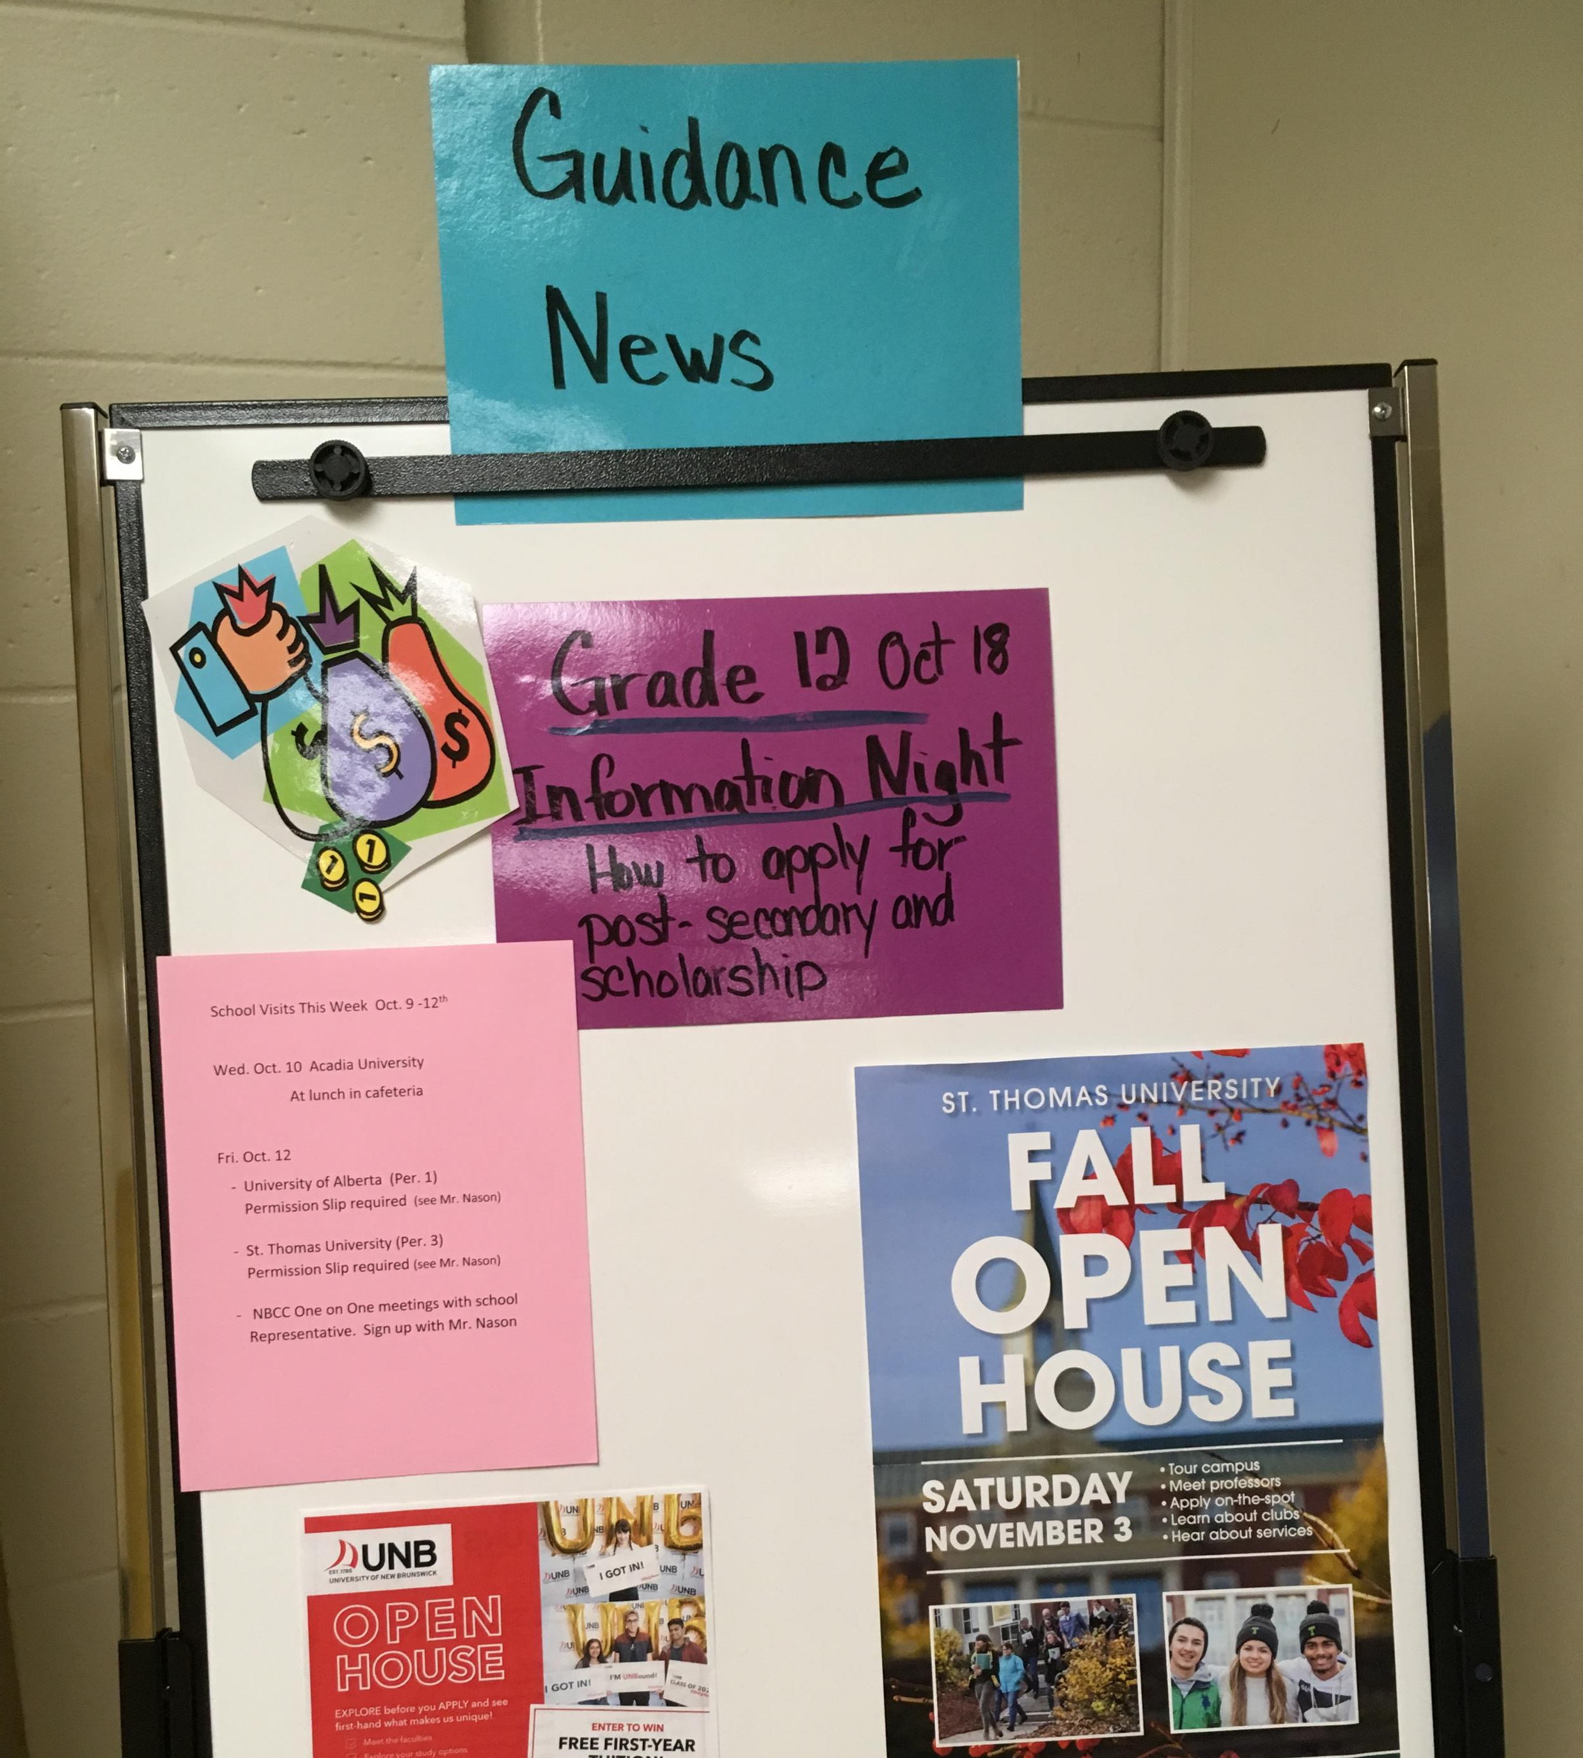
Where can I find scholarship information?
Scholarship board in the Guidance Office
Watch OHS video announcements

Slide 5
Where can I find scholarship information?
Visit scholarship websites
Anglophone West Scholarship Website
http://web1.nbed.nb.ca/sites/ASD-W/scholarships/Pages/default.aspx
OHS Scholarship Website
https://secure1.nbed.nb.ca/sites/ASD-W/Ohs/Guidance/default.aspx

Slide 6
Where can I find scholarship information?
Canadian Scholarship Information
https://scholartree.ca/
https://studentawards.com/
https://www.scholarshipscanada.com/
https://www.schoolfinder.com/Schools/SchoolSearch.aspx

Slide 7
Parent & Student Resources
Free Tuition Program*
eligibility is based on family income and number of dependents and enrollment in approved New Brunswick College or University.
You must go through student loan application in May
*this is a government program and subject to change

Slide 8
Parent & Student Resources
The following sites can provide information on government incentives, student loan information and labour market trends.
www.jobbank.gc.ca
www.studentaid.nb.ca
www.canlearn.ca

Slide 9
Need assistance sifting through all this information?
Please see your guidance counsellor to help you look at scholarships that might be right for you!!
Ms. Pryor A-Go
Ms. Kokoski Gr-N
Mr. Nason O -Z
Not all scholarships are based on academics. Many scholarships are based on the extra-curricular and leadership activities students are involved in!!

Slide 10
Enjoy the Journey!

