Slide 1
Pride Family RMS
GSA

Slide 3
What is GSA?
GSA stands for
G - Gay
S - Straight
A - Alliance
G – Gender
S – Sexuality
A – Alliance
or
GSAs are student-run organizations that unite LGBTQ+ and allies to build community and organize around issues impacting them in their schools and communities. GSAs have changed over the years and our now safe spaces for LGBTQ+ youth in middle schools and high schools and have emerged as vehicles for deep social change related to racial, gender, and educational justice.

Slide 4
2
Two-Spirit (2 Spirit or 2S) is a person with both a feminine and a masculine spirit living in the same body.
It’s an important term within Indigenous cultures and some Indigenous people use it to describe their
sexual orientation, gender identity and/or spiritual identity.

Slide 5
OUR STORY
At RMS the name of our GSA is
PRIDE FAMILY.
It began 2 years ago, because students asked for it!

Slide 6
WHAT IS THE GSA’S PURPOSE?
A GSA’s is a student-run group that provides a safe space for any and all kinds of students to meet and learn about all different orientations, to support each other while working together to end **homophobia/transphobia, and to raise awareness and promote equality for all human beings. In addition to being a group dedicated to support, it also strives to educate the surrounding areas and the community on different gender and equality issues.
**homophobia/transphobia = dislike of or prejudice against gay/trans people.

Slide 7
Who should come?
Members of the LGBTQ2+ community.
Allies
Anyone (student or staff) interested in making the world a safer and more equitable place for the LGBTQ2+ community.

Slide 8
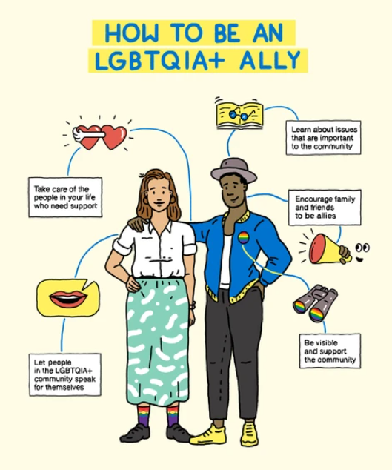

Slide 9
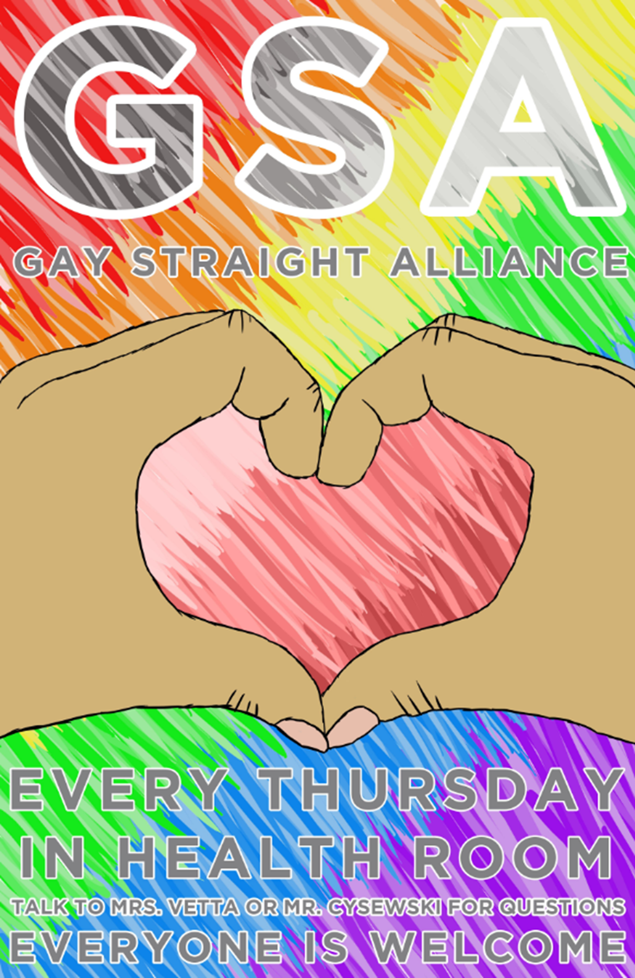
EVERY WEDNESDAY IN THE ART ROOM
TALK TO MRS. HANSCOMB OR MR. POWELL FOR MORE INFORMATION
EVERYONE IS WELCOME!

Slide 10
Don’t want to come to the club?
That’s ok!
You can still reach out and talk.
If you’re questioning your identity or want to explore these
ideas reach out to Mrs. Hanscomb, Mr. Powell or ANY adult in the building. We’re all here to help and listen.
We want you to feel safe and accepted at RMS!

