Slide 1
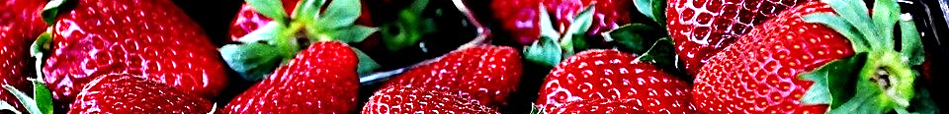












Fresh Fruit Cup | $2.75
Yogurt & Granola Parfait | $2.75
Bagel with Butter | $2.25
Bagel with Cream Cheese | $3.00
Yogurt Cup 100ml | $1.50
Fresh Fruit | $1.25
Garden Salad | $4.25
Caesar Salad | $4.25
Tomato Basil Pasta Salad | $4.25
1oz Cookie | $0.80
2 oz Cookies | $1.25
Muffin | $1.75
Cinnamon Roll | $1.75
Chicken Caesar Wrap | $5.75
Tuna Salad Sandwich | $4.10
Chicken Finger Snack Wrap | $4.00
Small White Milk | $0.60
Small Chocolate Milk | $0.60
Juice Can | $2.00
Juice Box | $1.35
ICEE Slush Cup | $1.75
Water 500ml | $1.50
Water 591ml | $2.00
Daily Special (Includes milk or 114ml juice) | $6.00
Grilled Cheese Sandwich | $4.00
Popcorn Chicken with Sauce | $3.65
Hamburger | $4.00
Cheeseburger | $4.75
Grilled Chicken Sandwich | $4.75
Roasted Potato Wedges | $3.35
Smoothie | $2.50
Baked Tortillas & Salsa | $2.75
Veggies & Ranch Dip | $2.75
Apple Wedges & Dip | $3.00
Frozen Yogurt | $1.75
Pudding Cup | $2.30
Sunchips | $2.00
Pizza Slice | $4.15
Pizza Roll | $2.00

