Slide 1
Welcome to Royal Road Elementary School

Slide 2
Ready Set Go: Off to School
Notes:
Who here this is your first child off to school raise hands. Second child or have a child in school. Make friends with them.
Folders- go through.

Slide 3
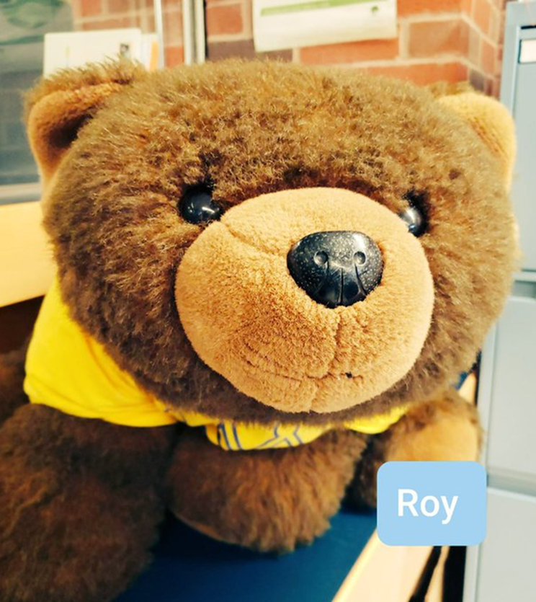
QUICK FACTS ABOUT Royal Road Elementary School
Our school mascot is “Roy the Bear”
Our school motto is “To Learn, To Grow, To Lead”
We are a Kindergarten to Grade 5 school.
Principal is Ms. Legere and Vice-Principal is Madame Brophy.
Notes:
Parents have the option to enroll their child into Grade 1 French Immersion or have them remain in the English Prime Program. This decision and registration process for French Immersion usually happens in February of the child’s Kindergarten year. All students remain at Forest Hill School for Grade 1 whether they remain in the English Program or move into the French Immersion Program

Slide 4
Hours of Operation
Drop Off- 7:45 am - 8:00 am
Bell Rings- 8:00 am
Classes Begin- 8:05 am
Recess- 10:05 am - 10:20 am
Lunch - 12:00 pm - 12:20 pm
Lunch Recess- 12:20 pm - 12:55 pm
K-2 – 12:55 pm – 1:40 pm
3-5 – 12:55 pm – 2:55 pm
Wednesday Dismissal- 11:50 am
Notes:
Play before lunch as it gives them a chance to eat and finish up.

Slide 7
Safe Arrival
SafeArrival through SchoolMessenger
Call from SafeArrival goes out at 8:30 am, if your child is not here and we have not been notified.
To report your child’s absence, you can call the school and leave a message or call 1-833-294-4838.
Notes:
Absent call or download app and input in school messenger.

Slide 8
Transportation
Bussing Information
453-5454
Or
Anglophone West Website

Slide 9
Drop off and Pick Up

Slide 10
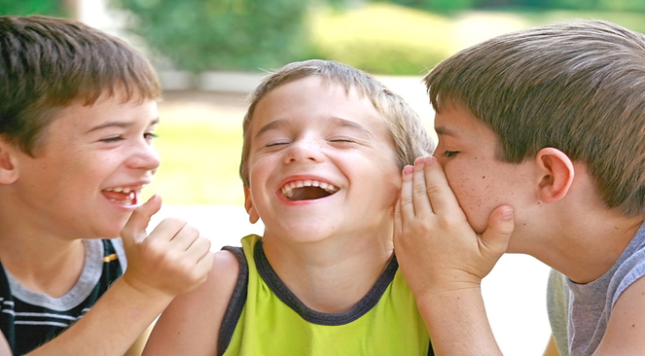
Playground
Morning/Recess/Lunch
Notes:
All students are on playground together.
Come play over the summer.

Slide 11
Communication
School Messenger
Classroom SeeSaw
School Website
Email
Phone Calls
Notes:
SeeSaw

Slide 12
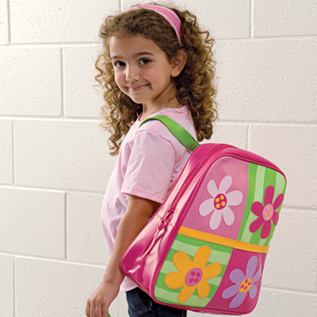
Helpful Hints
Book Bag
Indoor/Outdoor Footwear
Weather
Extra Clothing
Toys/electronics/cell phones
Snacks/Lunches (Opening/Allergy Alert)
Jobs Unlimited (Hot Lunch)
Breakfast Program
Notes:
Look for a backpack book bag that is the right size for your child. It should be able to fit their lunch bag and some items / books from school.
Look for indoor shoes that your child can put on and wear independently. No laces unless children can tie them themselves. Velcro sneakers with non-marking soles are the best option as they are active in the gym numerous times each week. No crocs or sandals for inside.

Slide 13
Other Information
Student Fee (schoolcashonline) $32
Immunization Records Updated
Legal Custody
Health Concerns
Ways to get involved- Home and School & PSSC

Slide 14
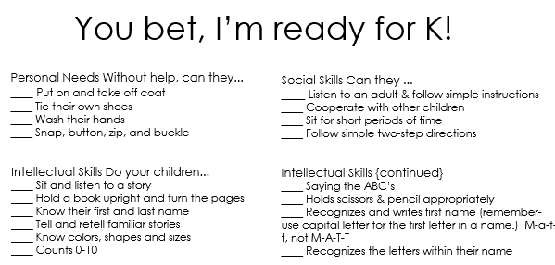

Slide 15
The First Days of School
September 6th and 7th
9:00-11:00am
September 8th Full day
Bring the Backpack Back
Notes:
Staggered entry……
Sign up today before you leave for one of the days. Once the boxes are full there is no more space.
We will call and email remind you of your start date in August.
Meet teacher night

Slide 16
Questions???
Contact us at anytime 453-5438

