Slide 1
Madame Doyle
Grade 3 FI
Welcome families!

Slide 2
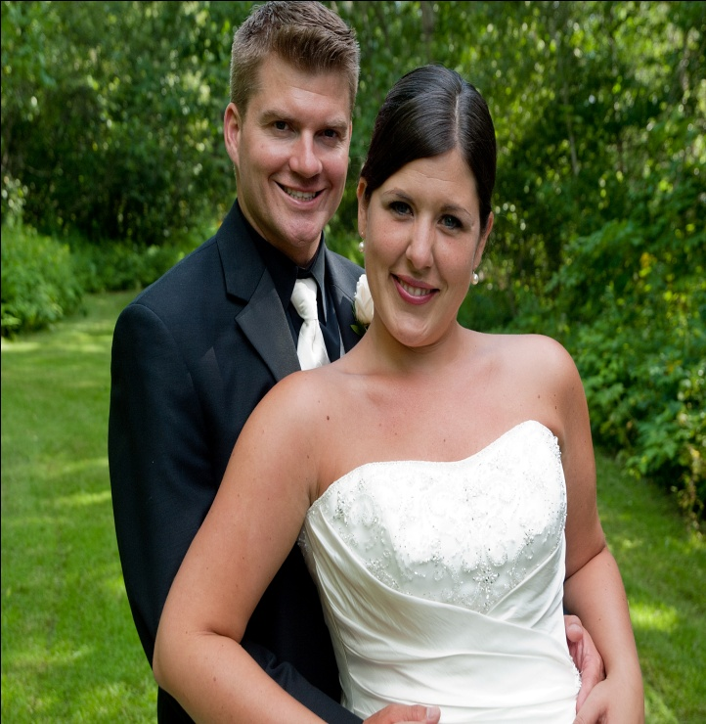
All About Me
My background
  I grew up in Fredericton.
  I have one younger sister.
  I am married and we just celebrated our 6th year wedding anniversary on Aug. 7th!
  We have two beautiful daughters. Molly is 4 ½ yrs. old and Elly will be 3 tomorrow. We also have a black lab named Jasper.
My teaching experience
  I’ve been teaching for 10 years.
  I have taught Grades 1, 2, 3, and 4 and
  I have taught at Sylvan Learning Centre

Slide 3
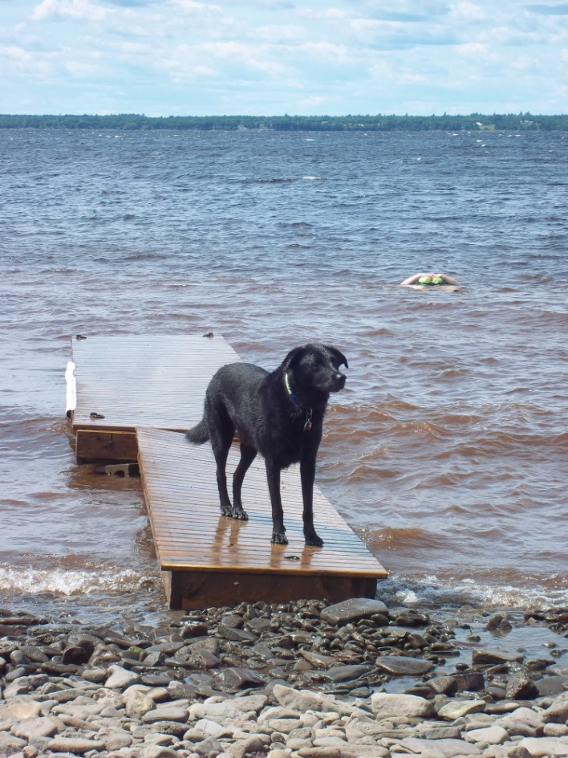
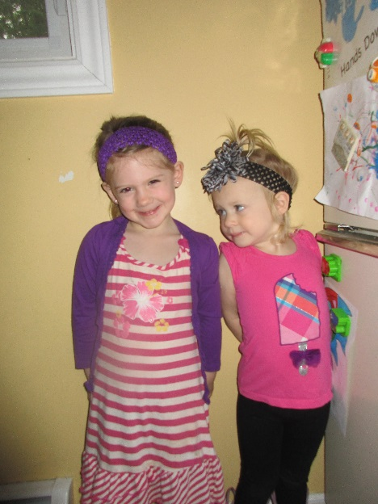
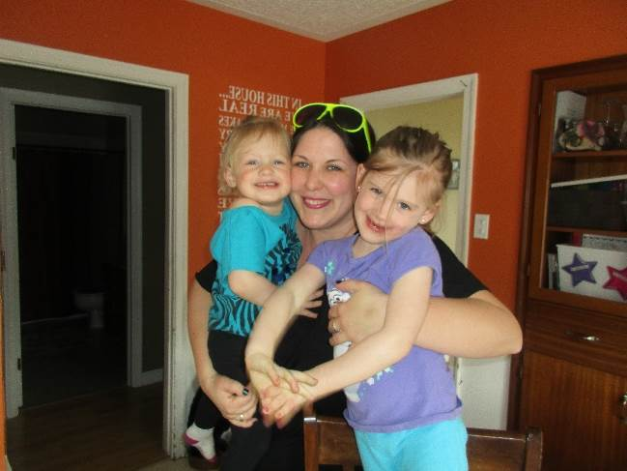
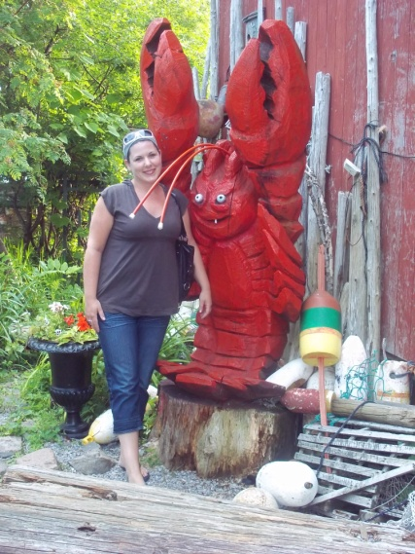
Things I love to do!
Spending time with my girls, Molly and Elly!
Visiting St. Andrews by the Sea

Slide 4
Grade 3
French Immersion Program
Program
Block 1
Homework
Literacy
Reading
Math
English
Report card/communication
Expectations
Email
School Website—Teacher page

Slide 5
Program
Did you Know… that there are 4 stages of language acquisition:
Confusion
Frustration
Comprehension
Oral communication

Slide 7
Block 1
2 modules:
  What makes me unique?
  What is it like to belong in this place?
Focusing on literacy and language acquisition.

Slide 8
Homework
Homework will be assigned on Monday and/or collected on Friday.
It will include nightly reading, vocabulary activities and/or a math activity (on occasion).
Teacher page on school website will contain links to websites for students.

Slide 9

Literacy
Working within Daily 5
  Listening activities
  Speaking
  Reading
  Writing
  Games, interviews, art activities, songs, poems and discussions.
  Final project at the end of each module.
  Learning videos

Slide 10
Writing
Your child will have many opportunities to write on a regular basis.
The writing will be based on themes and the modules in which we are working on.

Slide 11
Math
This will be taught for 300 minutes per week in French.
We will be covering the same outcomes as the students in the English program.

Slide 12
English
Your child will receive 150 minutes of English literacy instruction per week with Madame McGraw.
The topics covered will include:
Social Studies
Writing Workshop focusing on: Narratives, Procedures and Persuasive Writing.

Slide 13
Evaluation / Communication
Your child will receive their first report card in November.
It will be based on:
  Observations and discussions
  in class
  Evaluations
  During the reporting period, you will be invited to come and meet with me so we can discuss your child’s accomplishments.

Slide 14
Expectations on the program
Please remember that each child learns at their own rate.
They may feel overwhelmed at the beginning however this feeling will be short lived.
I will work very hard to ensure that your child has a positive experience in the journey to learning a new language.

Slide 15
How to help your child
Ask your child to talk about their day.
Ask questions.
Listen to your child read (approx. 15 min.)
and ask what they read about.
Eventually, your child will bring home books in French, even if you don’t understand, you can still encourage your child to look at the pictures, make predictions, etc.
If you have any questions or concerns please contact me as soon as possible.

Slide 16
Phys. Ed.—3 times per week
Monday, Tuesday, Thursday
Music—1 time per week
Friday
Library—1 time per week
Wednesday

Slide 17
Our new school website

Slide 18


Email/phone call
monica.doyle@nbed.nb.ca
School # 453-5438

Slide 19
Let’s Have a Great Year!

