Slide 1
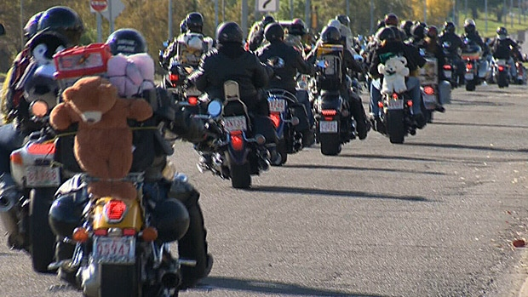
FMC 33rd Annual Toy Ride
June 10th, 2017
The ride begins at 11 am in the parking lot behind the Brookside Mall, onto the Royal Road through to Stanley for a Show and Shine/BBQ, then onto the DECH parking lot where club members make their donations!
Donations such as:
Markers
Crayons
Coloring Books
Games
Puzzles
Stickers
Monetary Donation
Royal Road Staff and Students
will be collecting for the Month of May!
Support the Fredericton Motorcycle Club and their TOY RIDE for the Child Life Unit at the DECH!
Together we can make a child happy!
Fredericton Motorcycle Club
President: Janet Crammond

