Slide 1
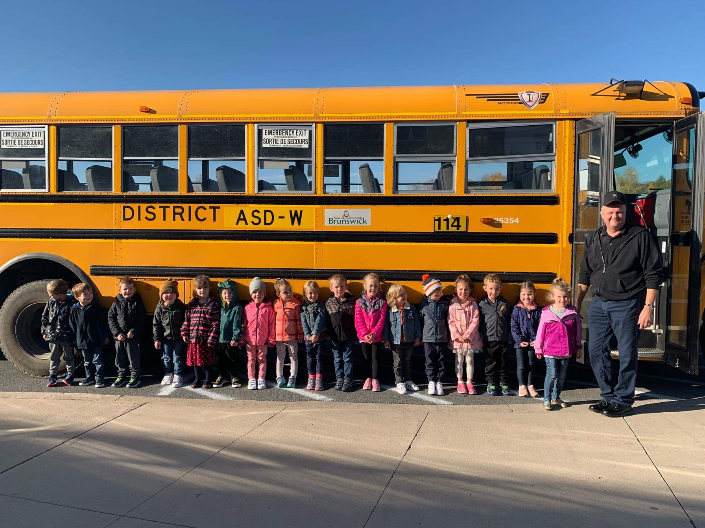
ASD-W Town Hall on Transportation

Slide 2
Agenda
Welcome and introductions – 5 minutes
Presentation – 35 minutes
Questions – 10 minutes
Round table discussions
Round 1 – 15 minutes
Round 2 – 15 minutes
Round 3 – 15 minutes
Wrap-up – 25 minutes

Slide 3
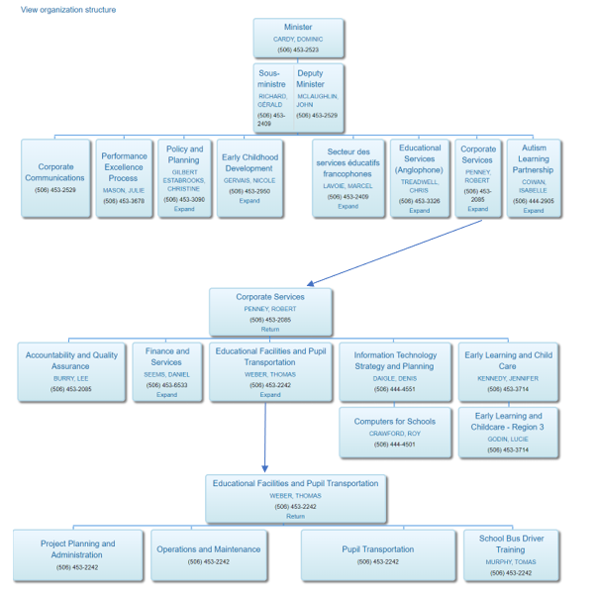
Staffing Complement
ASD-W Transportation Organizational Chart
EECD Transportation Organizational Chart
Assistant Transportation Manager (OEC)
Superintendent
Director of Finance and Administration
AA to DFA and Transportation Manager
Assistant Transportation Manager (WEC)
Assistant Transportation Manager (FEC)
Transportation Clerk (OEC)
Transportation Clerk (FEC)
Transportation Clerk (WEC)
Transportation Manager

Slide 4
Relative Legislation
New Brunswick Regulation 2001 -51, Under the Education Act
Sections often referred to:
Conveyance to and from school
3(1) The superintendent of each school district shall provide for the conveyance to and from school of all pupils (a) who are entitled to free school privileges under section 8 of the Act, (b) who are living at least two and four-tenths kilometres from the school that they attend, and (c) whose conveyance privileges have not been suspended under section 6.
3(2) The superintendent concerned may, with the approval of the District Education Council and within the limits of the budget provided by the Minister under section 50.2 of the Act, provide for the conveyance of pupils living less than two and four-tenths kilometres from the school that they attend
General rules of conduct
5 The superintendent of each school district shall make and enforce rules, consistent with the Motor Vehicle Act and its regulations and the Education Act and its regulations, for the proper conduct of pupils while embarking onto, travelling in and disembarking from school vehicles.
https://www.gnb.ca/0062/acts/BBR-2001/2001-51.pdf

Slide 5
EECD & ASD-W POLICIES
EECD Policies: https://www2.gnb.ca/content/gnb/en/departments/education/k12/content/policies.html
ASD-W Policies: http://web1.nbed.nb.ca/sites/ASD-W/Policies/Pages/default.aspx?RootFolder=%2Fsites%2FASD%2DW%2FPolicies%2FDocuments%2F500%20%2D%20Transportation&FolderCTID=0x0120007A665E94AF29954B91053AA282A3BBF9&View={F4AF97A1-7600-4CA2-8A19-051B6F923F0E}

Slide 6
School Bus Driver Training Program
This policy applies to all drivers of school buses, or other school vehicles that are classified as buses, that convey students in the New Brunswick public school system.
All new drivers must participate in the provincial School Bus Driver Training Program before they are permitted to convey students on behalf of the public education system.
All drivers must participate in an annual driver-training refresher course.

Slide 7
Afternoon School Bus Stops
There are two afternoon school bus stop options for students in grades K–5; one primary and one alternate address of the parent’s/guardian’s choice.
School bus stops for primary and alternate addresses other than the home address, if approved, must be on an existing school bus route and there must be space for the student on the bus.
For grades K-2 and 3-5 students, “best practice” is for the parent / guardian / caregiver to be visible at the afternoon bus drop-off location. Students may be returned to the school at the discretion of the bus driver if there is no one to meet the student when typically there would be.

Slide 8
CLOSURE OF SCHOOLS AFTER SCHOOLS HAVE OPENED FOR THE DAY
It may be necessary to close schools after schools have opened to ensure that students are not endangered by deteriorating weather or road conditions, loss of essential services, or property damage.
Individual bus drivers have a responsibility to recommend to the Transportation Manager either cancellation or a delay for their individual bus run should they encounter a particular safety concern.
The final responsibility for determining whether or not students attend classes on days when hazardous weather conditions exist or are predicted (e.g. extreme wind chill) rests with parents/guardians. Students will not be disadvantaged in any way for absences in these circumstances.

Slide 9
Conveyance Privileges
Walking distance to schools
 | K-5 | 6-8 | 9-12
ASD-W | 2.4km* | 2.4km | 2.4km
ASD-S | 1.5km | 1.5km | 1.5km
ASD-E | 1.5km | 1.5km | 2.4km
ASD-N | 1.0km | 1.0km | 1.0km
DSFS | 1km | 1.5km | 1.5km
DSFNO | 1.0km | 1.0km | 1.0km
DSFNE | 500m | 500m | 500m
Walking distance on side roads
 | K-5 | 6-8 | 9-12
ASD-W | 1.0km | 1.0km | 1.0km
ASD-S | 1.5km | 1.5km | 1.5km
ASD-E | 1.5km | 1.5km | 1.5km
ASD-N | 1.0km | 1.0km | 1.0km
DSFS | 1.0km | 1.0km | 1.0km
DSFNO | 1.0km | 1.0km | 1.0km
DSFNE | 500m | 500m | 500m
*For 13 elementary schools only

Slide 10
Current Transportation Statistics
Currently 257 school bus routes, making up 920 school bus runs
There are 16966 students eligible for school bus service
Average ride time is 23.46 minutes
Average distance students live from their school is 8km
Average distance students are required to walk to their bus stop is 293m
Our fleet of school buses travel approximately 34500km per day
Our current Transportation budget funded by EECD is $12 970 000

Slide 11
Boundaries
School district boundaries are created based on the number of students in a geographical area surrounding each school
Boundaries can be modified by the Superintendent should it be deemed necessary
The purpose of this practice is to ensure schools do not exceed their functional capacity
When schools do exceed their functional capacity, boundary lines may be changed, or the DEC may request a new school

Slide 12
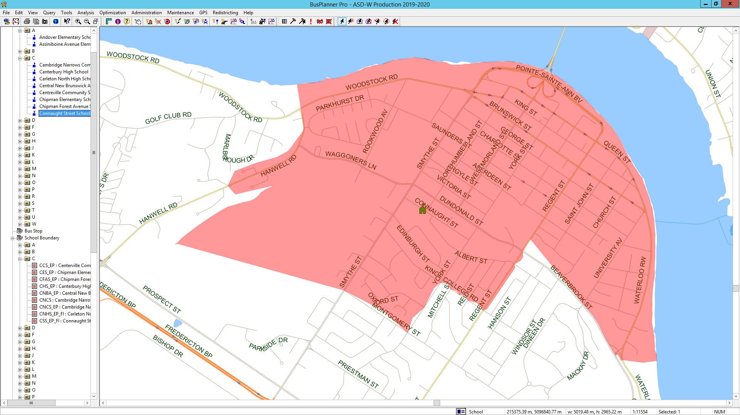
Boundary Example

Slide 13
ASD-W Operating Procedures
asdw500-01 Operator Complaint Procedure
asdw500-02 Bus Returning to School
asdw500-03 Full-Time Driver Replacements
asdw500-04 Students with Specific Needs - Request for Bus
asdw500-05 School Bus Driver Cleaning Requirements
asdw500-06 School Bus Driver Fueling Procedures
asdw500-07 School Bus Driver Towing Procedures
asdw500-08 School Bus Driver Record Keeping Procedures
asdw500-09 School Bus Safety Guidelines
asdw500-10 Bus Driver Safety Vest Procedure

Slide 14
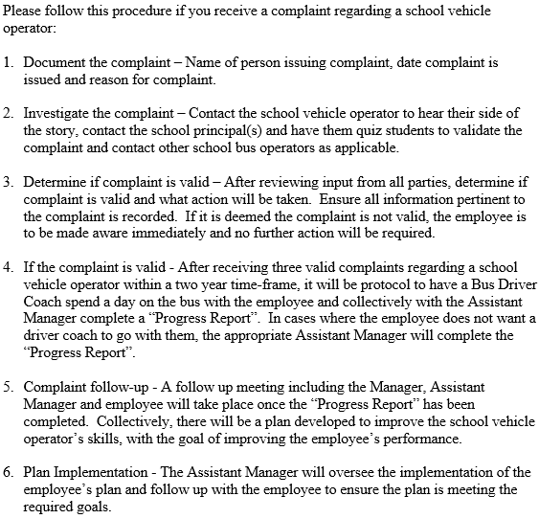
Operator Complaint Procedure

Slide 15
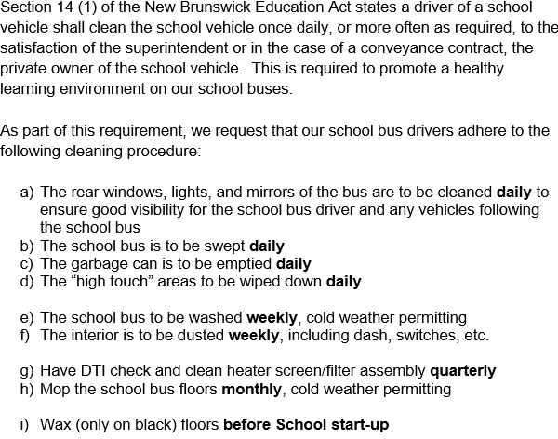
School Bus Driver Cleaning Requirements

Slide 16
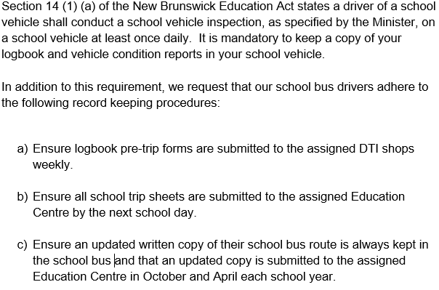
School Bus Driver Record Keeping Procedures

Slide 17
Current Tools
Bus Planner Pro
Bus Planner Trips
Bus Planner Web
MyGeotab (GPS)
NBTMR Radio System
Wood Weather Forecast

Slide 18
Current Challenges
Shortage of casual school bus drivers in our system
Aging work force, approximately 29% of drivers are 60+ years old
DTI winter weather program (Start and end dates, fewer snowplows, fewer staff, use of salt, level of service, etc.) https://www2.gnb.ca/content/gnb/en/news/news_release.2011.11.1177.html
Growing number of new and existing students with altered instructional days

Slide 19
Snow Days
Options Considered
Schools open as usual: no communication required.
All schools closed for the day: see “Communication” section below.
A school or schools in a particular zone of the district closed: see “Communication” section below.
All school bus routes delayed by one hour: On these occasions, all schools in the district will open at their regular time to receive walking students and drop-off students. Students arriving late will not be disadvantaged.
Schools may be closed early on days when it is anticipated that weather conditions may deteriorate significantly. It is important that parents have alternate arrangements for their children if they or another adult will not be at home to receive the students. Please ensure that the school has up-to-date contact numbers for parents (work numbers, cell numbers, etc.) and at least one emergency contact. It will be announced that buses will run their afternoon runs one, two, or three hours earlier than usual, whatever time is determined.
Power Outage: In the event that a particular school is without power, the school will be opened at the regular time, unless otherwise communicated by the Superintendent. In some power outage cases, the decision regarding school closure for the day may be deferred from 6:00am to 7:00am.

Slide 20
Snow Days
School Zones
Edmundston
Grand Falls, Plaster Rock, Perth-Andover
Florenceville-Bristol, Bath, Centreville, Hartland, Woodstock
Canterbury, Nackawic, Burtts Corner, McAdam, Harvey
Stanley, Boiestown, Doaktown
Greater Fredericton Area (including New Maryland, Keswick Ridge, Nashwaak Valley)
Oromocto, Geary, Burton, Lincoln, Fredericton Junction
Chipman, Minto
Cambridge Narrows, Gagetown
Decision Process
The Superintendent of Schools makes the decision to close schools after district transportation personnel provide current information about weather and road conditions. The school district transportation department has access to current weather and road conditions throughout the district through the Department of Transportation and Infrastructure road supervisors, a contracted weather information service provider, as well as other internet sites. Inclement weather predictions are monitored closely throughout the prior evening and again from 5:00 a.m. onward.

Slide 21
Snow Days
 | Delay Full District | Delay Partial District | Closed Full District | Closed Partial District | Early Closure Full District | Early Closure Partial District
2018-19 | 1 |  | 8 | 5
2017-18 |  | 1 | 5 | 4 |  | 1
2016-17 |  |  | 6 | 4
2015-16 | 1 | 1 | 6 | 3 |  | 1
2014-15 |  | 1 | 7 | 7

Slide 22
Questions

Slide 23
Round Table Topics
Table 1 – Financial Considerations (Shawn Tracey, Director of Finance and Administration)
Table 2 – Transportation Technology (Mark Manderson, Assistant Transportation Manager)
Table 3 – Storm Days (Ed Hogan, Assistant Transportation Manager)
Table 4 – Catchment Areas and Standards (Daniel Wishart, Transportation Manager
Table 5 – Policies and Procedures (Carol Lunn, Assistant Transportation Manager)

Slide 24
Thank You
Presentation and notes will be posted on our district website
We plan to host two more Town Hall Meeting with different topics this year in different areas of the district

