Slide 1
Mrs. Smith’s Grade 2 Burton Elementary School

Slide 2
Schedule
7:40-8:00-Transition to School
8:00-Instruction Begins
9:50-Snack
10:00-Recess (20 minutes)
11:30-Lunch
11:55-Lunch Recess (30 minutes)
1:45-Dismissal
Physical Education will be on Monday, Tuesday, Wednesday and Thursday.
Library will be on Friday. Please ensure all Library books are returned by Wednesday of each week.

Slide 3
Supplies
Change of clothes (pants, shirt, underwear, socks-all labeled with name and stored in a plastic bag labeled with name)
Indoor sneakers (preferably Velcro)
Large book bag, lunch box and water bottle
1 large and 1 small box of Ziploc bags
1 box of tissues
2 glue sticks and 1 package of Expo dry erase markers
2 community masks
$30.00 for remaining school supplies and a $10 Agenda fee (Please pay both fees via CashNet).

Slide 4
Homework
Nightly reading and Sight Word Review will be the only assigned homework for this year.
Reading book(s) and Sight Word Books will be sent home on Mondays and expected back on Fridays.
However, green communication bags, red homework duotangs and agendas will travel back and forth to school each day.
Please check bags and agendas each night.
Should you need to send a note to school, please place it in the communication bag or in the plastic sleeve inside your child’s agenda.

Slide 5
Class Websites
We have a Grade Two class website that we will use frequently. Here you will find a variety of resources and links to other websites we also use in class, as well as various academic videos and the curricular outcomes we will be covering throughout the year. You will also find important information on upcoming class events. Please be sure to familiarize yourself with our website using this link: https://burtongradetwo.weebly.com/
Your child will also have their own Raz Kids account for online reading. They will be using this each day at school and are encouraged to also use it at home. Login instructions will be sent home shortly.
Also, please check our School website frequently to stay up to date on all school-related activities: https://secure1.nbed.nb.ca/sites/ASD-W/burton/Pages/default.aspx

Slide 6
Contact Information
School Phone: 357-4074
Email: tanya.smith@nbed.nb.ca
If your matter is time sensitive, (i.e. your child is getting picked up after school instead of taking the bus), please phone the school and Mrs. Morabito will give me the message immediately as I don’t always get a chance to check my email during instructional hours.

Slide 7
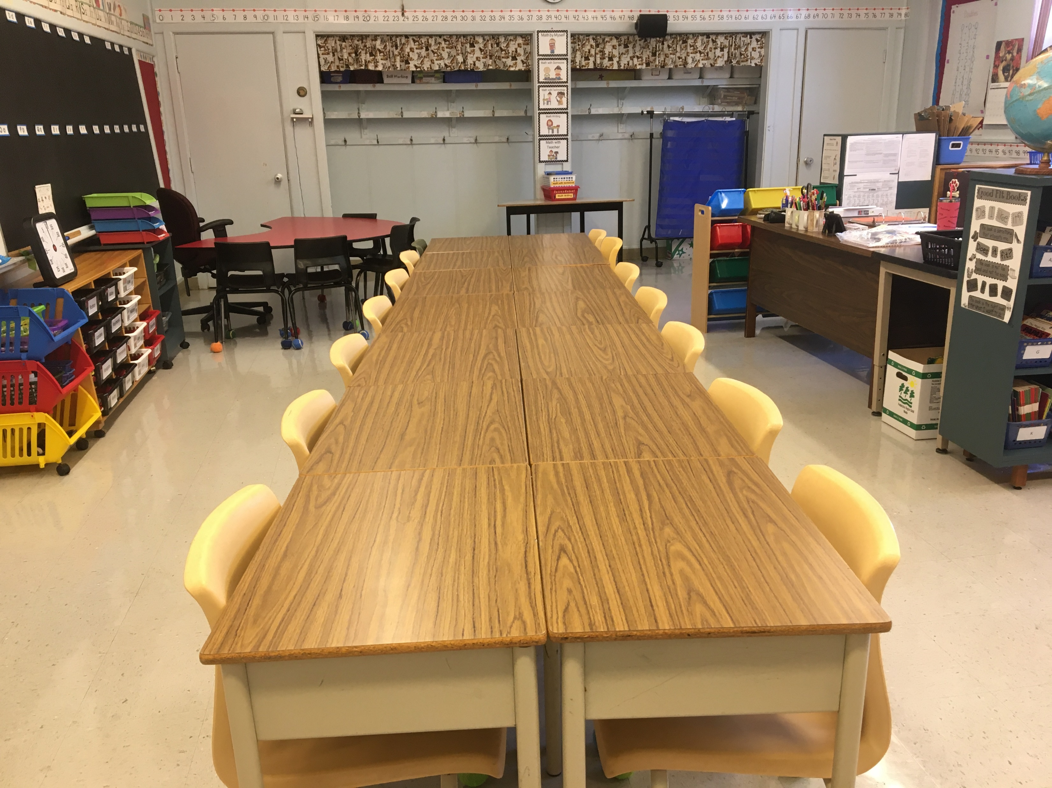
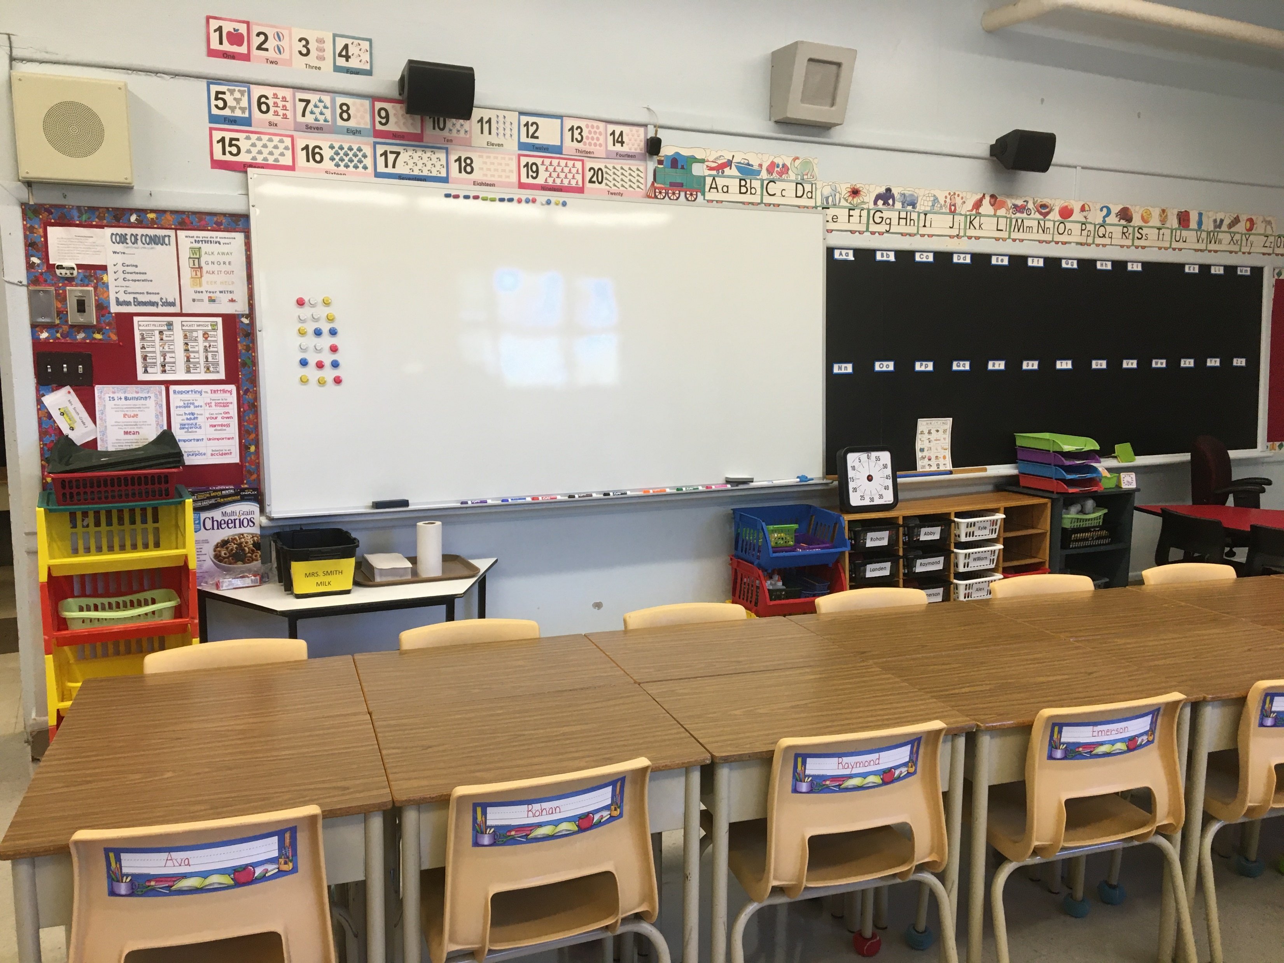
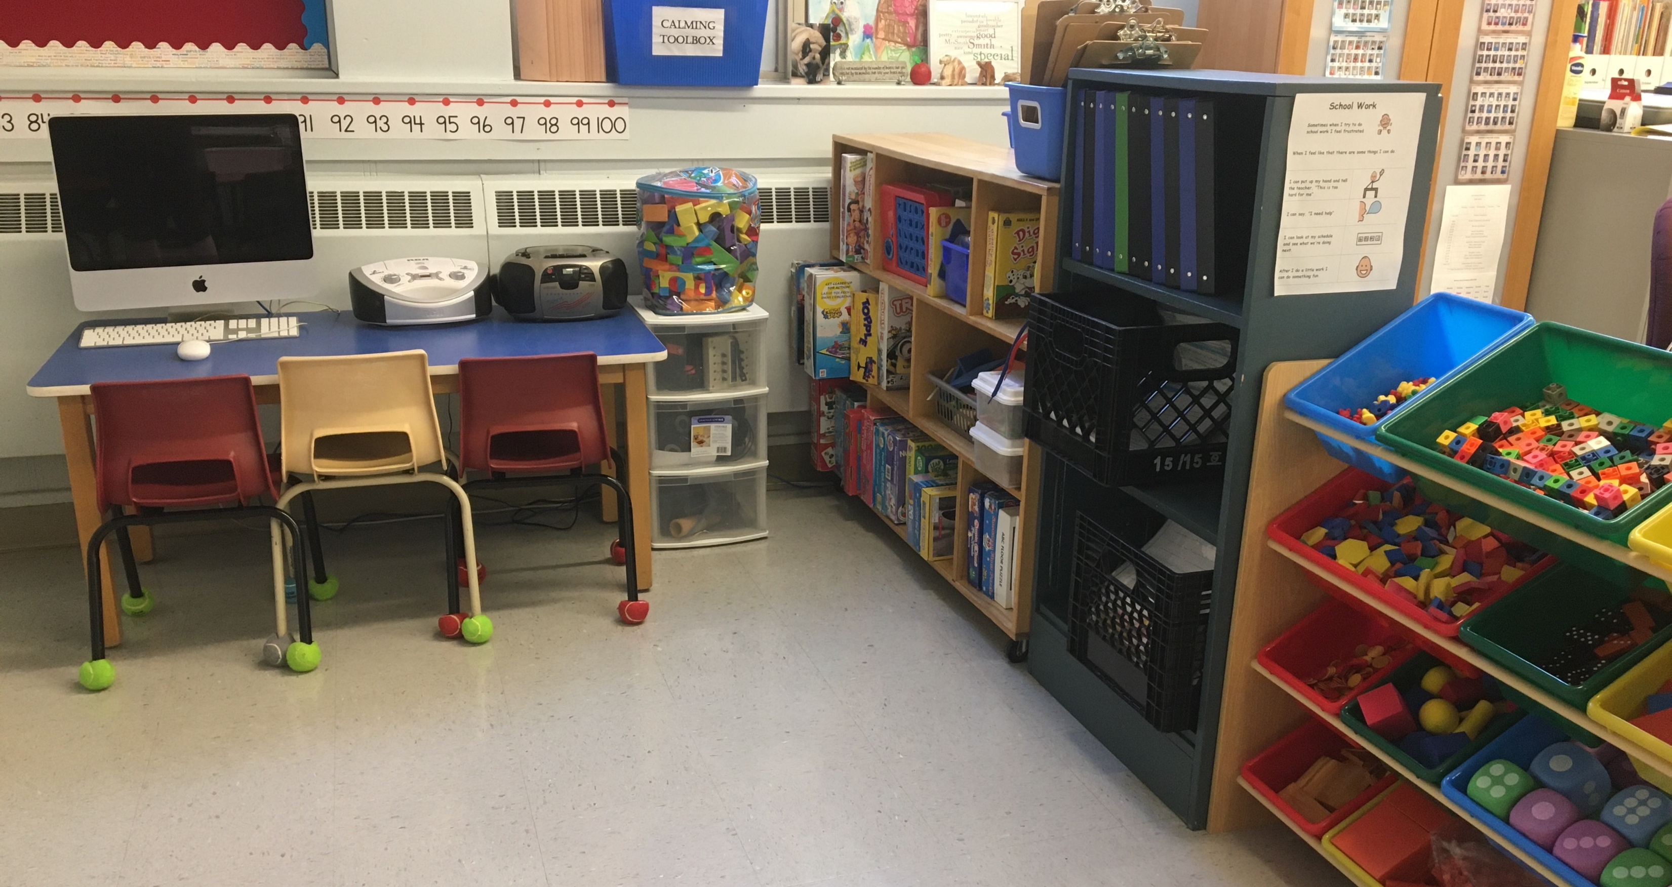
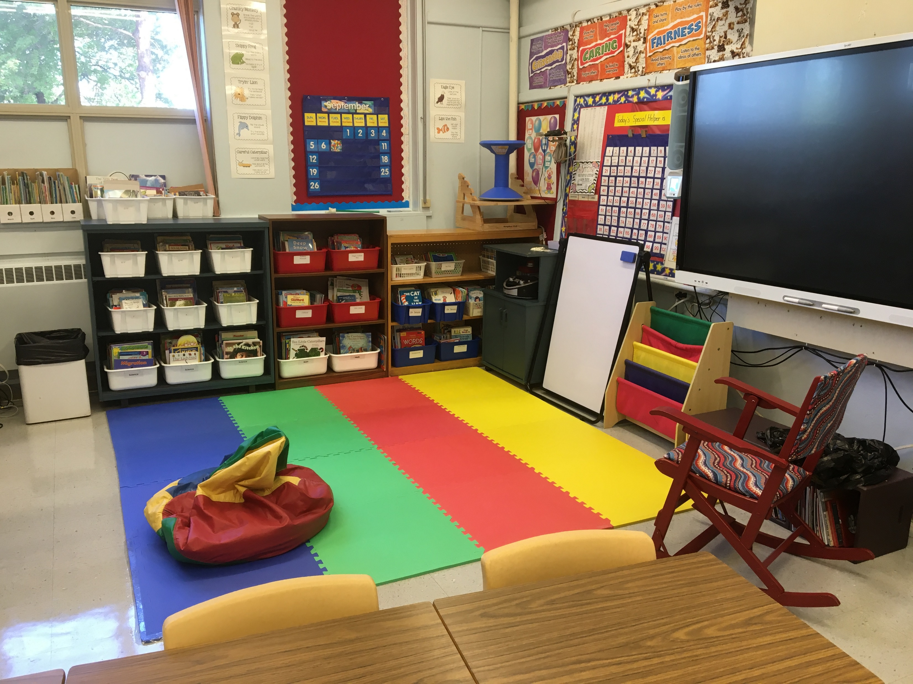
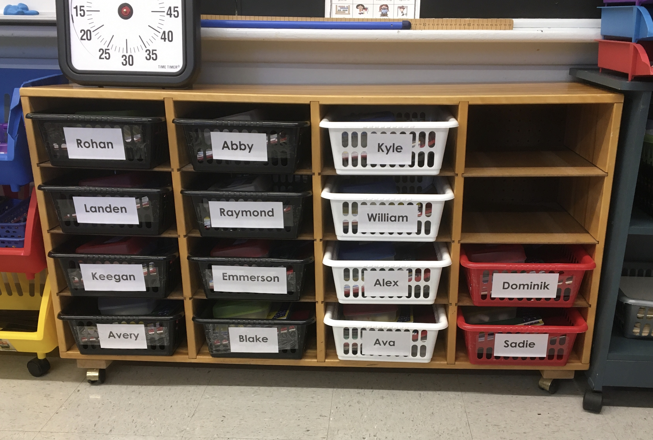
Our Classroom

Slide 8
SCHOOL- WIDE EXPECTATIONS
Be kind. Follow Adult Direction. Own your behavior.
At BES, Students will… | Classrooms | Hallways | Washrooms | Playgrounds | Bus Zone
Be Respectful | -Listen and accept others’ ideas or opinions when they are talking -Use appropriate volume | -Use quiet voice/feet -Respect belongings of others | -Use quiet voice -Respect privacy -Use supplies properly | -Respect nature | -Use quiet voice -Wait patiently
Be Responsible | -Take care of materials and workspace -Follow routines -Be aware of surroundings | -Take care of belongings | -Clean up after yourself -Ask to go at appropriate times -Flush and wash | -Follow entry/exit routines -Use your W.I.T.S. | -Be aware of your surroundings -Stay with your line
Be Safe | -Move safely -Hands and feet to self -Use tools and materials appropriately | -Walk -Stay to the righthand side -hands and feet to self | - walk -Keep water in sink and toilets -hands and feet to self | -Move safely inside boundaries -Dress for weather -Use equipment safely | -Walk -Hands and feet to self -Follow the bus rules -Dress for the weather
Be a learner. | -Use whole body listening -Do your best work -Persevere | -Get ready quickly and quietly -Return to class quickly | Return to class quickly | -Play fair -Practice Sportsmanship when winning or losing -Be a problem solver | -Know the bus rules

