Slide 1
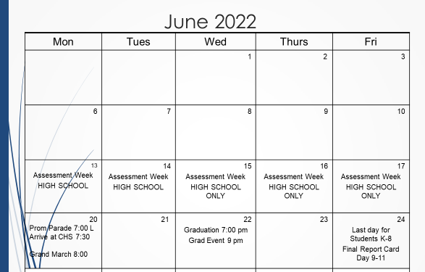
Graduation Events 2022

