Slide 1

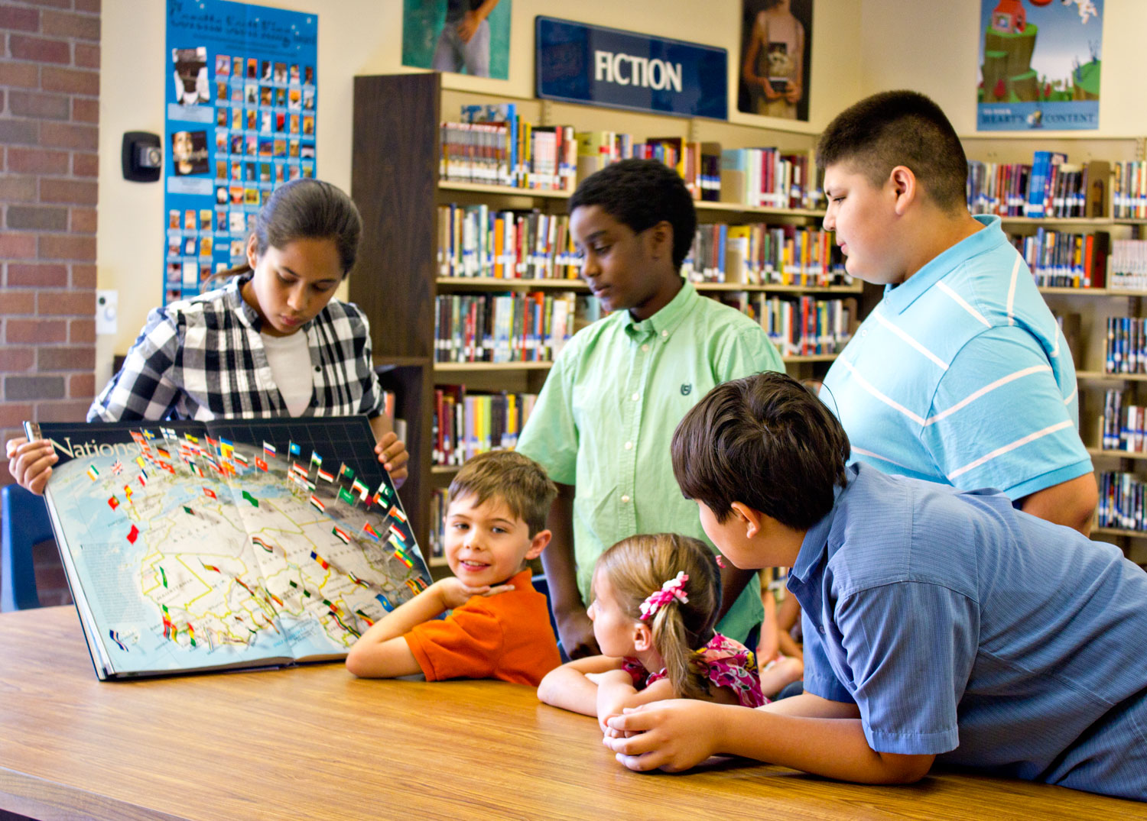
Social and Emotional Learning for Parents
Developed by
ASD-W ESS Leads:
Nancy Gray
Stacey Killam
Suzanne Larsen
Mark Nicholson
Lynette Smith
Lynn Thomas-Grattan
- April 2020

Slide 2

What are your hopes and dreams for your children and the children in your community?

Slide 3
  What is Social and Emotional Learning (SEL)?
Social and emotional learning (SEL) provides the structure and process for adults and children to develop fundamental emotional and social competencies and experiences to:
  understand and manage emotions
  set and achieve positive goals
  feel and show empathy for others
  establish and maintain positive relationships
  make responsible decisions
SEL builds and strengthens a positive learning environment.

Slide 4
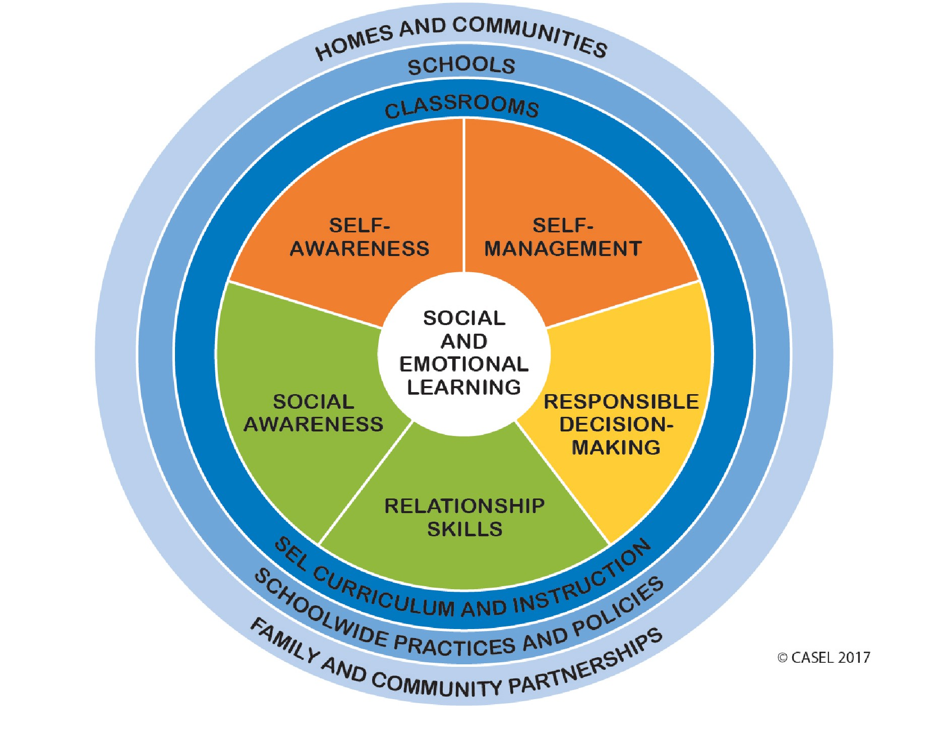
Social and Emotional Learning Core Competencies

Slide 5
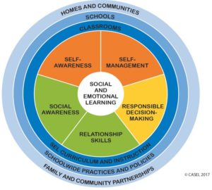
5 Competencies of Social and
Emotional Learning (SEL)
Self Awareness -The ability to accurately recognize one’s emotions and thoughts and their influence on behavior. This includes accurately assessing one’s strengths and limitations and possessing a well-grounded sense of confidence and optimism.
Self Management-The ability to regulate one’s emotions, thoughts, and behaviours effectively in different situations. This includes managing stress, controlling impulses, motivating oneself, and setting and working toward achieving personal and academic goals.
Social Awareness-The ability to take the perspective of and empathize with others from diverse backgrounds and cultures, to understand social and ethical norms for behaviour, and to recognize family, school, and community resources and supports.

Slide 6
5 Competencies of Social and
Emotional Learning
Relationship Skills-The ability to establish and maintain healthy and rewarding relationships with diverse individuals and groups. This includes communicating clearly, listening actively, cooperating, resisting inappropriate social pressure, negotiating conflict constructively, and seeking and offering help when needed.
Responsible Decision Making-The ability to make constructive and respectful choices about personal behaviour and social interactions based on consideration of ethical standards, safety concerns, social norms, the realistic evaluation of consequences of various actions, and the well-being of self and others.

Slide 7
Why is Social and Emotional Learning (SEL) Important?
Short-term benefits for children and youth
  Increased positive social behaviours and attitudes
  Growth in empathy skills
  Improved ability to manage stress and depression
  Fewer conduct problems
  Better attitudes about themselves, others and school
Long-term benefits for children and youth
  Higher academic achievement
  Decreased high school drop out rate
  Less mental health disorders

Slide 8
Social and Emotional Learning at Home
Ideas for strengthening SEL with families
Follow a routine
Practice gratitude
Show kindness
Develop a Growth mindset (change thinking from “I can’t do it” into “ I can’t do it yet, but I will keep trying”)
Establish strategies for handling conflict
Take “Activity Breaks” during learning time
Set and accomplish goals each day
Express feelings through art or journal writing
Build/maintain relationships through virtual playdates/social time with friends
Use music as a calming strategy or a mood booster
Allow for choice in daily activities
Engage in mindfulness or calm breathing exercises
Practice yoga or stretching
Play games
Talk about emotions Source - https://confidentparentsconfidentkids.org

Slide 9
SEL in action
https://www.youtube.com/embed/DqNn9qWoO1M?rel=0

Slide 10
Sources
https://casel.org/core-competencies/
https://confidentparentsconfidentkids.org/
https://www.youtube.com/embed/DqNn9qWoO1M?rel=0

