Slide 3
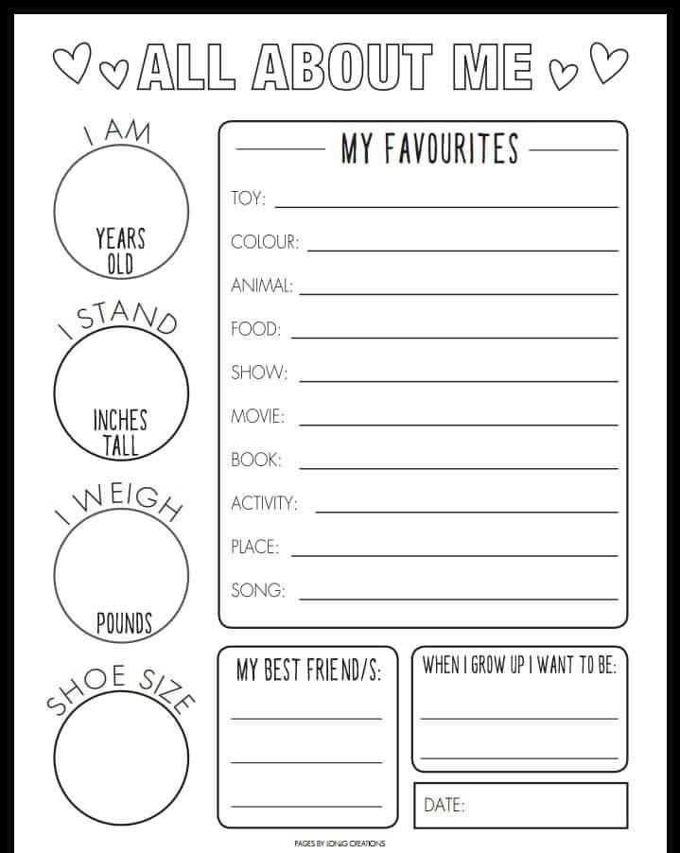

Slide 4
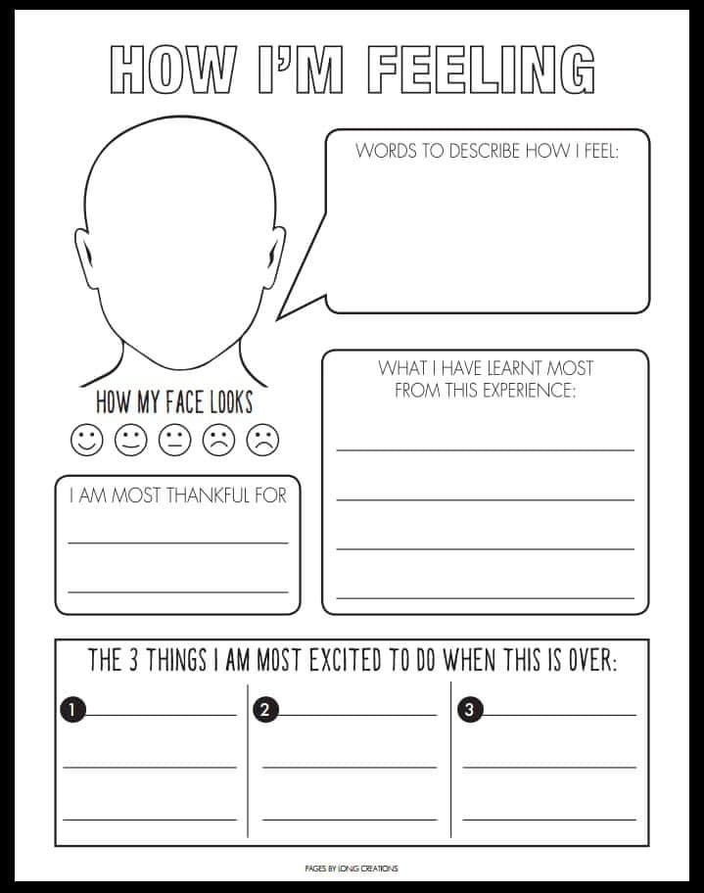

Slide 5
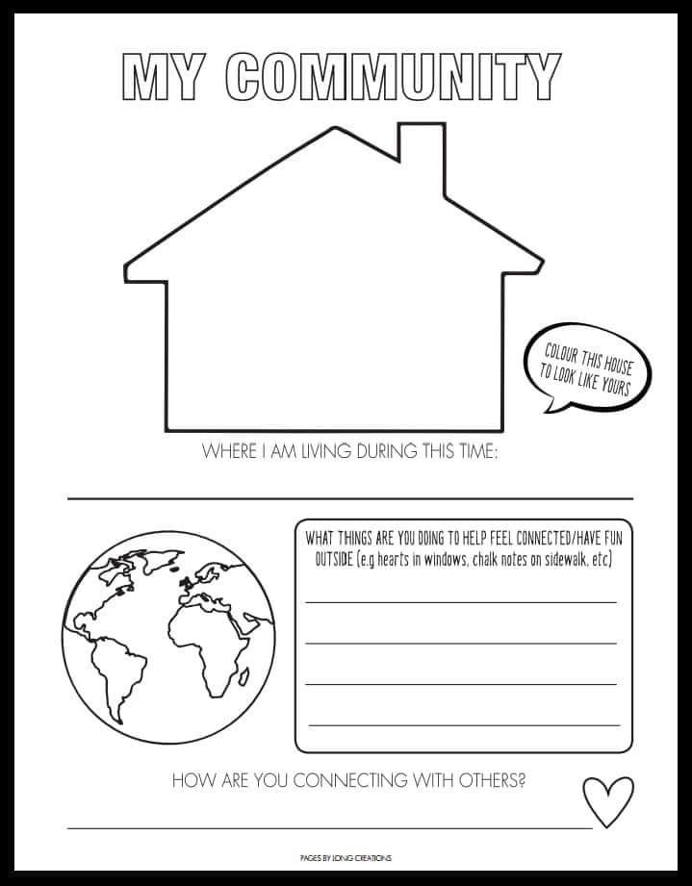
DESCRIBE YOUR HOUSE

Slide 7
ON A BLANK PAPER, HANDPRINTS OF ALL THE PEOPLE LIVING IN YOUR HOME (IN DIFFERENT COLOURS) AND UPLOAD A PICTURE OF YOUR PAPER HERE

Slide 8
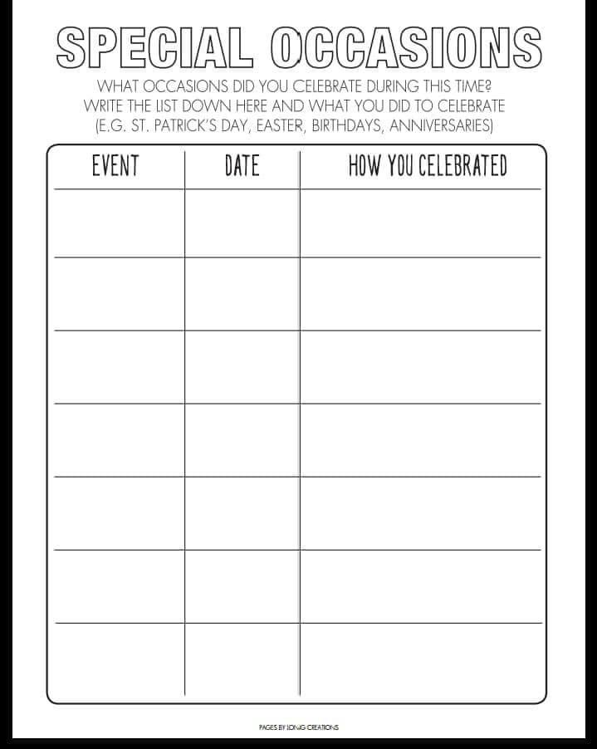

Slide 9
DATE:

Slide 11
DATE:

