Slide 1
Report Card Pilot K – 8
2014 – 15
Anglophone West School District
Notes:
Speaking Points:
Emphasize this is a pilot and that feedback on the new reporting process will be collected throughout the school year.
It is also important to note that this is a collaborative initiative among NBTA , EECD Curriculum Branch and school districts; all saw the need for change and worked together on the proposed changes.
The pilot is occurring only in ASD-W in conjunction with the implementation of PowerSchool, the new student information system.

Slide 2
Why a new reporting process?
To improve accuracy and consistency
To increase alignment with provincial curricular learning goals
To provide clearer descriptions about what students know and are able to do
Notes:
Speaking Points:
You may be asking why a new reporting process. The major reasons are
To improve accuracy and consistency of reporting
To increase alignment with provincial curricular learning goals
To provide clearer descriptions about what students know and are able to do.

Slide 3
Parent Survey Results
Notes:
Speaking Points:
Parents and teachers had the opportunity to provide feedback about versions of the proposed reporting process. The majority of these people said they support the proposed changes. Of nearly 1500 parents, 84% agreed or strongly agreed with the changes.
All schools with Kindergarten to Grade 8 students in ASD-W will pilot the proposed changes to the reporting process in 2014-15.
The major changes are:
Report cards will now look the same from Kindergarten to Grade 8 and use the same grading scales.
The new reporting process will include two types of reports: two Progress Reports and two Achievement Reports. That means you will receive four reports throughout the school year.
New grading scales will provide information about how well students are meeting learning goals.
Newly defined Learning Habits will be evaluated in both types of reports.
The remainder of this presentation gives more details about the changes which will be piloted.

Slide 4
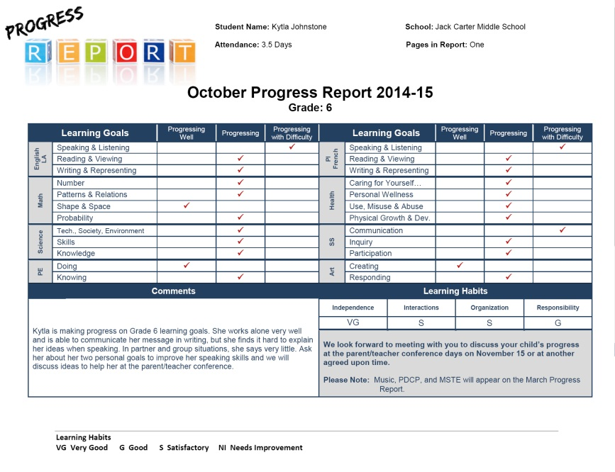
Progress Report
SAMPLE
Notes:
Speaking Points:
You will receive a Progress Report in early November and again in early April to give you a general update about the progress your child is making.
These reports will indicate if your child is:
progressing well,
progressing or
progressing with difficulty
in each area of learning.
These reports will be sent home just before parent/teacher interviews. Please note that the report cards shown in this presentation are not exactly like the ones you will receive which will be generated through PowerSchool, the new student information system being introduced in ASD-W.

Slide 5
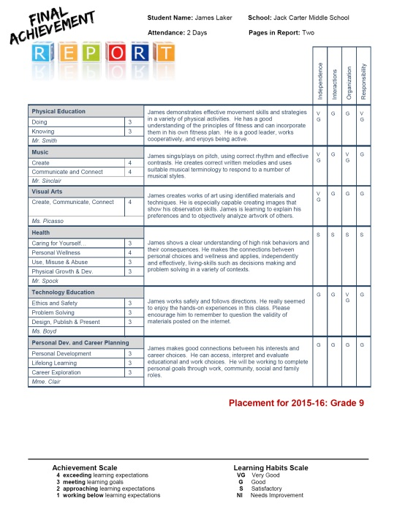
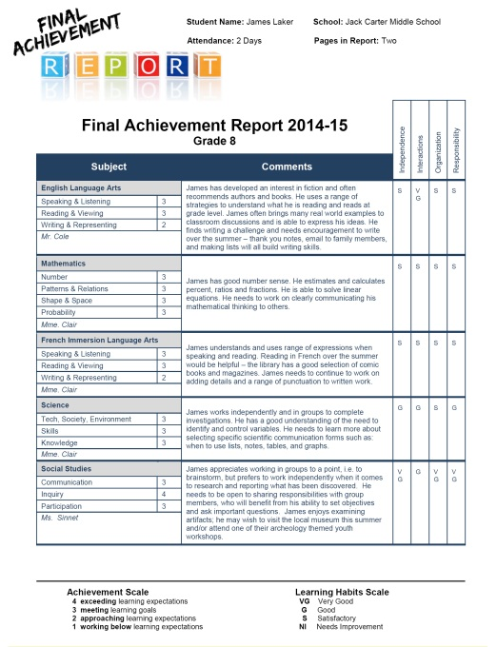
Achievement
Report
Subject-specific and grade-specific rubrics will be used to determine achievement.
Notes:
Speaking Points:
The Achievement Reports issued at the beginning of February and near the end of June provide you with an evaluation of how well your child is achieving learning goals in each subject area. Teachers will use subject-specific and grade-specific rubrics, or scoring guides, to determine if your child is exceeding, meeting, approaching or working below learning goals. You will also have access to these rubrics.

Slide 6
Learning Habits
Independence
Interactions with Others
Organizational Skills
Responsibility
Notes:
Speaking Points:
Both the Progress and Achievement reports will include an evaluation of your child’s Learning Habits.
These have been identified as key areas which support success in learning and in life.
Learning Habits are evaluated separately from progress and achievement.
The same habits will be addressed throughout K-8 to help students in their personal goals. Expectations for each habit will increase with development and maturity.

Slide 7
Four Reporting Periods
Notes:
Speaking Points:
In summary, there are four reporting periods:
two for Progress reports (early November and early April); and
two for Achievement reports (the beginning of February and near the end of June).

Slide 8
Thank you in advance for your feedback!
Notes:
Speaking Points:
Thank you for your participation this evening and for your feedback throughout the year.
Please watch for communication regarding opportunities to provide feedback on the new reporting process.
Your input is valuable to the pilot process!

