Slide 1




Everyone at Their Best
Choosing a French Second Language Program
2020-2021
In New Brunswick, all students have an opportunity to learn French.
Notes:
Welcome to this presentation on New Brunswick French second language programs. No matter where you live, your child will learn French as part of the curriculum. Although this presentation outlines all programs, your school administration will communicate how French Second Language is taught in your school. Thank you for taking the time to review this short information session to learn more about French Second Language as part of your child’s education.

Slide 2

French Second Language (FSL) Programs
French Immersion Program Entry Points
  Grade 1 (Early Immersion)
  Grade 6 (Late Immersion)
English Prime with Intensive French Program
  K to Grade 3: French Learning Experiences/FLORA
  Grade 4: FLORA/Pre-Intensive French
  Grade 5: Intensive French
  Grades 6 to 12: Post-Intensive French
  As a support during the pandemic, FLORA modules have been made available to all elementary school teachers.
Notes:
There are multiple French programs in New Brunswick:
Where circumstances warrant, students may enter French Immersion in Grade 1 or in Grade 6.
Pre-intensive, Intensive and Post-Intensive French are offered in all schools for English Prime students. As well, all students in the primary grades participate in French language and cultural learning experiences to support positive attitudes and introduce some simple French vocabulary. In some schools, elementary students may be learning French through FLORA which will be explained in the following slide.
For all programs, French is compulsory until the end of Grade 10. In Grades 11 and 12, there are additional opportunities to build French Language skills.
Each French Second Language program has its own language targets describing how well learners will speak, read and write. Language learning is a lifelong pursuit. Students are provided with opportunities to use the language in various contexts. We will expand on this later in the presentation.

Slide 3

French Second Language (FSL) Programs
FLORA (French Learning Opportunities for Rural Areas):
  Is a made-in-New Brunswick French program for K−3 that includes educational songs, animated characters, readings and activities
  The resources are flexible and online materials can be accessed from home
  FLORA uses the same approach as Intensive French, with lots of modelling
  This program is used to support beginning stages of French language development
Notes:
FLORA (French Learning Opportunities for Rural Areas):
FLORA is a made-in-New Brunswick French program for K−3 that includes educational songs, animated characters, readings and activities.
This program is in the final year of piloting and has been adopted by some schools to support French learning as part of the return to school plan.
The resources are flexible and online materials can be accessed from home.
FLORA uses the same approach as Intensive French, with lots of modelling.
This program is used to support beginning stages of French language development.

Slide 4

French Immersion Overview
Language proficiency targets
Each program has its own language proficiency targets in the areas of oral proficiency, reading, writing.
Program availability
Early registration will support district planning.
Families are encouraged to register within the designated dates.
Depends on such factors as student enrollment (see Policy 309).
French Immersion and Inclusion
If French Immersion is available in your community, it is an option for all learners.
Notes:
Each FSL program has its own language targets describing how well learners will speak, read and write. Language learning is a lifelong pursuit. Students are provided with opportunities to use the language in various contexts. We will expand on this later in the presentation.
French Immersion program availability depends on student enrollment (and sustainability of the program).
If French Immersion is available in your community, it is an option for all learners.

Slide 5


Grade 1 French Immersion
Grade 1 entry to FI was successfully reintroduced in September 2017.
Program is designed for early learners.
Emphasis on oral language in all subjects, followed by learning to read and write in French from the beginning of the program.
Language is modelled; teachers support students as they learn the new language at their own pace.
Based on the most current research.
Notes:
In the Grade 1 French Immersion program, children will learn language through a literacy based approach. They will develop skills by exploring familiar topics of personal interest.
Teachers will model the language and support young learners as they acquire French through authentic language experiences. The interactive program uses music, poems, games and educational play.
Teachers might provide a model. For example, they might say: Je m’appelle Paul, comment t’appelles-tu ? while using gestures to help with understanding. Students will practice this together and then they would read about introducing themselves and then write an introduction of themselves.

Slide 6

Grade 1 French Immersion Overview
Subjects taught in French
Most subjects are taught in French (literacy, social studies, math and science).
Specialties (art, music, physical education, etc.) may be taught in French.
During the pandemic, French Immersion has been scheduled as close to the programming recommendations as possible. Districts and schools may require adjustments to meet their needs.
French instruction
Grades 1 and 2:
Grades 3 to 5:
Grades 6 to 8:
Grades 9 and 10:
Grades 11 and 12:
90%
80%
70%
50%
25%
Notes:
In the French Immersion program, most subjects are taught in French; this typically includes Literacy, Social Studies, Math, and Sciences.
Other subject areas are also included according to the number of hours needed to complete program requirements.
The percentage of French instruction depends on the grade level.
English Language Arts is taught in Kindergarten as well as grades 3 to 12.

Slide 7

Grade 1 French Immersion Program Overview
90% of instruction is in French in Grades 1 and 2.
80% of instruction is in French in Grades 3 to 5.
English Language Arts is introduced in Grade 3.
Curriculum has been updated to reflect the new entry point.
Notes:
In the Early French Immersion Program, 90% or more of the instructional day is in French in grades 1 and 2. In grades 3 to 5, 80% of the day is in French.
There is an integrated curriculum to introduce Science, Social Studies and Well-Being. There are resources appropriate for younger learners to support language development and learning in these areas.
English Language Arts is introduced in Grade 3. However, many of the skills acquired through French literacy are transferable and coordination between French and English Language Arts (beginning in grade 3) supports literacy development in both languages.

Slide 8

Grade 6 Late French Immersion
Literacy skills are developed through both French Immersion Language Arts and English Language Arts.
There is an emphasis on oral language in all subjects, followed by learning to read and write in French from the beginning of the program.
Language is modelled; teachers support students as they gradually learn new concepts in their second language.
70% of instruction is in French in grades 6-8
50% of instruction is in French in grades 9-10
25% of instruction is in French in grade 11-12
Notes:
The Late French Immersion program begins in Grade 6 if circumstances warrant.
Exposure to the French language at the elementary level enables students to transition smoothly to French Immersion in grade 6.
Teachers will model the language to support students success through French Immersion Language Arts as well as content areas such as math, science and social studies.
In FI Language Arts, the beginning of the year has a focus on building confidence in oral language, speaking and listening. Reading and writing instruction is gradually introduced. Teachers will build on previously acquired skills to support literacy instruction.
In content area classrooms, the teaching of vocabulary and oral language skills specific to the topics of study are used to learn. Reading and writing is modelled at the beginning to support language skills being acquired.

Slide 9

High School French Immersion
French instruction:
    50% in Grades 9 and 10
    25% in Grades 11 and 12
  The following online courses are now offered:
  FSL Law
  FSL Environmental Science
  FSL Writing
  FSL Hospitality andTourism
  FSL Co-op and Virtual Co-op Education
These options are open to Post-Intensive French students in grades 11 and 12.
Notes:
In Grades 9 and 10, 50% of courses are offered in French.
In order to develop a strong foundation and confidence in French, students are encouraged to enroll in as many French courses as their circumstances permit in Grades 11 and 12.
Students enrolled in a French course in grade 12 are eligible for an oral proficiency interview through the province of NB.
To ensure a strong program for all schools, the Department of Education and Early Childhood Development continues to expand offerings of French high school online courses and experiential learning.

Slide 10

English Prime Program Overview (K to 3)
French language and cultural experiences K−3.
FLORA (French Learning Opportunities for Rural Areas) is now available for K−5 schools.
Subjects taught mostly in English with time for learning French.
French is compulsory in Grades 4−10 and offered as an elective in all schools in Grades 11−12.
Intensive 5 month block usually offered in Grade 5.
At Grade 6, students may enroll in the late immersion program where available.
Notes:
For all students in the English Prime Program, French instruction starts in Grade 4. In Grade 5, students learn French in an intensive 5 month block.
Prior to French instruction starting in Grade 4: Learning experiences that introduce French language and culture or the FLORA program create excitement for learning French for learners in K – 3.
The FLORA program, which has been piloted in 13 schools, is now available to other elementary schools. Its flexibility allows it to be used by teachers, in centers, in groups on-line, or individually.
French language learning is compulsory from Grades 4-10 and French courses are offered in all schools in Grades 11-12.
Intensive is usually offered in Grade 5.
At Grade 6, students may enroll in the late immersion program where the program is available.

Slide 11

English Prime with Intensive French
All learners in English Prime will have an opportunity for an enhanced experience in French through the Intensive block in Grade 5.
Learners will:
  speak, read, and write in French daily;
  acquire basic language skills and foundational vocabulary;
  learn to communicate in full sentences; and
  explore a variety of themes of interest (e.g., me, my family, food, clothing, leisure, and activities: sports, music, etc.).
Notes:
The Intensive block offers learners an enhanced experience in French. Learners in this model, adopted in 2008, have shown better oral proficiency results than the previous Core French program.
Learners will:
speak, read, and write in French daily
acquire basic language skills and foundational vocabulary
learn to communicate in full sentences
explore a variety of themes of interest (such as the family, food, clothing, leisure, sports, music, etc.)
Research has shown that a concentrated period of language instruction builds confidence and a solid foundation for future language growth.

Slide 12
English Prime with Intensive French (Grades 4 and 5)
Pre-Intensive French or FLORA (Grade 4):
2 to 3 blocks (approximately 9% of instructional time/week)
Intensive French (Grade 5)
Intensive Block (5 months): Approximately 60% of the day
Less Concentrated Block (5 months): 2 to 3 blocks (approximately 9% of instructional time/week)
Notes:
In FLORA and Pre intensive French, students build initial skills such as speaking in full sentences, reading simple texts and writing short texts.
In Grade 5, there are 2 blocks: for 5 months, 60% of the day is in French. The other 5 months, only 9% of the day is in French. Please note that these targets may be met in a cross-curricular setting.
The Intensive block uses a literacy-based approach to develop students’ capacity to speak, read and write in French. In Grade 5, some subject areas are compacted and instructed during the non-intensive block.
Scheduling in 2021-2022 may be affected by the pandemic. Districts and schools may have made adjustments to meet the needs of their learners.

Slide 13
Intensive French School Year
First Term (5 Months) Intensive French Block | Second Term (5 Months) Non-Intensive French Block
September – January ←→ February – June
French Language Arts Development of literacy skills in French | English Language Arts Science (English) Social Studies (English) Well-Being (English)
 | French Language Arts
Mathematics (English)
Physical Education, Music, Art (English)
Notes:
This is a visual representation of the Intensive French Year. Usually, the Intensive French Block is in the first term but occasionally it happens in the second term. There is a heavy emphasis on language arts which is beneficial to students’ overall language development in both French and English.

Slide 14
English Prime with Intensive French (Grades 6-12)
Post-Intensive French Grades 6−8
    2−3 blocks/classes per week of French
    Focuses on further development of oral, reading, and writing communication skills
Post-Intensive French Grades 9−10
    1 course per year
    Reading texts that include greater complexity
    Writing tasks are more complex
Post-Intensive French Grades 11−12
    Available for all students
    Both courses are available online
    May select additional courses in French (e.g., Writing 110, Law 120)
Notes:
Students who learn French as a second language through the English Prime program will continue until Grade 10. From Grades 6 through 8, 12% of the weekly instructional time is in French.
Students will have the opportunity to improve their language skills and aim for higher oral, reading and writing competencies. More complex learning will take place in Grades 9 and 10, where there is one course at each level.
Students enrolled in a French course in grade 12 are eligible for an oral proficiency interview through the province of NB.
The online courses for Post-Intensive French 110 and 120 allow for all students and schools to access quality French instruction. These courses have a strong oral component and are interactive in nature. In grades 11 and 12, students may choose to enroll in any course offered in French. There are online courses in French accessible from every high school – including, Coop Education, Intro to Environmental Science, Hospitality and Tourism, Law, and Writing.

Slide 15

Cultural and Language Learning Opportunities
New Brunswick Summer French Program for Students in Grades 9 and 10: 4 week program at Université de Moncton (held virtually in the summer of 2019).
New Brunswick−Québec Exchange Program: Virtual possibilities are being explored
Explore (ages 16+): 5 week summer French program in locations across Canada. (https://englishfrench.ca/)
Explore Youth Initiative (ages 13−15): 3 week summer French program in New Brunswick/Québec. (https://englishfrench.ca/)
For up to date information, please visit www.gnb.ca/fsl. Under French Second Language Opportunities, select the For Students tab.
Notes:
It is recommended that learners plan to participate in other exciting opportunities offered through government programs. These will maximize French language development. Doing a bilingual exchange or participating in summer programs can dramatically improve a student’s confidence and ability in French.
For more information about summer and exchange programs for Grade 9 – 12 students, please visit www.gnb.ca/fsl

Slide 16
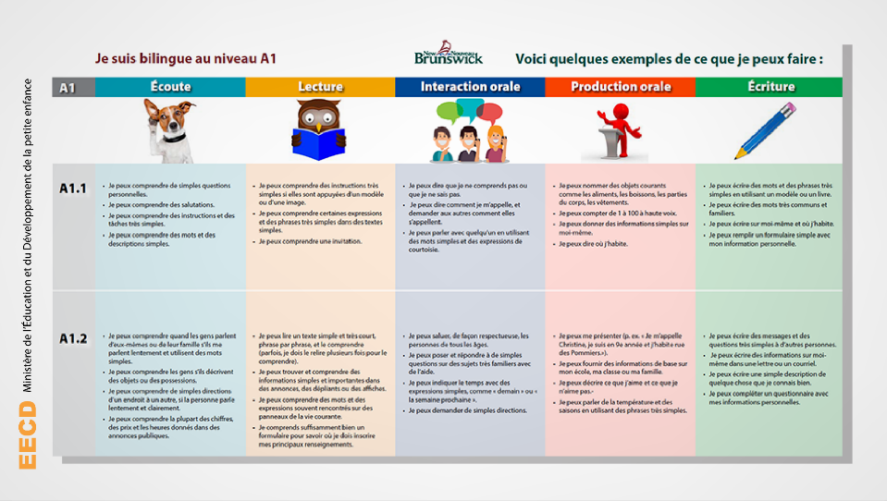
Language Proficiency Posters
English poster may be found at https://bit.ly/3kHLeMs
Notes:
New Brunswick has introduced posters to help learners understand their progress in French.
The proficiency levels are based on the levels described in the Common European Framework of Reference. They are available in English and French.

Slide 17

The Role of Families/Family Support
Attitude and motivation contribute to success in learning a new language.
The level of French that students attain by high school graduation will vary from one student to another, in the same way as performance varies in other subject areas.
Your enthusiasm and encouragement will help your child to get the most from their program of choice.
French materials may be accessed through:
Electronic Library New Brunswick (ELNB)
French Language Learning @ GNB
Notes:
Regardless of the program, activities such as reading for pleasure or watching a show in French will help students develop their second language skills. Services such as Netflix and YouTube provide easier access to French materials which will appeal to students’ interests. Families are also encouraged to access materials from Electronic Library New Brunswick (ELNB) (“virtual branch” of New Brunswick Public Libraries) as well as French materials on the Education and Early Childhood Development (EECD) website.

Slide 18
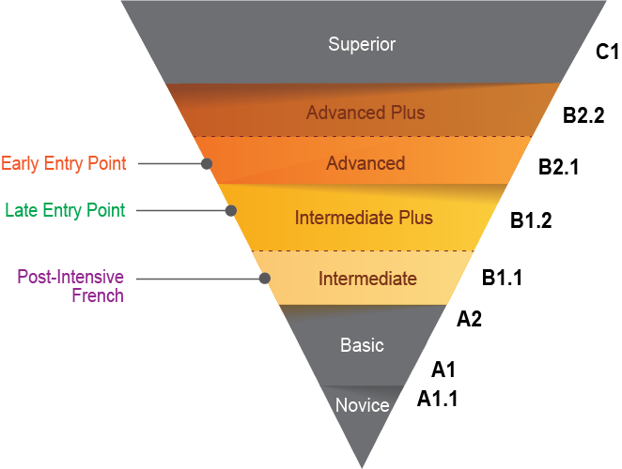

Oral Proficiency Levels
Notes:
There are Oral Proficiency target levels for each French Second Language program. Student performance will depend upon various factors such as personality, attitude, motivation, and French language opportunities. Not all students will reach the program target while some will exceed it.
Please refer to the brochure for more detailed descriptions of the levels of proficiency (OPI and CEFR).
NOTE: Hover the mouse over each audio icon to reveal the audio control bar. Then, click on the play icon to hear examples of what to expect..

Slide 19




Everyone at their best!
For more information, visit:
Everyone at their best:
Learning French as a Second Language
Notes:
Thank you for your interest in New Brunswick’s French second language programs. If you have additional questions about current programs, please contact your local school district.
http://www2.gnb.ca/content/gnb/en/departments/education/k12/content/promos/learning_french_as_a_second_language.html

Slide 20
A Typical Day in French Immersion - 2021-2022
Grades 1−2 (Exploration Time) | Grades 3−5 (Cross-Curricular Block) | Late Entry 6-8
 |  | Early Entry 6-8
Warm-up (French) | English Language Arts | English Language Arts
Message of the day: word work and sound work (French)
 | Science (French)
Oral (French) |  | Science (French)
RECESS | RECESS | RECESS
Oral (French) | Social Studies (French) | Social Studies (French)
Reading (French) | Health and Well-Being (French) | Health and Well-Being (French)
LUNCH | LUNCH | LUNCH
Writing (French) | French Language Arts | French Language Arts
Math (French) | Math (French) | Math (French)
Physical Education, Music, Art (English) | Physical Education, Music, Art (English) | Physical Education, Music, Art (English)
Notes:
This slide shows what a typical day in French Immersion might look like next year. In powder blue, you will see the subjects taught in French. Phys Ed, Music, and Art may be taught in English or French.
*The middle school day would be similar for early and late immersion learners.

Slide 21
A Typical Day in the Intensive Block
Intensive Block | Non-Intensive Block
Warm-up (French) | English Language Arts
Message of the day: word work and sound work (French)
Oral (French) | Science (English)
RECESS | RECESS
Oral (French) | Social Studies (English)
Reading (French) | Well-Being (English)
LUNCH | LUNCH
Writing (French) | French
Math (English) | Math (English)
Physical Education, Music, Art (English) | Physical Education, Music, Art (English)
Notes:
This slide represents a typical day in both the Intensive and the non-Intensive blocks in a grade 5 year. Times may be reduced in 2021-2022 due to the pandemic.

