Slide 1


Slide 2
I travel because…
Notes:
SPEAKER:​
​
[I travel because…]​
My first travel experience was transformative… [describe experience]​
I want the same for our students so…​
​Expand their knowledge of the world around them​
Discover more about themselves​
Grow more confident and independent​
Understand more about new people, places & cultures​
​
GOAL:​
Show students and families your passion for travel and why you want to make this a reality for your students and community.​
Why travel is important right now​
Its important that families feel confident in you taking their child abroad

Slide 3






Our Roadmap
The impact of educational travel
Travel and safety
Your itinerary
Cost & payment options
How to enroll
Notes:
SPEAKER:​
​Today we are going to cover:
The impact of educational travel
Travel and safety
The trip itinerary
Cost & payment options
How to enroll
Q&A
If you have questions throughout, please hold them to the end and if we haven’t answered them, we will make sure to do so. ​
​
And with that, let’s dive in!​
​
​
GOAL:​
Let families know what’s in store​

Slide 4

I The impact of travel is real and long-lasting
Notes:
Speaking points:
EF focuses on both a wide impact (to give the opportunity to travel to as many students as possible) and creating a deep personally impactful experience for each one of our travelers
Let’s start with a personal story from one of our travelers about how her EF trip changed her perspective and learn about some of the take-aways both students and parents may experience
Goal:
Have the video ready to show families
For virtual meetings be sure to check if you are sharing your sound

Slide 5
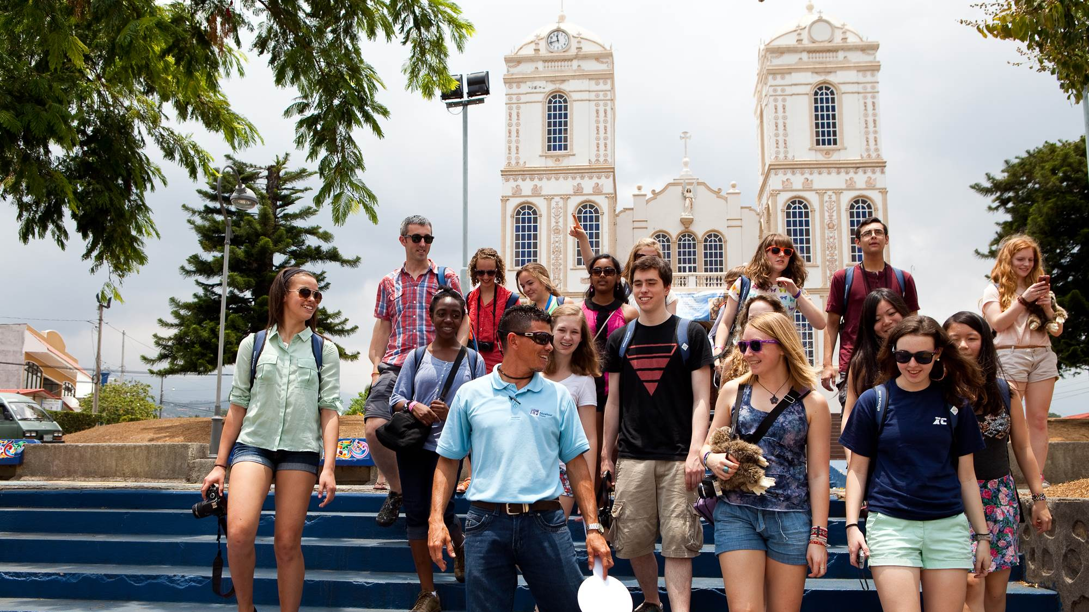
93%
89%
Of travelers say their tour expanded their knowledge of the world
Say they understand more about new people, places, and cultures
92%
88%
Say they discovered more about themselves
Of travelers say they grew more confident and independent
Source: EF Educational Tours 2019 Post-Tour Student Survey
Notes:
SPEAKER:​
Now that we’ve heard from one student about her journey, here is some data that we’ve collected about our broader student experiences.

Slide 6
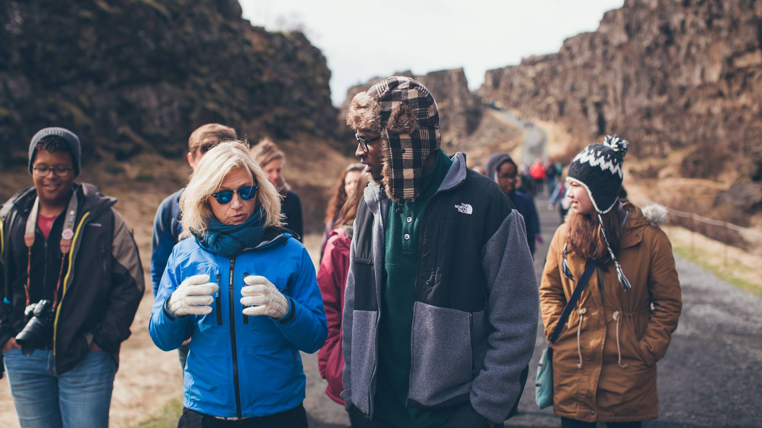
Travel and Safety
Notes:
SPEAKER:​
Now onto safety…

Slide 7
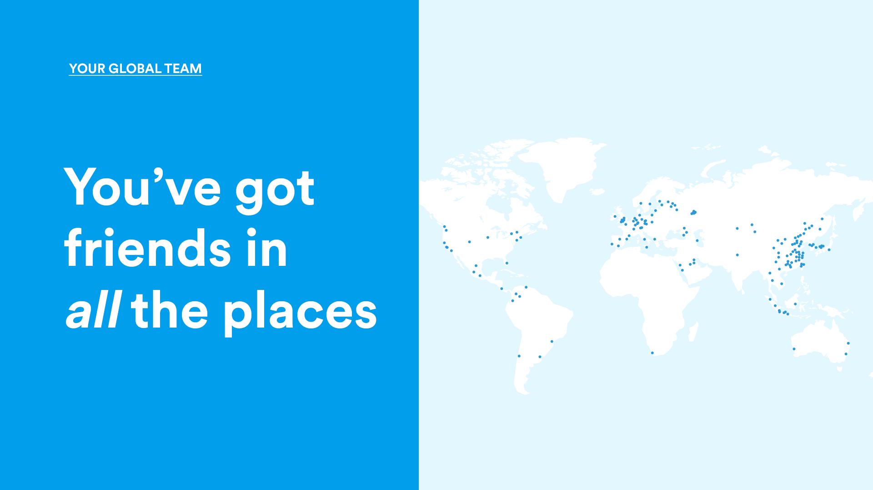
Our global
presence
52,000
612
EF employees &
educators worldwide
Offices and schools. Headquarters: Lucerne, Switzerland
55
114
Years EF has
been in business
Countries and regions. North and South America, Europe and Asia
Largest safety & security team in the industry with 24/7, 365 coverage.
Official sponsor of the Olympic Games and Nobel Museum
1
Shared passion for
helping people become citizens of the world
Notes:
SPEAKER:​
​
EF has…
over 55 years of experience which means they have seen it all and know how to respond.​
always knows what is happening on the ground which is critical in an everchanging environment​
They know how to safely navigate a city as true locals​
They have an office close to us on tour in case we were to need extra support​
​​
​
​
MATERIAL REFERENCE:​
To learn more about EF and all they have to offer, you can refer to the Parent Information Section online: https://www.eftours.ca/how-it-works/parent-info

Slide 8

Safety is by far the #1 priority
EF has the largest safety & security team in the industry with 24/7, 365 coverage
Only company in the industry with dedicated staff for safety and security
Local offices in virtually every travel destination offered globally
EF staff personally visit every hotel, restaurant, attraction and bus company utilized
EF has earned the World Travel & Tourism Council’s Safe Travels stamp—the world’s first ever global safety and hygiene stamp for Travel & Tourism, designed specifically to address COVID-19 and similar outbreaks.
Notes:
SPEAKER:​
This trip is going to be fun, but our first priority with EF is that it is Safe.
EF has the largest safety & security team in the industry with 24/7, 365 coverage
Only company in the industry with dedicated staff for safety and security
Local offices in virtually every travel destination offered globally
EF staff personally visit every hotel, restaurant, attraction and bus company utilized

Slide 9


Ready to take flight?
Notes:
SPEAKER:
Want to see a sneak peak of what the EF experience is really like?
GOAl:
Get students excited for the itinerary presentation.

Slide 10
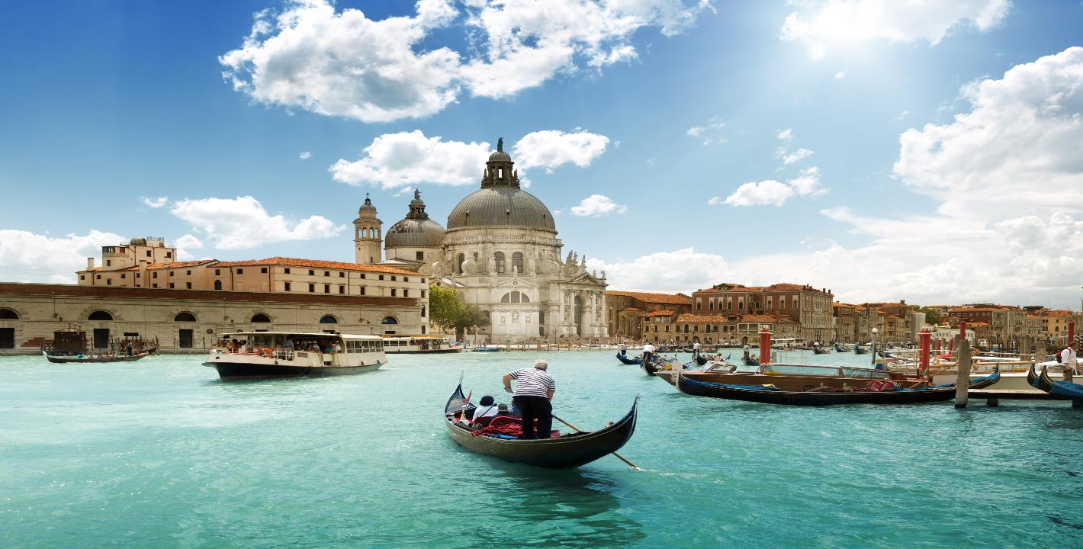
Let’s go to…
Italy
✈
Venice, Florence, Rome – 8 Days
Notes:
Welcome/ Thanks for coming to learn about this exciting opportunity for your child to travel abroad on an educational tour ____________ during _____________

Slide 11
Notes:
SPEAKER:​
Ready for the trip of a lifetime?! Mark your calendars! Block off these days in your family schedule– Like I said, now is the time to start planning for future travel!​
We’ll be leaving as early as the date referenced above and returning as late as the date reference above. This flexibility is how EF matches us with another group and keeps price low.​
We’ll know our set dates 3-4 months before tour!​
​
GOAL:​
Families can mark their calendars– easy!​
This might be the first time families are hearing of a travel window. This is an important part of understanding group travel and departure flexibility– it keeps costs down!

Slide 12
Venice, Florence and Rome

Slide 13
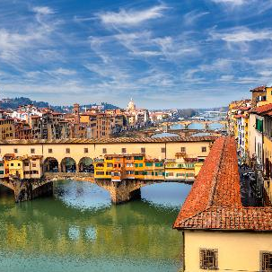
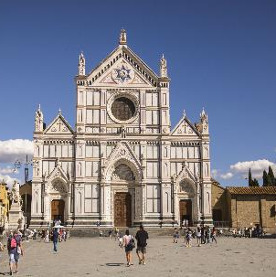
Day 5

Slide 14
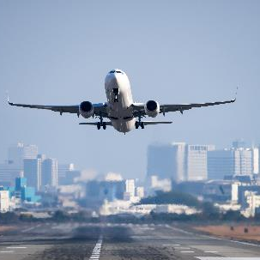
Day 8

Slide 15
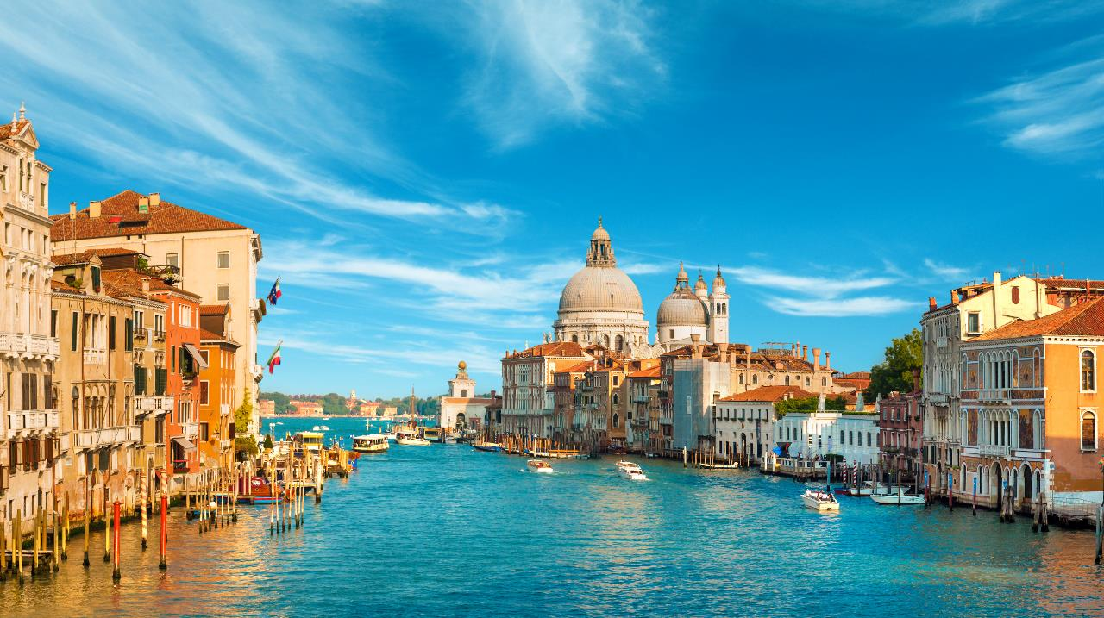
Cross the Rialto Bridge overlooking
Venice’s Grand Canal
Notes:
SPEAKER:
Directions: Read from slides
GOAL:
Hypes up and reminds students and parents why they want to enroll!

Slide 16
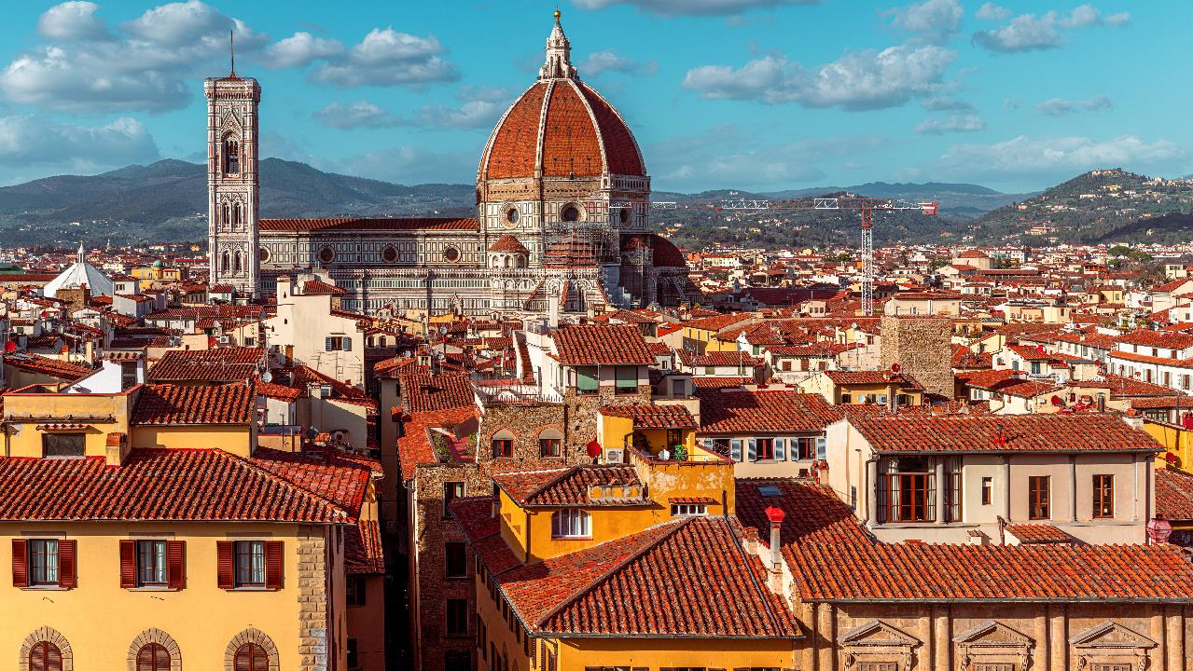
Gaze up at
the Duomo
Notes:
SPEAKER:
Directions: Read from slides
PURPOSE:
Hypes up and reminds students and parents why they want to enroll!

Slide 17
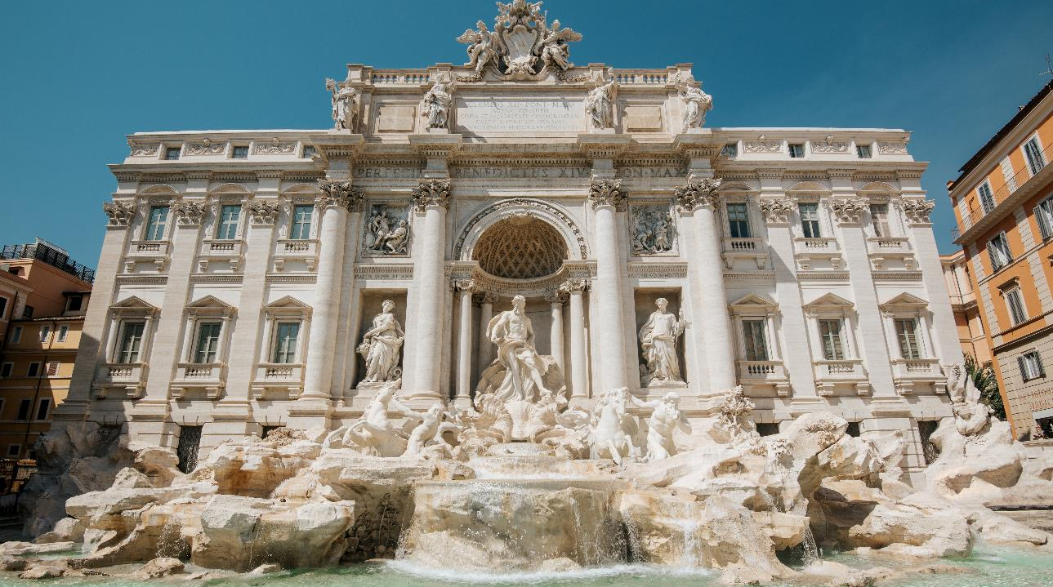
Add large beautiful images
Toss a coin in the
Trevi Fountain
Notes:
SPEAKER:
Directions: Read from slides
PURPOSE:
Hypes up and reminds students and parents why they want to enroll!

Slide 18
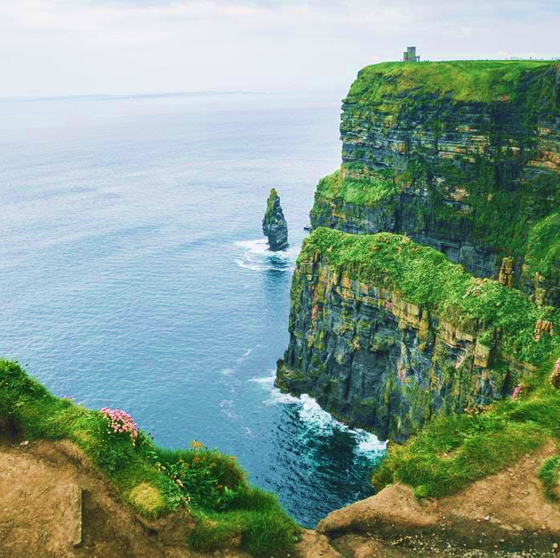





Ready, Set, Prepare:
Spending money
Free time excursions
Customary gratuities
Lunches and snacks
Passports & Visas
Notes:
SPEAKER:
[Not included]
A few things to keep in mind while preparing for your trip:
Be sure to budget for some spending money on tour
If there is extra free time, your tour director may have some fun activities to recommend. If there are entry fees that are not included on the itinerary, travellers will be responsible for that extra (and VERY Optional) cost
Your Tour director, bus drivers and expert local guides work tirelessly to ensure travellers are well taken care of, it is customary to tip these wonderful people on your tour and we will have more information on how much to budget for in our pre-departure meeting
While EF does cover breakfast and dinner, students are responsible for bringing some spending money to cover lunches and snacks. EF does this to allow flexibility for travellers to explore the city, eat at a café that catches their eye or pick up a Gelato on the go during their tour
For most countries, Canadians will not need a visa for their tour, however if you are not a Canadian citizen, please take a look at the possible travel documents you may be responsible for during your travels as this is not something EF can arrange for you
GOAl:
Outline all of the fees not covered by EF

Slide 19
You will need government issued ID’s for all travellers including a passport and possible visas for international destinations
Passports must be valid for 6 months past the date of travel
The name of the traveller on the account needs to match ID
Passport
Reminder!
EF Educational Tours | eftours.ca
Registration Numbers: TICO-2395858, 50018789 | CPBC-73991, 73990 | OPC-70273
Notes:
SPEAKER:
For anyone who has tried to renew their passport in the last year, I’m sure you can help me emphasize the importance of getting your passport renewed as early as possible!
A few things to remember when enrolling:
- You will need government issued ID’s for all travellers including a passport and possible visas for international destinations
Passports must be valid for 6 months past the travel date
For any student who does not go by the name written on their passport please use the matching name to enroll. Once your student is enrolled, please let your group leader (me) know and we can make sure your preferred name is used by our staff on tour
GOAL
To clarify what documents travellers will need to prepare leading up to their tour

Slide 20
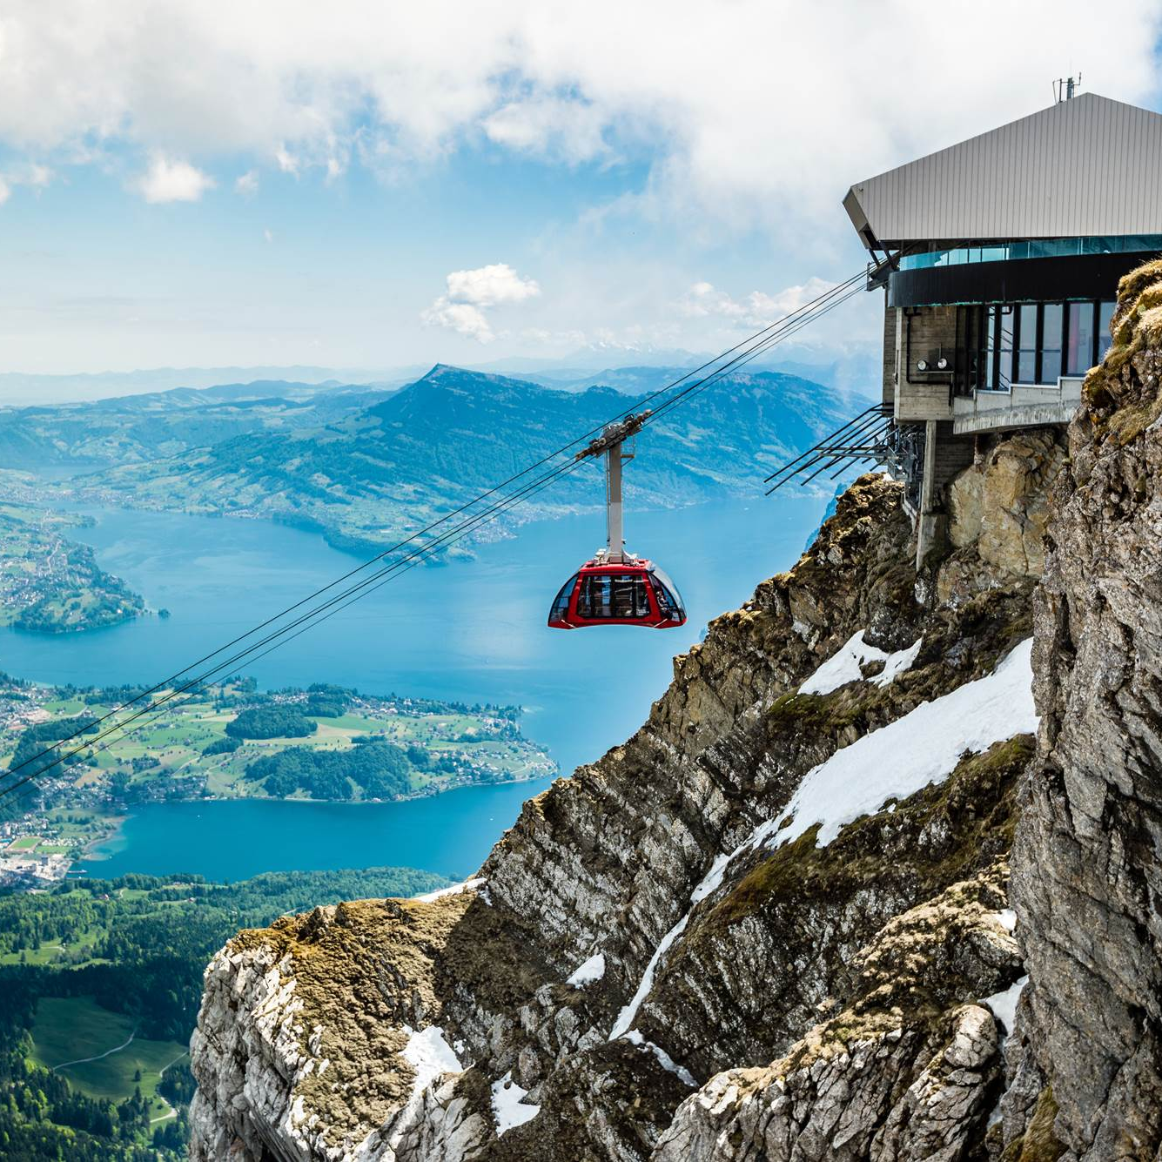
Coverage and policy flexibility
Cancel for any Reason (Individual Coverage)
We understand that plans can change due to unforeseen circumstances. That’s why we offer our travellers the Cancel for Any Reason Policy. Exclusive to EF, this new option provides individual travellers with an upgraded level of payment protection to help take the worry out of planning future travel.
Global Travel Protection Plan (Individual Coverage)
EF’s recommended coverage plans let you explore the world worry-free. EF offers a Global Travel Protection Plan that gives you all the coverage below at one great price. With this plan, you are covered wherever you are in the world and have access to Insurance representatives 24 hours a day. All your plan details are kept with your Tour Director while on tour, so you can relax and enjoy your trip.
EF’s Peace of Mind (Provided to all groups)
Available to the entire group when you sign up for tour
EF Educational Tours | eftours.ca
Registration Numbers: TICO-2395858, 50018789 | CPBC-73991, 73990 | OPC-70273
Notes:
SPEAKER:​
EF offers a ton of options so that families feel covered.
With EF’s recommended Cancel for Any Reason Plan you are covered leading up to tour with options to save your value if you need to cancel worry free in the time leading up to your trip. You can find more details about the amount of coverage you are eligible to receive at eftours.ca/bc.
With EF’s recommended Global Travel Protection Plan you are covered wherever you are in the world and have access to Insurance representatives 24 hours a day. All your plan details are kept with your Tour Director while on tour, so you can relax and enjoy your trip of a lifetime!
The Global Travel Protection Plan includes:
Illness and Accident Coverage
Baggage and Property Coverage
Tour Cancellation and Interruption Coverage
24-hour Emergency Assistance
Think of Cancel for any reason as your pre-tour coverage, and Global Travel Protection as your on-tour coverage.
Both must be purchased or removed no later than 30 days after enrollment.
GOAL:
Introduce travelers to their coverage options
MATERIAL REFERENCE:​
https://www.eftours.ca/help-centre/policies/coverage-flexibility

Slide 21
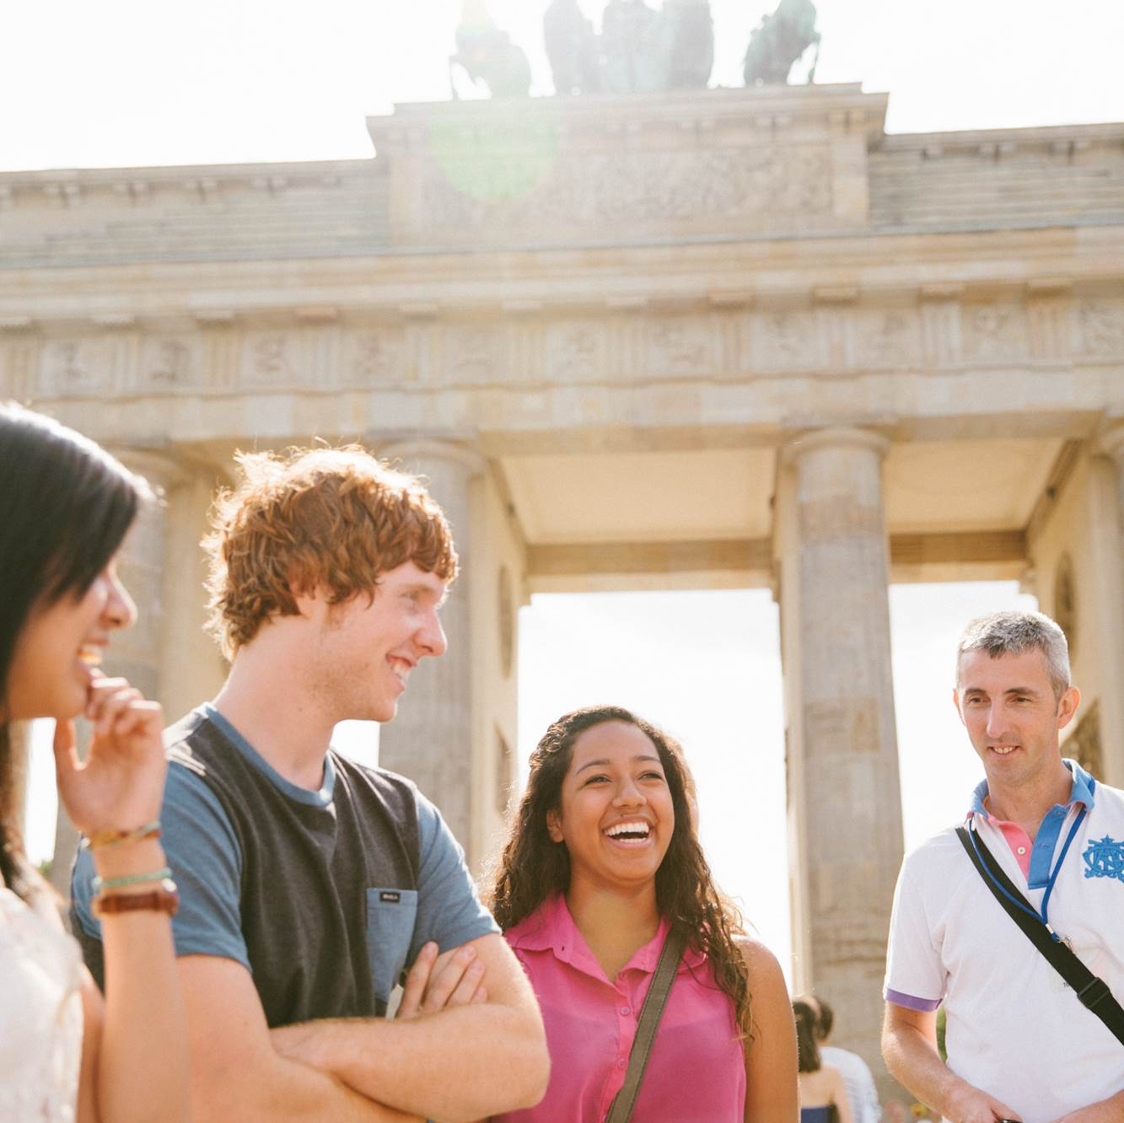











Big belly laughs shared with your travel team
Memories to last a lifetime to bring back home
Everything
Included:
Learning opportunities around every corner
New friendship opportunities
Exploring for hours on end
Scenic drives down
Cross cultural learning experiences
Airfare and on-tour transportation
24-hour emergency assistance
Leadership development
Winding roads waiting to be explored
Hotel accommodations
Peace of Mind Program
New horizons
Beautiful sunsets
Breakfast and dinner daily
Worldwide presence
Watching the sun rise every morning
Dreams coming true
Guided tours, activities, and entries
Safety precautions and procedures
The traveller app
Airport excitement
Full-time professional Tour Director
Traveller Support resources
Sleeping in new (and very old) cities
Tour donation page
Developing a global mindset
Expert local guides
Time to think about your global impact
Travel gear
Months of excitement leading up to the trip
An amazing team to answer all of your travel questions
EF Educational Tours | eftours.ca
Registration Numbers: TICO-2395858, 50018789 | CPBC-73991, 73990 | OPC-70273
Notes:
SPEAKER:​
[So, what’s included?]​
Pretty much everything.​
Directions: read through each one. ​
​
GOAL:​
Its important for families to see everything that is included before we display the price​
​

Slide 22
Tour price
Program base price:
$ 3715
Global Travel Protection Plan:
$ 199
Cancel for any Reason Coverage:
$ 99
Early Enrolment Discount (until December 14th 2022):
- $ 200
Total price:
$ 3813
Payments per month (over 15 months):
$241
Notes:
SPEAKER:​
For this amazing adventure, the tour price is $_____________, or $____________ a month
We are going to talk more about what is included and how you can break that down. ​
GOAL:
Go over the complete pricing of the tour.

Slide 23
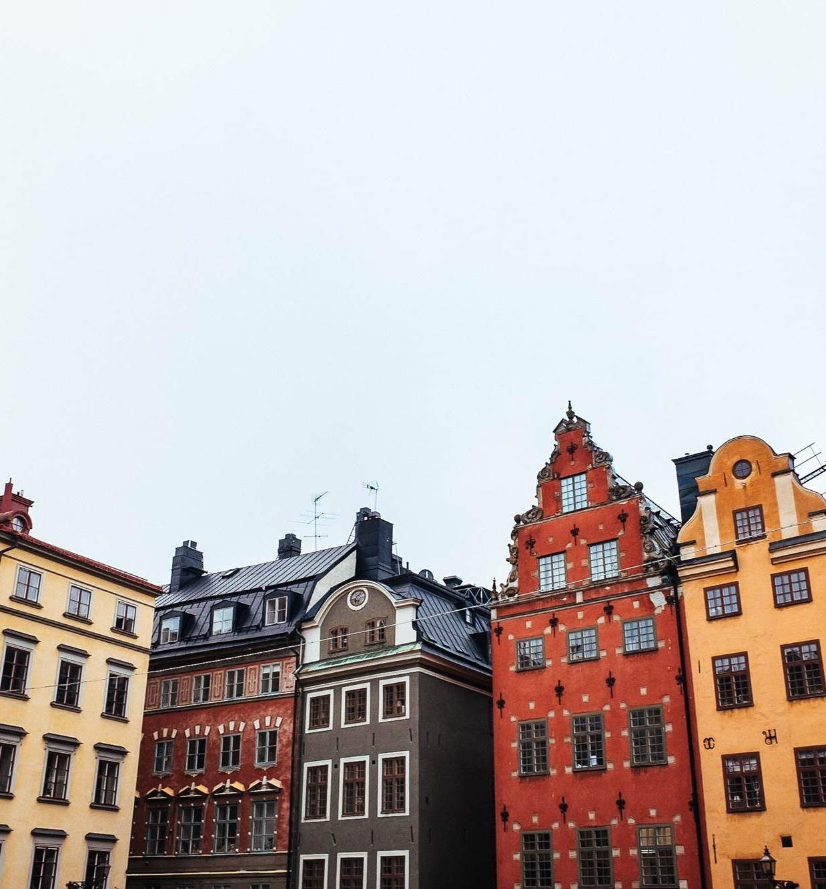
Option 1: Pay in full at enrolment
Flexible payment
options:
Option 2: Automatic Payment Plan
Choose the payment frequency (monthly or bi-weekly) deducted from your bank account. Final payment is due 25 days prior to departure.
Option 3: Manual Payment Plan
Receive invoices and make your payments in less frequent installments based on the date of enrolment.
Option 4: Pay with Uplift
Book now, pay over time. Spread the cost of your trip over low monthly payments, even after you’ve travelled.
Payment methods accepted: direct debit, chequing or savings account, or credit card (Visa or MasterCard)
For specific plan details, see our full Booking Conditions at eftours.ca/bc
EF Educational Tours | eftours.ca
Registration Numbers: TICO-2395858, 50018789 | CPBC-73991, 73990 | OPC-70273
Notes:
SPEAKER:
Making it happen! There are a lot of flexible payment options. The first being
[Pay-in-full]
Pretty self-explanatory. You may pay-in-full, which includes the initial 199 dollar non-refundable deposit
[Monthly]
This payment is for [X] months and is after the initial 199 dollar non-refundable deposit
[Manual]
With the Manual Payment Plan, you will not have automatic deductions. You can make as many or as few payments as you like - as long as you meet specific payment deadlines.
Want more options? We have other payment plans. Just give us EF’s traveller support team a call and they can help.
[Uplift]
Now travelers can finance their tour even past their return date. With Uplift students can pay an even lower monthly fee than the automatic payment plan, just over a longer period of time to help make the trip more affordable.
GOAL:
Display payment options available to families, but keep it short, simple, and sweet.

Slide 24
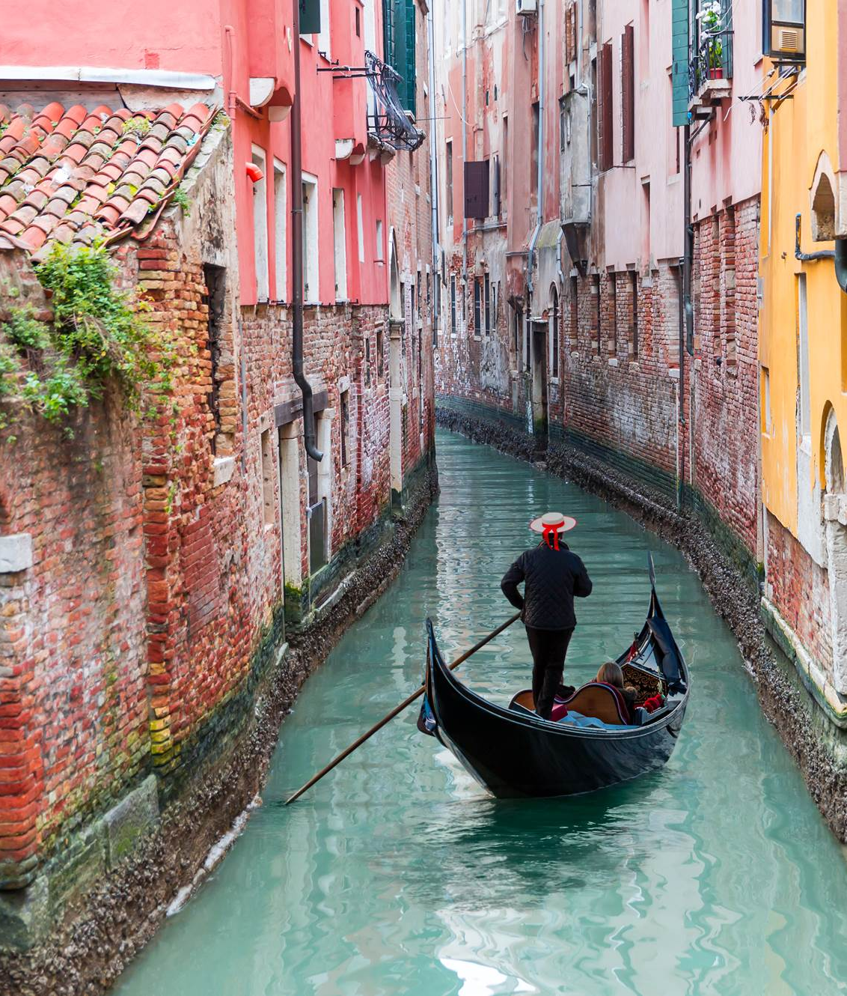

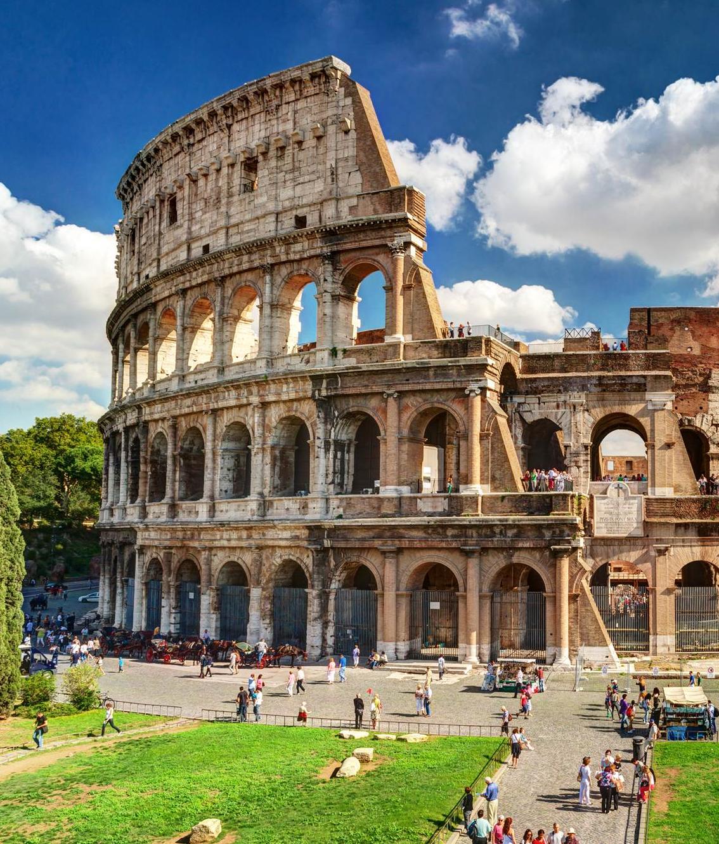
Trip Highlights:
Notes:
SPEAKER:
A few of my personal favourites from this tour that I wanted to highlight just one more time,
I just can’t wait to see
I’ve always dreamt of eating a ______ in ________
___________ is something I can’t wait to share with you because …
GOAL:
To highlight some of the key things on tour that you are looking forward to!

Slide 25
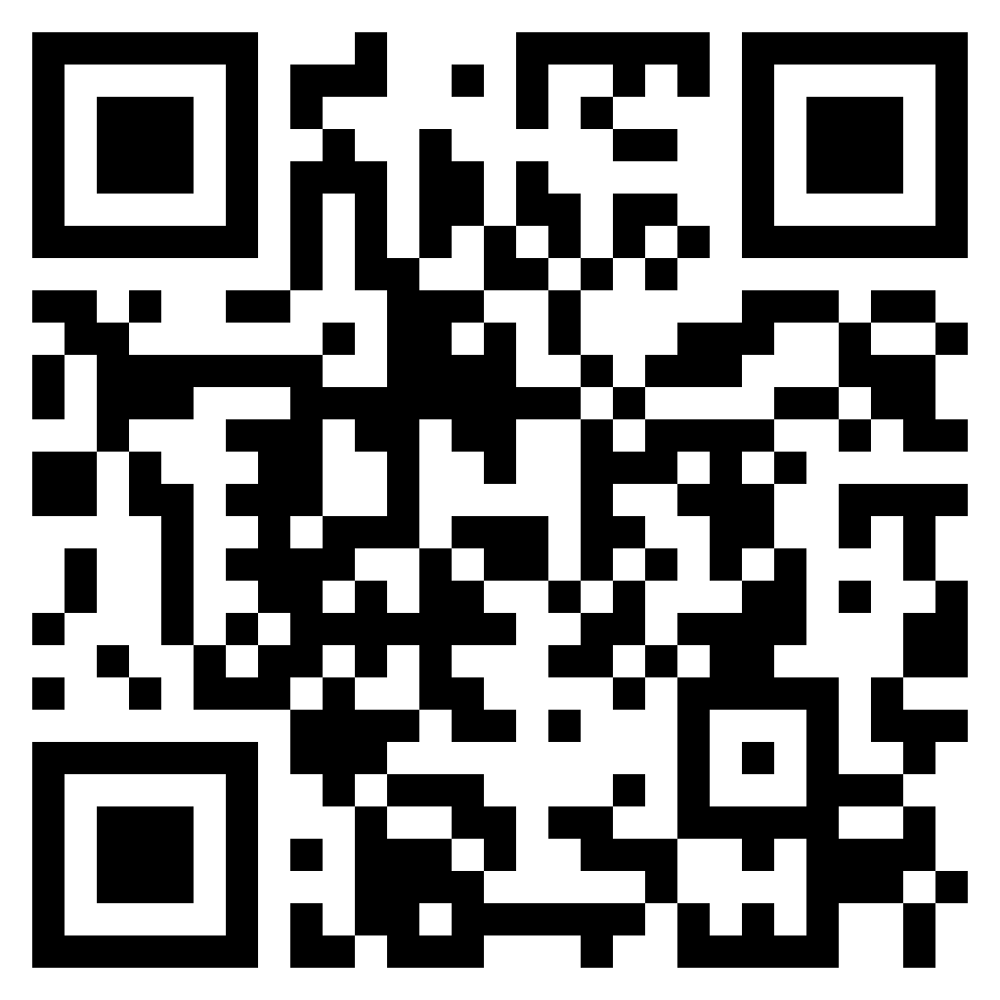
INSERT QR CODE
Notes:
SPEAKER:
Who’s ready to enrol? To sign up for our tour you can visit www.eftours.ca/enrol and enter our trip number here or scan the QR code to go directly to our trip’s enrollment website. If you’d like to call in, use the number on the screen to get in contact with EF’s amazing traveller support specialists and they can help you enroll as well.
Questions?
GOAL:
Get everyone signed up and answer questions

