Slide 1
Welcome to...
d
d
l
m
i
NACKAWIC
e
hello
MIDDLE
SCHOOL
“preparing youth for the challenges of tomorrow.”

Slide 2
Our goals
Develop the desire for life-long learning; a sense of pride in work and a feeling of self-worth and strong character.
Instill a sense of community and citizenship.
Provide students with opportunities to develop skills in all subject areas, with a focus on numeracy, literacy and science inquiry.

Slide 3
SCHOOL MOTTO
“Own it!”

Slide 4
We believe….
All students have the right to a safe positive and productive learning environment.
All students have the ability to learn.

Slide 5
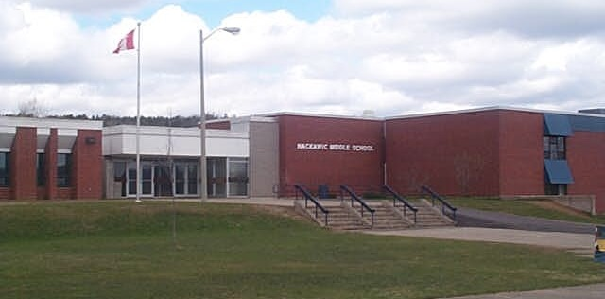
Nackawic Middle School
“preparing youth for the challenges of tomorrow.”

