Slide 1
Welcome
PSSC 2020
Claudine Dionne
Beth Boyd
Leah Allen
Sandra Hudson
Trisha Perley
Jessica Post
Tanya Adams
Tracey Brown

Slide 4
Agenda
Call to Order:
Election of Officers: new members \ chair
Approval of the Agenda:
Approval of the Minutes from Previous Meeting:
Business Arising from the Minutes:
New Business:
Operational Plan
School Improvement Plan (SIP) & PLWEP positive learning working plan
Update on fundraising activities
Sports
Dates for meeting for the year
Principal report:
Correspondence:
Closing Comments:

Slide 5
Election of officers
Chair
Vice Chair
Secretary

Slide 6
PAMS Operational Plan
Developed using specific guidelines outlined by EECD
Reviewed by a school team for feedback
Approved by Director of schools and worksafe coordinator
Presented to staff, visiting professionals and students
Staff used the PBIS model to Teach / Model and reinforce when presenting to students

Slide 7
Main components of the operational PLan
Maintaining Classroom bubbles
Hand sanitizing upon entering and exiting all rooms in the building
Wearing masks in all common areas

Slide 8
Main components of the operational Plan – additions / changes
Duty areas - increased supervision
Winter plan
Addition -

Slide 9
Changes as a result of increase covid-19 cases in zones 1 and 5 (orange zones)

Slide 10
At PAMS, we create a positive learning environment that promotes a sense of belonging and resiliency for ALL.

Slide 11
The school Plan
To increase student / staff connectedness.
To decrease incidents of conflict.

Slide 12
1. To increase student / staff connectedness.
Indicators of success
Improved attendance
Participation in class
Participation in school activities
Greater Academic success
Improved results on Our school survey
Strategies
Student leadership
Build Class identity
Classroom meetings
PBIS celebrations
School wide virtual celebrations

Slide 13
2. To Decrease conflicts
Indicators of success
Positive language in class
Greater peer engagement
Fewer office referrals
Improved results on Our school survey
Decrease behavior interventions
Improved attendance
Strategies
Prevention strategies – outlets / escapes
Virtual connections with others
Responsible decision making – ethic / safety / social norms
Safe choices for self, others and school
Self management / self awareness

Slide 14
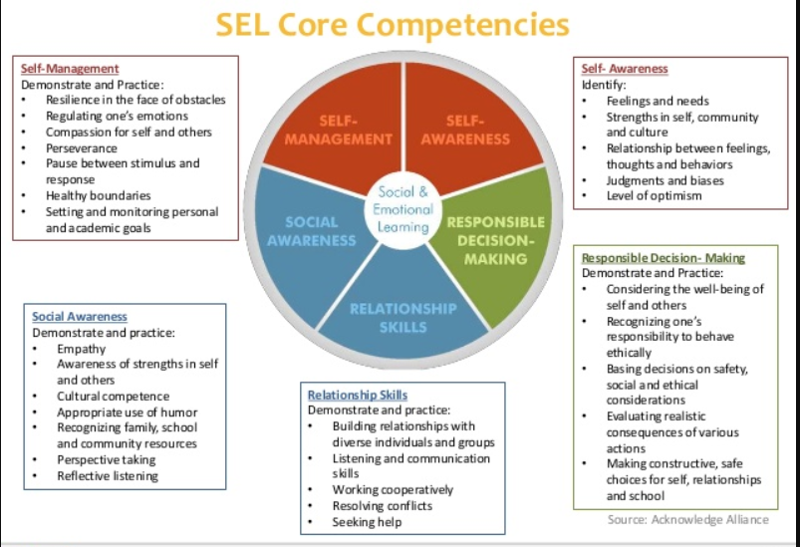

Slide 15
Fundraising 2020
Nov. 2 – Nov. 13
6 inch pots - $10
3.20 profit per pot

Slide 16
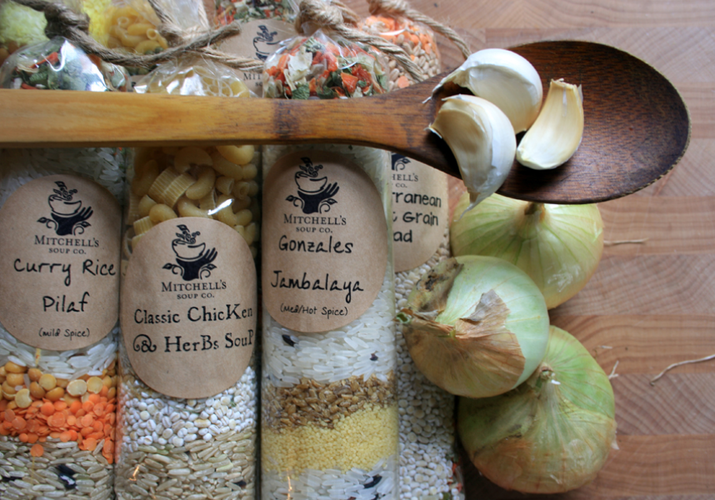
Fundraising 2020
Thoughts?
3 bags of soup for $30
Profit $7.50
Nov. 2 – Nov. 13
6 inch pots - $10
3.20 profit per pot

Slide 17
Meeting dates
December
February
April
June

Slide 18
Principal’s report – 189 students

Slide 19
PAMS
9 Classes
Teachers
Educational Assistants
3 grade 6
3 grade 7
1 grade 7/ 8
2 grade 8
15 Full time
1 part time teacher
1 change in Staff -
10 District Educational Assistants
2 First National Academic Support
1 Cultural Liaison

