Slide 1
Business Related to the First Meeting:
PSSC positions
PAMS cell phone Expectations update
Poinsettia Fundraiser
Principal’s Report:
Staff / Student update 2022-23
Capital Improvements / school upgrades 2023
School Improvement update
PBIS - update
Special events / projects
  New business:
  Progress reports
  Parent – teacher
  Surveys
  Family Fun night
  school winter plan
Agenda
Jan. 10th 2022

Slide 2
Business from previous meeting :
PSSC Positions
Chairperson: Chrissy Young
Vice Chairperson: Joe Bailey
Secretary: Christy Dingee

Slide 3

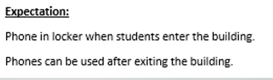
Business from previous meeting :
Cell Phone Policy update
- Very Successful implementation
- Little resistance from students
- No complaints received at school from parents
- Students more engaged during free time

Slide 4

200 plants sold
$750 profit
Business from previous meeting :
Poinsettia fundraiser

Slide 5
Staffing
Principal’s Report:
Temporary custodian – Mrs. Sherry Hansen
Mrs. Perley - TBD
Staff Changes

Slide 6
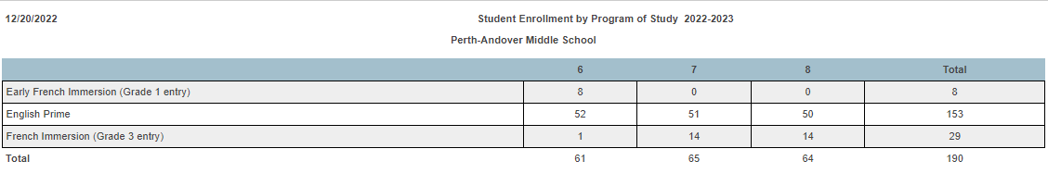
Staffing
Student enrollment update –
increase of 2 grade 6 students

Slide 7
Improvements for 2023
– Upgrade to concrete outside
- Computer lab upgrade
- PE equipment
- Science equipment
- Screen for gymnasium

Slide 8

School improvement Plan GOALS
Goal –
At PAMS, we will demonstrate a positive change in the sense of safety felt by students and staff. We will focus on the physical safety measured by the teacher perception/student survey.

Slide 9
Indicators of success
Bullying / Language
At PAMS, there will be a decrease of inappropriate language.
At PAMS, there will be fewer disruptions in the classroom.
At PAMS, students will feel safe.
Engagement
At PAMS, attendance will improve.
Increase in opportunities for parent engagement at PAMS.

Slide 10
At PAMS, attendance will improve.
#1 Follow up on absences and create a plan for improvement.
#2 Re-introduce Club day – an opportunity for students to interact with peers across grade level in a positive and fun environment.
#3 Support teachers in providing hands on learning activities for students.
#4 Create attendance incentives.
Ongoing
Round 3
Begins
Jan. 18th
Ongoing
Jan. 2023

Slide 11


Slide 12
Create and promote activities at PAMS to increase parent involvement and awareness
#1 Promote our first parent event – August BBQ
#2 Send a paper / email monthly newsletter
#3 Create a school / family committee to plan four main family events – Fall festival, February Fun night, spring fling, and summer kick off.
#4 Create a paper survey to identify the best way to receive information from the school, what type of activities they would participate in at PAMS, and how they can get involved. - results indicate email best way and interest in home and school.

Slide 13
To decrease disruptions and increase sense of safety
#1 Embed the behavior matrix by focusing on one component of the matrix as a theme for two months.
Sept – Oct. Belonging
Nov. – Dec. Empathy
Jan. – Feb. Achievement

Slide 14
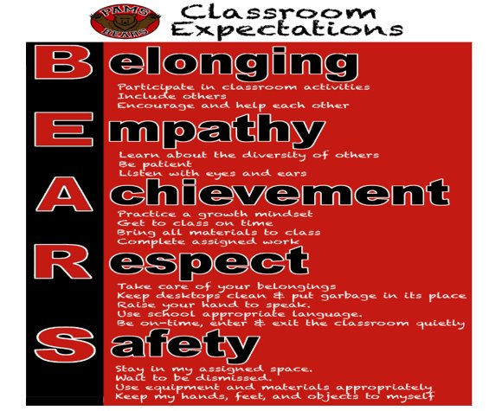
PBIS Focus January / February

Slide 15
SIP
Achievement
Practice a growth mindset
Get to class on time
Bring all materials to class
Complete assigned work

Slide 16
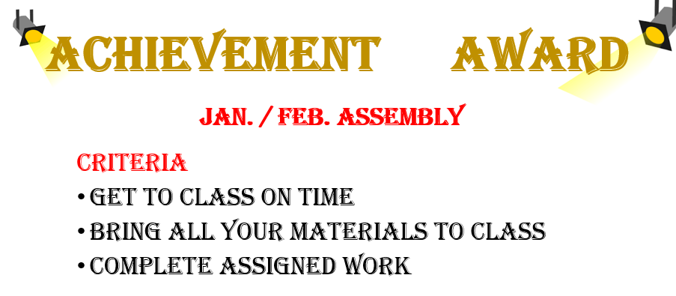

Slide 17
PBIS –
Positive Behavior Support System Goal
- Increase parent Involvement
- Introduced Family BINGO in Nov.
45 attended - Nov.
65 attended – Dec.
Next date – Jan. 18th
- 2nd Family / student activity - Feb. 2
- Teach/ model / reinforce school wide expectations

Slide 18
PBIS –
Positive Behavior Support System Goal
-
Teach/ model / reinforce school wide expectations
- School wide review of expectations
- New duty schedule with increased supervision to
support positive student choices
- Bi-Weekly social skill lessons
- Jan. 12 goal setting
- Jan. 26 growth mindset …)

Slide 19
  Special Events – Nov. / Dec.
5 week bullying awareness campaign ( each Tuesday)
Over $500 (food and cash) donated to the Food bank
School Wide Free Breakfast
School wide free Christmas lunch
$25 gift card to superstore sent to each family at Christmas
Return of the principle’s list

Slide 21
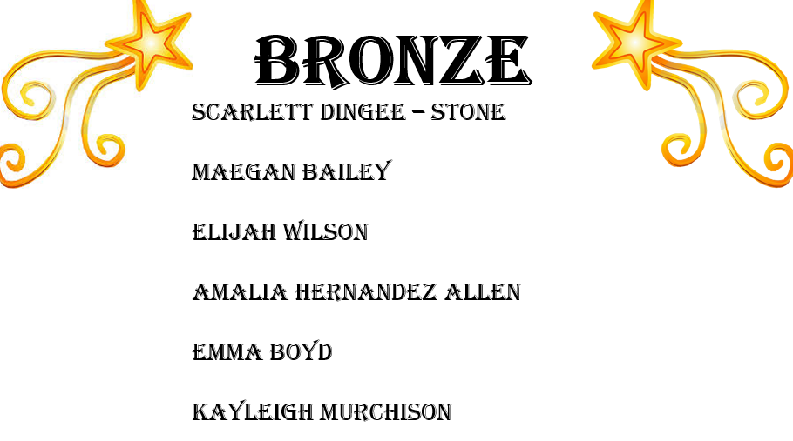
Bronze – no more than 8 3’s

Slide 22
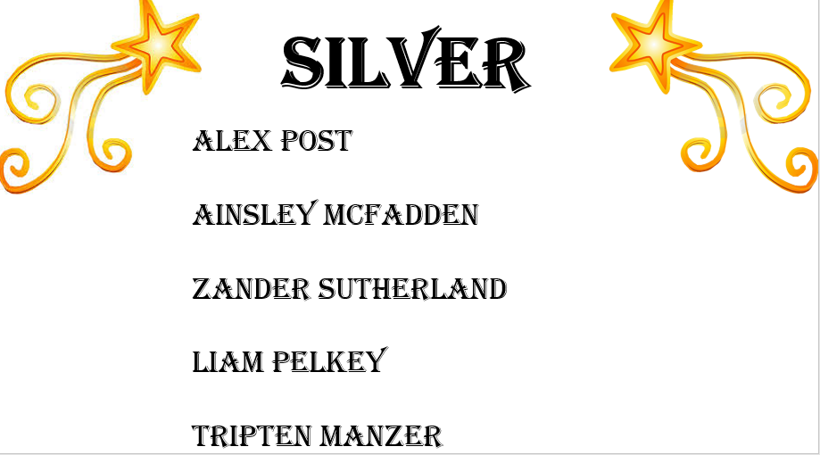
Silver – no more than 5 3’s

Slide 23
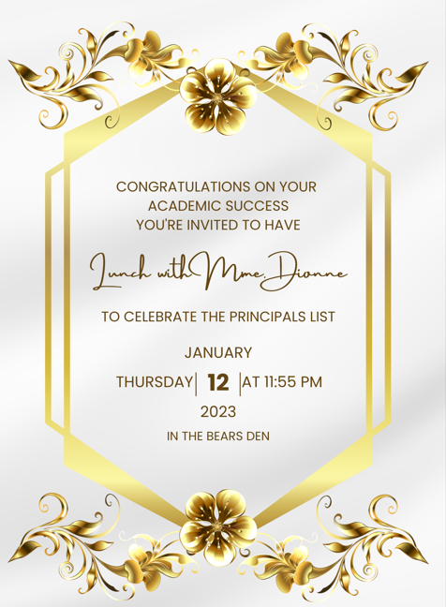

Slide 24
  Special Events – Nov. / Dec.
Robotics seminar
Monthly French Fridays
    November – Fricot
    December – Buche de Noel
    January – Pets de soeur

Slide 25


Slide 26
NEW BUSINESS –
Progress reports – Week of Feb. 6th
Report cards – April 12
Surveys –
Youth Check-In : themes related to student mental health, school relevance and school relationships. 3x/year
Annual provincial student survey: school experience,wellness bullying, and substance use

Slide 27
NEW BUSINESS –
Madd Presentation : Cannabis

