Slide 1

PSSC – June 10
Sit Dolor Amet

Slide 2
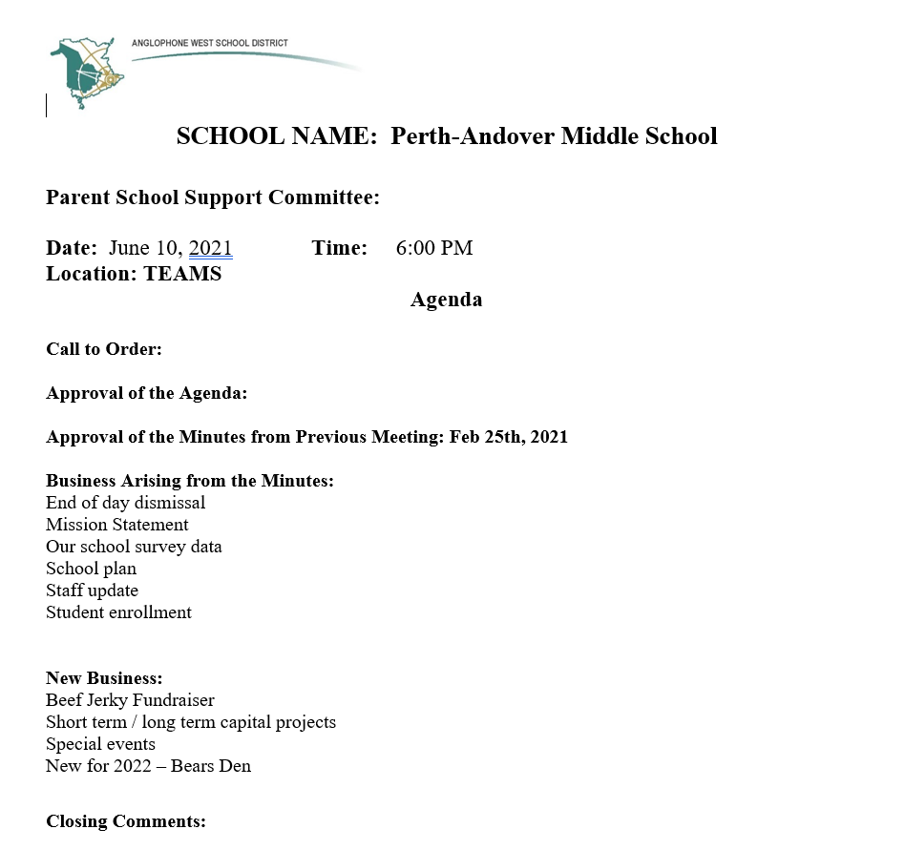
AGENDA

Slide 3
Business from Minutes
Business Arising from the Minutes:
End of day dismissal
    Effective to control safety for all
    Will be continued in 2021
    Concerns?

Slide 4
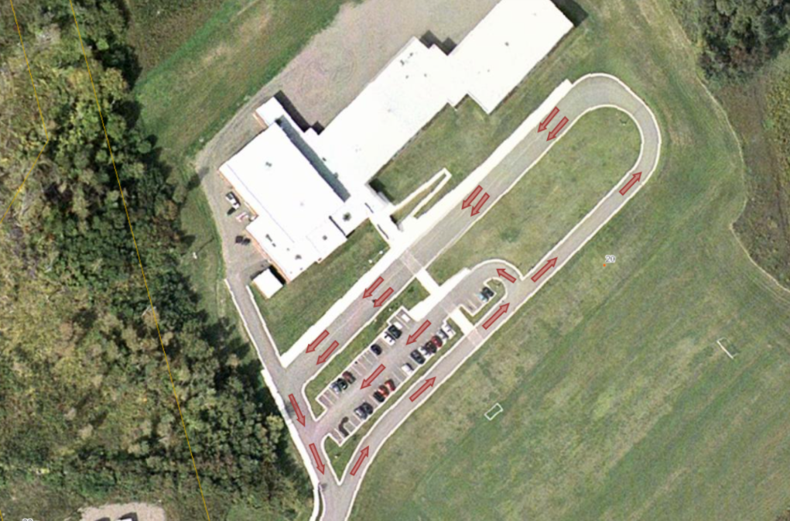

Slide 5
Business from Minutes
Business Arising from the Minutes:
Mission statements
In classes on the walls

Slide 6

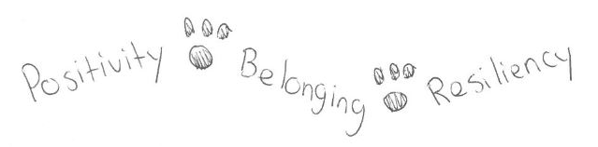

Slide 7
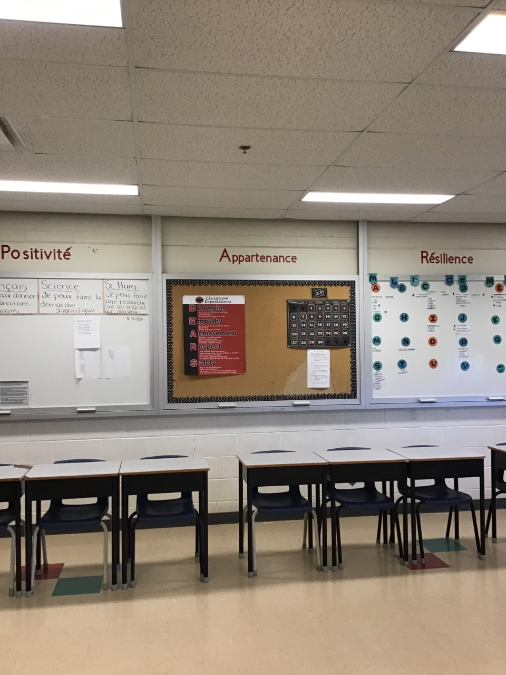

Slide 8
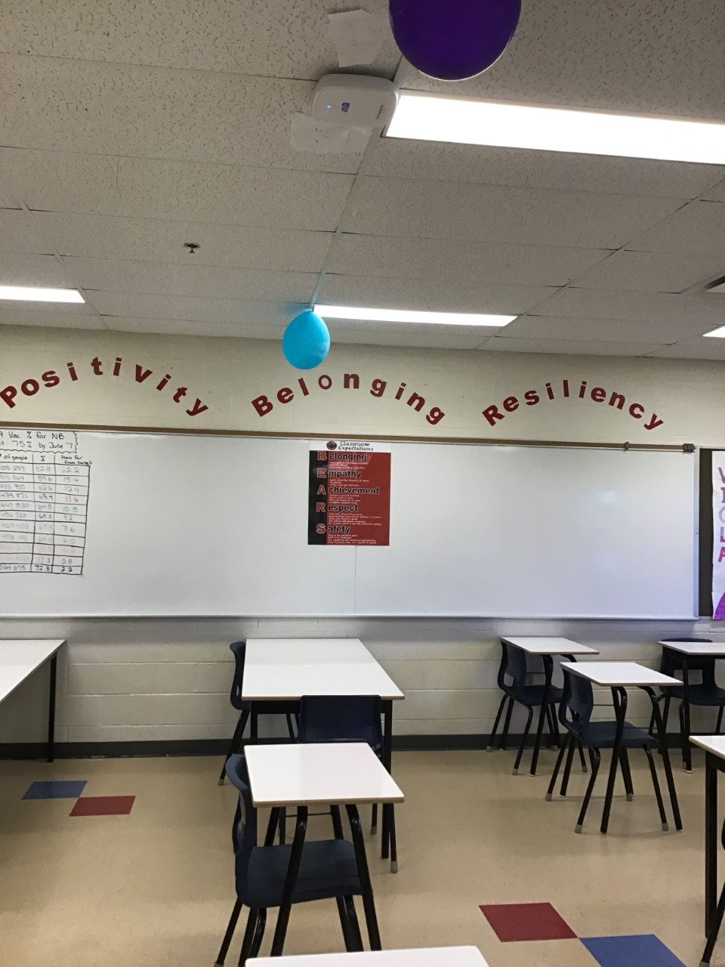

Slide 9
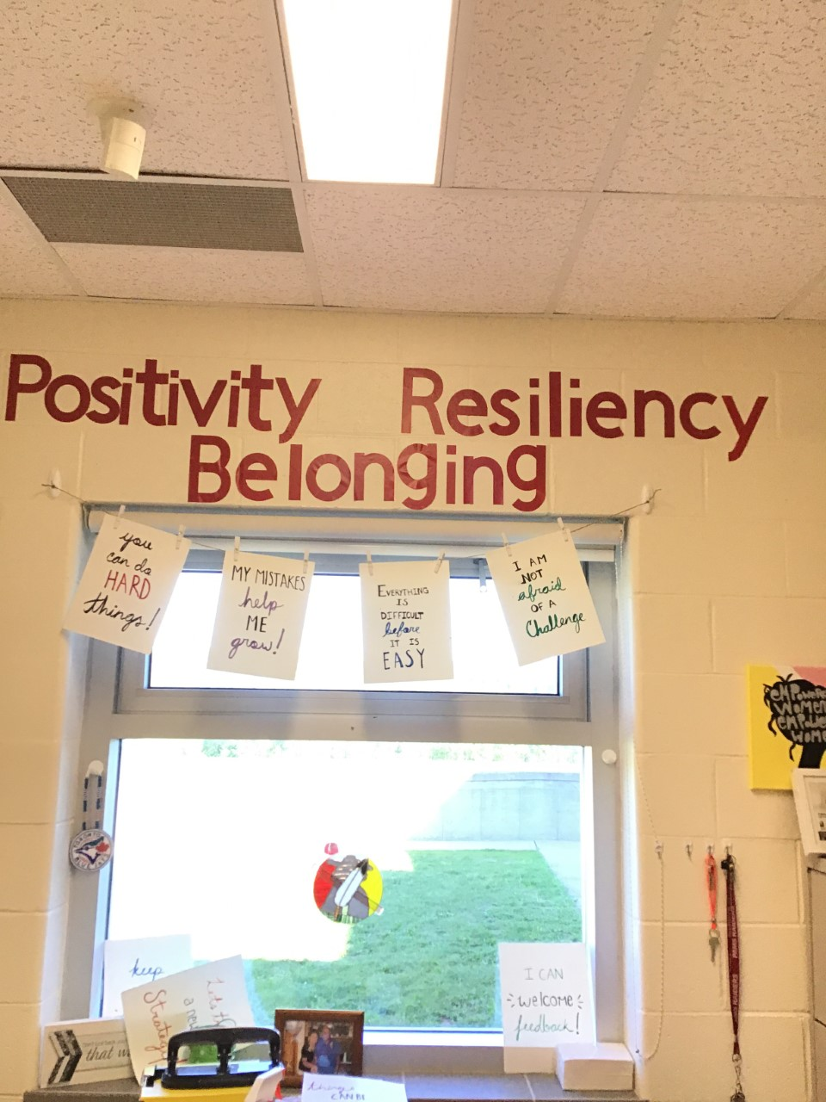

Slide 10
Business from Minutes
Business Arising from the Minutes:
Results. Our school survey

Slide 11
Business from Minutes
School plan

Slide 12


Business from Minutes
2. School Plan - Behavior Matrix Roll out
RESPECT – 4 lessons
EMPATHY - 3 lessons on diversity
2 lessons on communication
Open ended questions revealed only 35% of students knew BEARS matrix

Slide 13
Next Steps
1. Continue with Personal Development classes and teach :
  Belonging
  Achievement
  Safety
Implement TOKEN program to reinforce positive behavior.
Homeroom challenges and school wide activities that reinforce the matrix.
Pre-Post data to evaluate results.

Slide 14
Next Steps
New goal –
Focus on increasing the sense of belonging, Interest and motivation
Incorporating clubs into the schedule
- choice of activities
- weekly
- changes monthly

Slide 15
Business from Minutes
Staff update –
2020-21 14.3 teachers 2021-22 14.9 teachers
Behavior Intervention Mentor –
Kristen Murchison, May 10th
FN Enhancement Education Assistant –
Amy Moulton

Slide 16
Business from Minutes
Enrollment
  196 currently
  6 more expected (Homeschool + new arrivals in NB)
  202 students for fall 2021
  10 homerooms 3 - grade 6
  3 - grade 7
  4 - grade 8

Slide 17
NEW business
Beef Jerky Fundraiser
Exceeded expectations
Purchased $1600 of books with profit and
donations
2. Short term / long term capital projects
Move parking for staff
Expand play area by swings
Basketball court / play structure
Cut shrubs behind swings
Accessible path to field
3. Gardens – cucumbers and tomatoes, shrubs, flowers

Slide 18


Slide 19
NEW business
Bears Den
New idea for library

Slide 20
NEW business
Special events
Kenya Project
Student appreciation Day
No time for That Award – June 18
Indigenous Peoples Day – June 14
Grade 8 celebration – June 23
Transitions

Slide 21
NEW business
https://www.facebook.com/pams.middleschool

